Slide 1

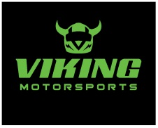
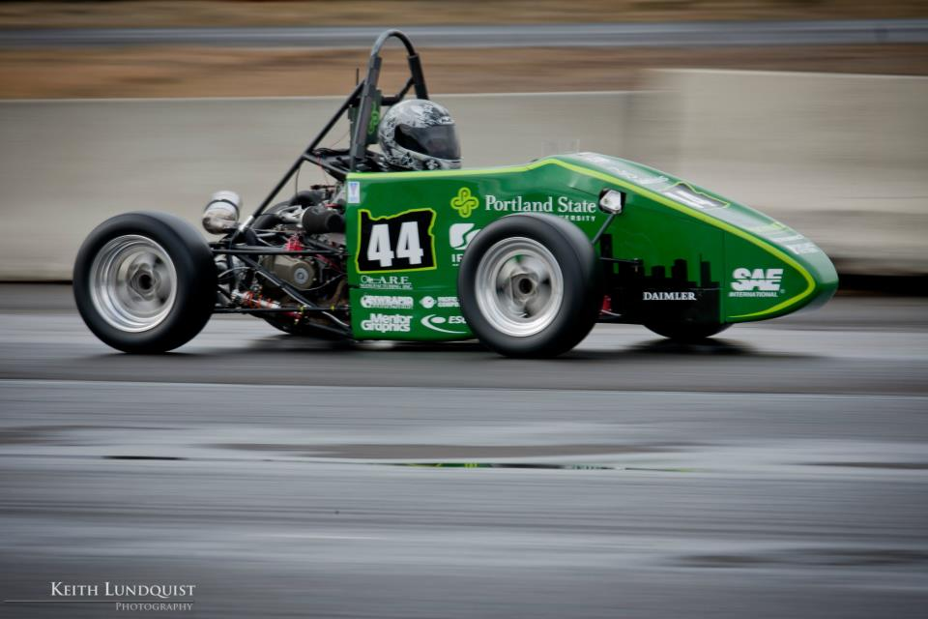
2012 Formula SAE
Outboard Suspension
Jose Colin
Efe Yildirim
Chip Larson
Rick Rickert
Carole Gayley
Thomas McCall
Industry Advisor: Evan Waymire
Academic Advisor: Lemmy Meekisho

Slide 2
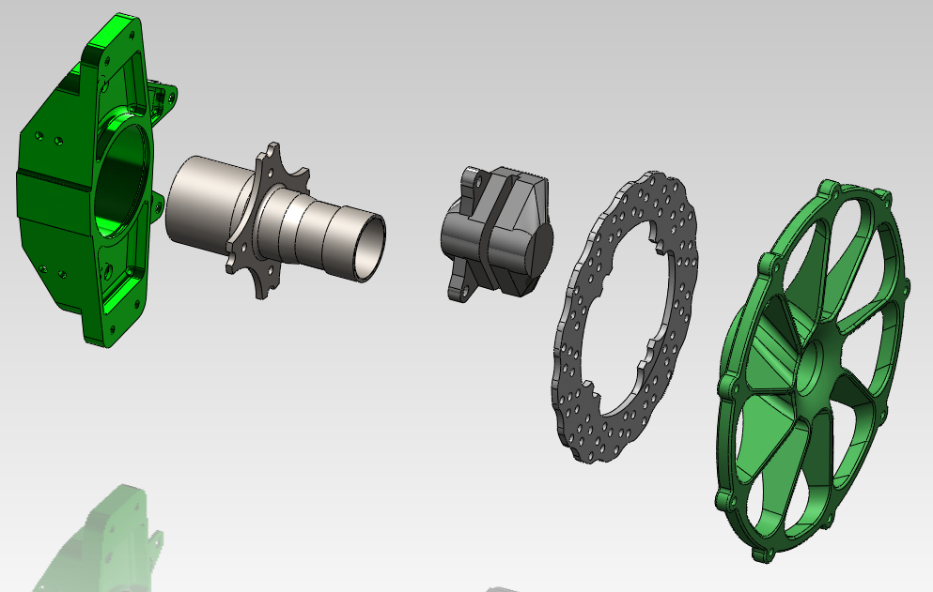
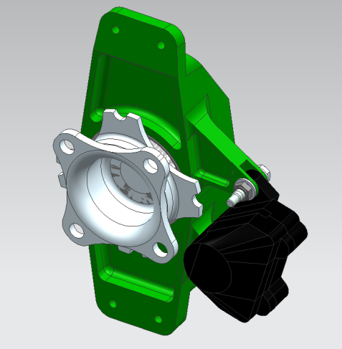
Overview
Introduction/Background
Mission Statement
Final PDS Summary
External Search
Internal Search
Concept Selection
Deadlines
Notes:
Chip – Over the next few minutes you will be exposed to the goals of the Outboard Suspension team and the Viking Motor Sports team, who is the primary customer of the Outboard Suspension Capstone project. You will also learn about the detailed design requirements of the Outboard Suspension Capstone project through an overview of our product design specifications.
Finally we will identify risks that could hinder the success of new outboard suspension design, and detail ways the team will monitor and if necessary mitigate these risks.
At the end there will be a chance to ask questions.
During the presentation you will hear us refer to various suspension parts. To aid in your understanding, the upper right corner of the screen has an exploded view of the major components of the outboard suspension off one corner of the car. From left to right you can see the upright (typically aluminum), the hub (one of our concepts), and the break and wheel assembly. Not shown are the bearings which go inside the upright. Last years hub and upright is shown as an assembly at the bottom of the screen.

Slide 3
Background
Each year, Viking Motorsport (VMS) designs
and builds an open wheel racecar.
Max 610cc displacement engine
Min 8” diameter wheels
Min 60” wheelbase
No minimum weight
2012 Competition: June 20-23 in Lincoln, NE
Notes:
Chip – Every year PSU’s Viking Motorsports team builds a open wheel race car, with a limit of a 600 cc engine to compete against other engineering schools in the international FSAE competition. Last year the team put in countless hour designing a new car from the ground up. This is the car you see pictured.
Though the car performed well, and its design is being used again this year, there were areas for improvement. The hubs were quite overdesigned for the application and had a complex 2 plane geometry that made them a machining nightmare. Also, the fit between the uprights, the bearings and the hub had too much of an interference. This gave the car an unnecessary amount of rolling resistance.

Slide 4
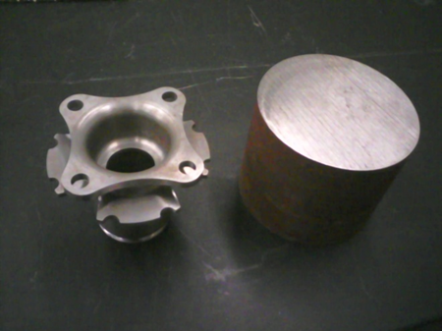
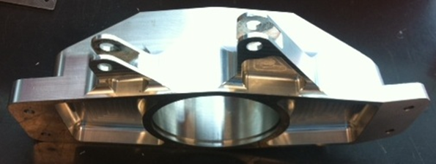
Mission Statement
Redesign hubs and uprights for:
VMS designed centerlock wheel
Decreased weight
Reduced machine time and cost
Notes:
Chip – This year the mission of the outboard suspension capstone is to redesign and improve the hub and upright . We will reduce the weight of the hub, but at the same time design a part that cuts the machining time and doesn’t add to cost.
The team will also analyze the incorrect bearing interferences experienced last year and determine the proper interference to maintain low bearing resistance, while not allowing the assembly to slip under a cornering load.
The capstone team will also incorporate a centerlock, single nut, wheel retention system into the hub design. This design allows for faster tire changes in a racing environment.

Slide 5
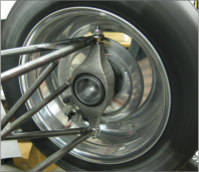
Final Product Design Specification Summary
Notes:
Chip – The life of these part is fairly short. The team typically uses a set of hubs for one year, then discards them and makes new ones. Even though they will most likely not be used more than one year, the design life is for 5 years to ensure that if required, the parts will hold up for multiple years of racing.
Once the parts are ready for disposal, the team will have an MSDS (material safety data sheet) for the hub, and upright material so they will know how to properly dispose of the components safely and as cost effectively as possible.

Slide 6
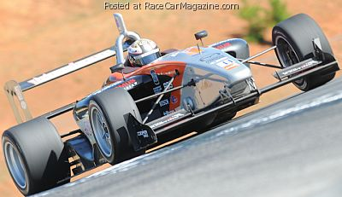
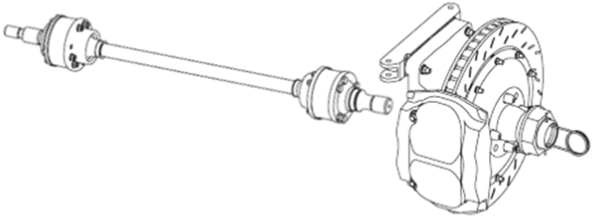
External Search
Existing Race Designs
Swift 016 rear outboard suspension
Hub/upright clamped by axle, separate wheel nut
Brake rotor and wheel driven by pins
Notes:
Rick – To mitigate the risk involved with undersizing the parts, we will do detailed FEA analysis and validate the results with engineering equations which should reduce the likelihood of having the parts undersized. To reduce the consequence of the parts being undersized, the car will go through a testing process that will start off with very low speed testing, then the parts will be inspected for wear or damage. The parts will then be reinstalled, and higher stress testing will begin. This process will be repeated until the car is brought up to full speed. Inspection will continue at designated intervals.

Slide 7
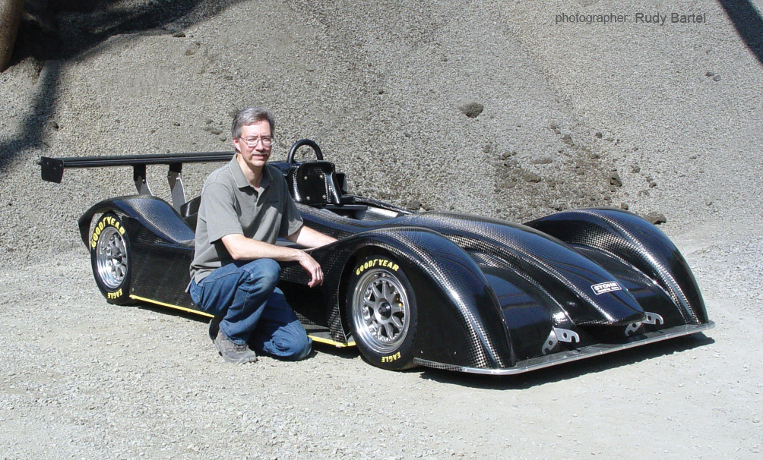
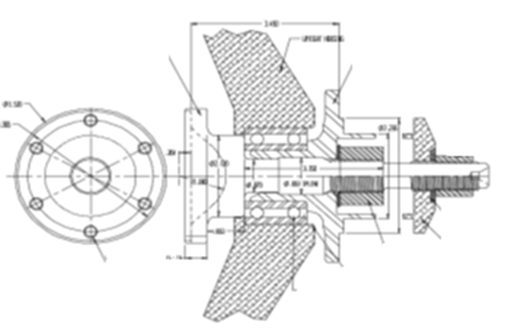
External Search
Off the Shelf Option
Taylor Race FSAE/DSR hub and upright assembly
Centerlock or multi lug hub
Oversized for FSAE
Notes:
Rick – To mitigate the risk involved with undersizing the parts, we will do detailed FEA analysis and validate the results with engineering equations which should reduce the likelihood of having the parts undersized. To reduce the consequence of the parts being undersized, the car will go through a testing process that will start off with very low speed testing, then the parts will be inspected for wear or damage. The parts will then be reinstalled, and higher stress testing will begin. This process will be repeated until the car is brought up to full speed. Inspection will continue at designated intervals.

Slide 8
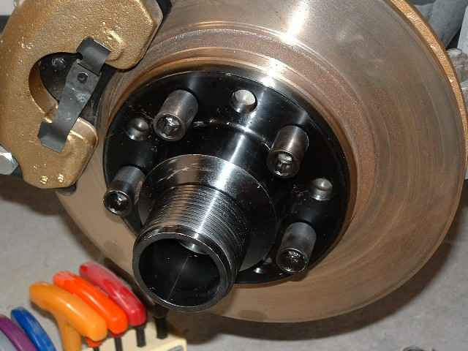
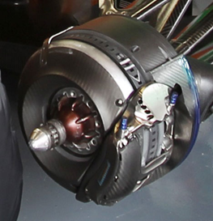
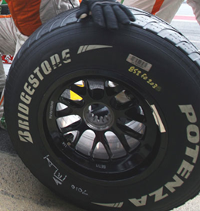
External Search
Wheel/Hub Engagement
Splines
Drive Pins
Excellent engagement
Expensive/difficult to manufacture
Cheap/easy to manufacture
Clearance between wheel and pins
Force India splined wheel/hub
Notes:
Rick – To mitigate the risk involved with undersizing the parts, we will do detailed FEA analysis and validate the results with engineering equations which should reduce the likelihood of having the parts undersized. To reduce the consequence of the parts being undersized, the car will go through a testing process that will start off with very low speed testing, then the parts will be inspected for wear or damage. The parts will then be reinstalled, and higher stress testing will begin. This process will be repeated until the car is brought up to full speed. Inspection will continue at designated intervals.

Slide 9
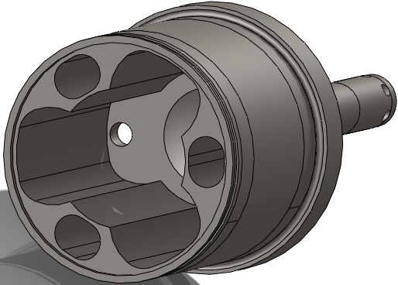
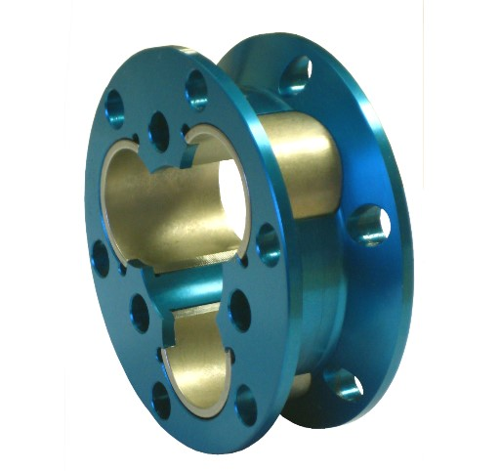
External Search
Tripod CV Joint
Integrated (2011 style)
External
Less weight
Retain 2011 axle length
Higher machine time
Available off the shelf
Potentially higher weight
Notes:
Rick – To mitigate the risk involved with undersizing the parts, we will do detailed FEA analysis and validate the results with engineering equations which should reduce the likelihood of having the parts undersized. To reduce the consequence of the parts being undersized, the car will go through a testing process that will start off with very low speed testing, then the parts will be inspected for wear or damage. The parts will then be reinstalled, and higher stress testing will begin. This process will be repeated until the car is brought up to full speed. Inspection will continue at designated intervals.

Slide 10
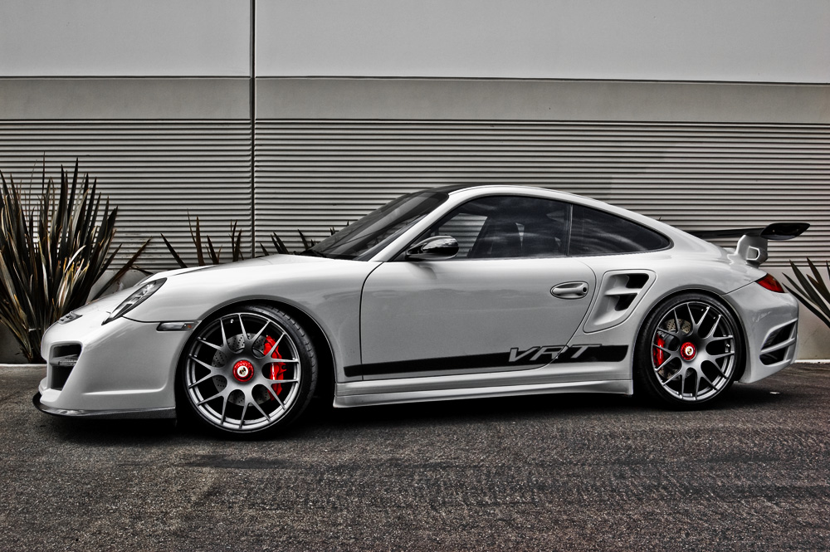
External Search
Wheel Nut Retention – Important!
FSAE Rule
Porsche recall

Slide 11
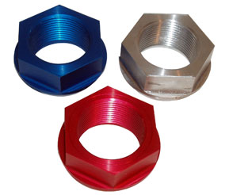
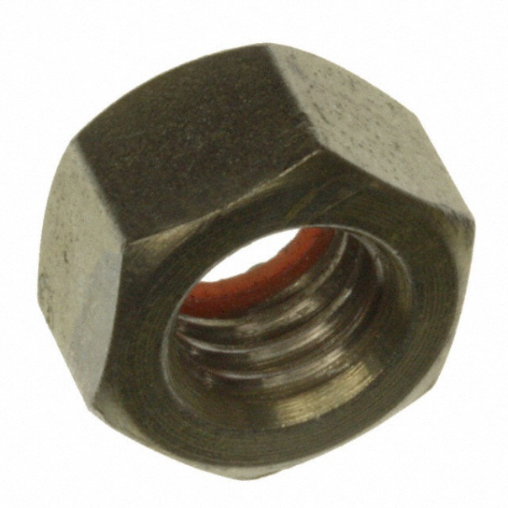
Internal Search
Wheel Nut
Large (~ 2”) Tapered Aluminum
Centers wheel
Expensive
Lower clamp force
Small (1/2” – 1”) Steel Hex
Inexpensive
Higher clamp force
Requires wheel centering method
Notes:
Rick – To mitigate the risk involved with undersizing the parts, we will do detailed FEA analysis and validate the results with engineering equations which should reduce the likelihood of having the parts undersized. To reduce the consequence of the parts being undersized, the car will go through a testing process that will start off with very low speed testing, then the parts will be inspected for wear or damage. The parts will then be reinstalled, and higher stress testing will begin. This process will be repeated until the car is brought up to full speed. Inspection will continue at designated intervals.

Slide 12
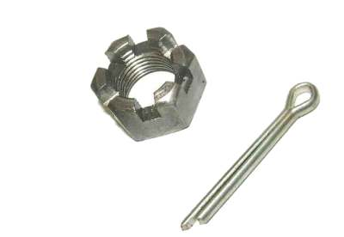
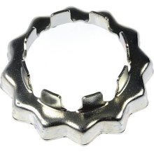
Internal Search
Wheel Nut Retention
Castle Nut
Available in many sizes
Able to modify existing nut
Cuts reduce thread engagement
Poor pin resolution (60*)
Spindle Nut Retainer
Inexpensive
Readily available
15* pin resolution
Difficult to produce custom units
Notes:
Rick – To mitigate the risk involved with undersizing the parts, we will do detailed FEA analysis and validate the results with engineering equations which should reduce the likelihood of having the parts undersized. To reduce the consequence of the parts being undersized, the car will go through a testing process that will start off with very low speed testing, then the parts will be inspected for wear or damage. The parts will then be reinstalled, and higher stress testing will begin. This process will be repeated until the car is brought up to full speed. Inspection will continue at designated intervals.

Slide 13
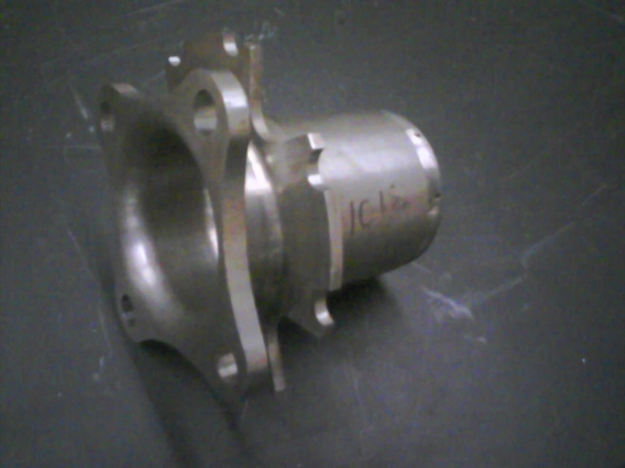
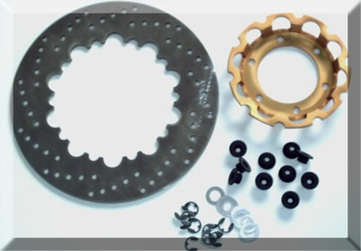
Internal Search
Brake Hat
2011 brake hats were integrated into hub
Excess machine time
Required larger OD material
2011 Integrated Brake Hat
Separate Brake Hat
Notes:
Rick – To mitigate the risk involved with undersizing the parts, we will do detailed FEA analysis and validate the results with engineering equations which should reduce the likelihood of having the parts undersized. To reduce the consequence of the parts being undersized, the car will go through a testing process that will start off with very low speed testing, then the parts will be inspected for wear or damage. The parts will then be reinstalled, and higher stress testing will begin. This process will be repeated until the car is brought up to full speed. Inspection will continue at designated intervals.

Slide 14
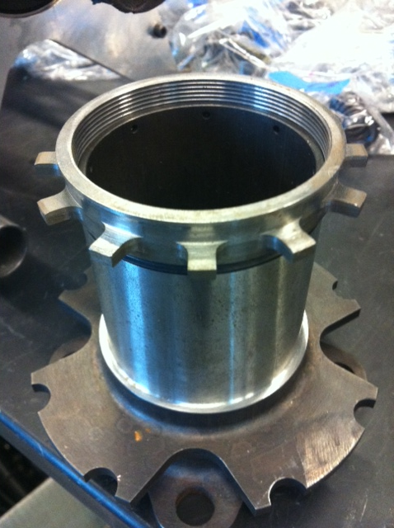
Internal Search
Wheel Speed Sensor
2011 Wheel speed sensors taped to the uprights
Custom tone rings were machined, threaded onto hubs
Notes:
Rick – To mitigate the risk involved with undersizing the parts, we will do detailed FEA analysis and validate the results with engineering equations which should reduce the likelihood of having the parts undersized. To reduce the consequence of the parts being undersized, the car will go through a testing process that will start off with very low speed testing, then the parts will be inspected for wear or damage. The parts will then be reinstalled, and higher stress testing will begin. This process will be repeated until the car is brought up to full speed. Inspection will continue at designated intervals.

Slide 15
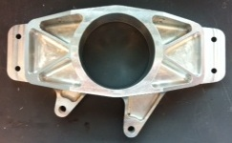
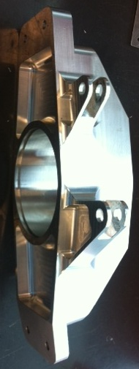
Internal Search
Upright
Small changes:
Retain 2011 geometry
Reduce machine time
Increase rigidity
Relocate wheel speed sensor
Notes:
Rick – To mitigate the risk involved with undersizing the parts, we will do detailed FEA analysis and validate the results with engineering equations which should reduce the likelihood of having the parts undersized. To reduce the consequence of the parts being undersized, the car will go through a testing process that will start off with very low speed testing, then the parts will be inspected for wear or damage. The parts will then be reinstalled, and higher stress testing will begin. This process will be repeated until the car is brought up to full speed. Inspection will continue at designated intervals.

Slide 16
Concept Selection
Hub – Hardened Steel
Integrated CV joint
Lighter
Retain 2011 axle
Front and rear hubs identical
Reduce design/FEA time
Remove CV from front
Upright – Aluminum
High strength
Ductile
Most likely 6061-T6
Wheel Speed Sensor
Threaded into upright
Read slots in brake disc
Notes:
Rick – To mitigate the risk involved with undersizing the parts, we will do detailed FEA analysis and validate the results with engineering equations which should reduce the likelihood of having the parts undersized. To reduce the consequence of the parts being undersized, the car will go through a testing process that will start off with very low speed testing, then the parts will be inspected for wear or damage. The parts will then be reinstalled, and higher stress testing will begin. This process will be repeated until the car is brought up to full speed. Inspection will continue at designated intervals.

Slide 17
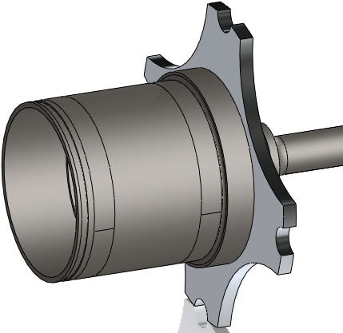
Concept Selection
Separate Brake Hat
Cut from plate
Manufactured in-house
Material choice
Allows smaller OD stock for hub
Notes:
Rick – To mitigate the risk involved with undersizing the parts, we will do detailed FEA analysis and validate the results with engineering equations which should reduce the likelihood of having the parts undersized. To reduce the consequence of the parts being undersized, the car will go through a testing process that will start off with very low speed testing, then the parts will be inspected for wear or damage. The parts will then be reinstalled, and higher stress testing will begin. This process will be repeated until the car is brought up to full speed. Inspection will continue at designated intervals.

Slide 18
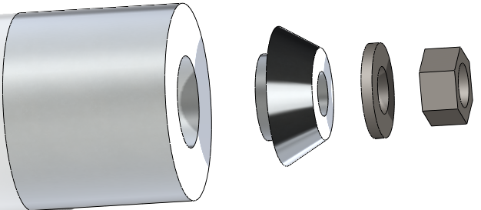
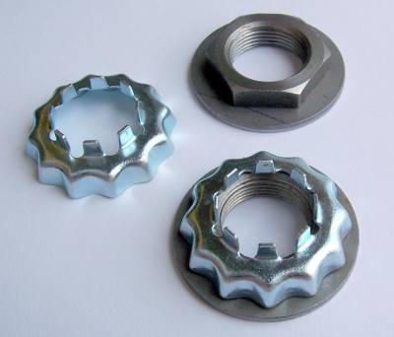
Concept Selection
Steel Wheel Nut
No more than 300lbf.ft installation torque
Clamp force must prevent slip on brake/acceleration
Must be < 1.1” nominal diameter
Spindle Nut Retainer
Readily available for metric hex nuts
5* resolution with 3 pin holes
Notes:
Rick – To mitigate the risk involved with undersizing the parts, we will do detailed FEA analysis and validate the results with engineering equations which should reduce the likelihood of having the parts undersized. To reduce the consequence of the parts being undersized, the car will go through a testing process that will start off with very low speed testing, then the parts will be inspected for wear or damage. The parts will then be reinstalled, and higher stress testing will begin. This process will be repeated until the car is brought up to full speed. Inspection will continue at designated intervals.

Slide 19
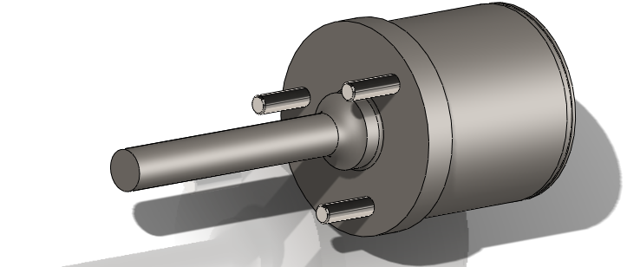
Concept Selection
Drive Pins
Safety net in case of loose wheel nut
Dowel Pins pressed into hub
Engage brake hat and wheel
Allows driver to safely park the vehicle
Notes:
Rick – To mitigate the risk involved with undersizing the parts, we will do detailed FEA analysis and validate the results with engineering equations which should reduce the likelihood of having the parts undersized. To reduce the consequence of the parts being undersized, the car will go through a testing process that will start off with very low speed testing, then the parts will be inspected for wear or damage. The parts will then be reinstalled, and higher stress testing will begin. This process will be repeated until the car is brought up to full speed. Inspection will continue at designated intervals.

Slide 20
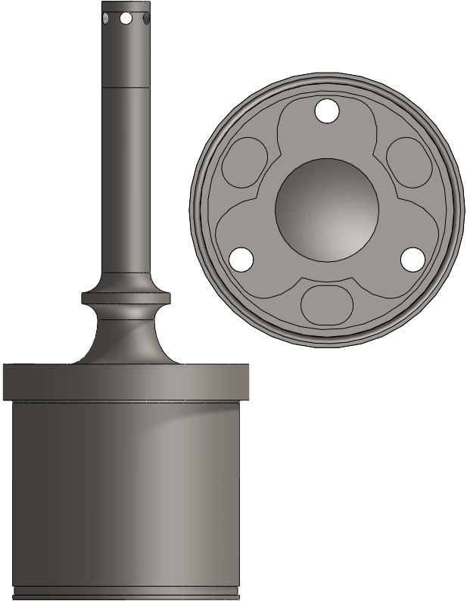
Design Progress
Hub and Wheel Nut
2G cornering, acceleration, braking
Infinite life
Target FOS = 1.5
Weight = 1.55lbf rear (2011 = 3.1lbf)
    = 1.40lbf front
M16x2.0 Wheel Nut
175lbf.ft torque
3” round stock (2011 required 5”)
Machining donated by ARE Mfg.
Heat treating donated by Beaver Heat Treat
Notes:
Rick – To mitigate the risk involved with undersizing the parts, we will do detailed FEA analysis and validate the results with engineering equations which should reduce the likelihood of having the parts undersized. To reduce the consequence of the parts being undersized, the car will go through a testing process that will start off with very low speed testing, then the parts will be inspected for wear or damage. The parts will then be reinstalled, and higher stress testing will begin. This process will be repeated until the car is brought up to full speed. Inspection will continue at designated intervals.

Slide 21
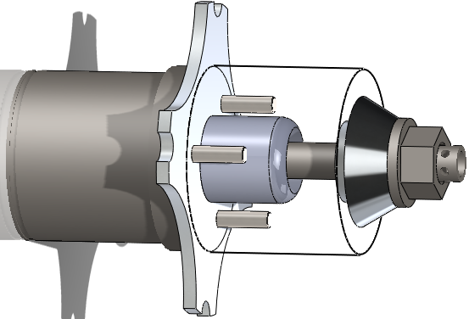
Design Progress
Peripheral Components
Wheel centered by 1.3” OD aluminum pilot
(3) ¼” OD x 1” long steel dowel pins
30* cone angle wheel nut spacer distributes clamp load
Notes:
Rick – To mitigate the risk involved with undersizing the parts, we will do detailed FEA analysis and validate the results with engineering equations which should reduce the likelihood of having the parts undersized. To reduce the consequence of the parts being undersized, the car will go through a testing process that will start off with very low speed testing, then the parts will be inspected for wear or damage. The parts will then be reinstalled, and higher stress testing will begin. This process will be repeated until the car is brought up to full speed. Inspection will continue at designated intervals.

Slide 22
Project Schedule
March
Validate hub design with FEA
Produce 2 sets of hubs
Design wheel pilot and spacer
Design uprights
April
Validate upright design with FEA
Produce 2 sets of uprights
Choose wheel bearings
Design brake hats
May
Produce brake hats, pilots, and wheel nut spacers
Assemble outboard suspension
Conduct on-vehicle testing
June
Final report
FSAE competition
Notes:
Rick – To mitigate the risk involved with undersizing the parts, we will do detailed FEA analysis and validate the results with engineering equations which should reduce the likelihood of having the parts undersized. To reduce the consequence of the parts being undersized, the car will go through a testing process that will start off with very low speed testing, then the parts will be inspected for wear or damage. The parts will then be reinstalled, and higher stress testing will begin. This process will be repeated until the car is brought up to full speed. Inspection will continue at designated intervals.

Slide 23

Q u e s t
I o n s
?
Notes:
Chip - Are there any questions?

