Slide 1
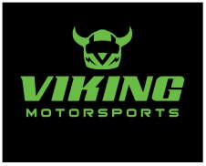
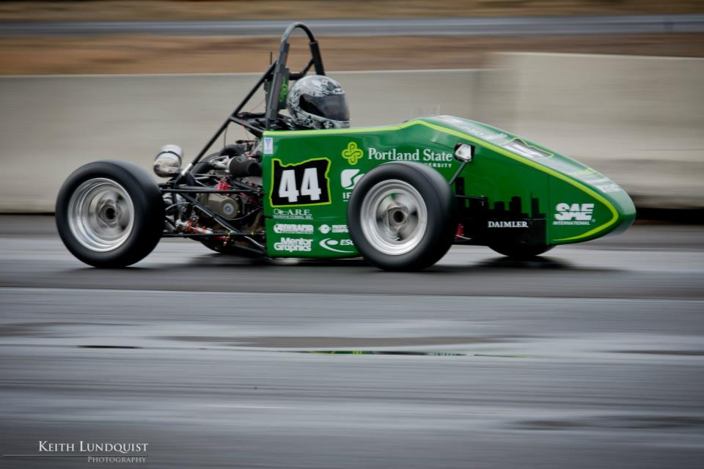
2012 Formula SAE Outboard Suspension
Jose Colin
Efe Yildirim
Chip Larson
Rick Rickert
Carole Gayley
Thomas McCall Industry Advisor: Evan Waymire
Academic Advisor: Lemmy Meekisho

Slide 2
Overview
Background
Mission Statement
Design Requirements
Off the Shelf or Custom
Custom Design options
Calculations
Design Decision
Final Design
FEA Analysis
Challenges and Solutions
Conclusion
Notes:
Chip – Over the next few minutes you will be exposed to the goals of the Outboard Suspension team and the Viking Motor Sports team, who is the primary customer of the Outboard Suspension Capstone project. You will also learn about the detailed design requirements of the Outboard Suspension Capstone project through an overview of our product design specifications.
Finally we will identify risks that could hinder the success of new outboard suspension design, and detail ways the team will monitor and if necessary mitigate these risks.
At the end there will be a chance to ask questions.
During the presentation you will hear us refer to various suspension parts. To aid in your understanding, the upper right corner of the screen has an exploded view of the major components of the outboard suspension off one corner of the car. From left to right you can see the upright (typically aluminum), the hub (one of our concepts), and the break and wheel assembly. Not shown are the bearings which go inside the upright. Last years hub and upright is shown as an assembly at the bottom of the screen.

Slide 3
Background
Each year, Viking Motorsport (VMS) designs
builds and tests an open wheel racecar. FSAE OS Team will redesign the outboard suspension for MY12.
2012 Competition: June 20-23 in Lincoln, NE
Notes:
Chip – Every year PSU’s Viking Motorsports team builds a open wheel race car, with a limit of a 600 cc engine to compete against other engineering schools in the international FSAE competition. Last year the team put in countless hour designing a new car from the ground up. This is the car you see pictured.
Though the car performed well, and its design is being used again this year, there were areas for improvement. The hubs were quite overdesigned for the application and had a complex 2 plane geometry that made them a machining nightmare. Also, the fit between the uprights, the bearings and the hub had too much of an interference. This gave the car an unnecessary amount of rolling resistance.

Slide 4
Functional need for center-lock wheels
Competition in Nebraska-it may rain at a moments notice, so wheel change would be quicker
Less rotational inertia
Notes:
Chip – Every year PSU’s Viking Motorsports team builds a open wheel race car, with a limit of a 600 cc engine to compete against other engineering schools in the international FSAE competition. Last year the team put in countless hour designing a new car from the ground up. This is the car you see pictured.
Though the car performed well, and its design is being used again this year, there were areas for improvement. The hubs were quite overdesigned for the application and had a complex 2 plane geometry that made them a machining nightmare. Also, the fit between the uprights, the bearings and the hub had too much of an interference. This gave the car an unnecessary amount of rolling resistance.

Slide 5
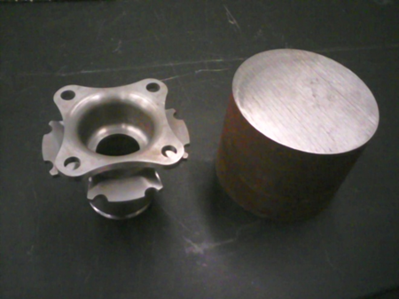
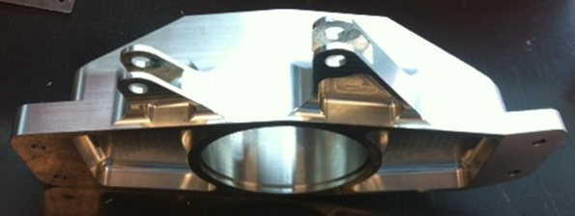
Mission Statement
FSAE-OS Team will design, validate and produce a new outboard suspension that will weigh less, have reduced part machining time and cost that integrates a centerlock system.
Notes:
Chip – This year the mission of the outboard suspension capstone is to redesign and improve the hub and upright . We will reduce the weight of the hub, but at the same time design a part that cuts the machining time and doesn’t add to cost.
The team will also analyze the incorrect bearing interferences experienced last year and determine the proper interference to maintain low bearing resistance, while not allowing the assembly to slip under a cornering load.
The capstone team will also incorporate a centerlock, single nut, wheel retention system into the hub design. This design allows for faster tire changes in a racing environment.

Slide 6
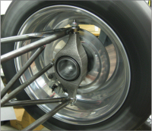
Design Requirements
2011 & 2012 parts are interchangeable
Back-up system in case of failure
Centerlock nut retention with two threads exposed
FSAE rule
Hub Weight
Target: 2lb
Must withstand 2G cornering load
Customer requirement
Notes:
Chip – The life of these part is fairly short. The team typically uses a set of hubs for one year, then discards them and makes new ones. Even though they will most likely not be used more than one year, the design life is for 5 years to ensure that if required, the parts will hold up for multiple years of racing.
Once the parts are ready for disposal, the team will have an MSDS (material safety data sheet) for the hub, and upright material so they will know how to properly dispose of the components safely and as cost effectively as possible.

Slide 7
Design Requirements
Ease of Manufacturing
Machining time: 80 min
Hub cost
$200 each
Service life
2 years
Installation torque
No more than 300 ft.lbf
Notes:
Chip – The life of these part is fairly short. The team typically uses a set of hubs for one year, then discards them and makes new ones. Even though they will most likely not be used more than one year, the design life is for 5 years to ensure that if required, the parts will hold up for multiple years of racing.
Once the parts are ready for disposal, the team will have an MSDS (material safety data sheet) for the hub, and upright material so they will know how to properly dispose of the components safely and as cost effectively as possible.

Slide 8
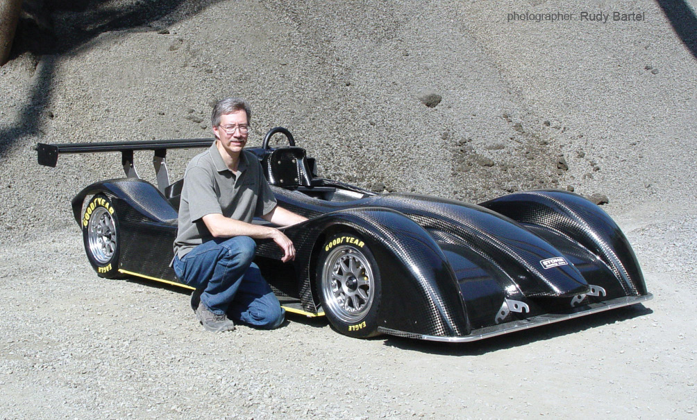
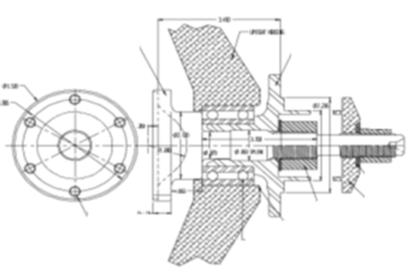
Off the Shelf Option
Taylor Race FSAE/DSR hub and upright assembly
Centerlock
Oversized for FSAE racecar
Tripod CV joint
Cost prohibitive ($4000)
Notes:
Rick – To mitigate the risk involved with undersizing the parts, we will do detailed FEA analysis and validate the results with engineering equations which should reduce the likelihood of having the parts undersized. To reduce the consequence of the parts being undersized, the car will go through a testing process that will start off with very low speed testing, then the parts will be inspected for wear or damage. The parts will then be reinstalled, and higher stress testing will begin. This process will be repeated until the car is brought up to full speed. Inspection will continue at designated intervals.

Slide 9
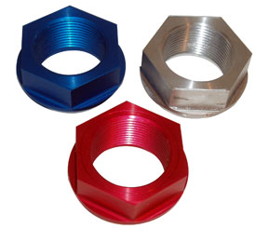
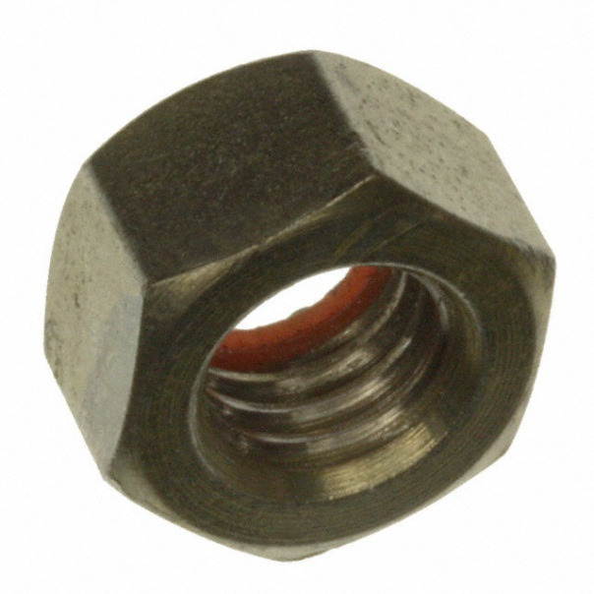
Custom Design
Wheel Nut
Large (~ 2”) Tapered Aluminum
Centers wheel
Expensive
Lower clamp force
Small (1/2” – 1”) Steel Hex
Inexpensive
Higher clamp force
Requires wheel centering method
Notes:
Rick – To mitigate the risk involved with undersizing the parts, we will do detailed FEA analysis and validate the results with engineering equations which should reduce the likelihood of having the parts undersized. To reduce the consequence of the parts being undersized, the car will go through a testing process that will start off with very low speed testing, then the parts will be inspected for wear or damage. The parts will then be reinstalled, and higher stress testing will begin. This process will be repeated until the car is brought up to full speed. Inspection will continue at designated intervals.

Slide 10
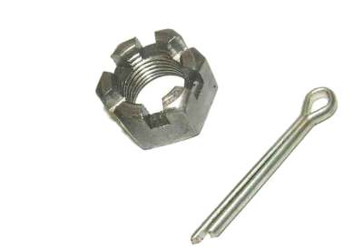
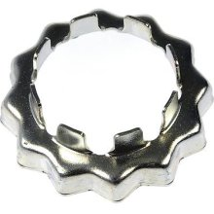
Custom Design
Wheel Nut Retention
Castle Nut
Available in many sizes
Able to modify existing nut
Cuts reduce thread engagement
Poor pin resolution (60*)
Spindle Nut Retainer
Inexpensive
Readily available
15* pin resolution
Difficult to produce custom units
Notes:
Rick – To mitigate the risk involved with undersizing the parts, we will do detailed FEA analysis and validate the results with engineering equations which should reduce the likelihood of having the parts undersized. To reduce the consequence of the parts being undersized, the car will go through a testing process that will start off with very low speed testing, then the parts will be inspected for wear or damage. The parts will then be reinstalled, and higher stress testing will begin. This process will be repeated until the car is brought up to full speed. Inspection will continue at designated intervals.

Slide 11
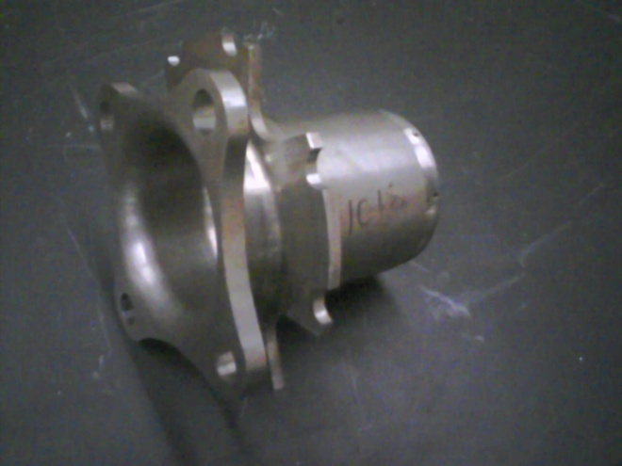
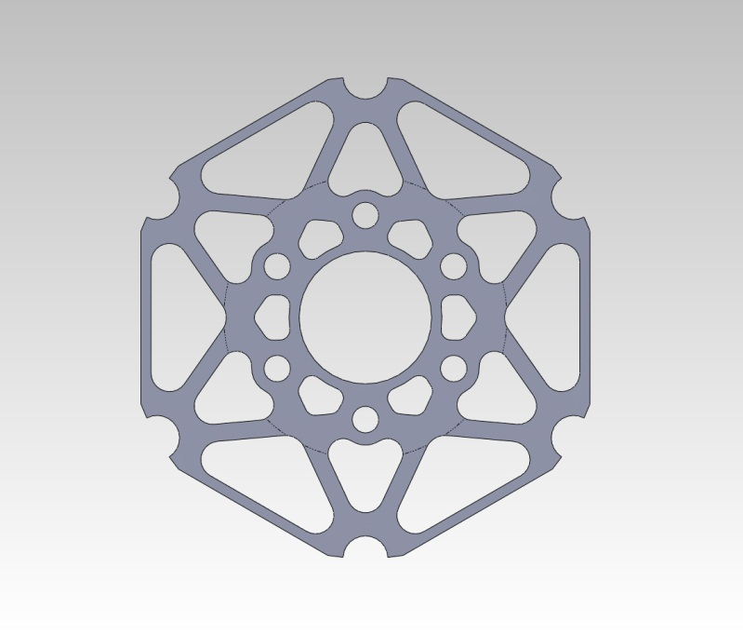
Custom Design
Brake Hat
2011 - Integrated brake hat
Increased machine time
Required larger OD material
2012 - Separate brake hat
Plate steel
Machined in-house
2011 Integrated Brake Hat
2012 Separate Brake Hat
Notes:
Rick – To mitigate the risk involved with undersizing the parts, we will do detailed FEA analysis and validate the results with engineering equations which should reduce the likelihood of having the parts undersized. To reduce the consequence of the parts being undersized, the car will go through a testing process that will start off with very low speed testing, then the parts will be inspected for wear or damage. The parts will then be reinstalled, and higher stress testing will begin. This process will be repeated until the car is brought up to full speed. Inspection will continue at designated intervals.

Slide 12
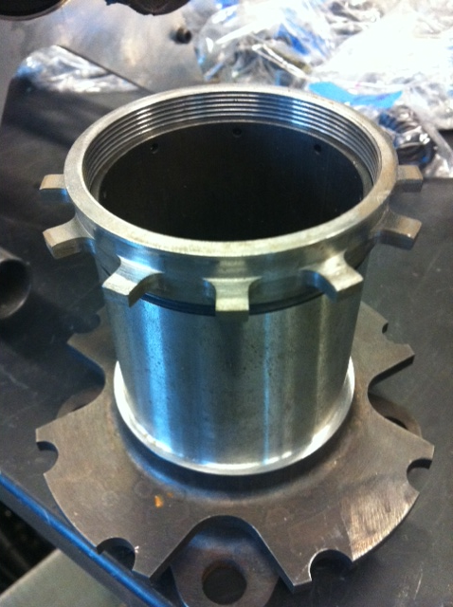
Custom Design
Wheel Speed Sensor
2011 Wheel speed sensors taped to the uprights
Custom tone rings were machined, threaded onto hubs
2012 Wheel speed sensors integrated into upright
Notes:
Rick – To mitigate the risk involved with undersizing the parts, we will do detailed FEA analysis and validate the results with engineering equations which should reduce the likelihood of having the parts undersized. To reduce the consequence of the parts being undersized, the car will go through a testing process that will start off with very low speed testing, then the parts will be inspected for wear or damage. The parts will then be reinstalled, and higher stress testing will begin. This process will be repeated until the car is brought up to full speed. Inspection will continue at designated intervals.

Slide 13
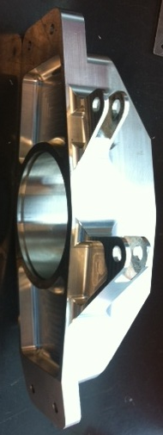
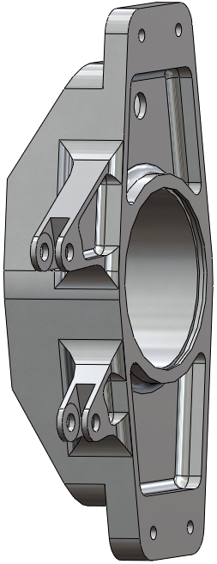
Custom Design
Upright
Small changes:
Retain 2011 geometry
Reduce machine time
Relocate wheel speed sensor
Realigned caliper mounting
Notes:
Rick – To mitigate the risk involved with undersizing the parts, we will do detailed FEA analysis and validate the results with engineering equations which should reduce the likelihood of having the parts undersized. To reduce the consequence of the parts being undersized, the car will go through a testing process that will start off with very low speed testing, then the parts will be inspected for wear or damage. The parts will then be reinstalled, and higher stress testing will begin. This process will be repeated until the car is brought up to full speed. Inspection will continue at designated intervals.

Slide 14
Calculations
Hub
Wheel nut torque
Pin wheel contact stress
Wheel to hub friction
Thermal expansion
Bearings
Loads from cornering
Bearing to upright interference
Bearing hub interference
Notes:
Rick – To mitigate the risk involved with undersizing the parts, we will do detailed FEA analysis and validate the results with engineering equations which should reduce the likelihood of having the parts undersized. To reduce the consequence of the parts being undersized, the car will go through a testing process that will start off with very low speed testing, then the parts will be inspected for wear or damage. The parts will then be reinstalled, and higher stress testing will begin. This process will be repeated until the car is brought up to full speed. Inspection will continue at designated intervals.

Slide 15
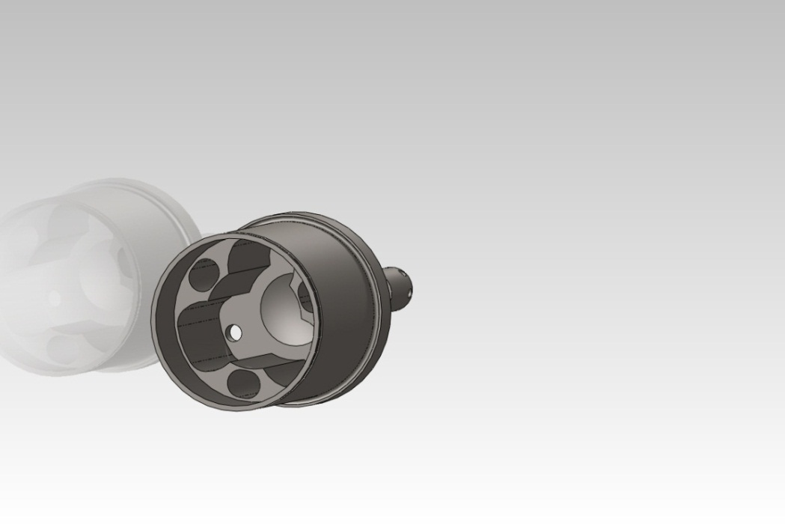
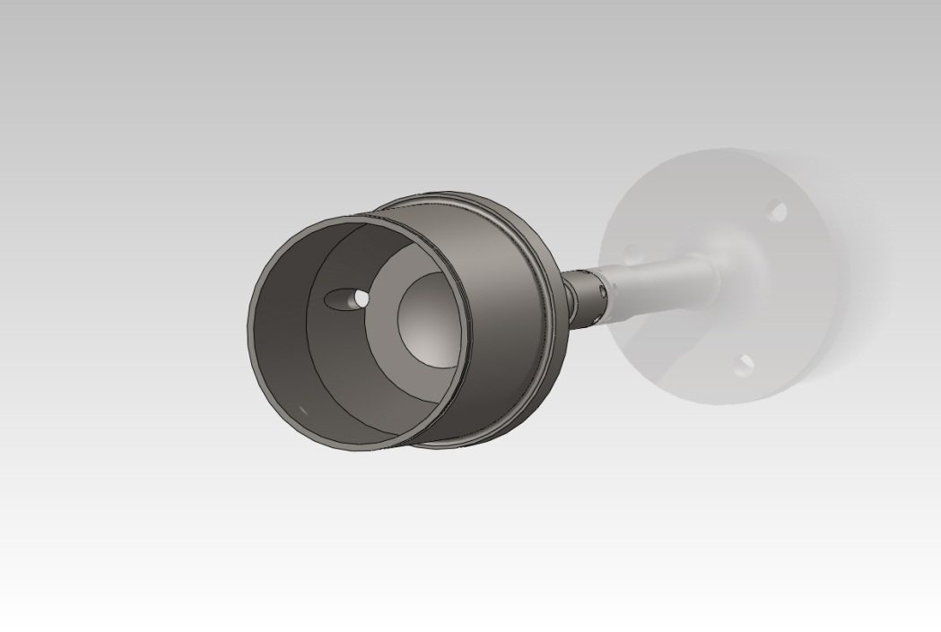
Design Decision
Hub – Hardened Steel
Integrated CV joint
Lighter
Retain 2011 axle
Front and rear hubs identical
Reduce design/FEA time
Remove CV from front
Notes:
Rick – To mitigate the risk involved with undersizing the parts, we will do detailed FEA analysis and validate the results with engineering equations which should reduce the likelihood of having the parts undersized. To reduce the consequence of the parts being undersized, the car will go through a testing process that will start off with very low speed testing, then the parts will be inspected for wear or damage. The parts will then be reinstalled, and higher stress testing will begin. This process will be repeated until the car is brought up to full speed. Inspection will continue at designated intervals.

Slide 16
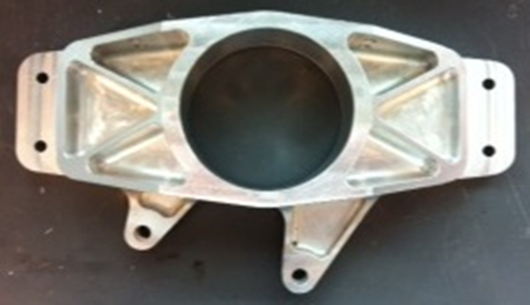
Design Decision
Upright – Aluminum
High strength
Ductile
Material: 6061-T6
Wheel Speed Sensor
Mounted inside upright
Reads slots in brake disc
Notes:
Rick – To mitigate the risk involved with undersizing the parts, we will do detailed FEA analysis and validate the results with engineering equations which should reduce the likelihood of having the parts undersized. To reduce the consequence of the parts being undersized, the car will go through a testing process that will start off with very low speed testing, then the parts will be inspected for wear or damage. The parts will then be reinstalled, and higher stress testing will begin. This process will be repeated until the car is brought up to full speed. Inspection will continue at designated intervals.

Slide 17
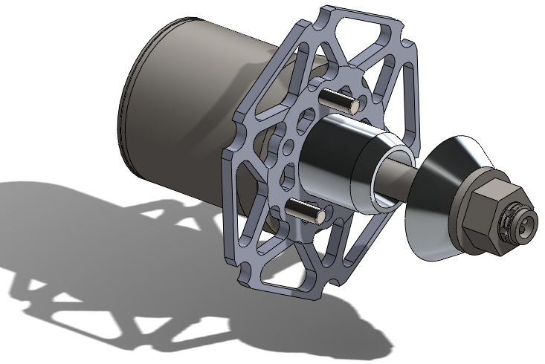
Design Decision
Separate brake hat, drive pins, wheel centering components and wheel retention
Brake Hat
Cut from plate
Machined in-house
4130 Steel
3” OD stock for hub
Drive Pins
3 - ¼” drive pins
Off the shelf
Wheel Retention
Aluminum spacer
Steel washer
M16x2.0 Class 12.9 nut
Spindle nut retainer
R-ClipWheel Centering
Aluminum pilot
Notes:
Rick – To mitigate the risk involved with undersizing the parts, we will do detailed FEA analysis and validate the results with engineering equations which should reduce the likelihood of having the parts undersized. To reduce the consequence of the parts being undersized, the car will go through a testing process that will start off with very low speed testing, then the parts will be inspected for wear or damage. The parts will then be reinstalled, and higher stress testing will begin. This process will be repeated until the car is brought up to full speed. Inspection will continue at designated intervals.

Slide 18
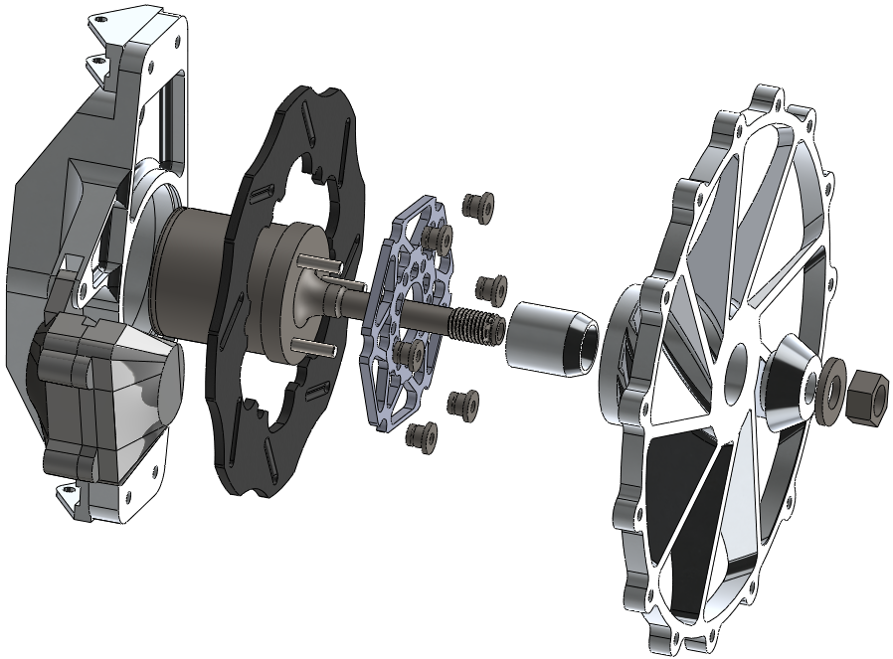
Final Design
Notes:
Chip – Over the next few minutes you will be exposed to the goals of the Outboard Suspension team and the Viking Motor Sports team, who is the primary customer of the Outboard Suspension Capstone project. You will also learn about the detailed design requirements of the Outboard Suspension Capstone project through an overview of our product design specifications.
Finally we will identify risks that could hinder the success of new outboard suspension design, and detail ways the team will monitor and if necessary mitigate these risks.
At the end there will be a chance to ask questions.
During the presentation you will hear us refer to various suspension parts. To aid in your understanding, the upper right corner of the screen has an exploded view of the major components of the outboard suspension off one corner of the car. From left to right you can see the upright (typically aluminum), the hub (one of our concepts), and the break and wheel assembly. Not shown are the bearings which go inside the upright. Last years hub and upright is shown as an assembly at the bottom of the screen.

Slide 19
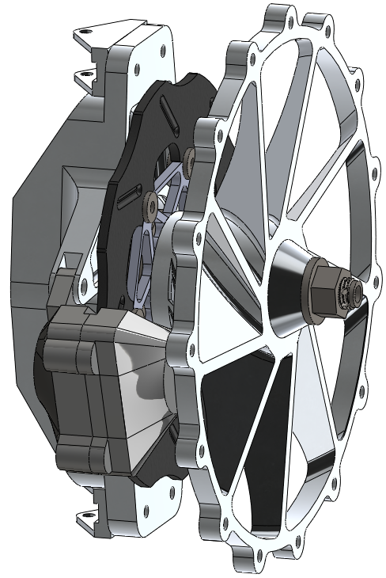
Final Design
Notes:
Rick – To mitigate the risk involved with undersizing the parts, we will do detailed FEA analysis and validate the results with engineering equations which should reduce the likelihood of having the parts undersized. To reduce the consequence of the parts being undersized, the car will go through a testing process that will start off with very low speed testing, then the parts will be inspected for wear or damage. The parts will then be reinstalled, and higher stress testing will begin. This process will be repeated until the car is brought up to full speed. Inspection will continue at designated intervals.

Slide 20
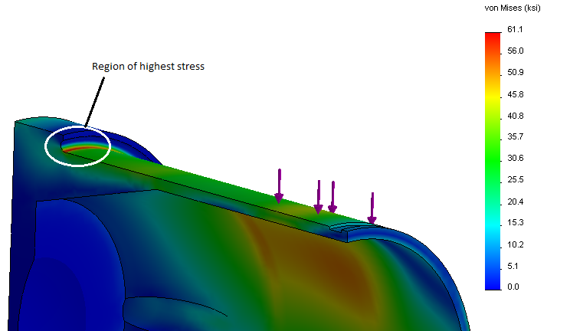
Final Design Analysis
Front Hub Bending 2G cornering
Notes:
Rick –0.040” undercut to mitigate stress concentration.

Slide 21
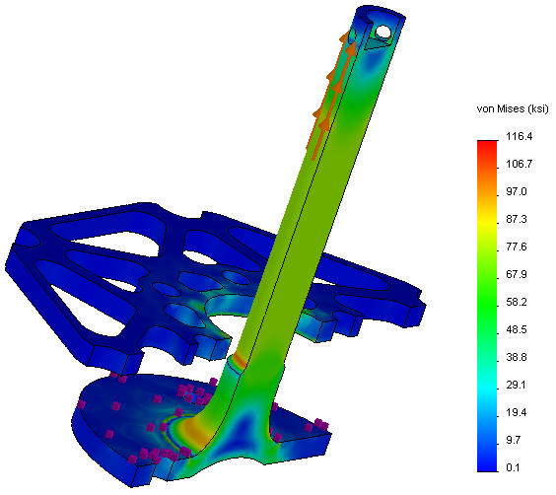
Final Design Analysis
Clamp force
Notes:
Rick –0.040” undercut to mitigate stress concentration.

Slide 22
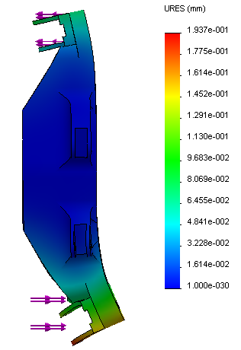
Final Design Analysis
Upright camber compliance
2G cornering load
Upper deflection: 0.063 mm
Lower deflection: 0.152 mm
Total deflection: 0.047*
Camber compliance : 0.024*/G
Notes:
Rick – To mitigate the risk involved with undersizing the parts, we will do detailed FEA analysis and validate the results with engineering equations which should reduce the likelihood of having the parts undersized. To reduce the consequence of the parts being undersized, the car will go through a testing process that will start off with very low speed testing, then the parts will be inspected for wear or damage. The parts will then be reinstalled, and higher stress testing will begin. This process will be repeated until the car is brought up to full speed. Inspection will continue at designated intervals.

Slide 23
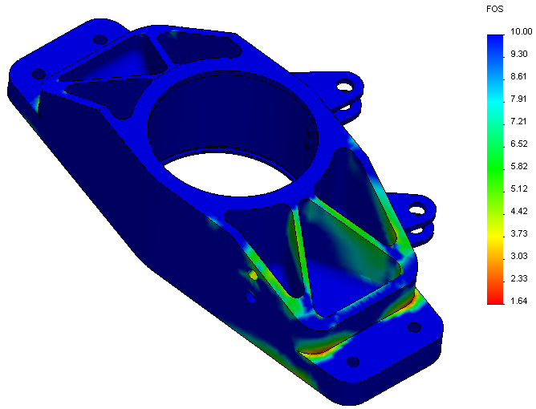
Final Design Analysis
Upright cornering
Notes:
Rick – To mitigate the risk involved with undersizing the parts, we will do detailed FEA analysis and validate the results with engineering equations which should reduce the likelihood of having the parts undersized. To reduce the consequence of the parts being undersized, the car will go through a testing process that will start off with very low speed testing, then the parts will be inspected for wear or damage. The parts will then be reinstalled, and higher stress testing will begin. This process will be repeated until the car is brought up to full speed. Inspection will continue at designated intervals.

Slide 24
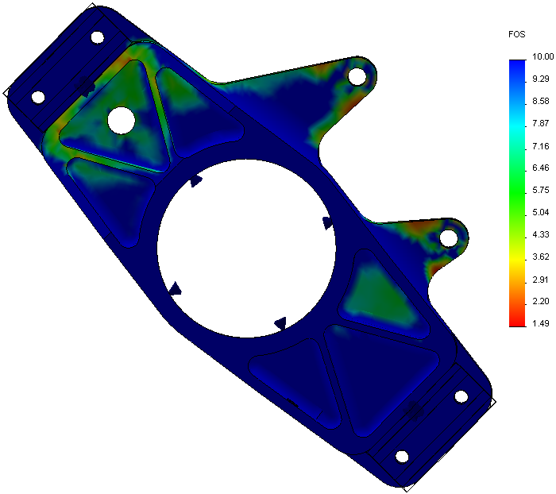
Final Design Analysis
Upright braking
Notes:
Rick – To mitigate the risk involved with undersizing the parts, we will do detailed FEA analysis and validate the results with engineering equations which should reduce the likelihood of having the parts undersized. To reduce the consequence of the parts being undersized, the car will go through a testing process that will start off with very low speed testing, then the parts will be inspected for wear or damage. The parts will then be reinstalled, and higher stress testing will begin. This process will be repeated until the car is brought up to full speed. Inspection will continue at designated intervals.

Slide 25
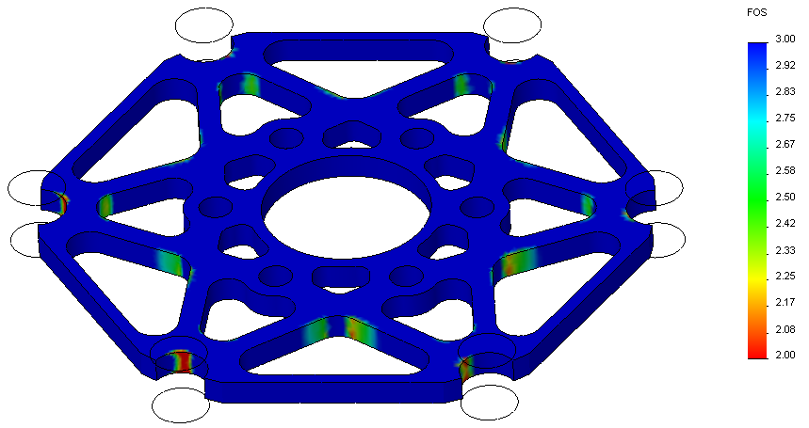
Final Design Analysis
Brake hat, clamped
Notes:
Rick – To mitigate the risk involved with undersizing the parts, we will do detailed FEA analysis and validate the results with engineering equations which should reduce the likelihood of having the parts undersized. To reduce the consequence of the parts being undersized, the car will go through a testing process that will start off with very low speed testing, then the parts will be inspected for wear or damage. The parts will then be reinstalled, and higher stress testing will begin. This process will be repeated until the car is brought up to full speed. Inspection will continue at designated intervals.

Slide 26
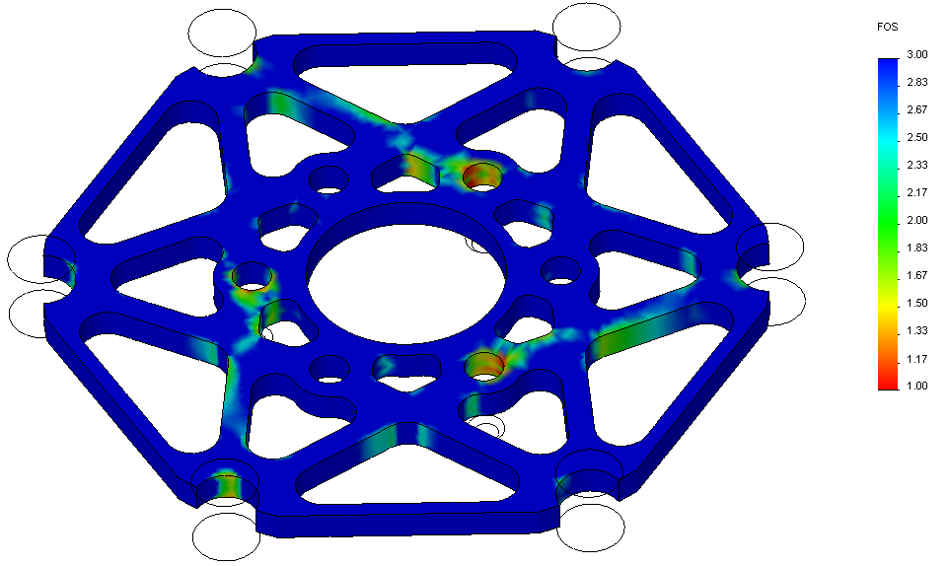
Final Design Analysis
Brake hat , no clamp load
Notes:
Rick – To mitigate the risk involved with undersizing the parts, we will do detailed FEA analysis and validate the results with engineering equations which should reduce the likelihood of having the parts undersized. To reduce the consequence of the parts being undersized, the car will go through a testing process that will start off with very low speed testing, then the parts will be inspected for wear or damage. The parts will then be reinstalled, and higher stress testing will begin. This process will be repeated until the car is brought up to full speed. Inspection will continue at designated intervals.

Slide 27
Challenges/Solutions
High fatigue cycling in hub requires infinite life
The hubs were designed using experimental fatigue data for similar materials and conservative assumptions
No dynamic vehicle data
Typical dynamic vehicle data from similar applications
No budget
Prototype parts were donated by Viking Motorsports, Warn Industries, ARE Manufacturing, Beaver Heat Treat, Dr. Lemmy Meekisho and Zdenek Zumr.
Notes:
Chip – Every year PSU’s Viking Motorsports team builds a open wheel race car, with a limit of a 600 cc engine to compete against other engineering schools in the international FSAE competition. Last year the team put in countless hour designing a new car from the ground up. This is the car you see pictured.
Though the car performed well, and its design is being used again this year, there were areas for improvement. The hubs were quite overdesigned for the application and had a complex 2 plane geometry that made them a machining nightmare. Also, the fit between the uprights, the bearings and the hub had too much of an interference. This gave the car an unnecessary amount of rolling resistance.

Slide 28
Challenges/Solutions
Due to the necessity of donated manufacturing services, parts of a new design will not be ready to test and use on the car within the same year
New designs tested and used on the next model year
Notes:
Chip – Every year PSU’s Viking Motorsports team builds a open wheel race car, with a limit of a 600 cc engine to compete against other engineering schools in the international FSAE competition. Last year the team put in countless hour designing a new car from the ground up. This is the car you see pictured.
Though the car performed well, and its design is being used again this year, there were areas for improvement. The hubs were quite overdesigned for the application and had a complex 2 plane geometry that made them a machining nightmare. Also, the fit between the uprights, the bearings and the hub had too much of an interference. This gave the car an unnecessary amount of rolling resistance.

Slide 29
Conclusion
The Product Design Specification is the roadmap for the final design. Its completeness in satisfying known and unknown customer requirements is directly related to how good the final design is.
Majority of time was spent working on non-design details
Notes:
Chip – Every year PSU’s Viking Motorsports team builds a open wheel race car, with a limit of a 600 cc engine to compete against other engineering schools in the international FSAE competition. Last year the team put in countless hour designing a new car from the ground up. This is the car you see pictured.
Though the car performed well, and its design is being used again this year, there were areas for improvement. The hubs were quite overdesigned for the application and had a complex 2 plane geometry that made them a machining nightmare. Also, the fit between the uprights, the bearings and the hub had too much of an interference. This gave the car an unnecessary amount of rolling resistance.

Slide 30
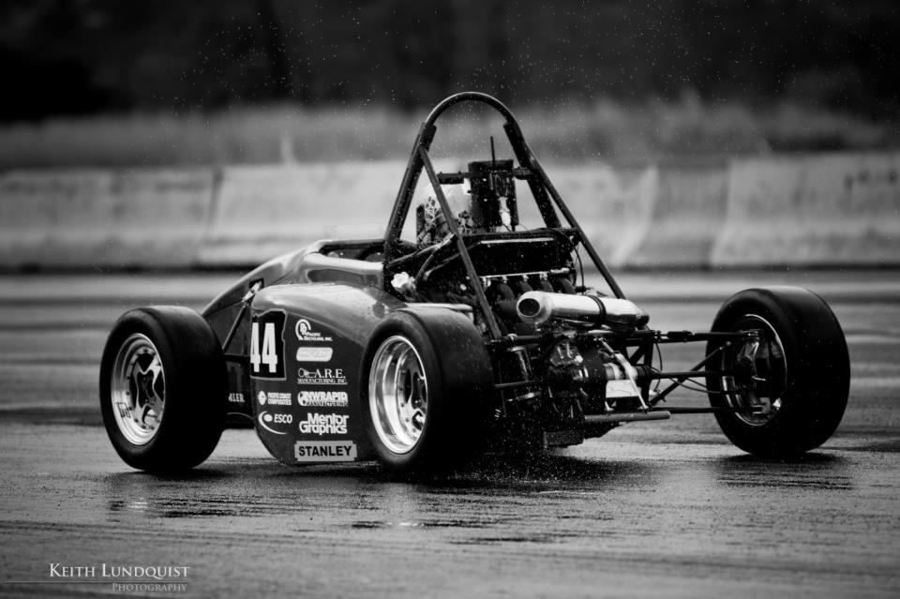
Q u e s t I o n s ?
Notes:
Chip - Are there any questions?

