Slide 1
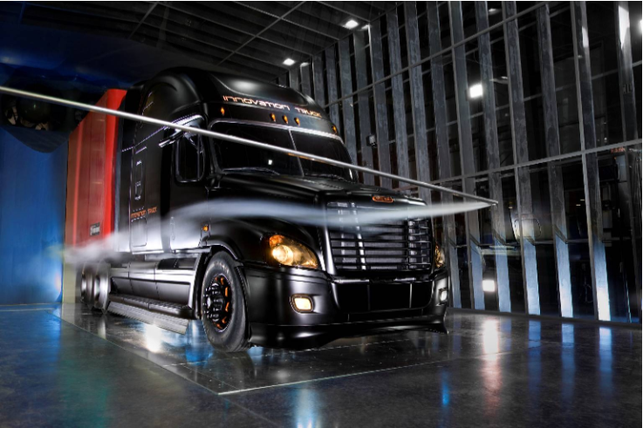

Daimler Wind Tunnel Project

Slide 2
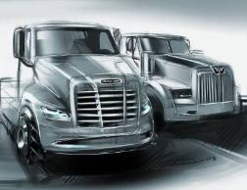
Project Review
Capstone Team
Andre Nylund
Chris Grewell
Craig Lechtenberg
Fadel Al Jutail
Matt Melius
Mufeed Yacoub
Team Advisor
Dr. Raul Bayoán Cal
Customer
Daimler Trucks North America

Slide 3
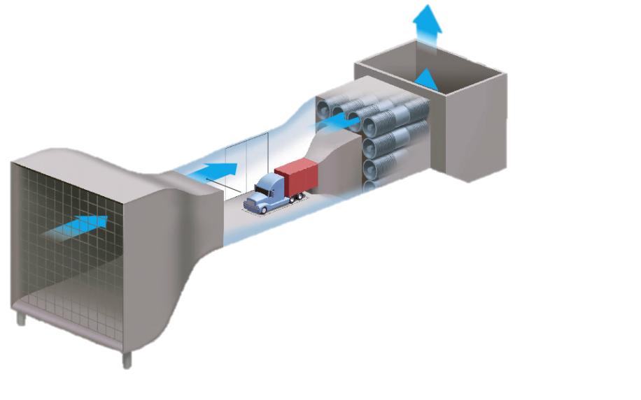
Project Review
Tunnel Details
12,000 sq. ft. facility
Wind speeds up to 65 mph
30ft long test section
21ft wide
26ft tall

Slide 4
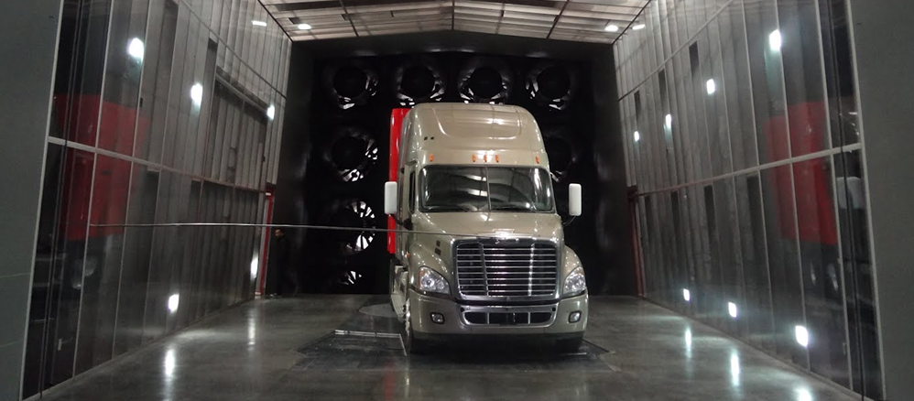
Project Review
Tunnel Details
Pressure sensitive floor for calculating trucks drag coefficient.
Smoke wand for flow visualization
Rotating floor panel to test various angles of attack

Slide 5
Issues with Current Smoke Testing Equipment
Smoke wand placement is limited by the length of the wand

Slide 6
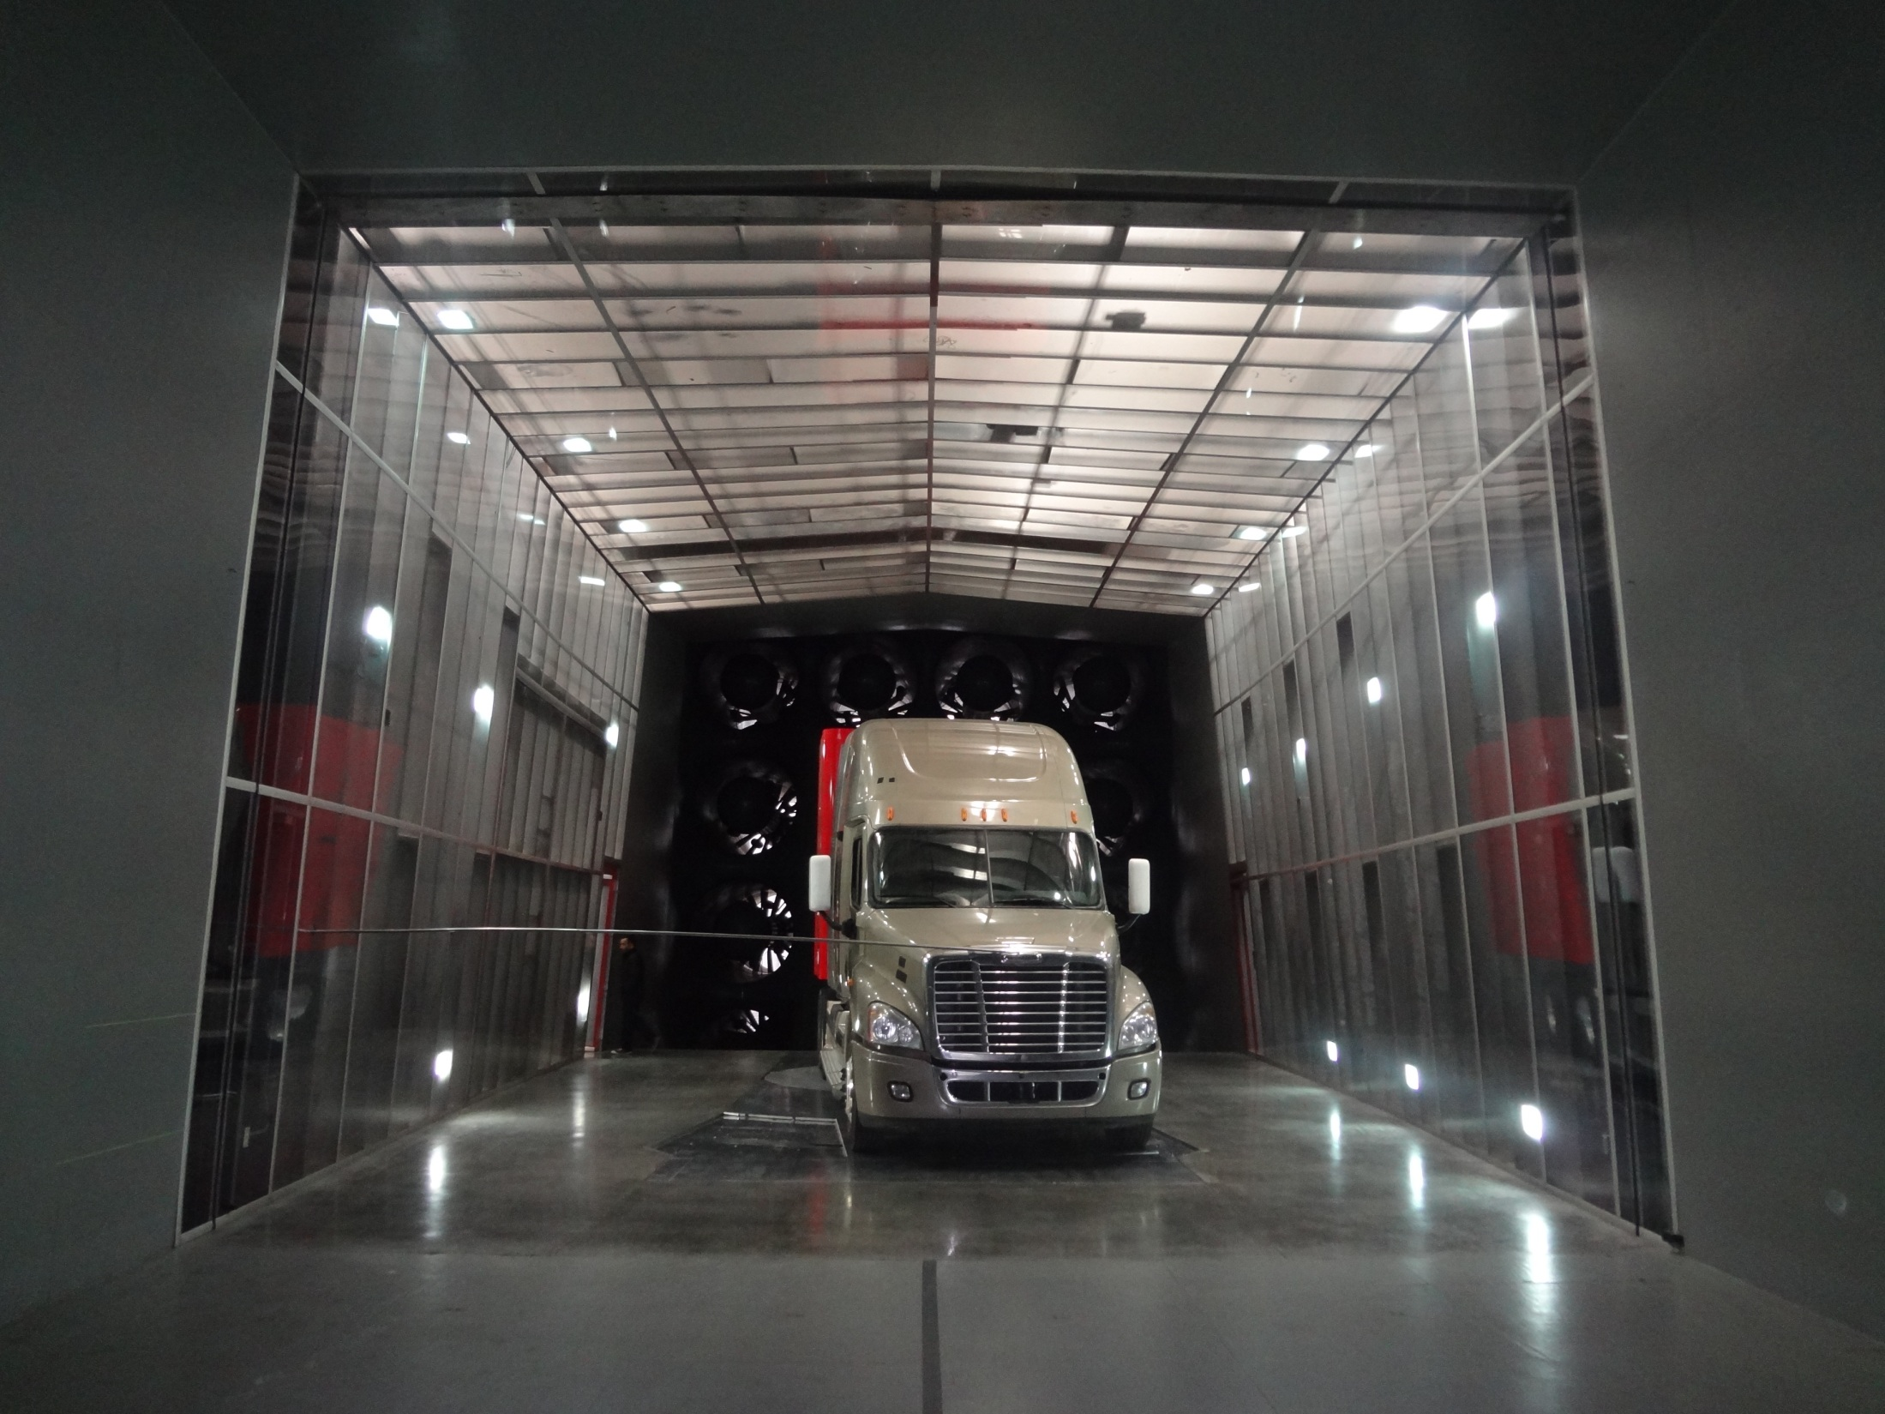
Smoke wand range

Slide 7
Issues with Current Smoke Testing Equipment
Smoke wand placement is limited by the length of the wand
Wand is manually held from outside the tunnel then angled into position, requiring extra personal to perform testing

Slide 8
Issues with Current Smoke Testing Equipment
Smoke wand placement is limited by the length of the wand
Wand is manually held from outside the tunnel then angled into position, requiring extra personal to perform testing
Manual control makes repeatable testing of an area difficult

Slide 9
Issues with Current Smoke Testing Equipment
Smoke wand placement is limited by the length of the wand
Wand is manually held from outside the tunnel then angled into position, requiring extra personal to perform testing
Manual control makes repeatable testing of an area difficult
Flexibility of current wand reduces accuracy of smoke placement during testing

Slide 10
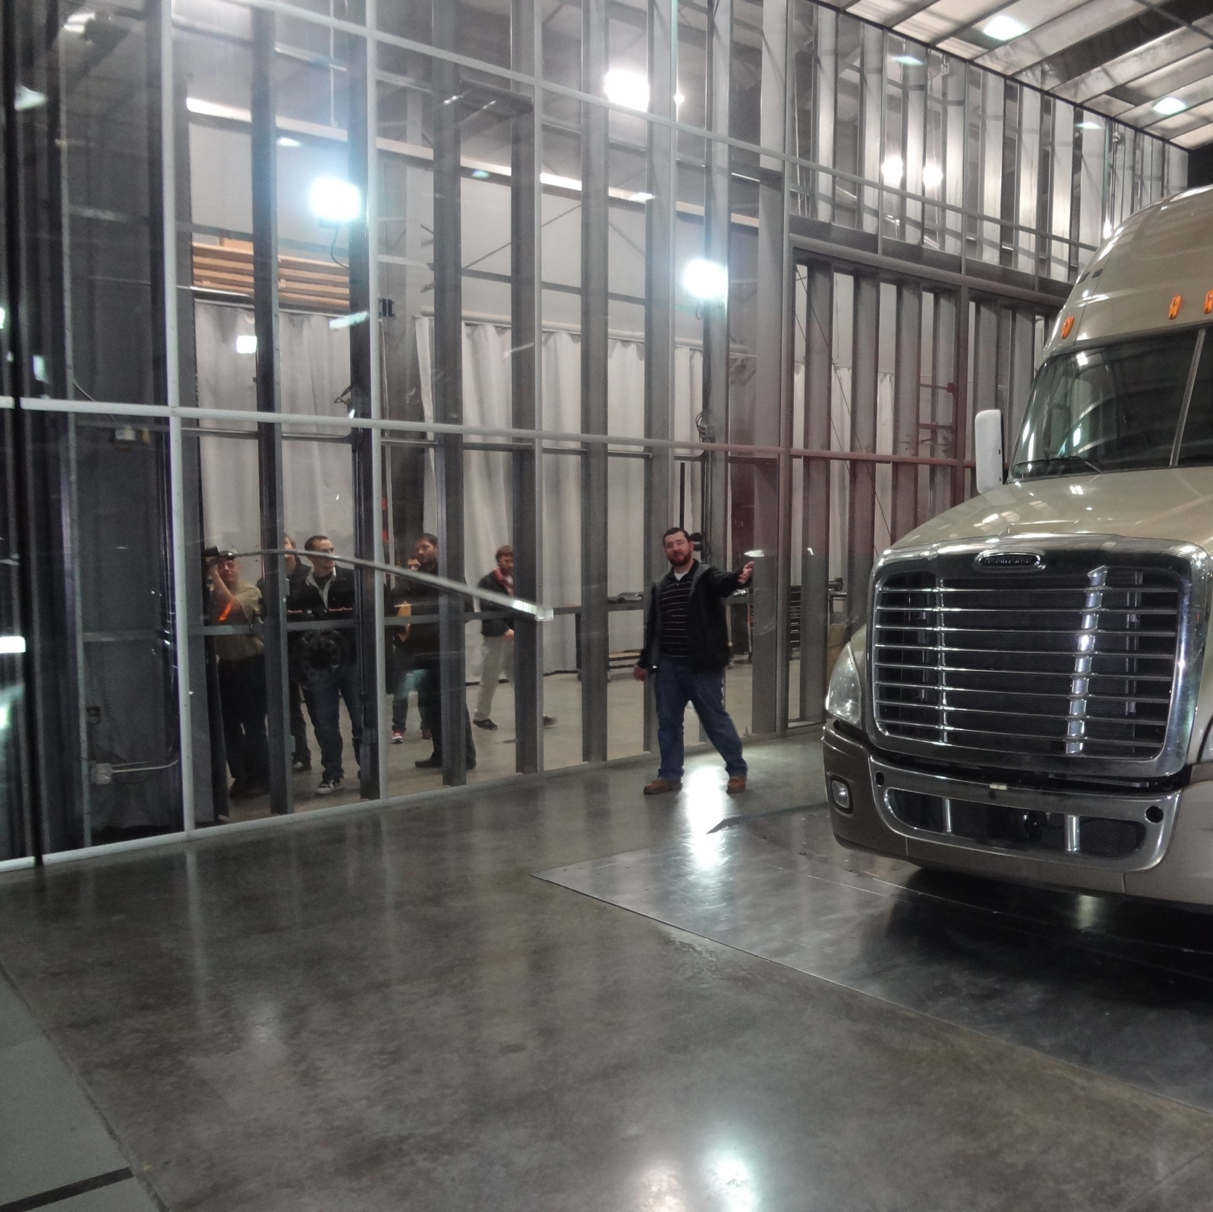

Slide 11
Project Review
Mission Statement: Improve smoke testing methods
  Increase the testable area within the wind tunnel
  Increase stability of the system
  Deliver smoke to location of interest accurately
  Provide these requirements while maintaining negligible aerodynamic impact to test region
  Design and delivery of final product by June,6th

Slide 12
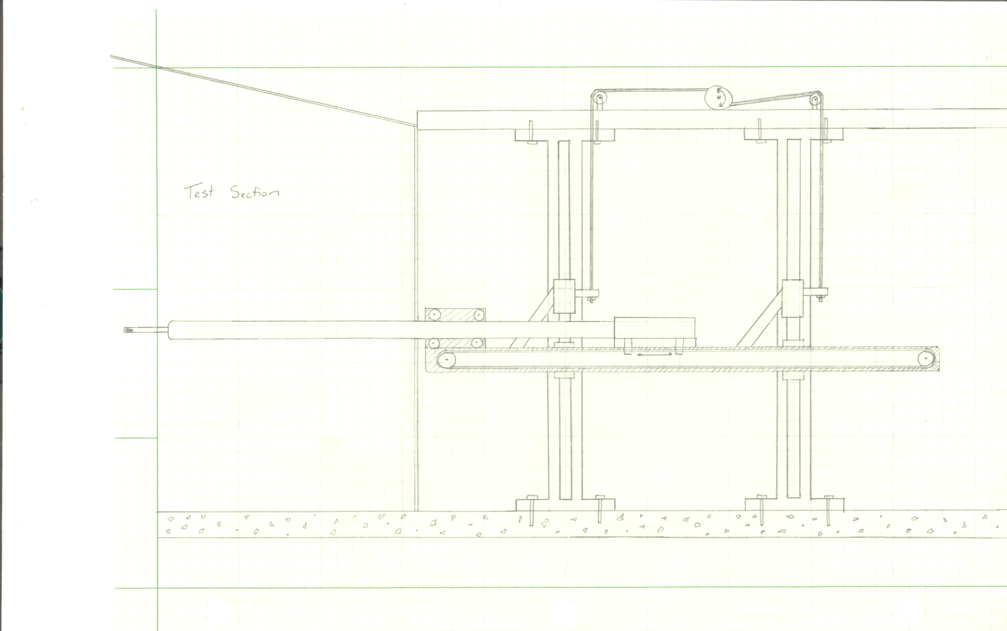
Concept Design
Wind Tunnel Wall
Wand Support Rollers
Drive Motor
Vertical Rails
Vertical Carriages
Smoke Wand
Horizontal Rail
Horizontal Carriage

Slide 13
System Overview
  Support Structure : Stable, inexpensive, and Easily Manufactured
  Traverse System:
    18’ x 16’ of testable area
    10ft/min vertical rise, 20ft/min horizontal motion
    Easily removed from wind tunnel when not in use
  Smoke Delivery:
    Simple to maintain
    Easy to use
    +/- 0.5” in expected accuracy with high repeatability
  Sealing System: Permanent System to prevent pressure related disturbances in test section
  Roller Box: Provides adjustability and stability to the smoke boom during testing.

Slide 14
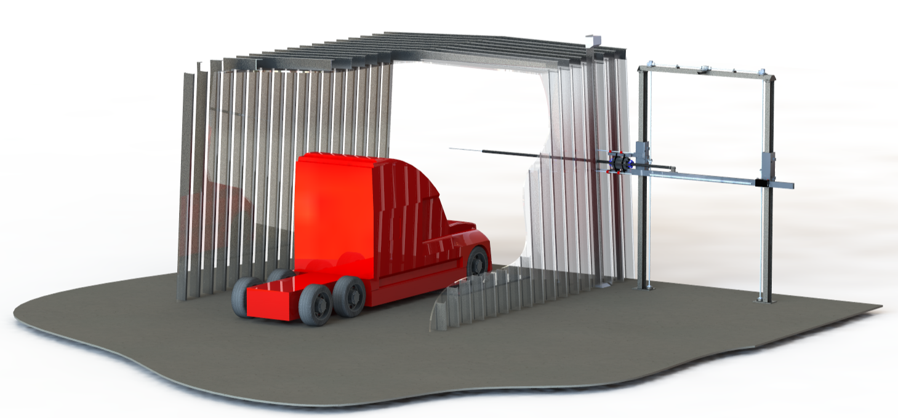
System Overview
Smoke Control
System

Slide 15
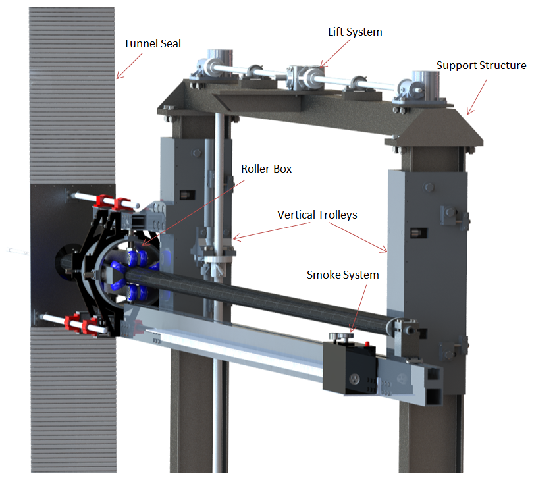
System Overview

Slide 16
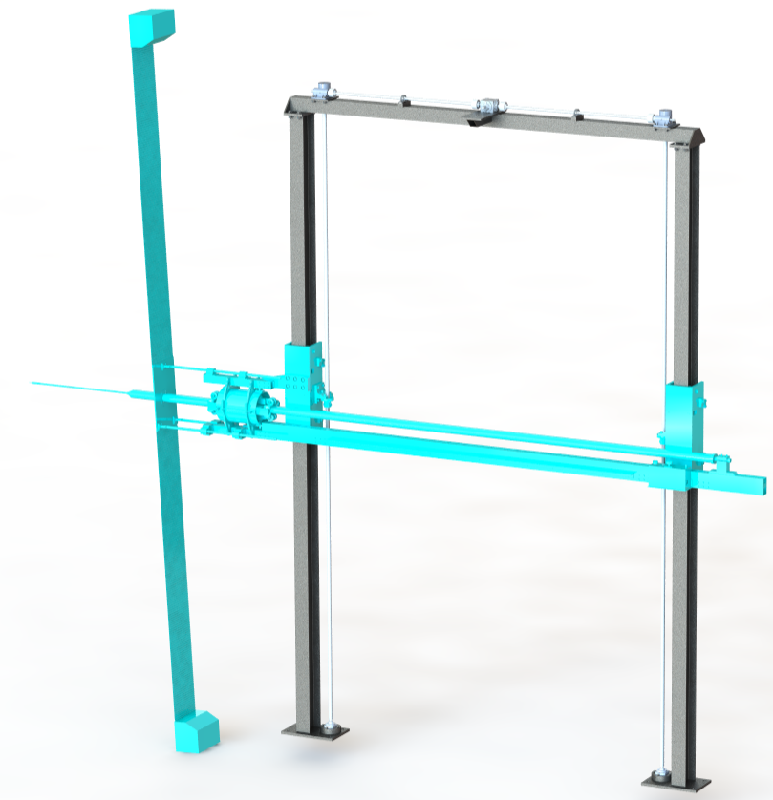
Support Structure
I-beams provide vertical support and trolley guidance
5”x5” Box beam for horizontal stability and mounting interface for drive system
Horizontal 5x5
Box Tubing
10W26
I-beam
Base Plates

Slide 17
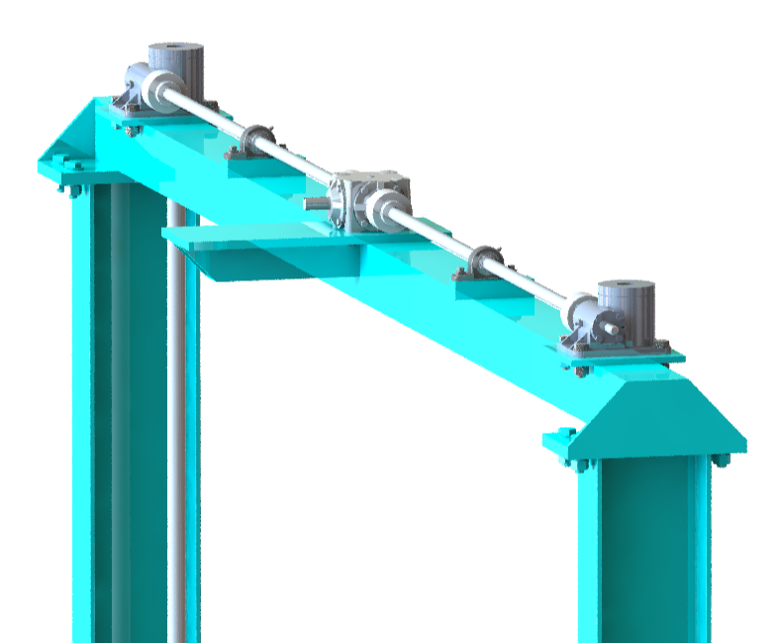
Lifting System
Parallel Ball Screw Assembly
2hp Motor
Two Inverted Actuators w/ 12:1 gear ratio
Rise time of 10ft/min
Actuator
Miter Box
Pillow Block
Drive Shaft
Ball Screw
Notes:
Each screw 20’ Long, 1.5” OD and a 1” lead
Required torque to turn it is 123lb-in
120 rpm = 10 ft/min
2 hp motor, 13” connecting shafts with single pillow blocks

Slide 18
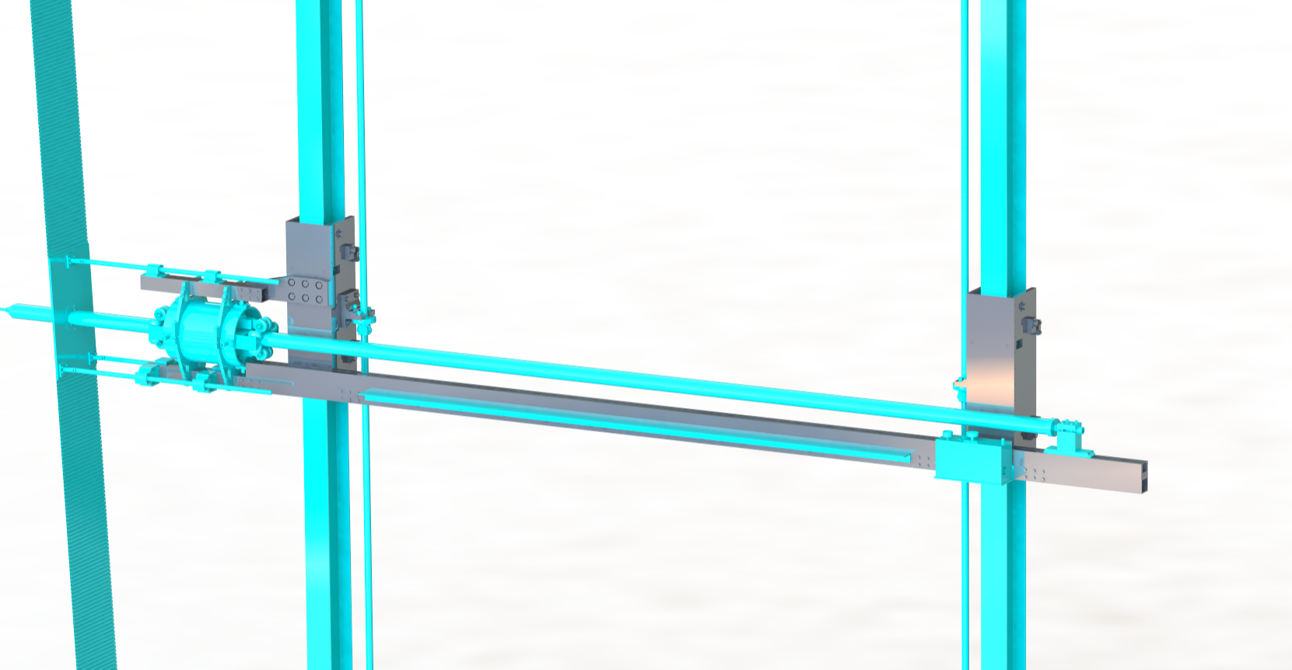
Horizontal Location System
Attaches to the vertical drive system
Controls the horizontal movement of smoke wand
Left Trolley
Right Trolley
Ball Screw Nut
Bracket
Linear Actuator

Slide 19
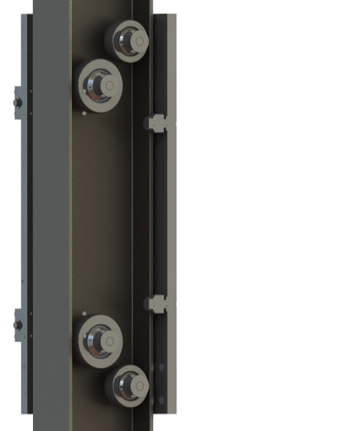
Horizontal Location System
Two key features
4 adjustable and 4 fixed wheels between the webs for vertical motion
4 flange rollers to control “walking”
12 points of contact
Web adjustment
wheels
Flange rollers

Slide 20
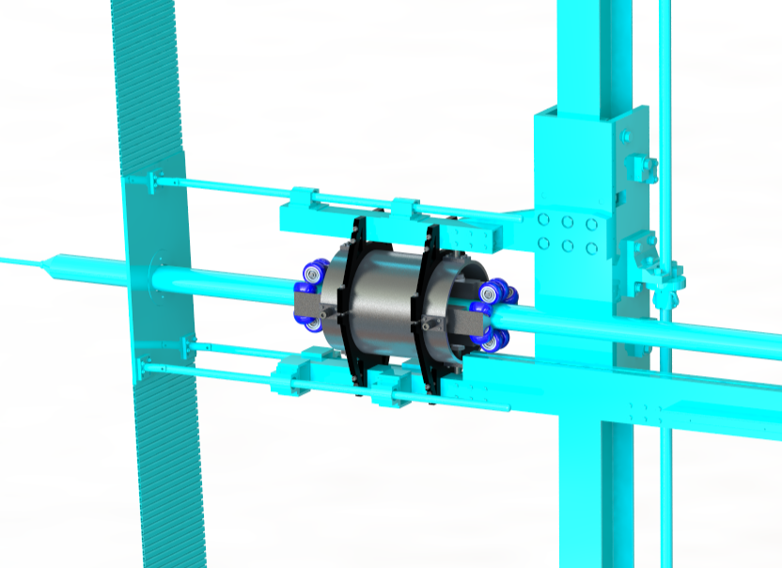
Roller Box
Attaches to the Horizontal Location System
Controls the smoke wand in and out of the wind tunnel
Roller Housing
Housing Clamps
Roller Assemblies
Notes:
The idea driving the design was to isolate the horizontal linear actuator from the wand forces allowing the linear actuator uninhibited motion while the wand is in operation. Four sets of roller assemblies accomplish this with sixteen points of contact.
Allowing for roller assembly adjustment was crucial to achieving the proper contact pressure on the wand. Each roller assembly has two adjustable set screws to accomplish this.
The adjustment screws on the roller assemblies also allow for different wand sizes and profiles.
To change the wand’s attack angle, the upper and lower brackets are loosened to rotate the roller housing to the desired angle. Also, the orientations of the roller assemblies ensure the wand will not slide out of position when the housing is rotated to different orientations.

Slide 21
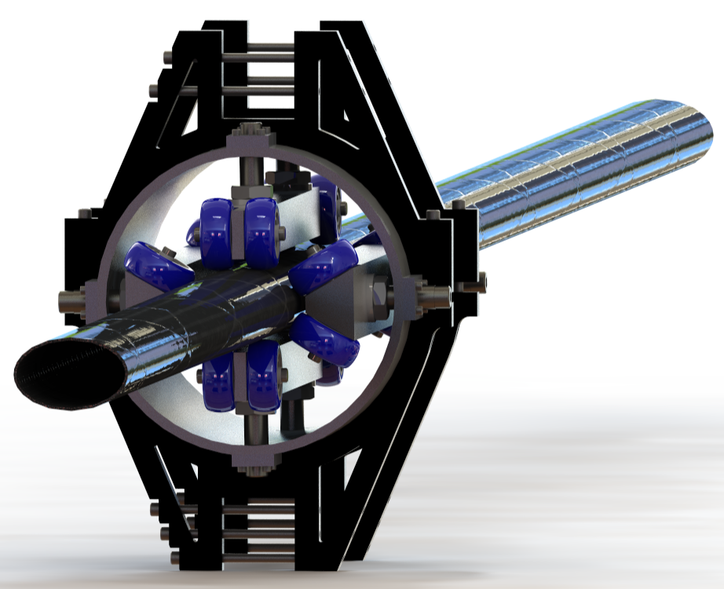
Roller Box
3 key features
Isolate reaction forces
Roller assemblies
3x4.75in Carbon Fiber Tube

Slide 22
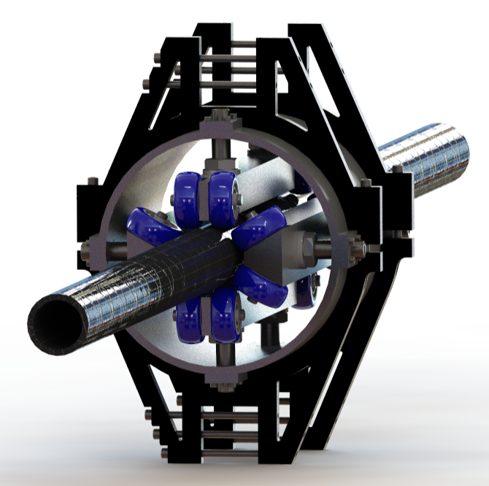
Roller Box
Adjustment
Screws
3 key features
Isolate reaction forces
Allow for different wand profiles
3in Carbon
Fiber Tube

Slide 23
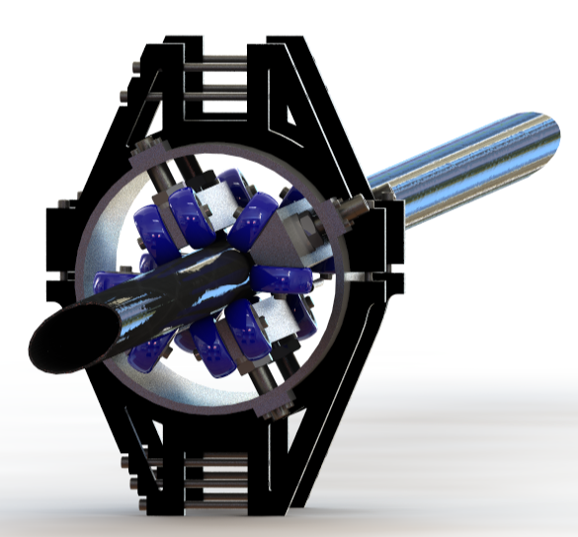
Roller Box
3 key features
Isolate reaction forces
Allow for different wand profiles
Adjust the angle of attack
Housing Clamps
Housing Clamp
bolts
Housing

Slide 24
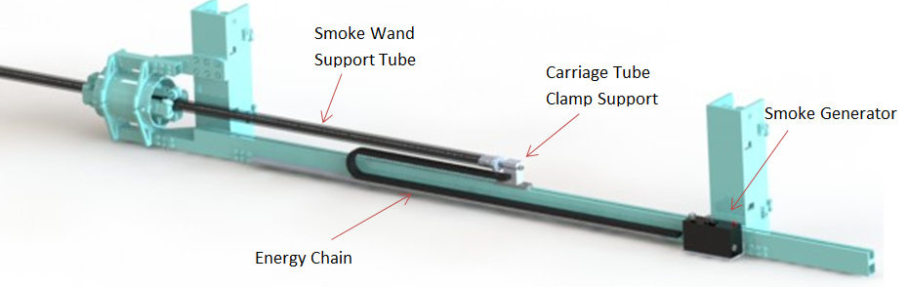
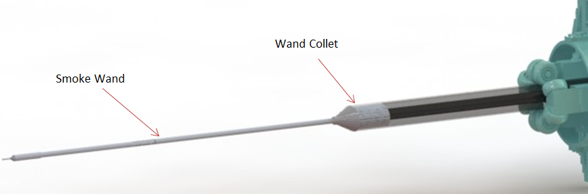
Smoke System
An Aerolab Smoke Generator attached to the Horizontal Support produces smoke by burning oil
The smoke wand will be supported at the end of a 19ft carbon fiber smoke wand support with a rapid prototype collet

Slide 25
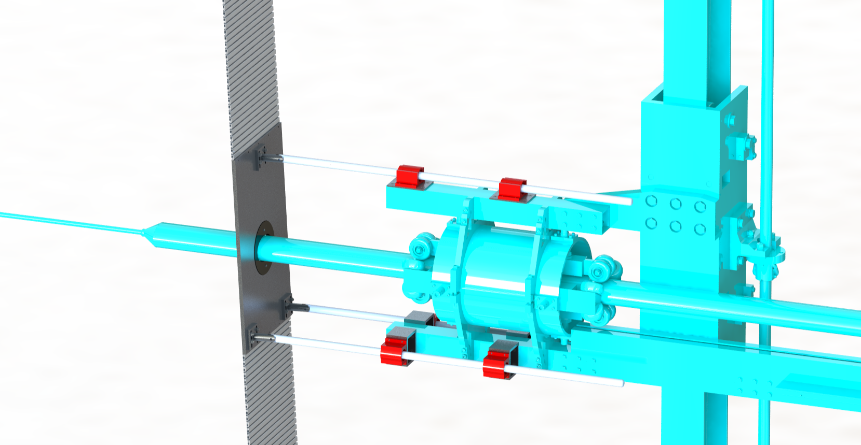
Wall Seal
Maintains pressure differential between inside and outside of the wind tunnel
slides vertically via lifting system
Lifting rod design accommodates tunnel wall angle.
Shutter
Lifting Rod
Bearing
Lifting Rod
Penetration
Plate

Slide 26
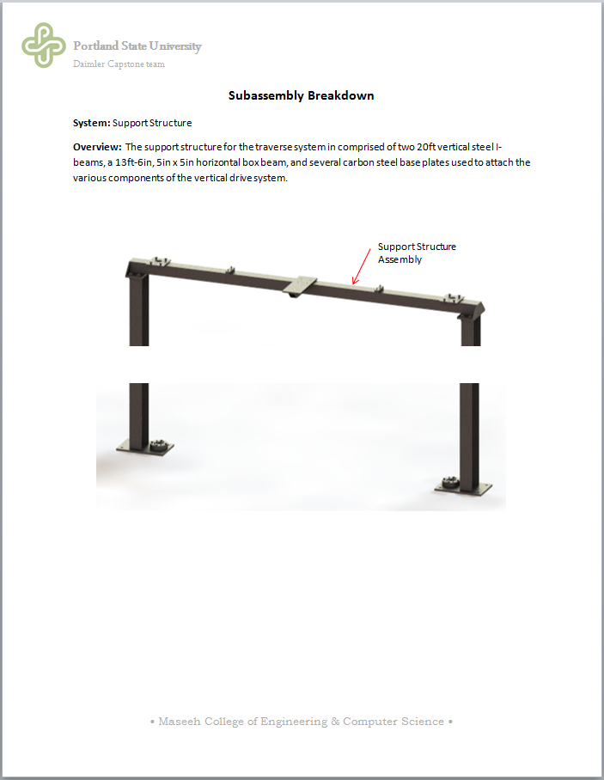
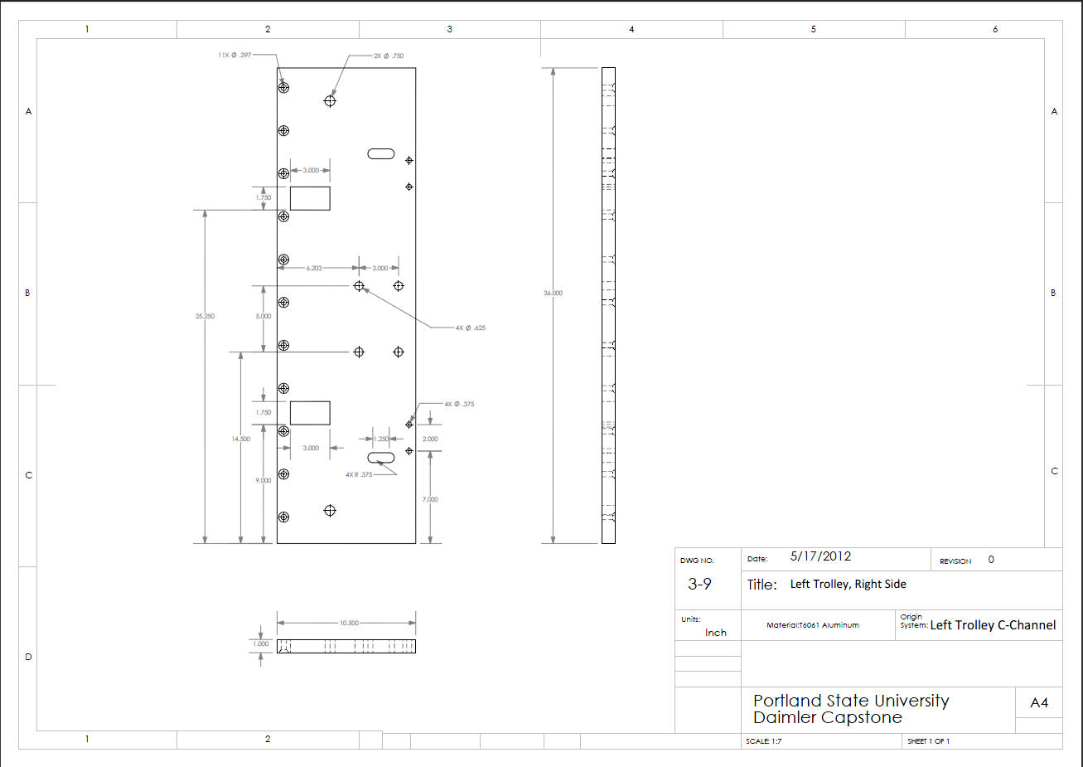
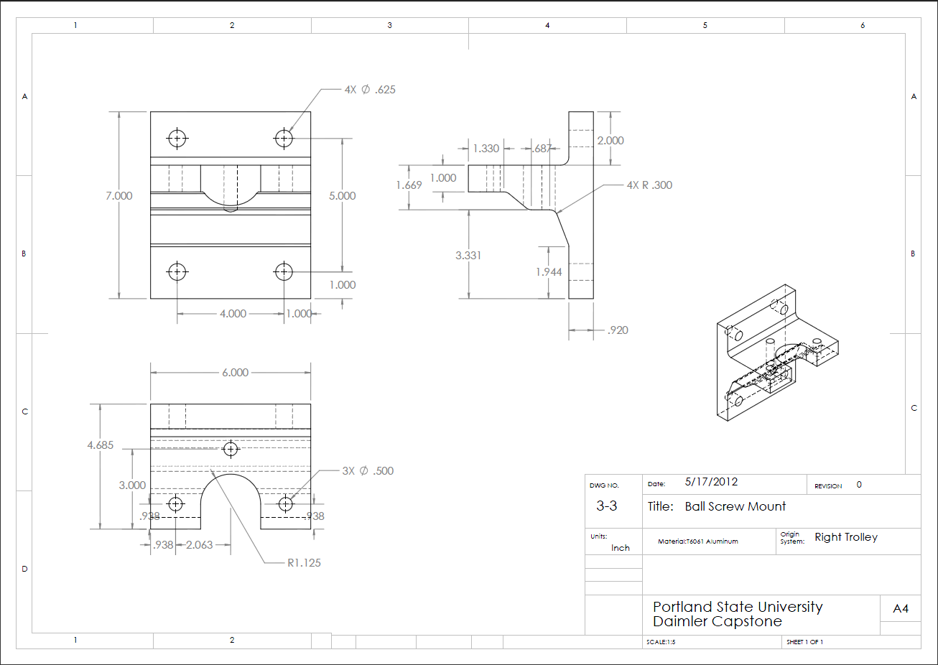
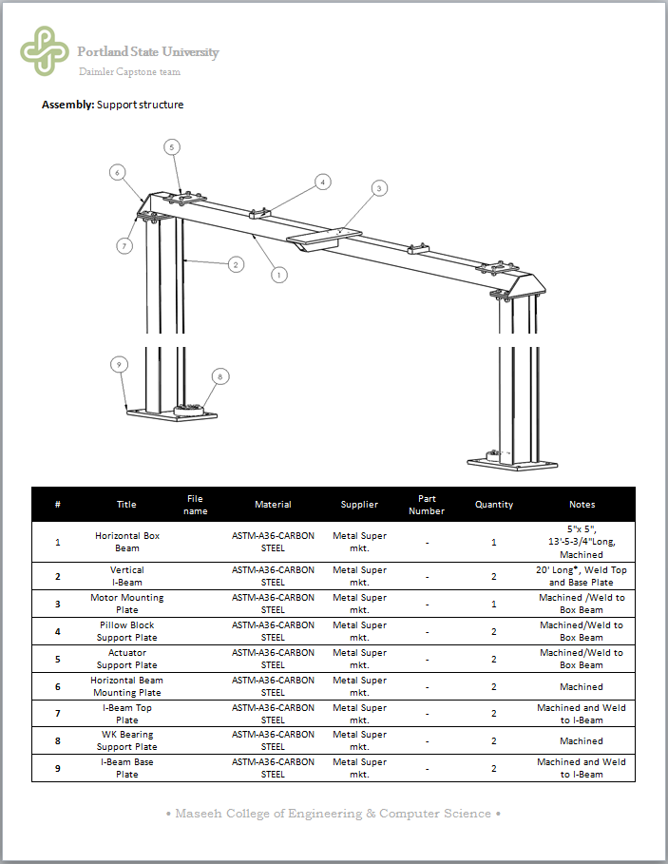
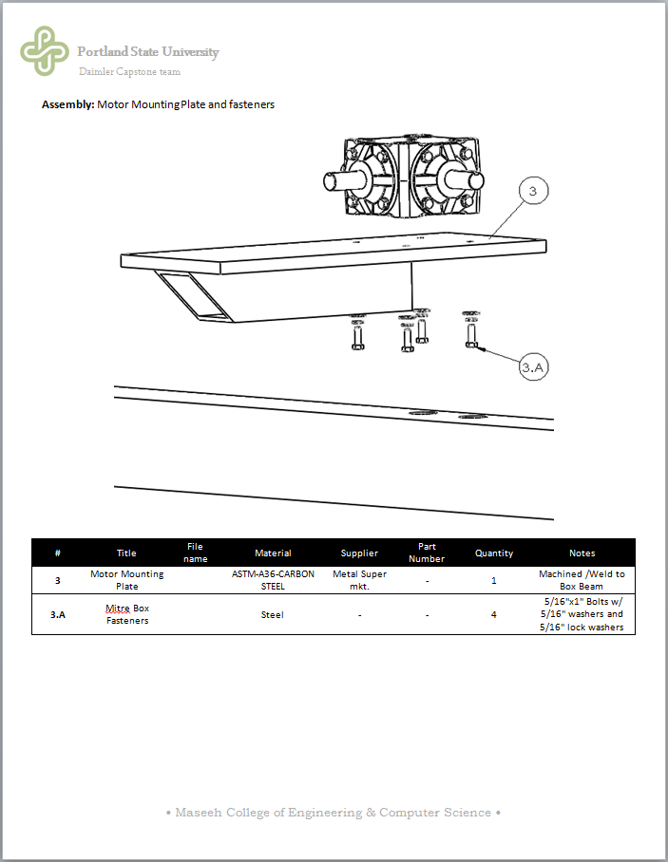
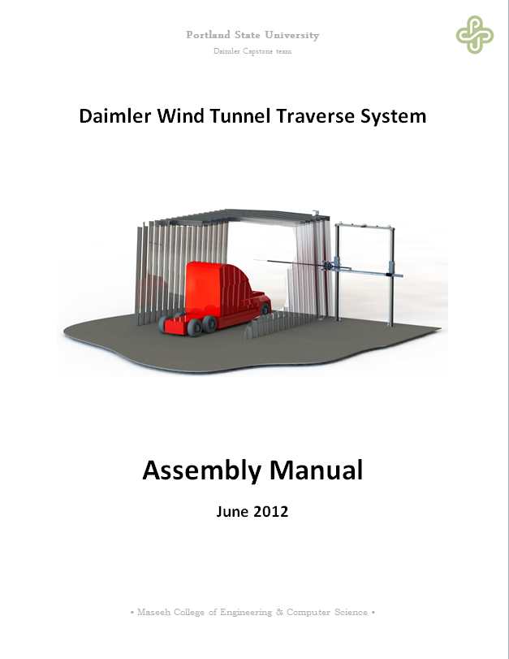
Documentation
Documentation provided to Customer:
  System assembly
  Parts list
  Custom Part Drawings

Slide 27

Questions

