Slide 1

Humidity Controlled Oven
Capstone Team 2012
Team Members:
Paul Lucas
Mircea Bec
Khoi Nguyen
Thong Truong
Meshari Al Ebrahim
Asgedom Gebrehiwot
PSU Faculty Advisor
Dr. Faryar Etesami
Boeing Industry Advisor
Rory Olson

Slide 2
Outline
Project Background
Mission Statement
Basic Requirements
Temperature Vs. RH Plot
External Search
Design Evaluation
Humidifier Sizing
Parts Illustration
Final Design
Conclusion
Questions

Slide 3
Project Background
Objective:
  Produce a retrofit-able sealant oven capable of controlling humidity and temperature that allows for more efficient flow control
Current Methods:
  Large size - Inefficient flow control
  Anchored to floor - Costly to move

Slide 4
Mission Statement
The Boeing Capstone Team will design an efficient curing oven that can embrace the advantages of each of the current sealing methods known as “lean” and “traditional”. The goal is to control the humidity and temperature to a certain level that allows for a better flow control. The final design will be prototyped and documented, with all of its performance characteristics quantified.

Slide 5
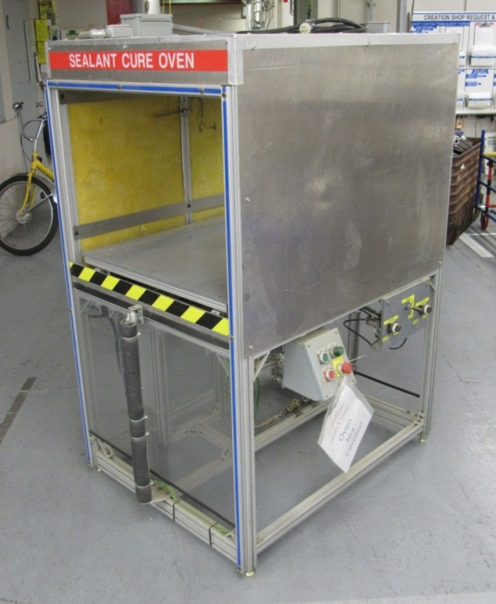
Basic Requirements
Humidity: RH 50 ± 5%
Temperature: 130 ± 5 º F
Water tank must be un-plumbed and less
than 35 lb in weight.
Power source must be 120v AC at 60Hz.
The oven must be lasted for at least
5 years

Slide 6
Temperature Vs. RH

Slide 7
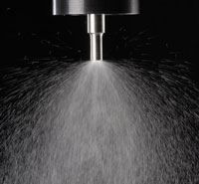
External Search
  Atomizing Water Method:
  Advantages
    Inexpensive
    Suitable for lower temperature
    and lower humidity
  Disadvantages
    Droplet/Moisture formation
    Temperature change

Slide 8
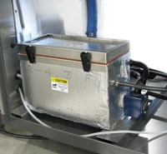
External Search Cont.
  Steam Injection Method:
  Advantages
    Higher RH (100%)
    Dry process
    No temperature change
  Disadvantages
    Delay initial steam supply
    More complex design
    Expensive (steam generator)
    Mass flow rate from 4 lbm/hr to 60 lbm/hr

Slide 9
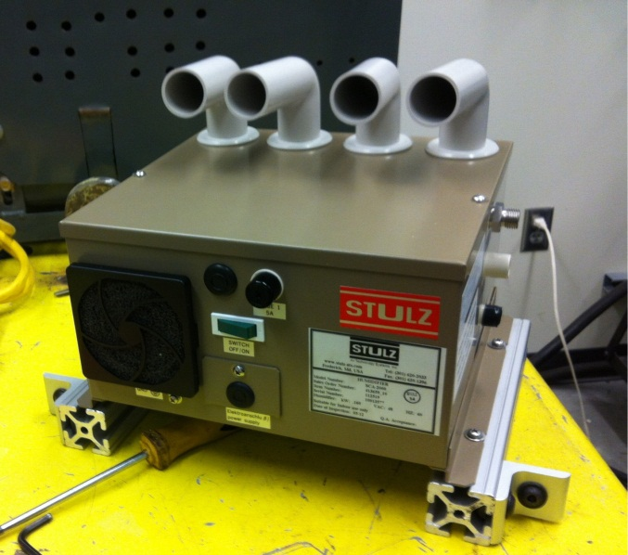
External Search Cont.
Stulz-Ultrasonic Humidifier: (Current Design)
  Advantages:
    Very fine mist: 1micro average diameter
    Small Size (10.71” x 8.27’’)
    Long service life
    Mass flow-rate from 2 to 4 lbm/hr

Slide 10
Design Evaluation
Concept Scoring Matrix
 | Weight | Atomizing Water | Steam Injection | Ultrasonic Humidifier
Performance Humidity Control Temperature Uniformity Moisture Prevention
 | 3 | 9 | 11 | 15
 | 1 | 2 | 3 | 4
 | 2 | 2 | 5 | 8
Cost | 3 | 12 | 3 | 3
Mobility | 1 | 3 | 2 | 5
Total | 10 | 28 | 32 | 35

Slide 11
Humidifier Sizing
State 1: (Room condition)
P_{1,a} = 101.33 kPa
T₁ = 25ºC = 278.15 K
RH = 65%
P*Air (25ºC) = 3.17 kPa
V = 36 ft³ = 1.02 m³
State 2: (Required condition)
P_{oven} = ?
T₂ = 57ºC = 330.15 K
RH = 50%
P*Air (57ºC)=17.85 kPa
V = 36 ft³ = 1.02m³
P_{oven} = 157.5 kPa

Slide 12
Humidifier Sizing Cont…
Ultrasonic Humidifier condition
T = 100ºC
P = 160 kPa
Inlet area = 0.0041 m²
Assume V_{vapor} = 0.03 m/s
Mass flow rate: 1.46 lbm/hr

Slide 13
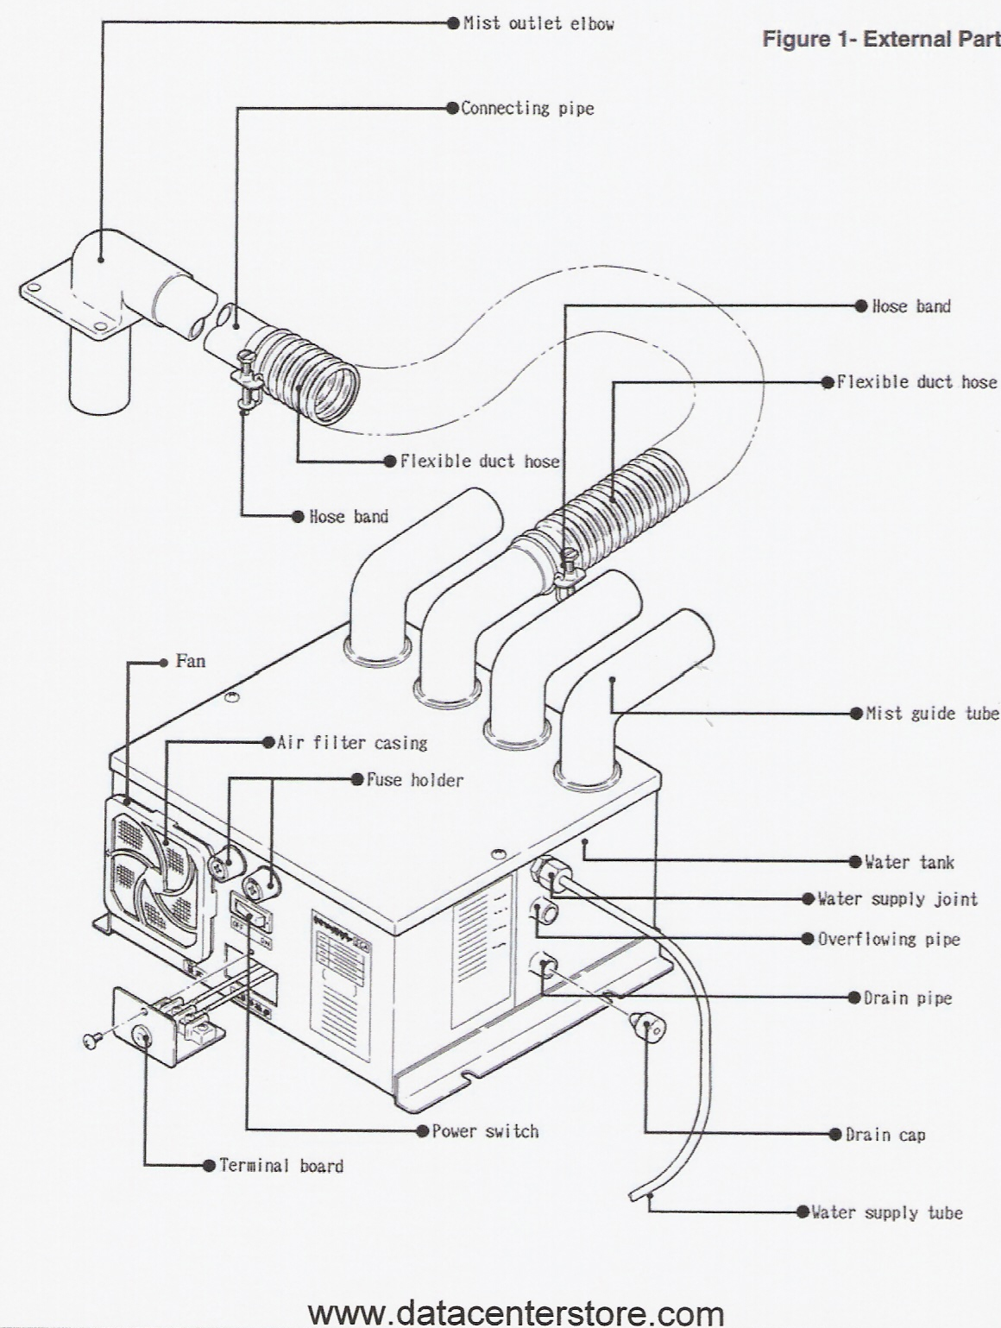
Parts Illustrations

Slide 14
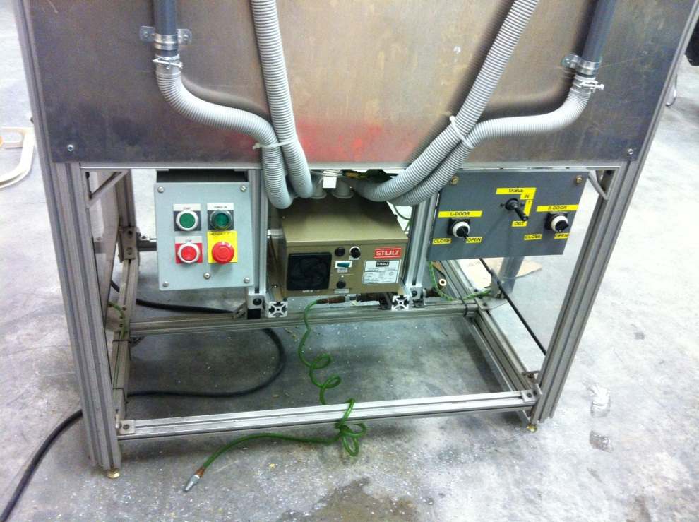
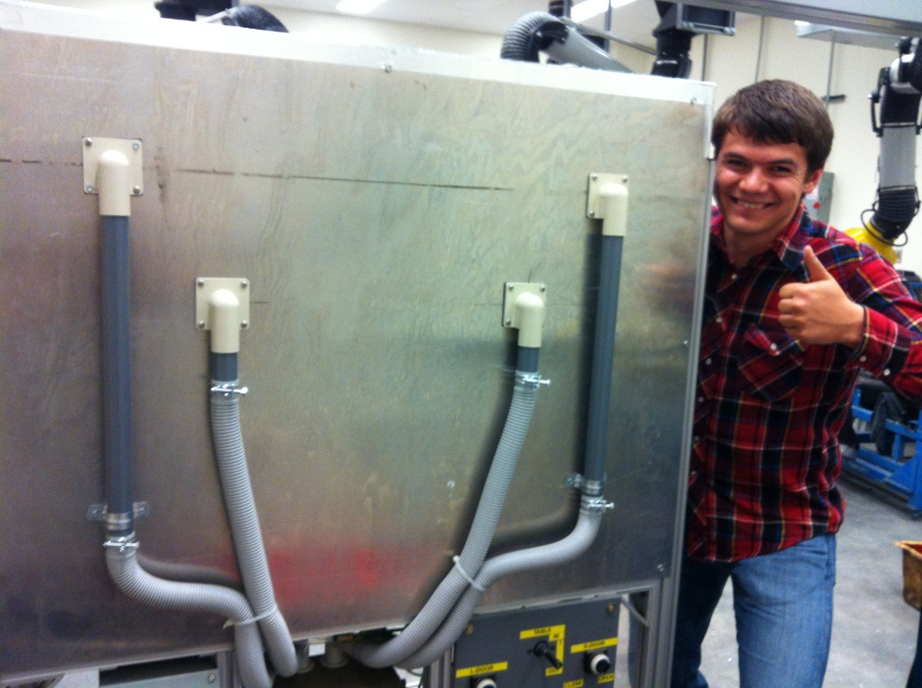
Final Design
Ultrasonic Humidifier was mounted to the oven

Slide 15
Conclusion
Project Requirement Achieved:
Performance
Life in Service
Ergonomics

Slide 16
Questions
?

