Slide 1
Vacuum Pump Vibration Isolation System
Advisor
Dr. Dave Turcic
Team Members
Duc Le
Ron Pahle
Thanh Nguyen
Khoa Tran
Sponsor
Edwards Vacuum Ltd.

Slide 2
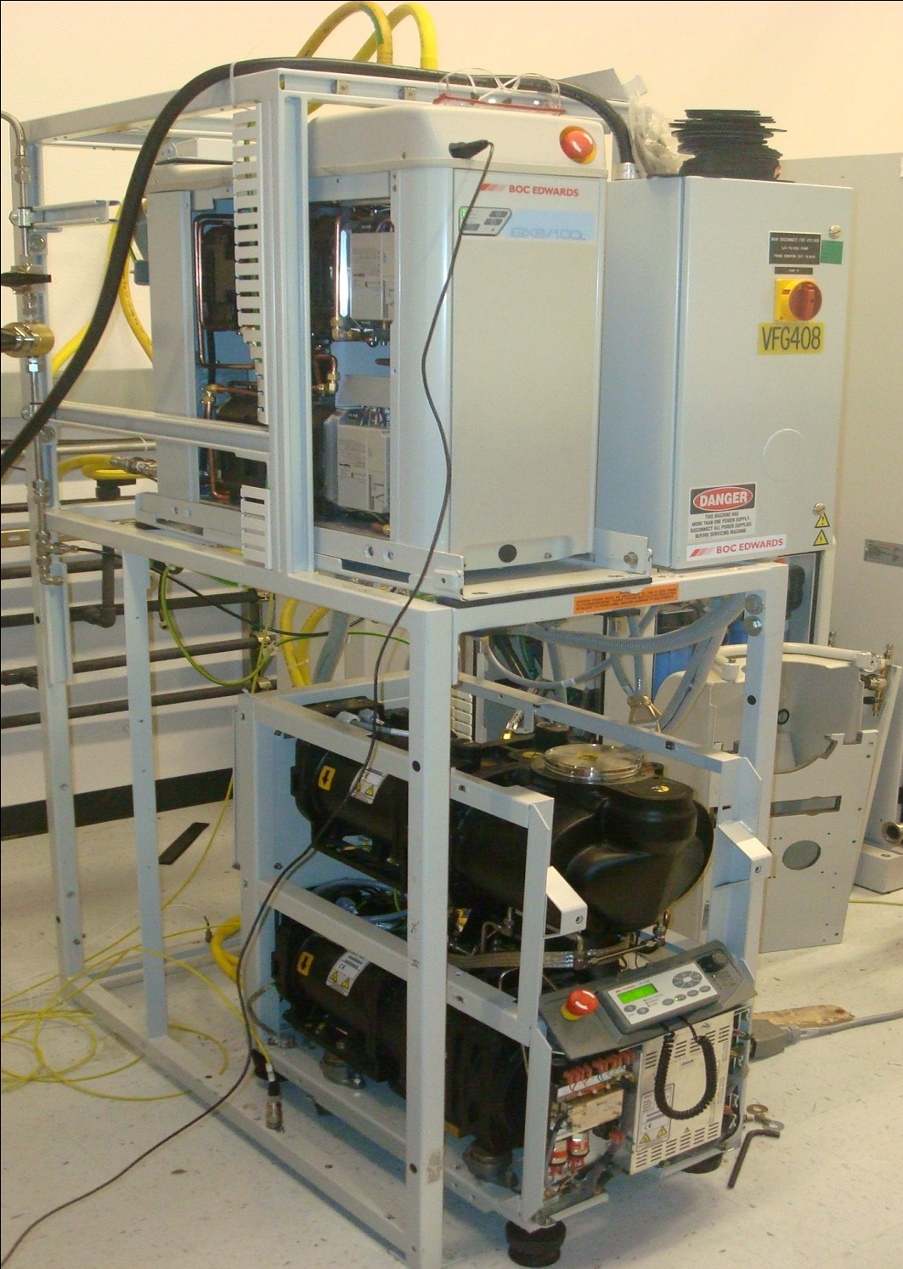
Project Background
Pump systems from Edwards are used in Intel’s microchip manufacturing factory.
Vibrations from the pump systems can affect the chip fabrication process.

Slide 3
Mission Statement
Devise a solution to minimize the vibration propagated from the pump system, through the steel frame, and to the surrounding workplace. This is meant to reduce any interference the pumps vibrations could have on sensitive manufacturing equipment.

Slide 4
Main Design Requirements
Design a system to reduce the vibration transmitted from the pump to the frame by at least 25% (measured by acceleration)
Requirements:
Cost less than $1000 per frame.
Require no power (passive).
Work at 4 designated pump speeds.
Fit within the current frame.

Slide 5
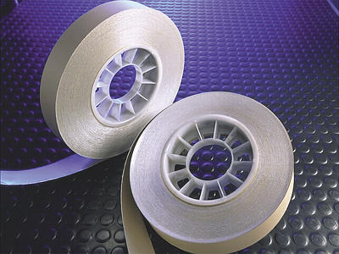
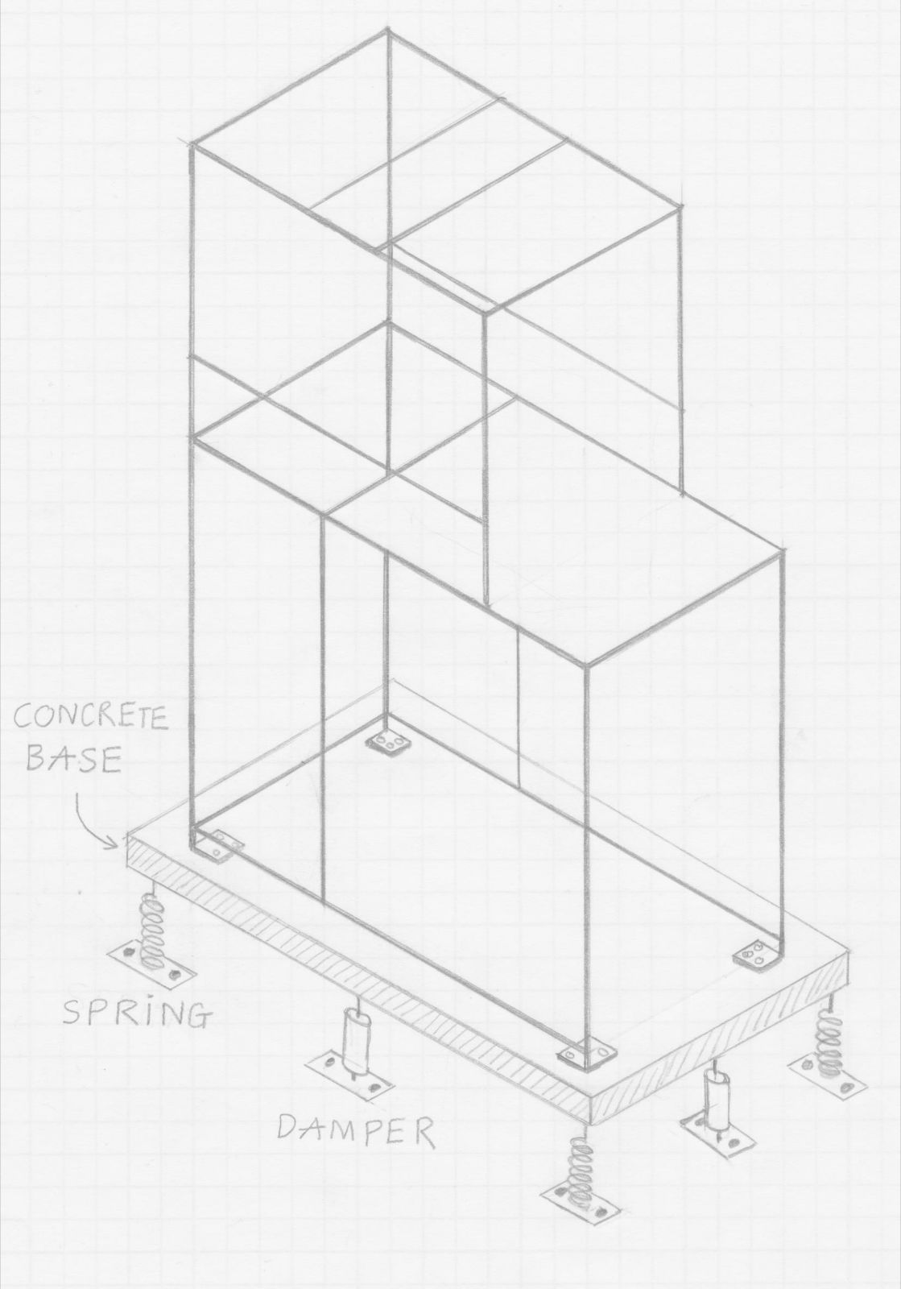
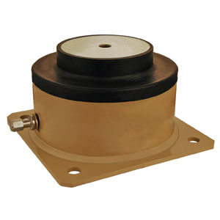
Alternative Design Concepts

Slide 6
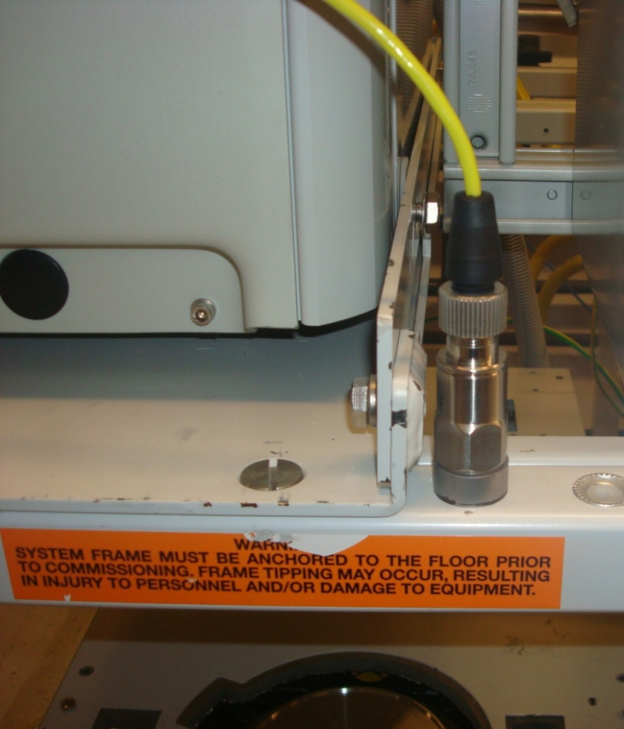
Diagnostic Testing
Frame is too soft.
Viscoelastic tape did not perform
Plate Isolation showed the best results

Slide 7
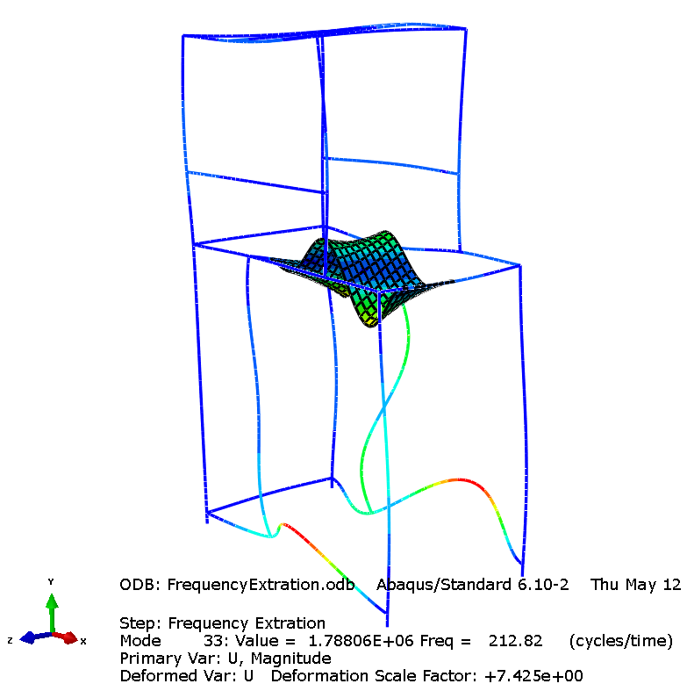
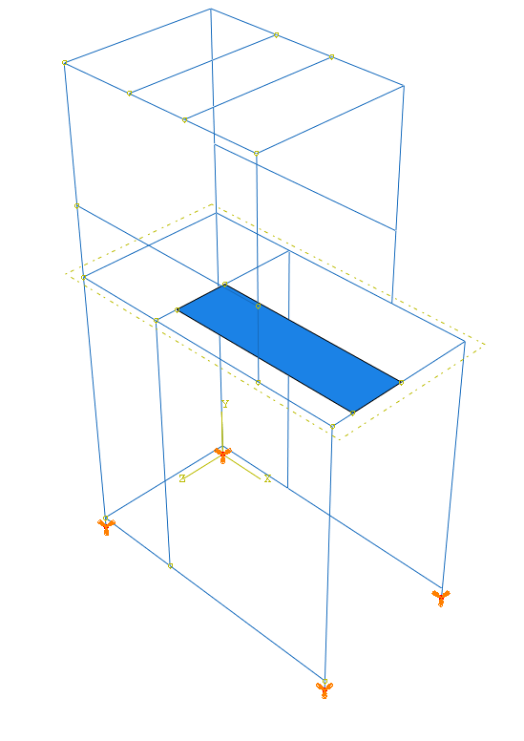
Frame Modal Analysis
Figure : Abaqus screenshot of resonance mode shape at 212.8 Hz and the original state of the frame. The final detail design was based heavily on experimental data with theoretical prediction as insightful guidance.

Slide 8
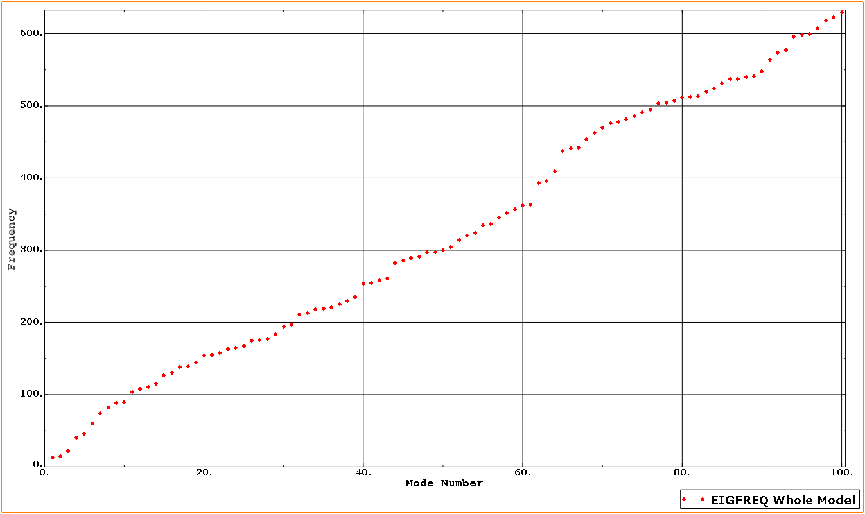
Frame Modal Analysis
Figure : The Abaqus simulation shows that the frame is very soft and has natural frequency ranging from as low as 13 Hz and up. Only the first 100 modes were calculated. Higher resonance modes still exist. The dynamics of the frame makes it not realistic for analytical calculation to be applied in designing vibration isolation solution.

Slide 9
Final Design
The design selected was a plate isolator system.
Back
Front

Slide 10
Final Design
By placing a soft rubber isolator between the plate and frame, the vibration is isolated to the plate and pump.
Back
Front

Slide 11
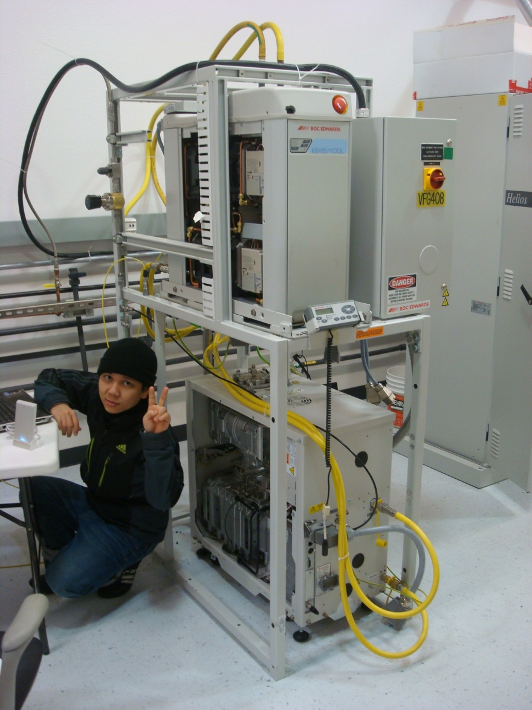
Improvement Testing
Testing was done to fine tune the isolators
  Area of contact
  Thickness
  Material

Slide 12
Improvement Testing
Figure : Vibration on the frame with dry pump speed of 85 Hz and booster speed of 50 Hz. Channel 4 shows the best vibration reduction with 3 rubber layers. Consistent vibration reduction also seen at channel 2 while vibration at the source (channel 1)

Slide 13
Improvement Testing
Figure : Vibration on the frame with dry pump speed of 85 Hz and booster speed of 50 Hz with reduced contact area rubber pad and viscoelastic material tape

Slide 14
Improvement Testing
Figure : Amplitude ratio between channel 4 over channel 1 with 3/8 inch thick of rubber inserted (red solid line) and without the rubber (blue dashed line). There is large amplification of vibration at frequency of 100 ~ 200 Hz but the ratio of amplification was significantly reduced consistently over the spectrum range with rubber inserted. Pump speed of 100 Hz and Booster speed of 105 Hz.

Slide 15
Testing Conclusions
Reducing the rubber pad’s contact area does not improve vibration isolation
Damping effect is much more critical than reducing the rubber stiffness
Thickness: 3/8 inch
Contact Area: Full
Material: Neoprene Rubber

Slide 16
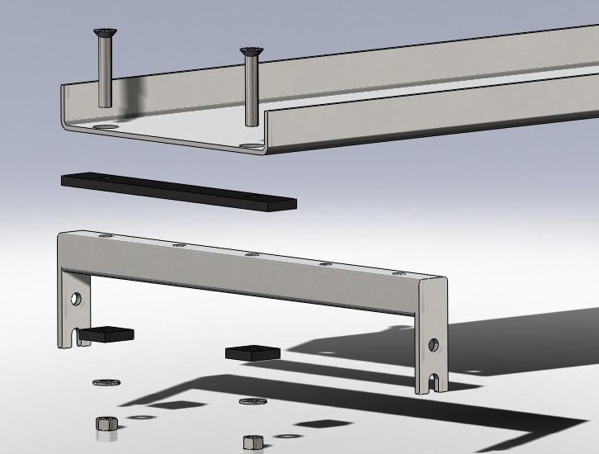
Final Product

Slide 17
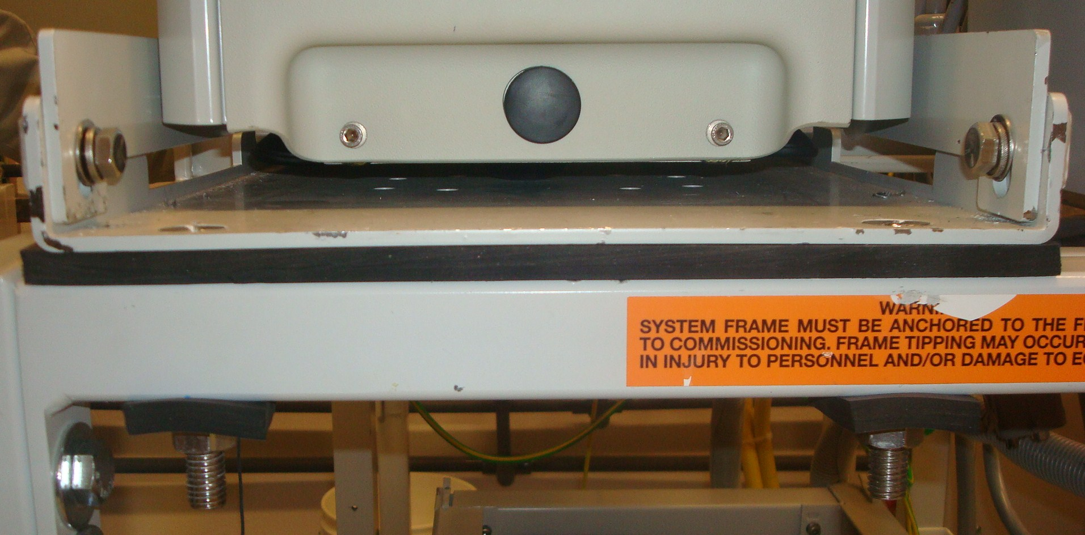
Final Prototype

Slide 18
Product Evaluation

Slide 19
Product Evaluation

Slide 20
Meeting Design Requirements
Khoa- why me??☺
Requirement | Expected | Results
Performance | 25% | 23%
Cost | $1000/frame | $83.81/frame
Power | None
Speeds | 4 Speed Combo
Frame Constraint | Fit in current frame

Slide 21
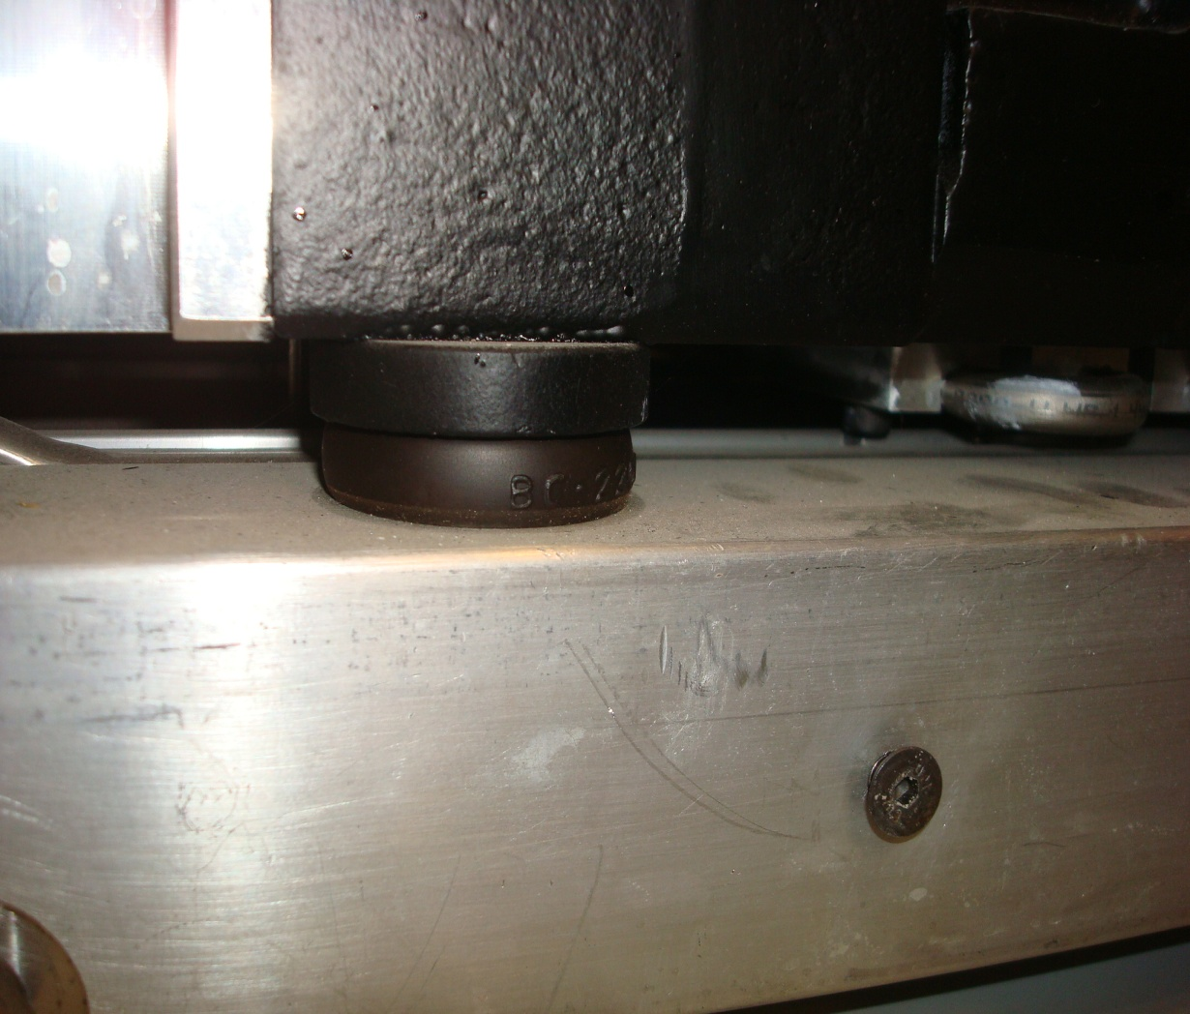
Technical Challenges
Pump was already mounted on isolators. The initial levels of vibration were low.
Learning how to use new testing equipment.

Slide 22
Project Challenges
Project has many unexpected elements.
Project’s scope has changed.
A lot of effort required to coordinate actions.

Slide 23
What We Learned
System Dynamics
Vibration Technologies and Approaches
Operation of Different Testing Equipment
Working as a team on a real technical project
Project management (people, time, money …)

Slide 24
Conclusion
The team has come up with a solution to reduce vibration transmission from the vacuum pump to the frame, built a prototype and tested it.
4 out of 5 criteria are satisfied. More work is still needed to achieve higher performance.
Made suggestions to improve the product based on our experience.

Slide 25
Questions ?

Slide 26
Thank you

