Slide 1


Capstone 2011
Mobile Environment Chamber
Team members:
Duc Tran
Tuan Ngo
Giang Nguyen
Peter Elabd
Thien Nguyen
The Duong
6/1/2011
Advisor:
Dr. Mark Weislogel

Slide 2
Outline
Introduction
Basic requirements
Design and manufacturing
Validation
Proposals
Conclusion

Slide 3
Introduction
A chamber that provides temperature controlled air to Solid State Drives (SSDs) while they are powered on and functionally tested.

Slide 4
Basic requirements
Temp. range: -5 ºC to 65 ºC
Accuracy: ± 2 ºC
Temp. uniformity: ± 4 ºC
Transient:10 ºC /minute
Airflow: ≥0.5 m/s
Capacity: 4-12 SSDs /chamber
Mobility
PC
Controller
Set T
Chamber
Actuator
Solid State Drives
Facility Chiller
Mobile temp. control system

Slide 5
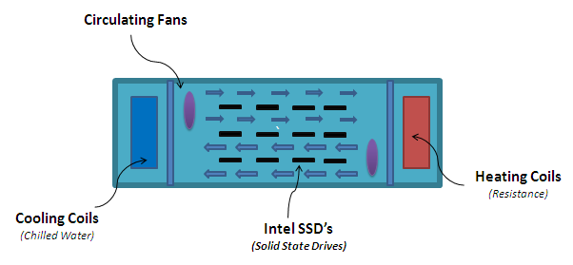
Design
Concept selection
PROS | CONS
Temperature uniformity | Space constraint
Condensation prevention | Number of SSDs
Counter-flow air movement
Manufacturing

Slide 6
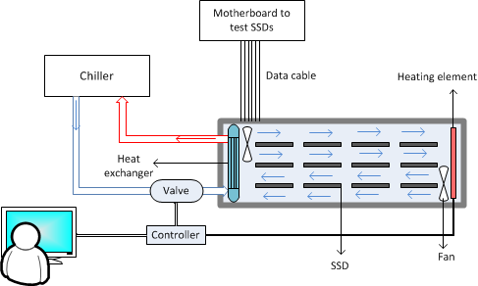
Detailed Temperature Control System
Notes:
Cooling mode: Heater is off. Based on the feedback from temp. sensor, the controller controls valve to regulate the flow rate of chilled water. Thereby, heat transfer rate between chilled water and air inside the chamber is controlled.
Heating mode: Valve is closed. The controller is switched to controlling the power of heater.

Slide 7
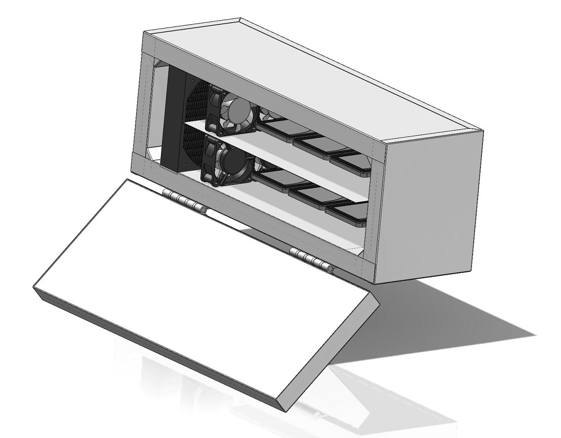
Mechanical Model

Slide 8
Electrical System
RTD
Heaters
Gateway/
Controller
Control Board
Valve
GUI
Fans
PC
Alarm
Power
Converter
AC Power

Slide 9
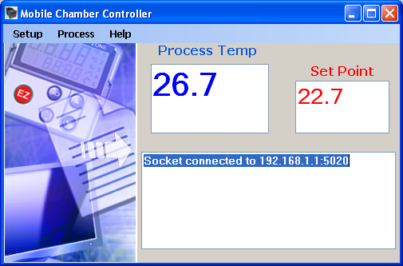
Software
Modbus TCP/IP
GUI
Intel® Modbus
Service
Profile loading
Data logging
Written in C#
Data Package Processing
Written in Python
Industrial standard
Communication over TCP/IP network

Slide 10
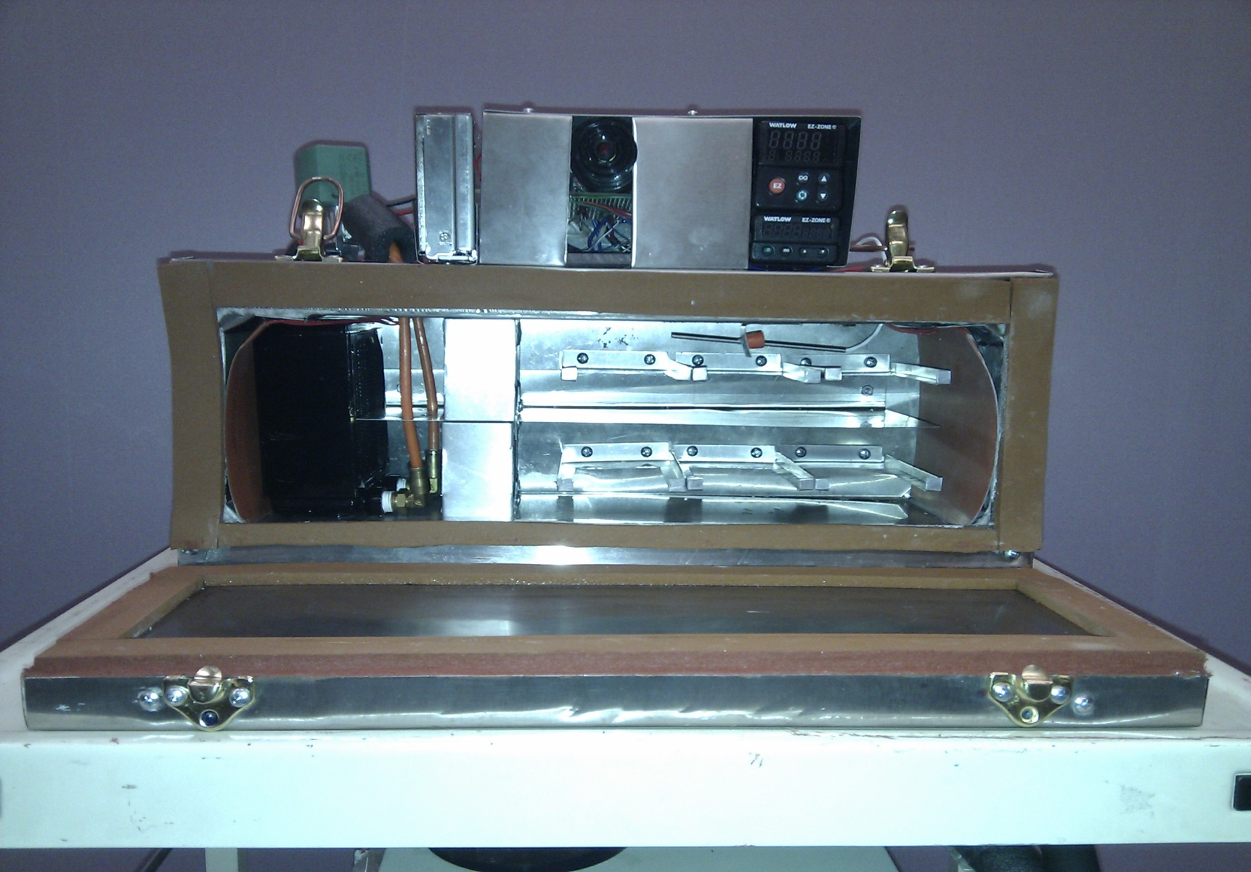
Final Chamber

Slide 11
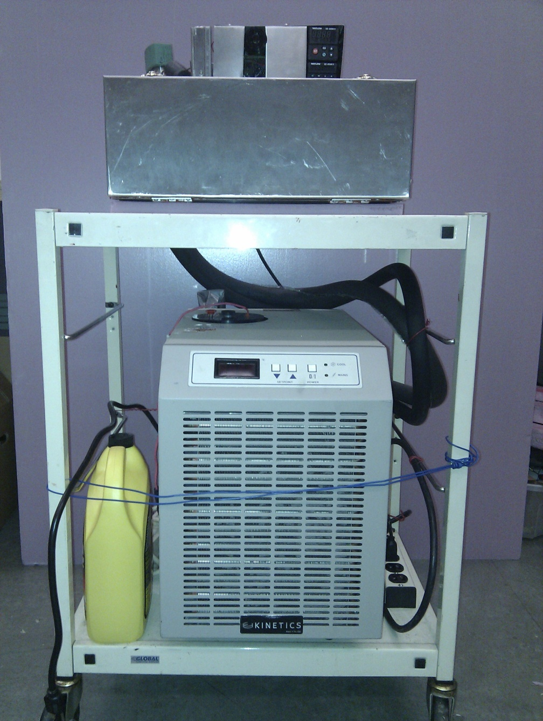
Final System

Slide 12
Validation

Slide 13
Validation
Temperature Uniformity
Test results:
Mean temp. difference: 0.64 ºC
Standard deviation: 0.39 ºC
Max: 1.6 ºC
Min: 0 ºC
Requirement:
Temperature difference: within ± 4 ºC

Slide 14
Stability
Extreme Max Temp
Extreme Min Temp
Maximum range: ± 1.6 ºC
Requirements:
Maximum range: ± 2 ºC from set point)

Slide 15
Ramp rate (transient)
System:
Average Ramp up: 17.5 ºC/minute
Average Ramp down: 10.7 ºC/minute
Requirement:
Ramp rate : 10ºC/minute (up and down)

Slide 16
Other Results & Requirements
 | Criteria | Chamber | Requirements
Mobility | Weight/Density Ratio (lb/in) | 20.62 | 75
 | Dimensions (in) | 19x5x5
 | 19" Form Factor | Yes | Yes
Capacity | Number of SSD's | 6 | 4-12
Airflow | Max (m/s) | 14.6 | NA
 | Min (m/s) | 1.35 | 0.5

Slide 17
Proposals
Use heater with fins
Proportional valve
Proportional controller
Manufacturing process: Stamping
Capacity: larger chamber
  19”x10”x10”

Slide 18
conclusion
Requirements have been achieved:
Budget
Mobility
Mechanical Aspect
Electrical Aspect
  Academic Achievement:
  Technical Design Process
  Teamwork
  Project Management
  Financial Management

Slide 19
Q & A

