Slide 1
A Sled System for
Motor Vehicle Crash Simulation and Forensic Biomechanics
Group Members:
Joshua Booren
Travis Deason
Steve Savas
Max Brunhart
Customer:
Dr. Sean Kohles, Ph.D.,
PSU Reparative Bioengineering Lab, Kohles Bioengineering,
and Forensic Research & Analysis
Advisor:
Evan Thomas PhD

Slide 2
End of Term Status
Status
Concept Overview
Decision Process
Merits and Challenges
Conclusion

Slide 3
Status
The Sled Team has evaluated options and settled on the options which best fit PDS criteria in the Following two Categories
  Propulsion
  Guidance
Concept selection will govern future design constraints and limitations

Slide 4
Criteria | Eng Spec/Target
Performance | 0 - 25 mph (min-max) 0 -15 mph (focus) ± 0.1 mph
Sensor Mounts | 1 6 axis load cell, accelerometer and camera mount
Durability | can sustain test impact forces of 15G
Precision | 10 trials with std dev < 0.15
Safety | 3 Factor of Safety, less than 1% of incidents
Size and Shape | Max: 4 ft wide x 20 ft long x 4 ft tall

Slide 5
Propulsion Goals
Accelerate to 25mph in 15 feet
Minimize cost
Minimize acceleration stresses
Produce repeatable and reliable results
Low maintenance and operating costs
Allows for future expansion

Slide 6
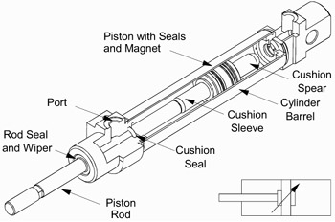
Pneumatic Actuators
Accelerate over a short length using compressed air

Slide 7
Pneumatic Actuators
Pros | Cons
Simplicity of design and fabrication Minimal fabrication Size and weight | Cost and availability of parts involved Availability of high pressure air Force of acceleration

Slide 8
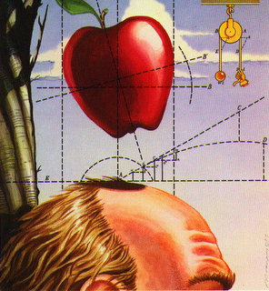
Gravity
Accelerate over a long distance using the force of gravity

Slide 9
Gravity
Pros | Cons
Design and operating simplicity Minimal acceleration stresses Low cost to build, operate and maintain | Final velocity fails to meet max velocity of PDS goals Requires fabricating a large structure, prone to vibration Presents issues involving future expansion

Slide 10
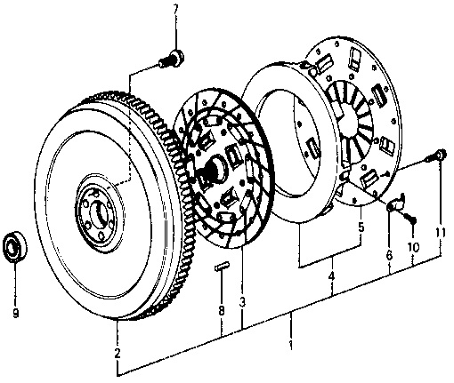
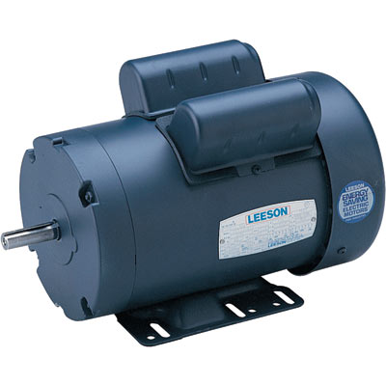
Motor and Flywheel
Accelerate over long distance using electric energy

Slide 11
Motor and Flywheel
Pros | Cons
Meets all PDS Criteria Minimal acceleration stresses transferred to sled Allows for future expansion Uses common power source | Complex design Significant fabrication required Presents issues involving future expansion

Slide 12
Decision Matrix
CRITERIA | Pneumatics | Gravity | Motor
Acceleration Force Transmitted Cost Operating and Maintenance Future Expansion Reliable Results | 5 2 1 3 4 3 | 2 5 5 5 0 4 | 5 4 3 4 5 4
Total | 22 | 21 | 25

Slide 13
Track and Sled Goals
Minimize surface friction
Minimize costs
Modular for mobility
Accommodates designed propulsion system
Minimize associated maintenance and operating complexity
Allows for future expansion

Slide 14
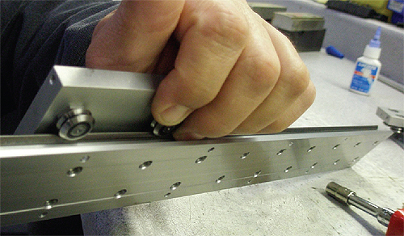
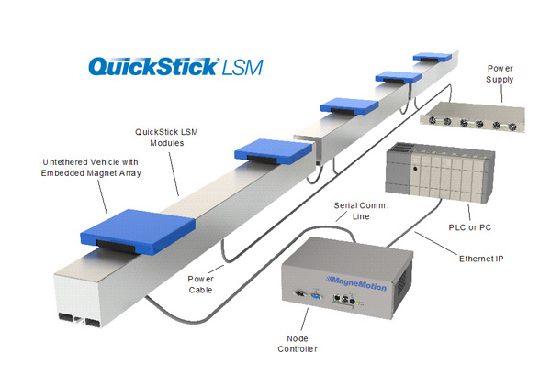
Prefabricated Options
Purchase a sled system which has specifications set by manufacturer

Slide 15
Prefabricated Options
Pros | Cons
Minimal Fabrication Values for max load and speed are well documented Allows for future expansion | All designs were found to be cost or load prohibitive

Slide 16

Track System
Wheels and bearings sourced from manufacturer, sled and track design in house

Slide 17
Track System
Pros | Cons
Able to absorb forces due to impact Falls within budget goals Possible to make in segments Custom made sled for expandability | Weight Design complexity of sled Requires fabrication and machining

Slide 18
Detailed Design Issues
Stress Analysis - High stress regions: Flywheel, impact zone, sled platform
System Losses - Part selection will allow for more precise analysis
Operating Constraints – Size, weight, power source
Cost Control
Notes:
Stress Analysis
All components selected will have to show they are capable of handing the high forces and energy that will be absorbed throughout the product life. Problem areas are expected to include: Flywheel, impact zone, and sled platform
System losses
Up to this point, design criteria have been idealized to ignore losses related to friction and transfer of energy. A precise system will require the design team to account for these losses
Operating Constraints
The design team will be expected to deliver a product which can operate in as many circumstances as possible and be operable by anyone who may be interested in the project.
Cost Control
The Design team will be required to stay within the budget allocated if at all possible. This could mean using lower cost components then those initially specified

Slide 19
Conclusion
A low cost system meeting customer’s specifications
A large amount of design and fabrication
Keeping costs low and adhering to deadlines will be the team’s greatest challenge

