Slide 1

PSU
2011 Human Powered Vehicle
‘Mjolnir’
Vehicle Testing Results
Tad Bamford
Ben Higgins
Chris Schultz
Aaron Stanton
Neal Pang

Slide 2
Overview
Concept
  Design Specifications
  Final Design
Prototype
  Testing (HPVC)
Failure Analysis

Slide 3
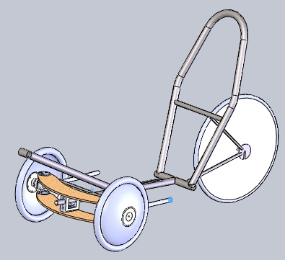
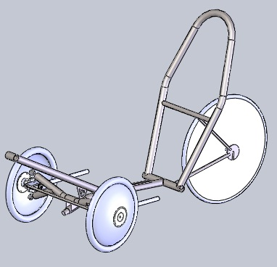
Final Design
Based on decision matrix:
  Three-wheeled “tadpole” style recumbent
  Energy storage deemed unfeasible
  Partial fairing
  Hub-centered wheels
  Leaning Frame

Slide 4
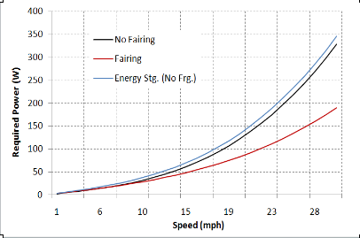
Energy Storage vs. Fairing
Energy Storage Device to heavy for power gain
Fairing More effective for speeds above 10 mph

Slide 5
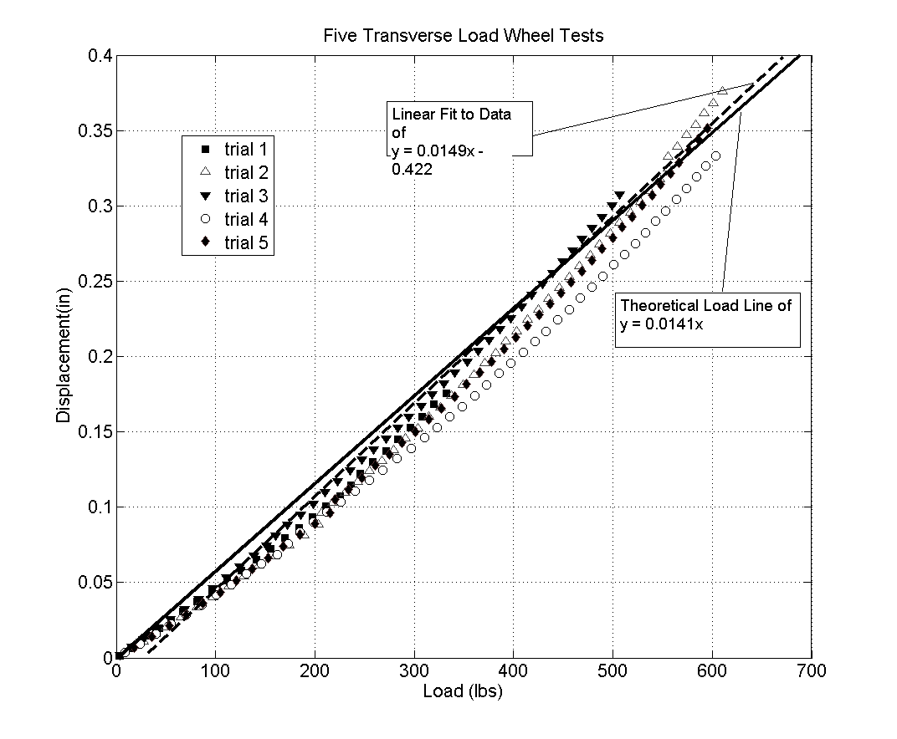
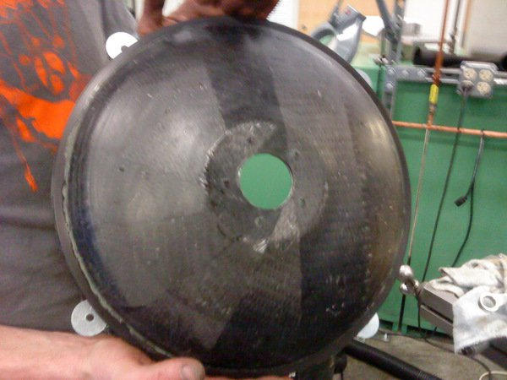
Carbon Fiber Hub-Centered Wheels
Manufacturing
Testing
Analysis

Slide 6
Testing
Due to leaning mechanism, vehicle was unstable and counterintuitive to ride.
  Lockout employed
  Further testing showed instability

Slide 7
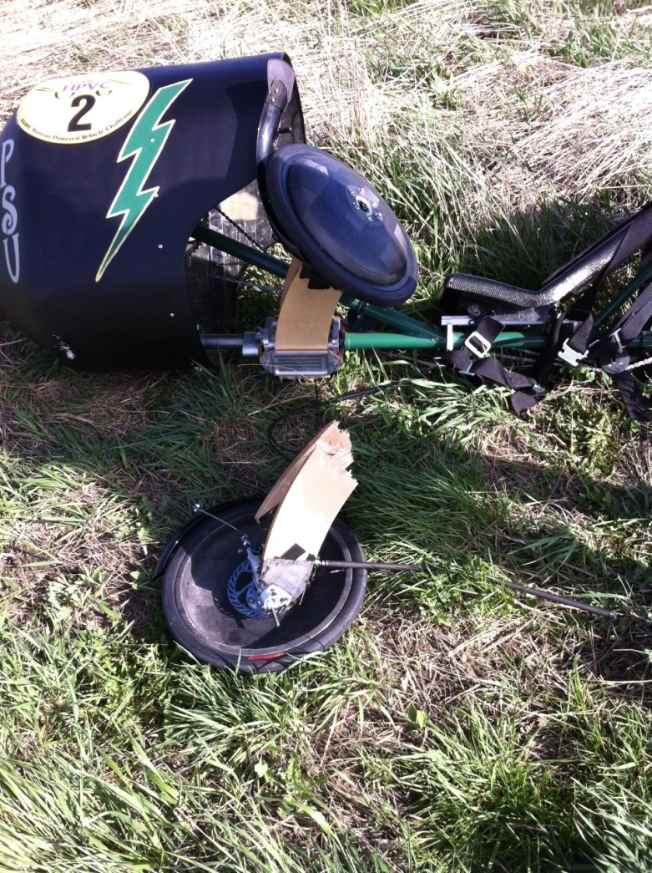
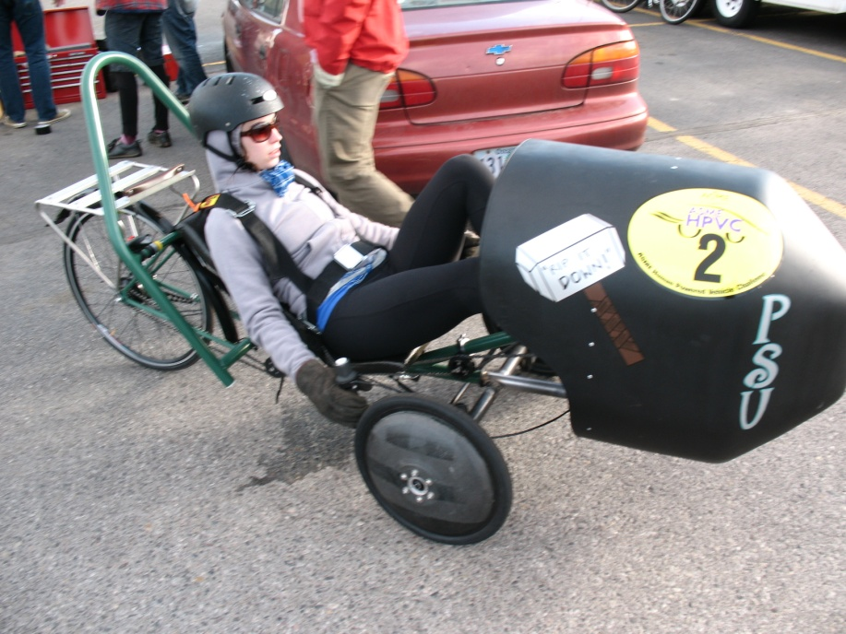
The HPVC
http://www.nbcmontana.com/news/27897784/detail.html

Slide 8
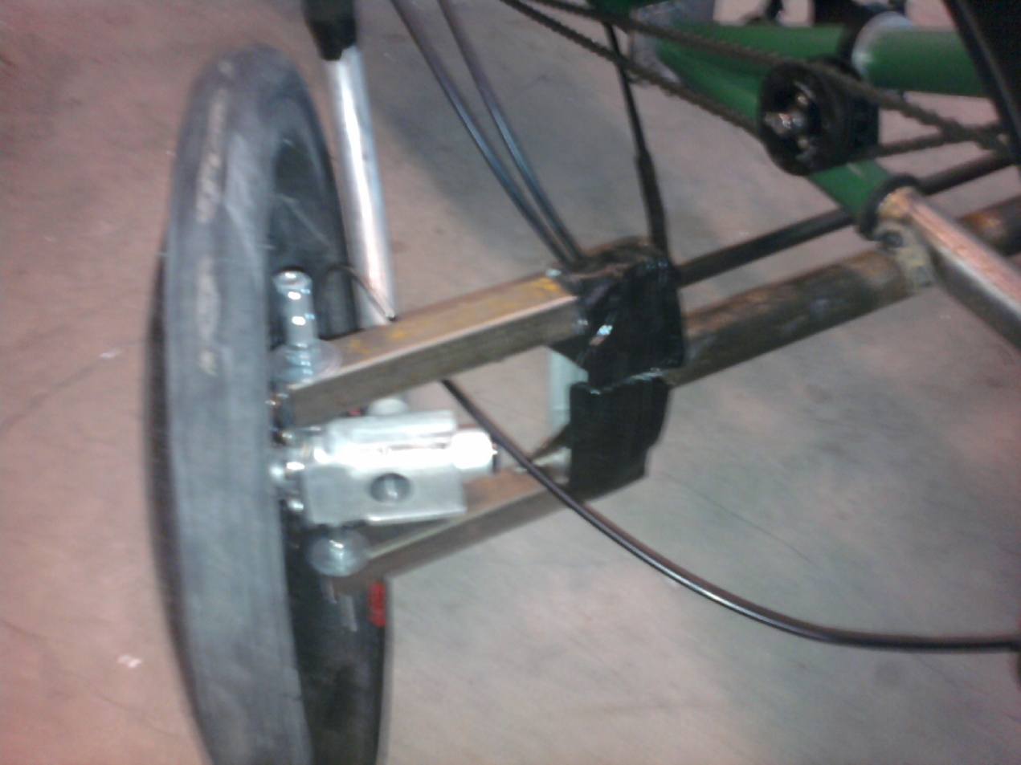
The HPVC
Redesigned Steel Front End

Slide 9
Failure Analysis
What Went Wrong
How it Could Have Been Prevented

Slide 10
Questions?

