Slide 1
Formula SAE
Cooling System
Reuben Ness
Riki Hopkins
Craig McLain

Slide 2
Background
Formula Society of Automotive Engineers (FSAE) is an international engineering competition where students design, build, and test small-scale autocross racing vehicles.
Competitions are held annually with regulations that create a real world challenge.
In the competition, cooling related problems are not uncommon amongst competitors, and Portland State University’s (PSU) FSAE team in 2010 was not an exception.

Slide 3
PSU’s FSAE team experienced the cooling challenges in 2010.
The engine ran at temperatures hotter then ideal for optimized performance during testing and competition.
The car would over heat when idled for an extended time, or when ran hard and then brought to an idle shortly there after, due to the insufficient airflow to the cooling system at idle.
The car had hard hot starting due to excessive temperatures.

Slide 4
Mission Statement
The FSAE Cooling capstone team will design a new solution for the cooling of the 2011 FSAE car. The goal is to produce a solution through an understanding of the physics involved in the problem and the application of effective engineering methods. The final design will be prototyped and documented, with all of its performance characteristics quantified.

Slide 5
Design Requirements
Quality and Reliability
Steady heat transfer of 30HP and maintaining 210°F at peak loading conditions.
Performance
Heat transfer of 30HP (1200Btu/min)
One year of service life
Size and shape
Must not extend beyond the outer edge of the tire and must not negatively effect the center of gravity of the car by more then 0.5 in.
Must meet all FSAE regulations
Must meet the $200 budget.

Slide 6
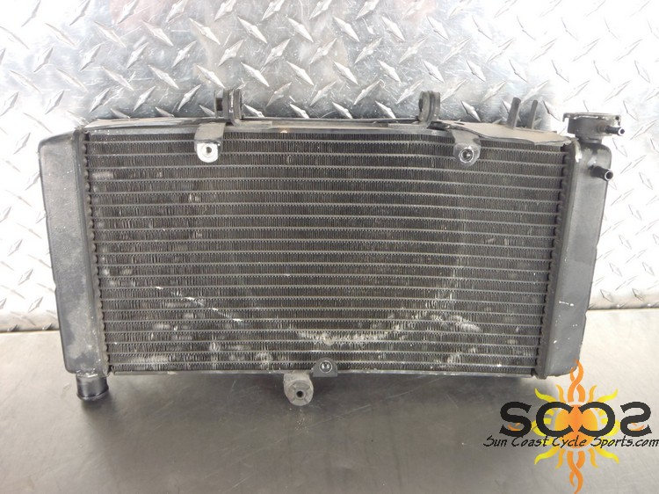
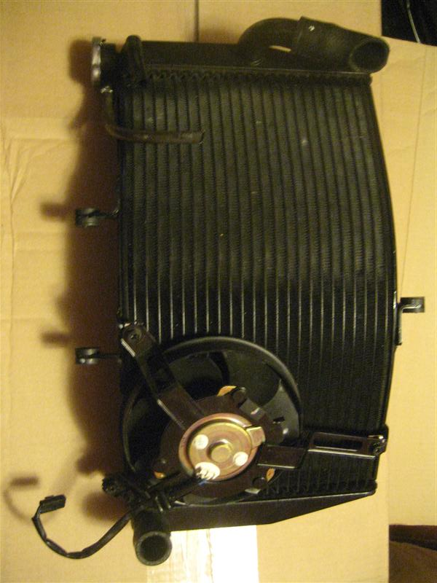
External Search
Motorcycle Engine Radiators
Honda CBR600F4i
Advantages
Cheap
Honda-designed
Disadvantages
Too small
Hard to package
Honda CBR900RR
Advantages
Larger size
Easier to package
Designed to be light and efficient
Disadvantages
Expensive
Hard to find

Slide 7
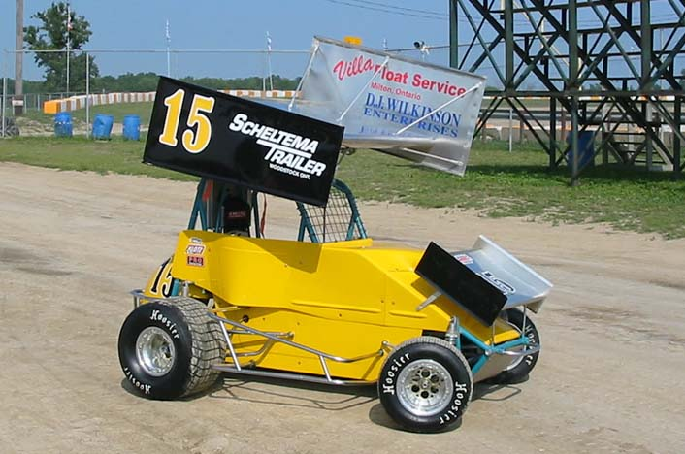
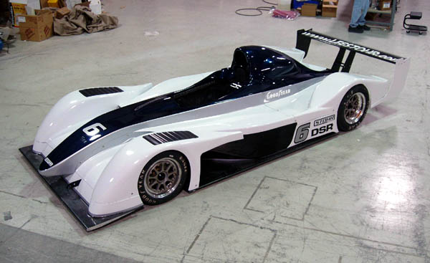
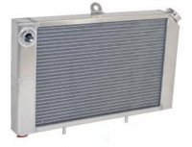
D-Sports Racer/Mini Sprint/Midget
Advantages
Designed for motorcycle engines
Correct core area
Designed to be light and efficient
Disadvantages
Core too thick
Hard to package

Slide 8
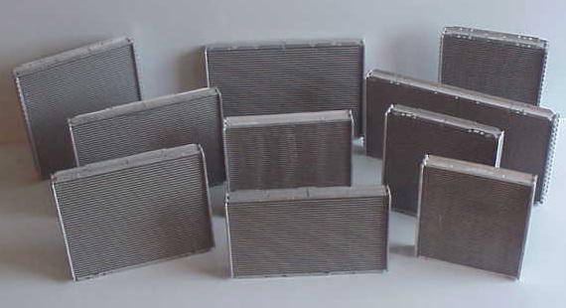
Custom Radiator
Advantages
Built to specification
Package how we want
Disadvantages
Expensive
Core properties unknown

Slide 9
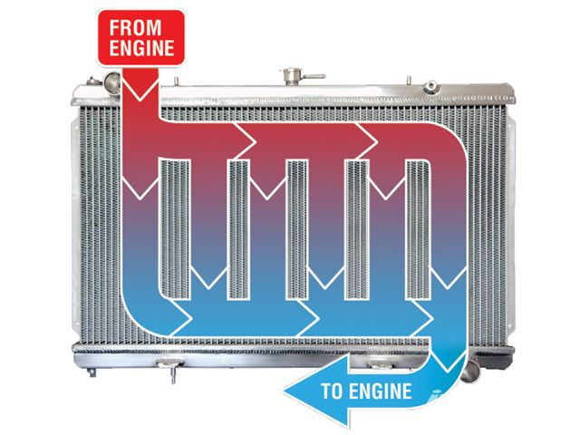
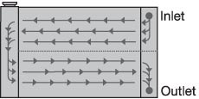
Single or dual pass
Single pass
Conventional
Heat transfer advantages
Fan performance
Dual pass
Easier to plumb
Harder to package tanks

Slide 10
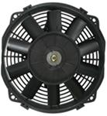
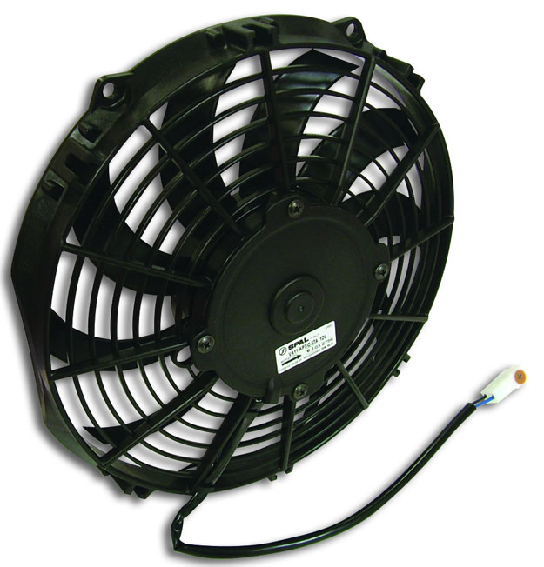
Fan Sizing
Cheap/Free
Too small (2010)
Unreliable
Quality
Known performance
Reliable
Expensive

Slide 11
Concept Evaluation
Laid out Decision Matrices
Engineering calculations

Slide 12
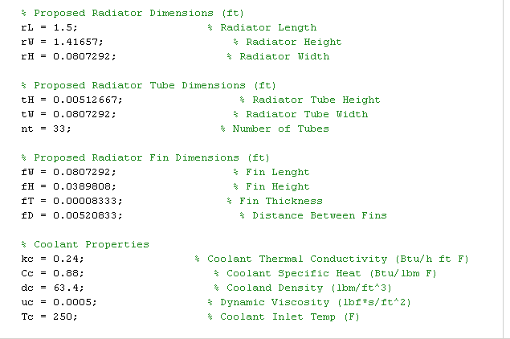
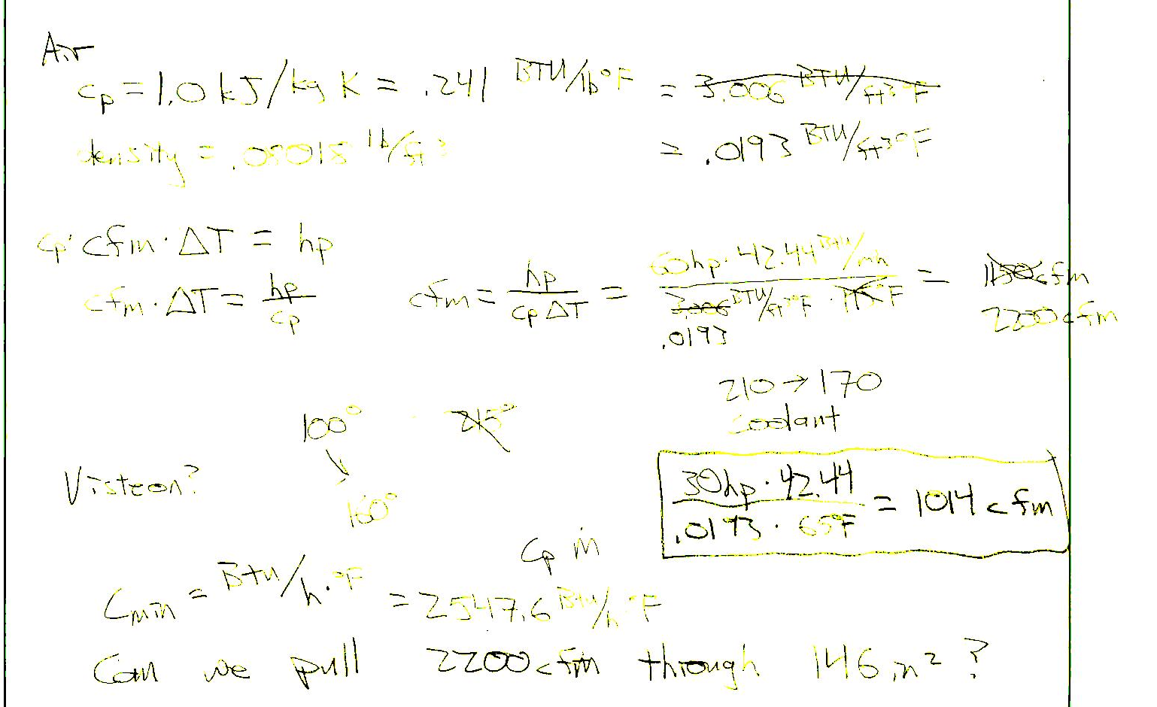
Calculations
Matlab
Extensive
Syntax issues
Not robust code
“Hand” Calcs
Heat transfer calcs
Tedious
Can be checked
Require more assumptions

Slide 13
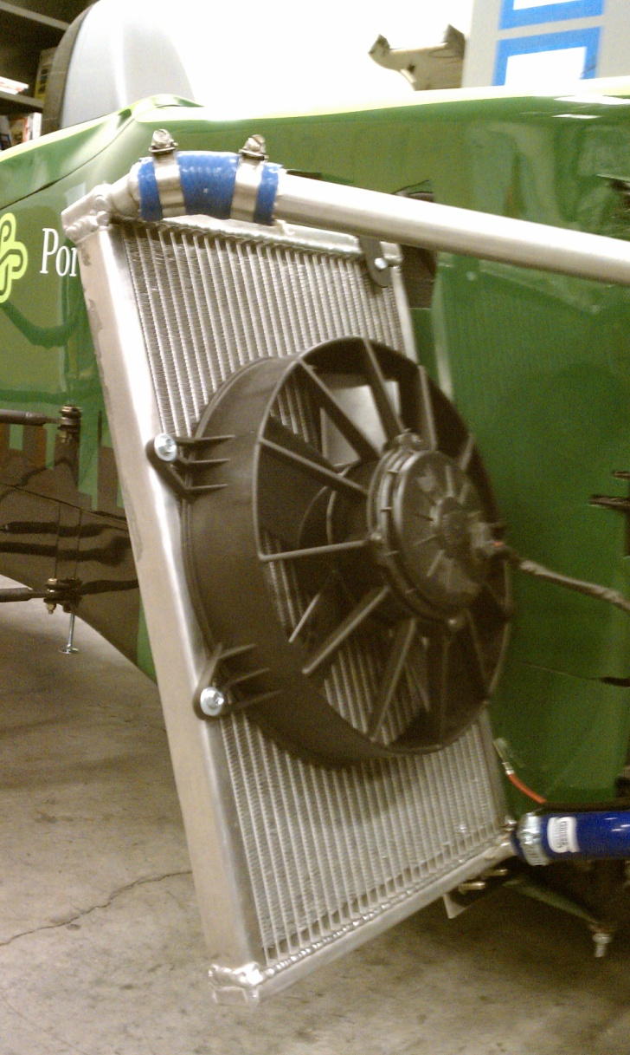
Final Design
Final Dimension: 10.75”x16.5” with a one inch core (177 sq inches)
Added one inch to each side for increased factor of safety
Aluminum hoses offer less weight than conventional hoses and cleaner looks
10” 1100 CFM fan to provide airflow

Slide 14
Analysis
Completed:
Pressure drop experiment
Idle heat load
Fan testing and validation
Attempted to find heat transfer coefficient
In Progress:
Experiment to confirm horsepower rejection at idle
Repeat experiment with the car on a dyno to obtain numbers with the engine under load
Data will be used to complete a mathematical model of the cooling system

Slide 15
Conclusions
There is no such thing as a perfect design
Goals:
Understand the system being designed
Prototype and test
Solve past problems
End Products:
Cooling system that satisfies the PDS requirements
Mathematical model of the Cooling system

