Slide 1
Corner Rounder Capstone Team
Team Members:
Melissa Anders
Andrew Dillon
Joshua Schmidt
Matt Kirtley
Faculty Advisor: Huafen Hu
Notes:
Introduction, speaks for itself

Slide 2
Background
Printing industry produces notebooks with rounded corners
Rounded corners are desirable for aesthetics and functionality
Corners are rounded as the last stage of the production process
Notes:
Read it, embellish it

Slide 3
Mission Statement
The Corner Rounder Capstone Team will develop and produce a device that will complete the final step in production for pocket sized notebooks.
The device will exceed the output of the equipment currently used in industry, improve scrap disposal, allow adjustment for various sizes of books, automate the cutting, meet safety regulations, and stay within budget.
Notes:
Read it

Slide 4
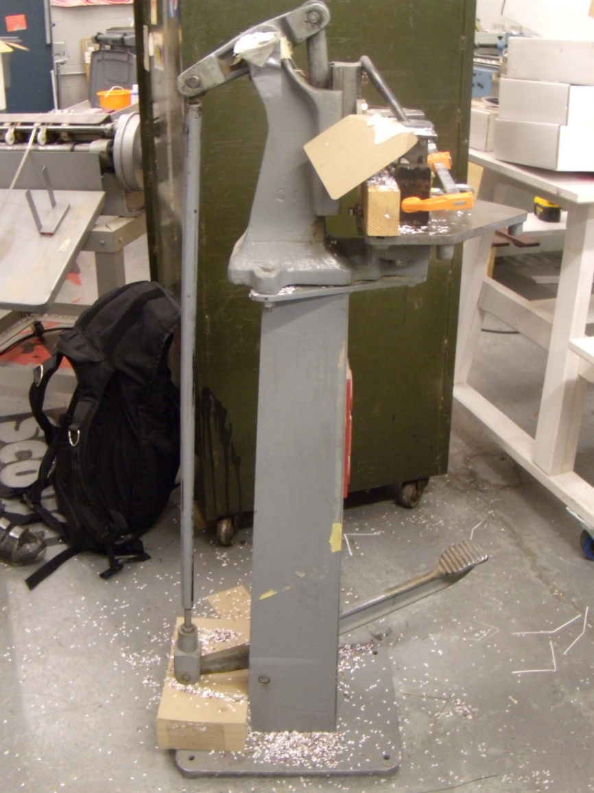
Why build it?
Commercial Cutters
  Expensive
  Single Die
Small Companies
  Don’t have access to large machines

Slide 5
Design Requirements
Capacity
  >2000 books/hour (1 book/1.8 Seconds)
  Cuts two corners at a time
Accuracy
  Tolerance of 1/64”
  Even Cutting of all pages
Adjustability
  3”x5” to 5”x7”
  Small Adjustments
Notes:
Capacity: Ability to cut at least 2k books per hour, based on what is possible with a single corner cutter shown in the last side. Cutting 2 corners at a time will help this process greatly
Accuracy: Tolerance is the size of the edge present on the corners from the corner to the straight sections. Even cutting means the die doesn’t compress the pages and skew them
Adjustability: When books come off of binders, the thickness of the books can vary between lots. The double cutter needs to be able to acount for this, also the cutter should be able to handle books of different sizes depending of the customers needs

Slide 6
Design Requirements
Safety
Labor
  1 person to operate
  Little training required
Reliability
Cost
Notes:
Safety: these cutting surfaces are sharp can easily cause physical harm if people aren't careful. Device needs to have safety mechanisms in place to minimize or eliminate injury
Labor: Machine in previous slide is bulky and takes a lot of force and experience to quickly cut corners. Device needs to be very easy to use with little to no specialized training
Reliability: long lasting with few specialized parts to make repairs easy and quick
Cost: 2500

Slide 7
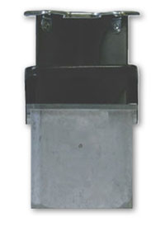
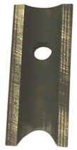
Top Level Design Decisions
Automated/not automated
Custom Dies, commercial dies
Notes:
Automated/not: Automated machine would easily increase capacity and make it a very easy machine to operate. Given the time and money budget, a fully automated machine was not feasible. Chose to make the cutting process semi automated, this made the project doable given our budget, and would still increase the output and decrease the difficulty of the use of machines simialr to the one shown
Custom Dies/Commercial: Custom dies would increase the number of creative ways the corners could be cut, commercial dies are limiting. However, commercial dies are easy to maintain and easy to get, and are tested for accuracy by the producers of them

Slide 8
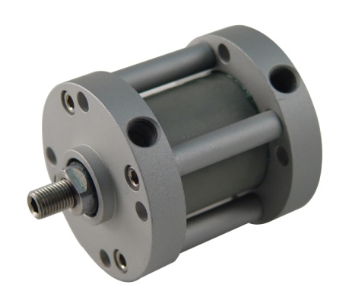
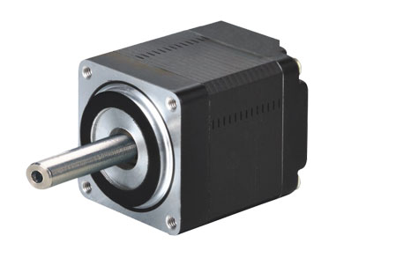
Top Level Design Decisions
Linear actuator/motor
Electrical/hydraulic/pneumatic
Notes:
Linear actuator: How to power the dies was the next big thing, first idea was to use a stepper motor to turn an elliptical gear. The elliptical gear would push down on a bar connected to the top of the Lassco dies. Ultimately thrown out due to its complexity compared to a linear actuator. The linear actuator would provide force that could push or pull the dies down onto the books to cut. Also it would remove the need to convert rotational motion to linear motion, minimizing the about of parts that needed to be machined. Less parts = less cost= less chance of breaking
Electrical/hydro/pneuma: Once linear actuators were chosen. Needed to determine how to power it. Electrical ones don’t put out a lot of force and are slow, but they are cost effective. Hydraulic and pneumatic actuators can put out the required force and speed. Both cost about the same. The team decided on a pneumatic for several reasons. If there is a problem with the hydraulic lines, it is messy and potentially devastating for a printing company. Problems with pneumatic lines are just noisy. Also, the pneumatic actuator would only require an air compressor, or better yet if the customer has air lines in the building. Hydraulic systems require resevoirs of fluid and compressors, it would overall cost more and be bulkier then the pneumatic option

Slide 9
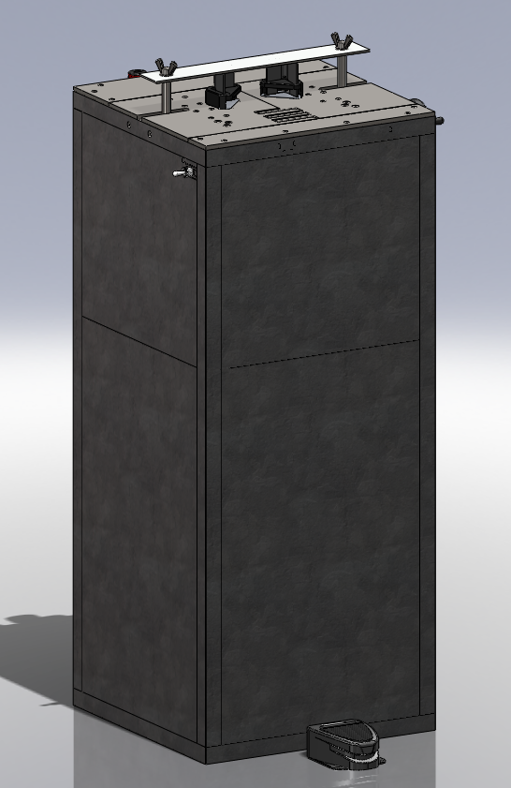
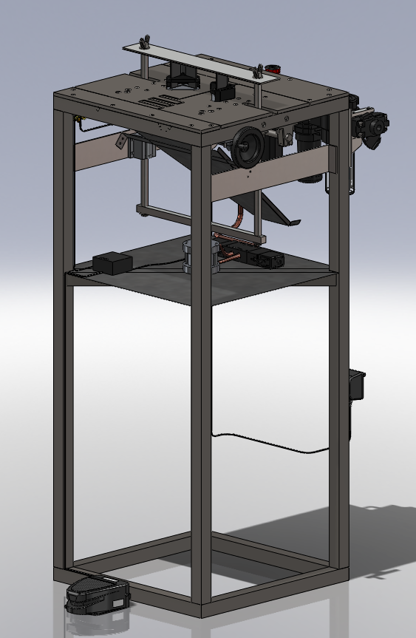
Final Design
Notes:
Use this slide to talk about over all design, and foot pedal operation, and scrap collector, and frame, and pneumatic controls

Slide 10
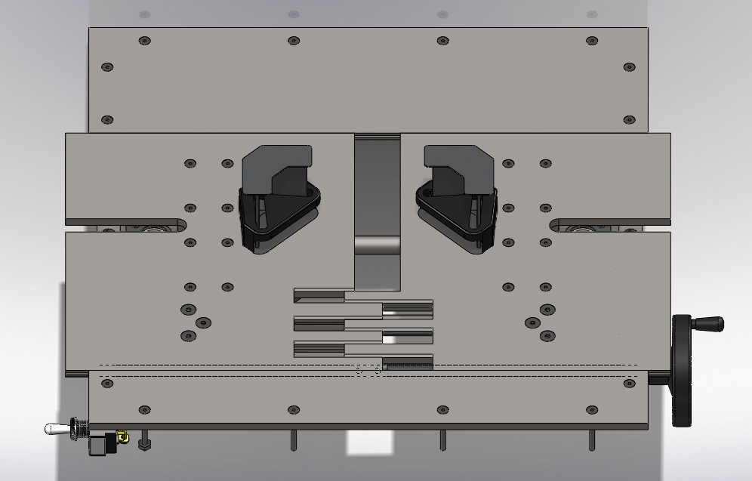
Final Design
Notes:
Top of Adjustable plate with dies – Meets the adjustability, double corner, accuracy: Commercially available lassco dies, hand crank with 1/16” per turn. Allowing for fine adjusting depending on the books. Fingers in front to keep book from getting caught in the edge and damaging the book. Not fingered in back because it doesn’t matter, so its easier to machine.

Slide 11
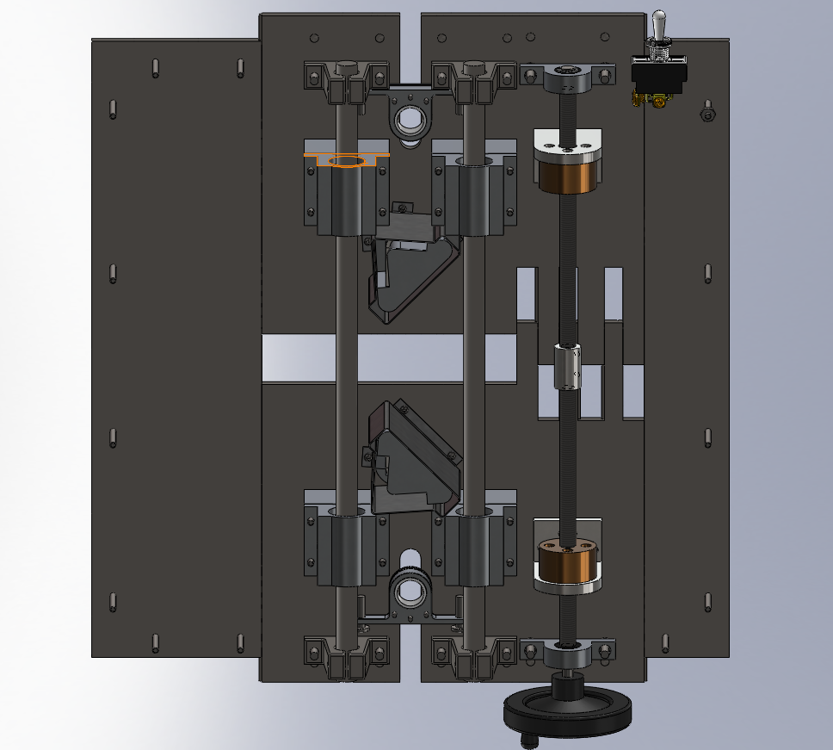
Final Design
Notes:
Bottom of adjustable plate Talk about load bars and their positioning. How they are designed to take the load from the actuator. Let Josh talk about the Power screw

Slide 12
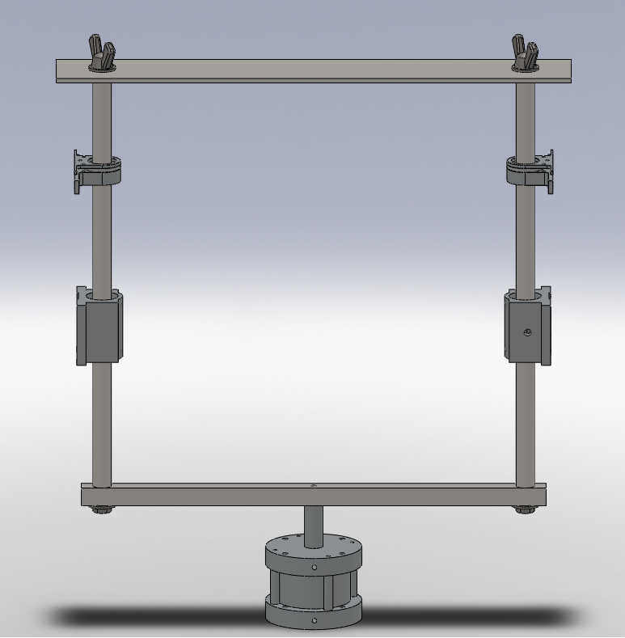
Final Design
Notes:
Actuator and pull bars. Meets capacity, adequate force. Pneumatic linear actuator, pull bars, with bearings and guides to minimize chance of binding and buckling. Wing nuts on top bars, allow for interchanging of dies with ease.

Slide 13
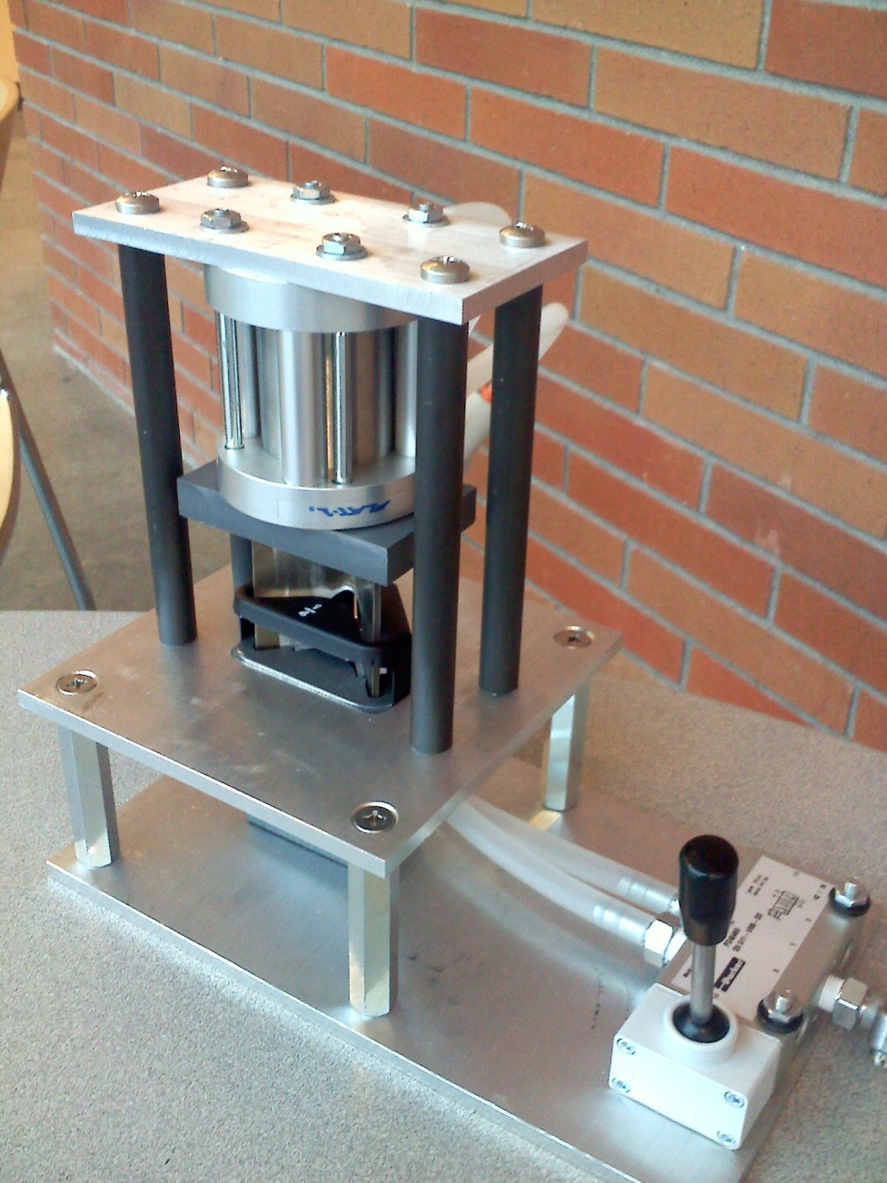
Proof of Concept
Pneumatic Linear Actuator
Lassco Die
Cost: $376
Notes:
Picture of the prototype, Talk about what we gained from prototype: Proof that a linear actuator can be used to power a lassco die. This machine does the same job that commercially available cutters do for a fraction of the cost. Lassco single die cutters cost upwards of $1500

Slide 14
Challenges
Unable to fully meet customer’s expectations
Funding

Slide 15
Special Thanks
Dr. Etesami
Frank Joyce
Intel
PSU ME Department

Slide 16
Questions?

