Slide 1
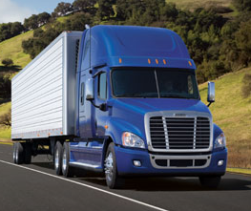
Axle Temperature Control Final Report
June 1, 2011
Team Members
Lee Zimmerman
Boun Sinvongsa
Emery Frey
Mike Erwin
Industry Advisor
Dave Ruuhela
Daimler Trucks North America
Academic Advisor
Lemmy Meekisho

Slide 2
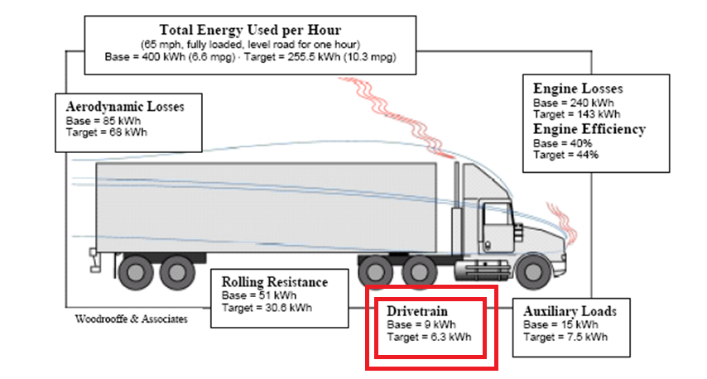
Background Information
2.25% of energy required to operate a truck at a steady highway speed is lost in the drivetrain
21st Century Truck

Slide 3
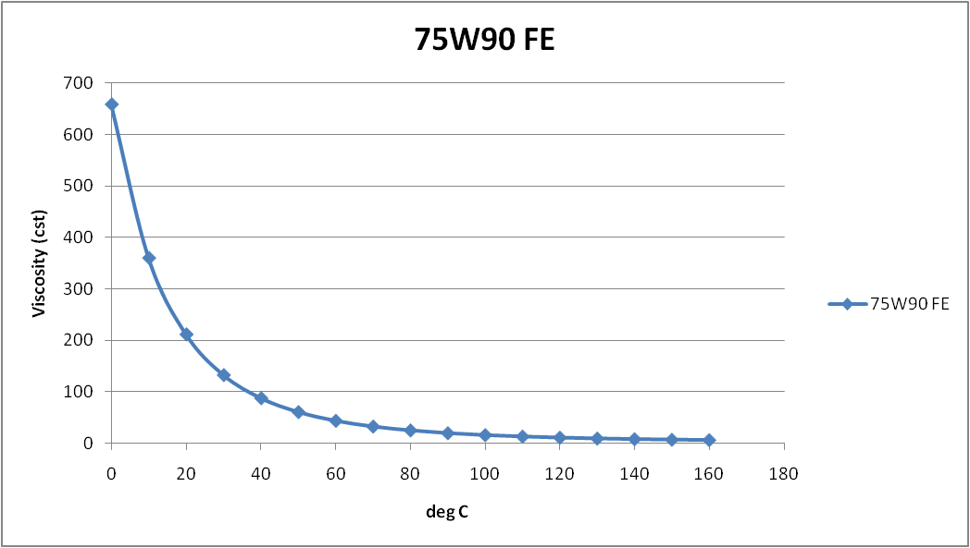
Background Information
Increasing the axle fluid temp will reduce energy loss
Up to a 0.7% improvement in drivetrain efficiency possible (apprx $600/year in savings in fuel costs)
Axle Temp. Project Specs, 2010

Slide 4
Requirements
Top PDS requirements
  Efficiency gain
    Device must achieve a net gain in efficiency
  Return on investment
    2 year payback period (apprx $1200 budget)
  Temperature control
    Achieve/maintain fluid temp of 65-80ºC (ambient above freezing) and 50-65ºC (ambient below freezing)
  Warm-up rate
    Achieve a warm-up rate of 2X current state (est. 2ºC/min)

Slide 5
Design Concepts
Heat Exchanger – Uses exhaust gas or engine coolant as a heat source
Electric Heater – Resistance heater that obtains power from truck’s charging system
Active Insulation – Relies on internally generated heat and has some form of cooling

Slide 6
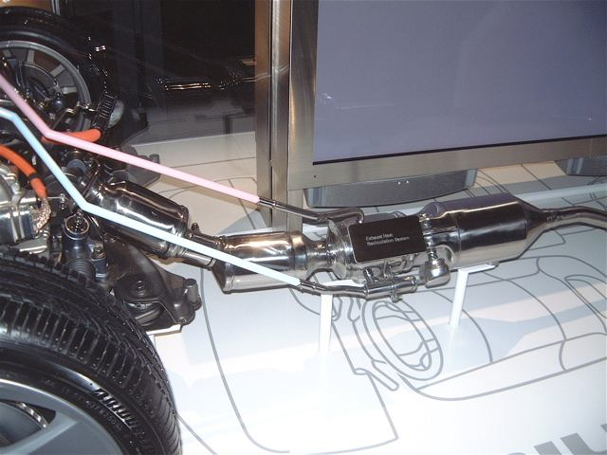
Heat Exchanger
Pros | Cons
Fast Warm-up Rate | Expensive
Utilizes Waste Energy | Complex
 | Reliability / Maintenance
 | Heavy

Slide 7
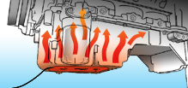
Electric Heater
Pros | Cons
Fast Warm-up Rate | High Electric Requirements
Simple | Inefficient
Low Cost

Slide 8
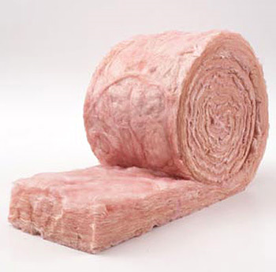
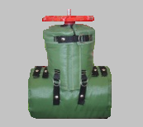
*Active Insulation
Pros | Cons
Simple | Limited Warm-up Rate
Reliable | Potentially less control
Low Cost
Minimal Energy Requirement

Slide 9
Concept Selection
Active insulation concept selected
-most reliable without compromising efficiency
- simple to manufacture
- utilized waste heat
- inexpensive components
- little to no modification to existing components
- no additional energy requirement

Slide 10
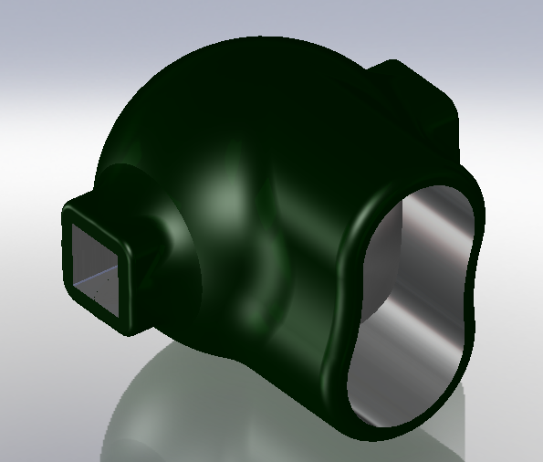
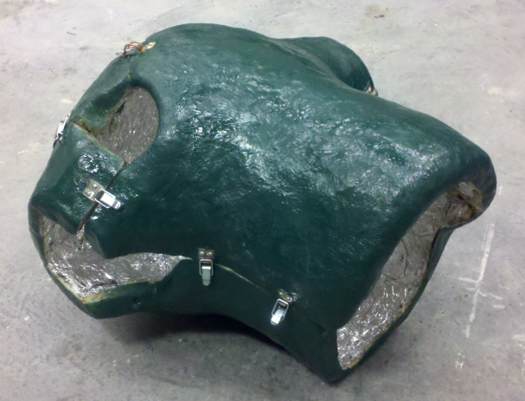
Insulation Design
A solid insulating shell made of expanding foam insulation was designed to retain internally generated heat while being able to stand up to harsh driving conditions.
Initial testing indicated that insulation would more than achieve the necessary temperature range while nearly satisfying the desired warm-up rate.

Slide 11
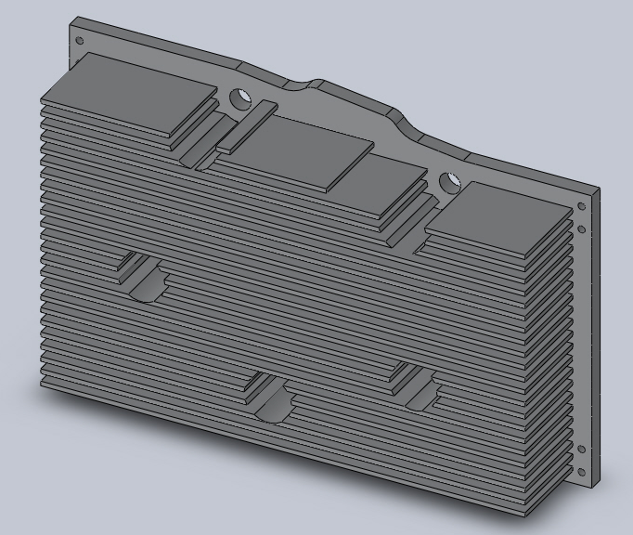
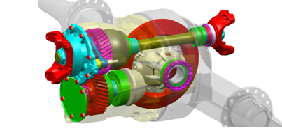
Heat Sink
A heat sink was designed that would replace an access cover on the front of the differential
The large heat load in extreme operating conditions required the heat sink base be as large as possible, with the number of fins calculated from an adiabatic fin tip approximation

Slide 12
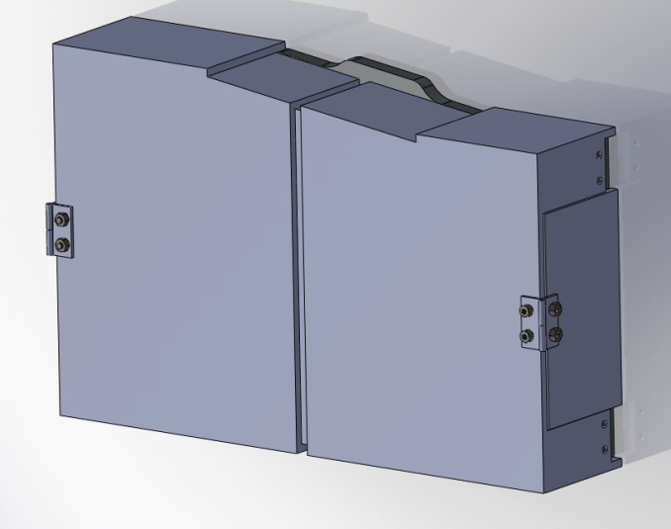
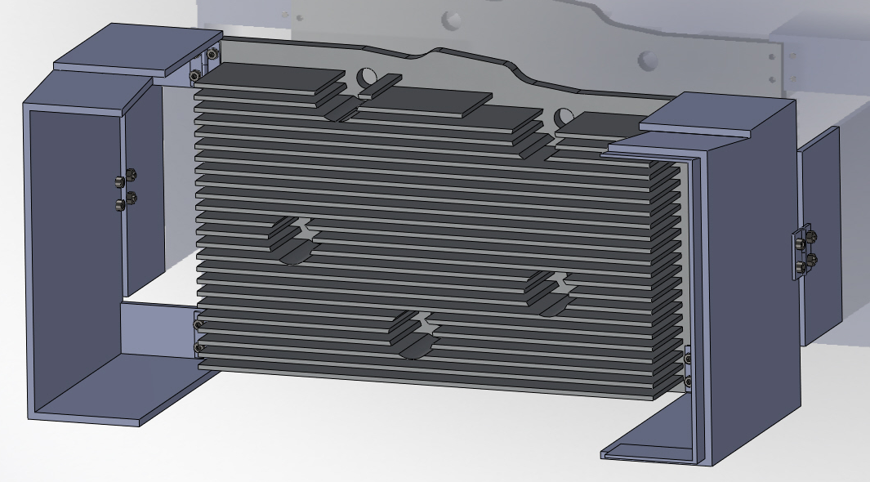
Heat Sink Sheild
The heat sink needed to be shielded from airflow during the warm up phase, but also required maximum airflow when cooling was required
The team designed a enclosure that would swing open to completely expose the heat sink to impinging air while creating a path for flow

Slide 13
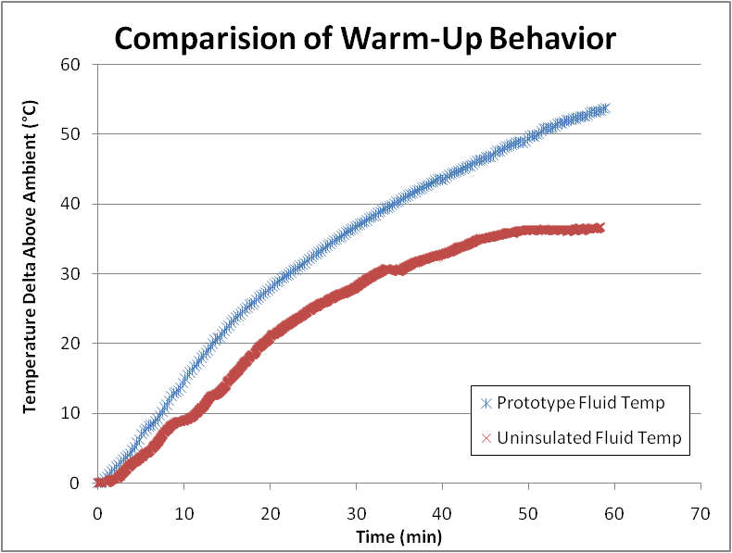
Prototype Testing
Uninsulated axle fluid warm-up rate to 30°C delta: .92 °C/min average
Prototype axle fluid warm-up rate to 30°C delta: 1.4 °C/min average
52% improvement in warm up rate

Slide 14
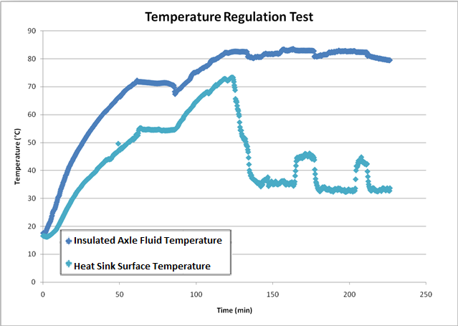
Prototype Testing
With heat sink exposed the axle fluid temperature stabilized, meeting the goal criteria, but it did not cool as expected.

Slide 15
Performance Analysis
Explanations for heatsink performance were generated
Hypothesis | Evidence (Likelihood)
Undersized Heatsink | Calculations were made to verify performance (Low – Medium)
Inadequate Airflow to Heatsink | Heatsink temperature remained very close to ambient temperature (Low)
Poor Thermal Continuity and/or Fluid Circulation | Numerous gears circulate fluid within a relatively conductive housing (Medium)
Inadequate Fluid Contact with Heatsink | Heatsink temperature raised drastically upon deceleration (High)

Slide 16
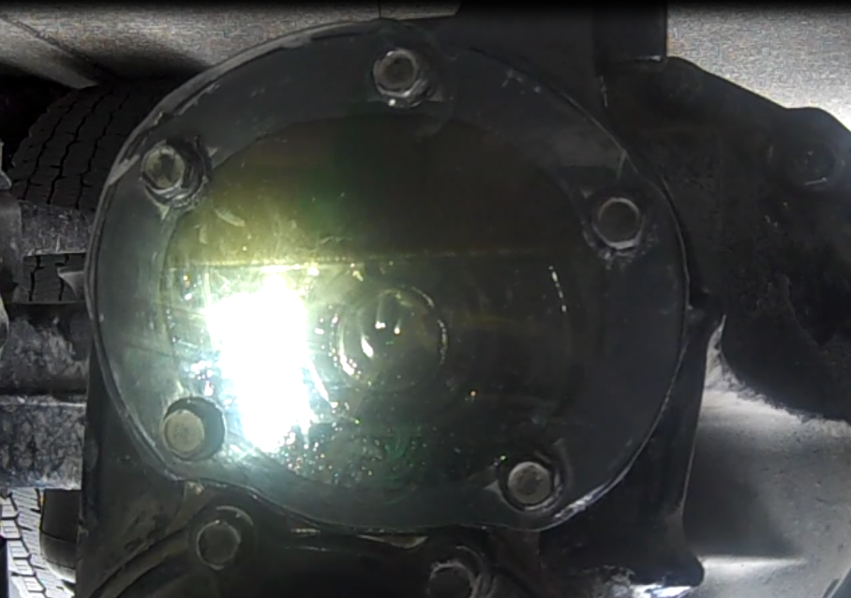
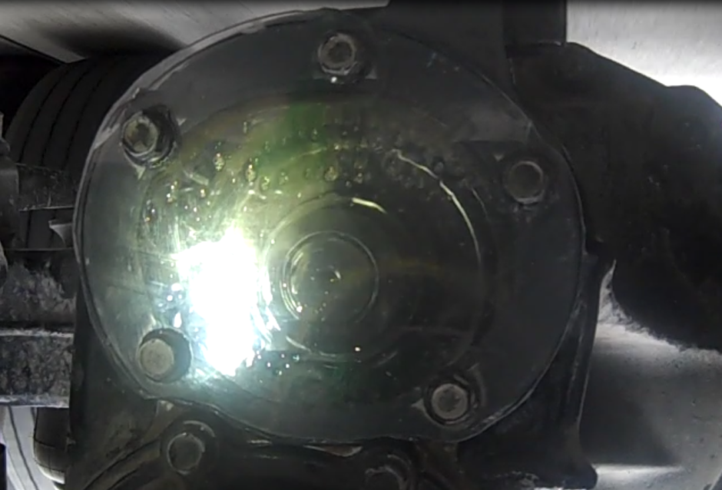
Follow-up Testing
To test hypothesis, a clear acrylic cover was attached to axle and viewed with camera
Static Oil Level, Level Ground
Oil Level with Constant Velocity

Slide 17

Follow-Up Testing (Acceleration)

Slide 18
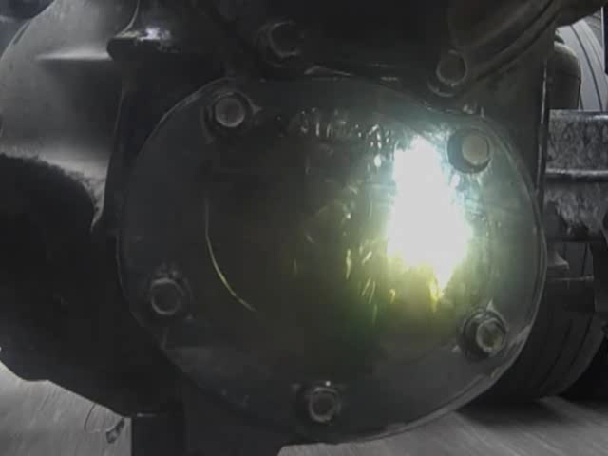
Follow-Up Testing (Steady State)

Slide 19
Results
Design Requirement | Result
Achieve and maintain fluid temperature of 65-80ºC (ambient temp. above freezing) | Temperature was maintained at 80ºC at 17ºC ambient temperature (∆T=63ºC )
Achieve and maintain fluid temperature of 50-65ºC (ambient temperature below freezing) | Maximum temperature differential (70ºC) from testing would maintain 50ºC fluid temperature at -20ºC
Achieve a warm-up rate of 2X current state (est. 2ºC/min) | 1.4 °C/min average (52% improvement in warm up rate). Improvements to heatsink enclosure will increase warm-up rate
2 year payback period (approximately $1200) | Total cost of insulation and enclosure was about _____. Extruded Heatsink with similar dimensions for $50 could be machined to specifications

Slide 20
Conclusion
Complex dynamics and shape of axle made design difficult to model
Many assumptions had to be made
Important parameters had to be estimated (convection coefficient)
Testing of assumptions was important to prove functionality

