Slide 1
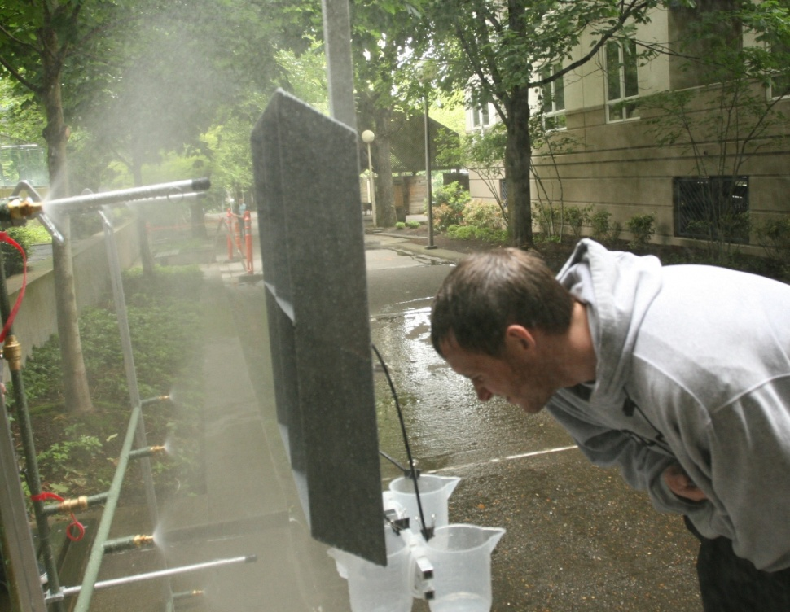
Water Penetration Testing Device
Portland State Capstone Project 2010
Team:
Luke Defrees
Brian Pinkstaff
Andrew Park
Andrew Williams
Contact/Sponsor: Brian Hays/Morrison Hershfield
Academic Advisors: Dr. Turcic

Slide 2
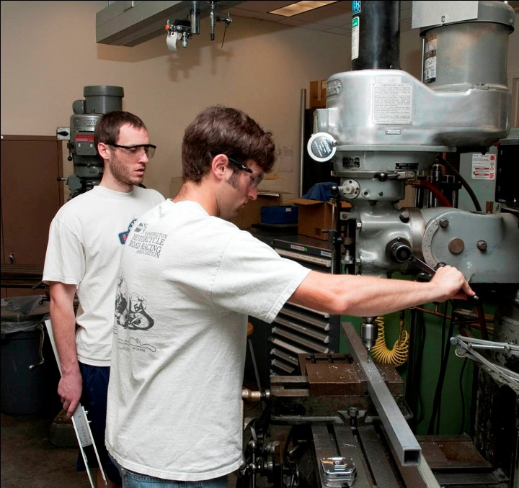
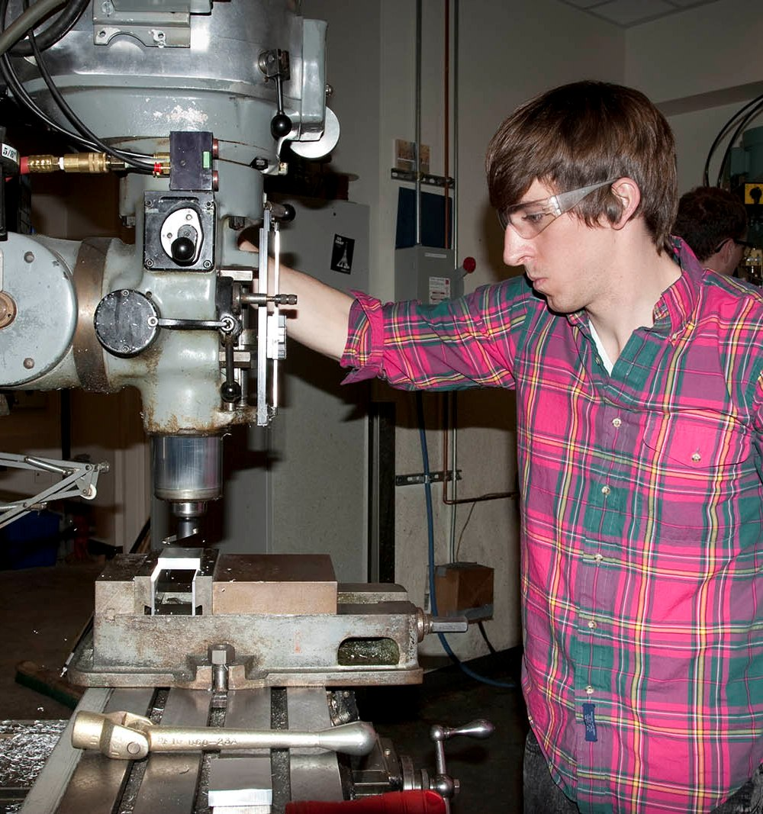
Introduction
Project Purpose
Build water spray rack device to test integrity of doors, windows, and other outdoor installations
Build a catch box that can be used to calibrate the rack twice a year
Rack must conform to ASTM E-1105-00 standards, and Morrison Hershfield’s constraints

Slide 3
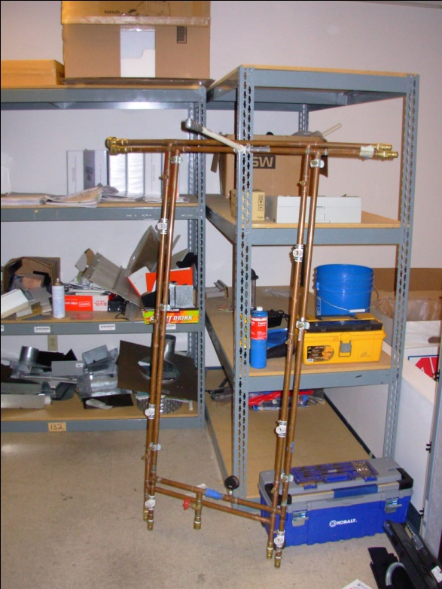
Company Constraints
Primary Morrison Hershfield Constraint:
- Flow rates over entire wall surface are within ASTM tolerances of 4-10 gal/hour*ft²
Areas Needing Optimization:
Inconsistent flow rates throughout rack
Rack is not very portable, requires at least compact truck to transport
Calibration box has no mounting apparatus, is cumbersome and heavy
Spray coverage area is relatively small

Slide 4
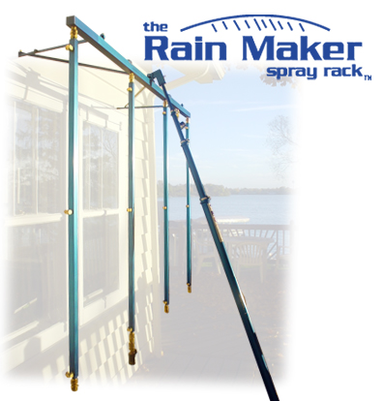
Design Specifications: Spray Rack
Design Considerations:
- Major and minor losses due to elevation, nozzles, pipe friction, and pipe fittings
Overall design is simpler with uniform pressure throughout rack
Lower elevations on rack will have higher pressures
Other Considerations:
- External search of competitor’s products
Patent search
- Component selection such as nozzle size/location, valves

Slide 5
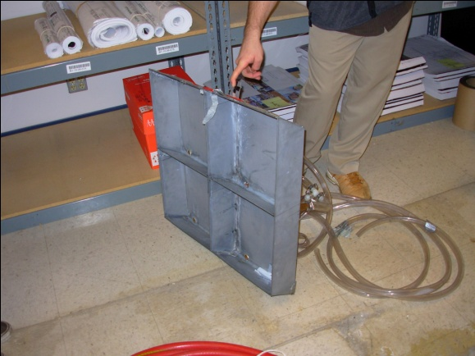
Design Specifications: Calibration Box
Design Considerations :
Must be hands free, and stand alone without assistance
Robust to withstand industrial handing
Resist weather and spray forces
during operation
Other Considerations:
- External search of competitor’s products
Patent search

Slide 6
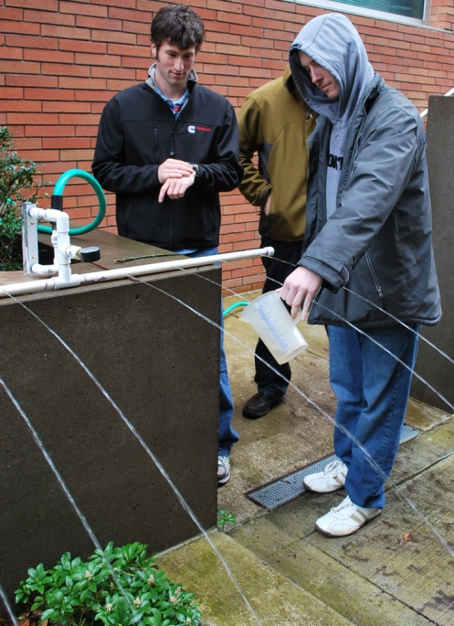
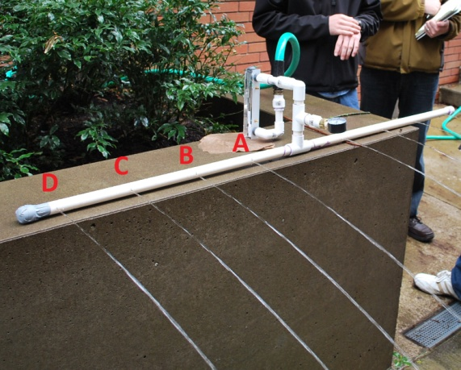
Spray Rack Analysis: Flow
Testing and Analysis
Performed experiment to test for junction and friction losses of PVC, which has similar friction factor to copper
- Performed separate experiment to compare pressure changes at varying elevations

Slide 7
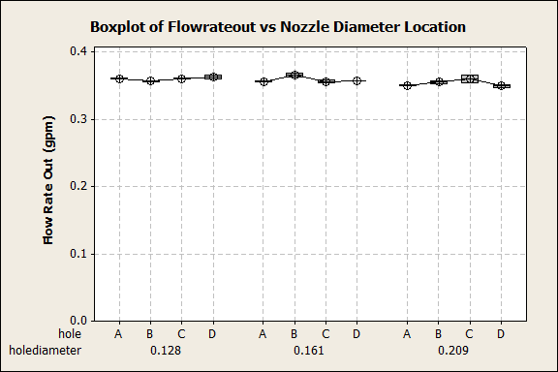
Spray Rack Analysis: Flow
Results of Testing and Analysis
Friction and junction losses in pipe are negligible, and were not detected in our tests
Steady state pressure difference of different elevations consistent with static pressure differences, or about 0.434 psi increase per vertical ft of water
- Some very small minor losses in pipe fittings (elbows, t-sections), but well within acceptable tolerance levels
A, B, C, D, are equidistant nozzle locations from center supply pipe

Slide 8
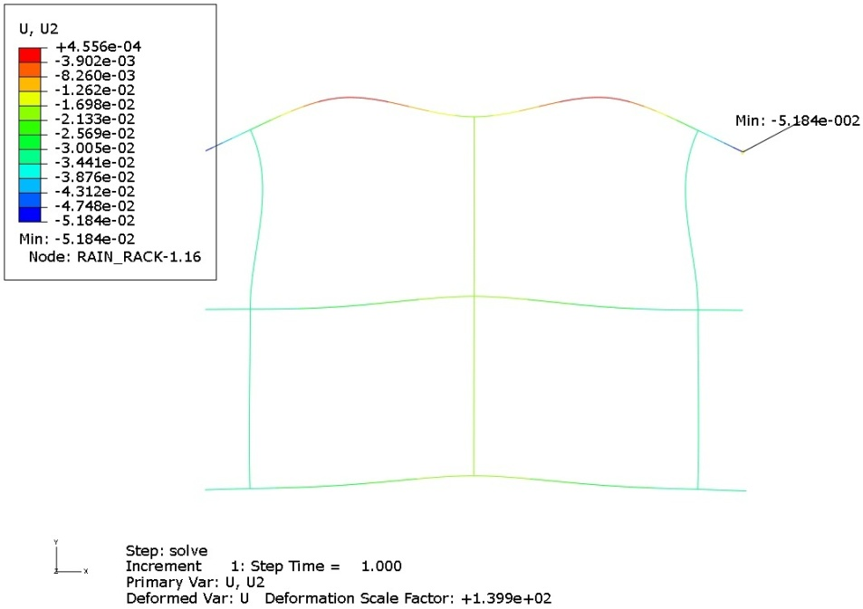
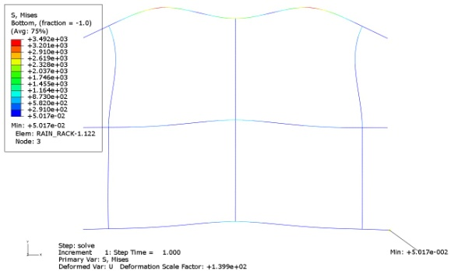
Spray Rack Analysis: Design
Results of Testing and Analysis
Rack weight with water expected to be about 35lbs.
Max deflection (FOS = 1.5) at top of stand ≈ 0.05 in.
- When mounted, max stress in rack is ≈ 3.5ksi

Slide 9
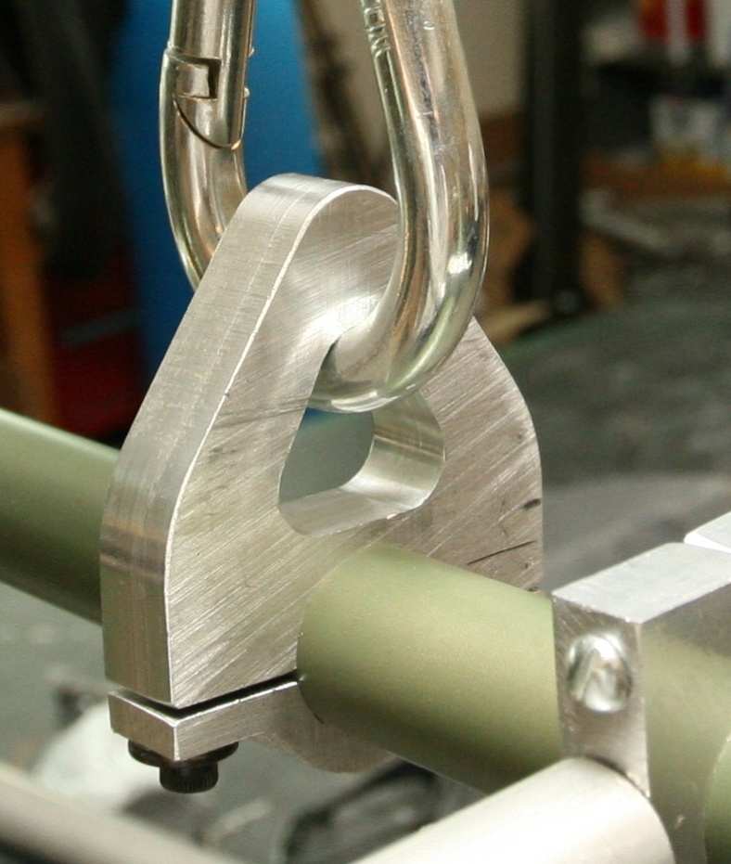
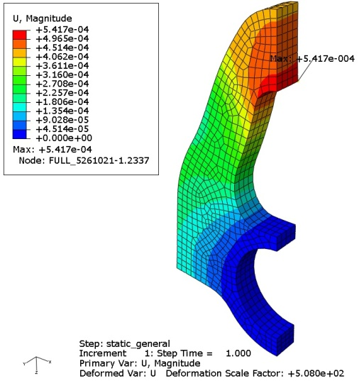
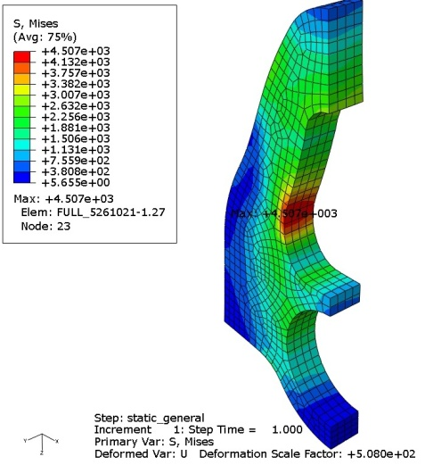
Spray Rack Analysis: Design
Results of Testing and Analysis
Box weighs approximately 6lbs
We expect max stress in hanging mounts to be ≈ 3.5ksi. (FOS = 1.5)
We expect max displacement in mounts to be ≈ 0.00054 in.

Slide 10
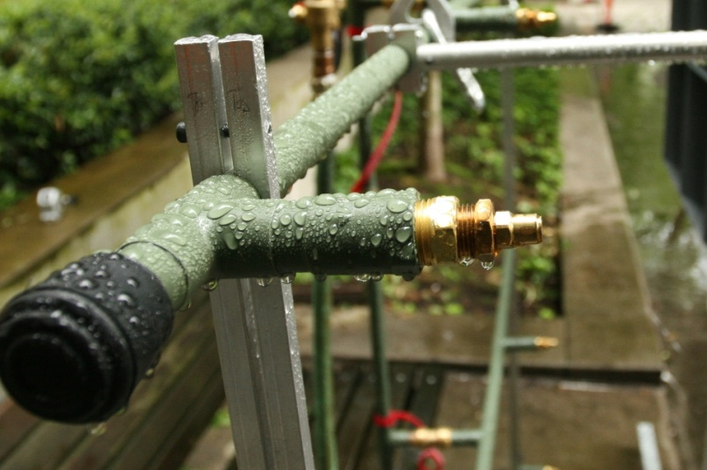
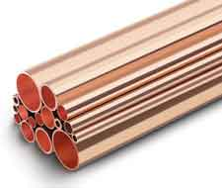
Final Spray Rack Design: Materials/Components
Copper Tubing
Chosen for cost, strength, easily replaceable parts
Paint to control corrosion/oxidation
Brass Nozzles, Bushings
Inexpensive, corrosion Resistant, easily replaceable parts
Full cone, 120° spray angle
Aluminum Side Supports
Minimize weight, strong, relatively inexpensive
Shark Bite Quick Connects
Non-permanent for disassembly, inexpensive

Slide 11
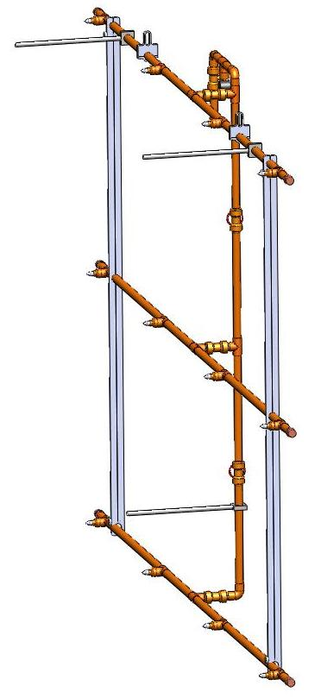
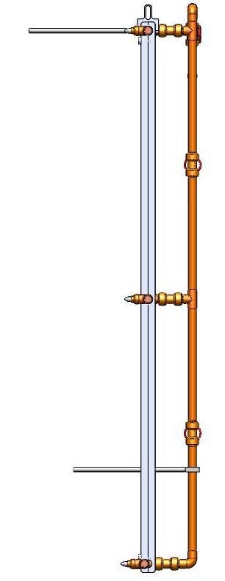
Final Spray Rack Design
A Single Supply Pipe Minimizes Overall Complexity
Two valves will be used to regulate flow and pressure inconsistencies in this design
- More economical. Less valves to purchase, maintain, and replace
Less valves minimizes frequency of rack falling out of calibration
- Complexity of flow is easier to analyze, resulting in more reliable results

Slide 12
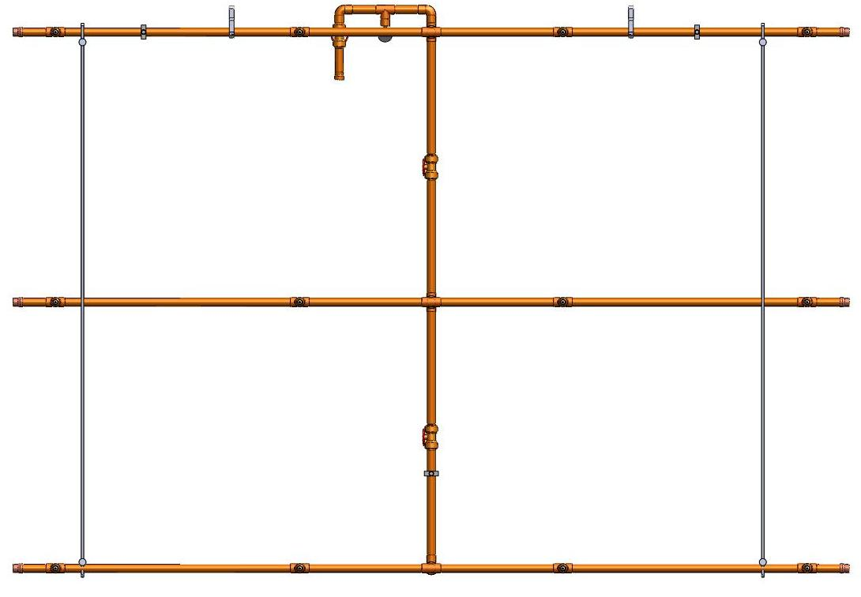

Slide 13
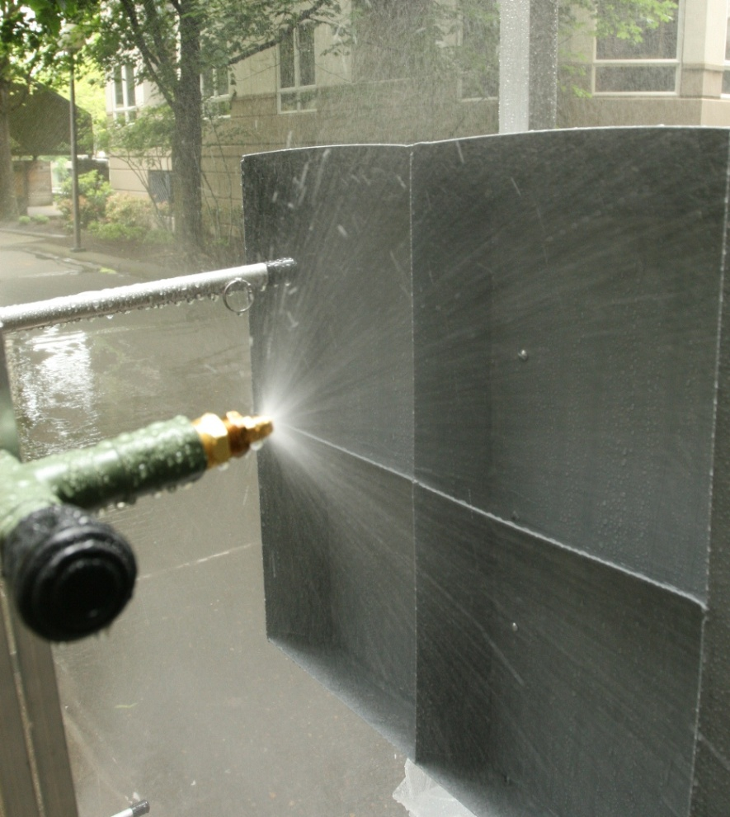
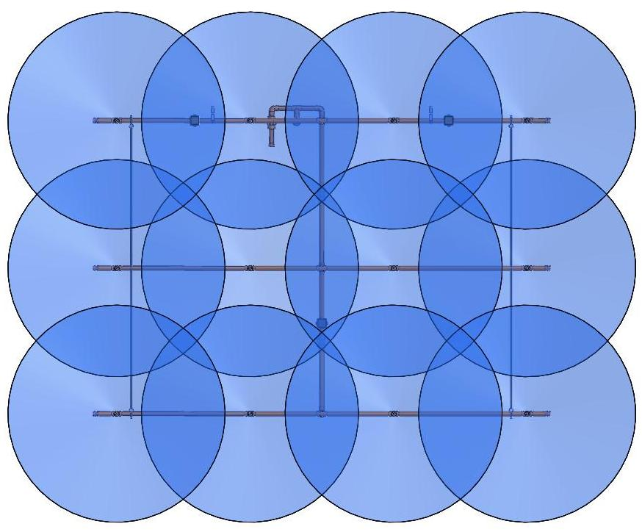
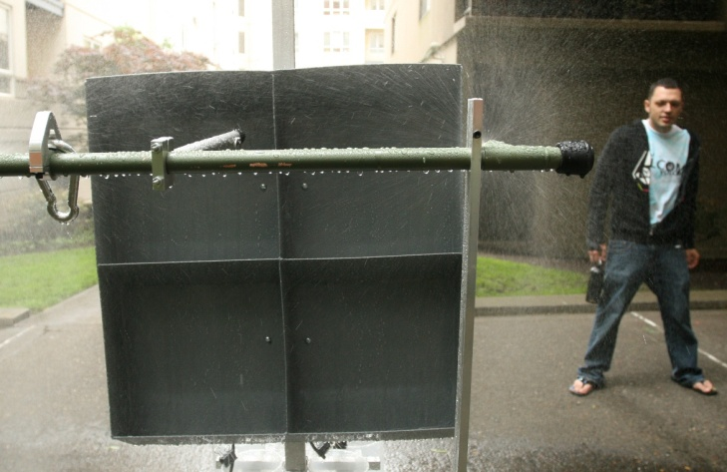

Slide 14
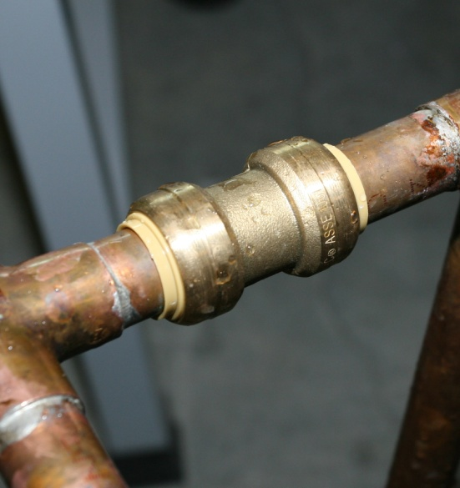
Final Spray Rack Design
Rack Can be Disassembled if Necessary
Shark Bites enable fast disassembly, and reliable connection for thousands of cycles
Fully disassembled, rack can be transported in small SUV type vehicle to site, and to test specimen

Slide 15
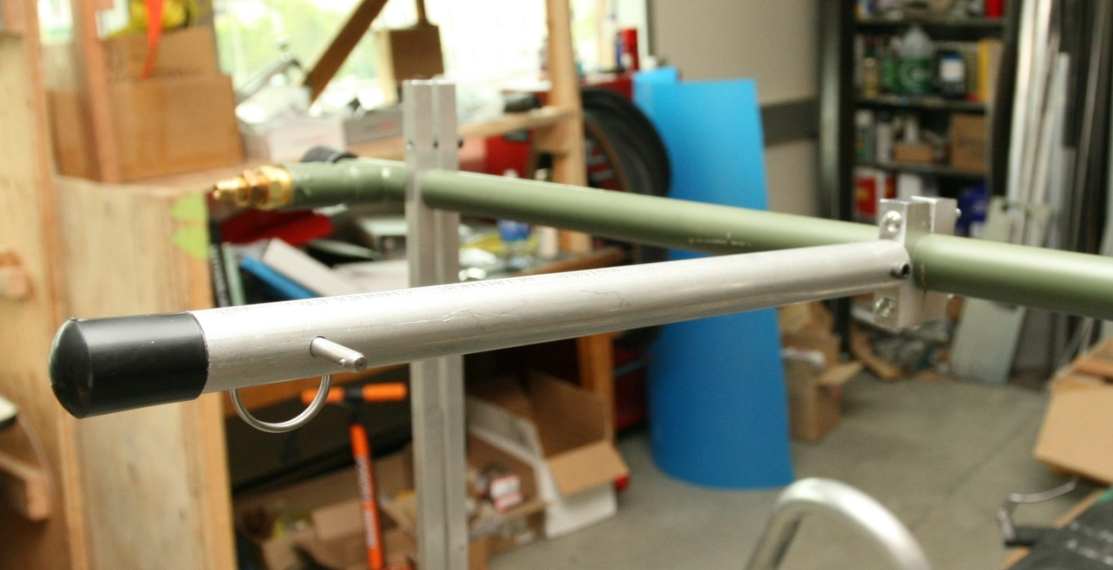
Final Spray Rack Design
Adjustable Wall Spacers
By increasing distance between the rack and the test specimen from 12 to 18 inches, spray coverage can be expanded from 6ft square to 8.5ft square.
- Can also be used for irregular wall shapes, i.e. recessed windows

Slide 16
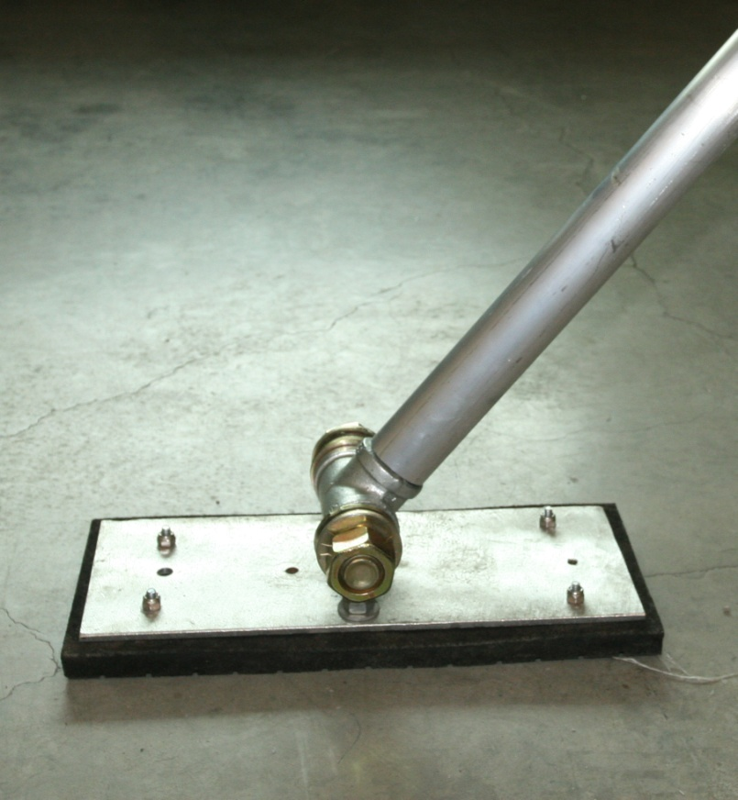
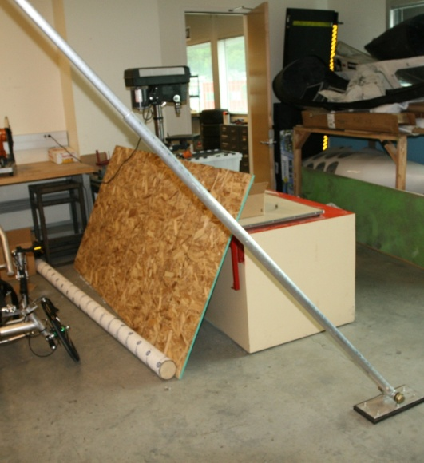
Final Spray Rack Design – Stand
Used for Mounting Rack
Telescoping
Hands free operation of rack when mounted
Rotating foot

Slide 17
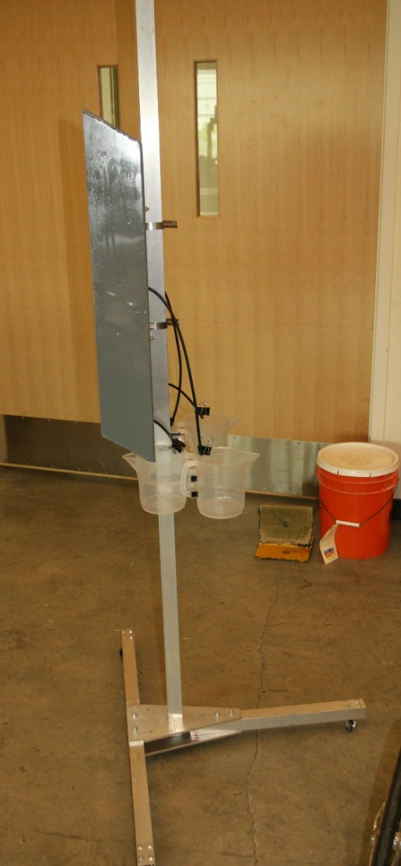
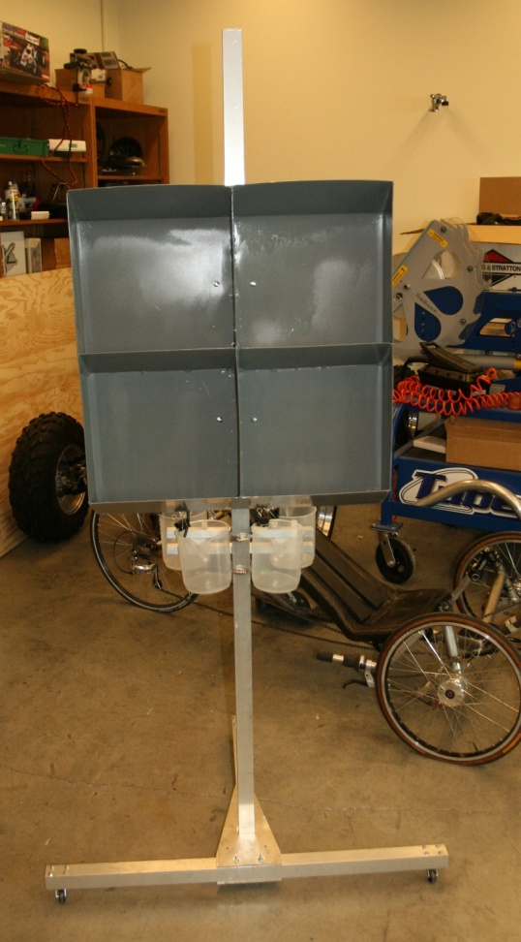
Final Calibration Box/Stand Design
Optimizations
Aluminum for corrosion resistance
- Box can be moved up and down beam to test different areas of rack
Can be disassembled
Graduated pitchers for collection and measuring of water volume
Wheeled stand for easy manipulation

Slide 18
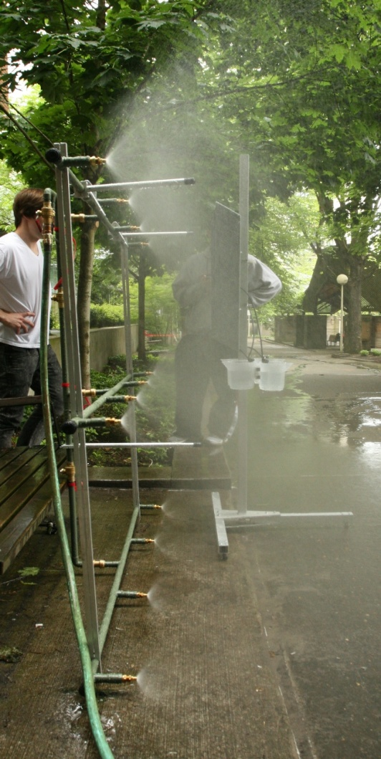
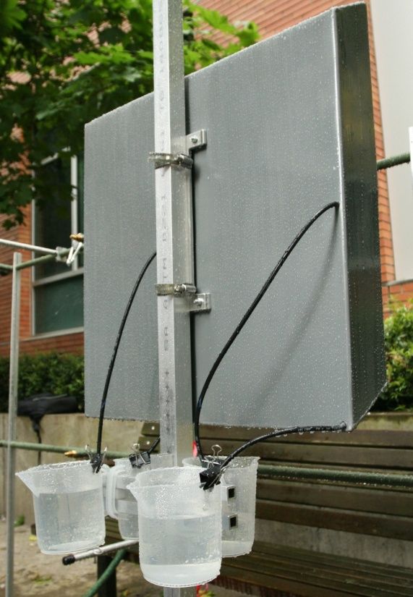
Testing, Proof of Concept
Testing Results
Flow rates range from 0.25-0.5L/(min*ft²), which falls within acceptable tolerance levels
Various locations of the rack were tested
Internal Pressure minimum of 25 psi needed to meet tolerances

Slide 19
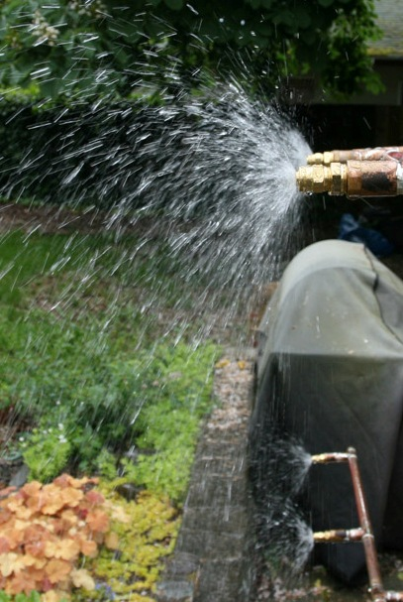
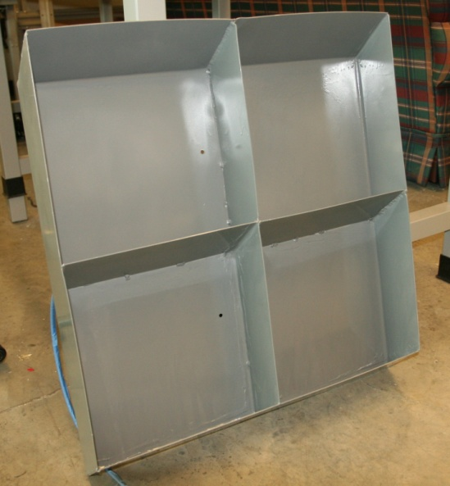
Errors, Unexpected Occurrences
A lot, but most notably:
- Overestimated available water pressure: orifice diameter too large on 1st attempt at nozzle selection
Did not allocate enough time or resources to have calibration box welded: box was not finished as originally planned.

Slide 20
Questions/Comments
?

