Slide 1
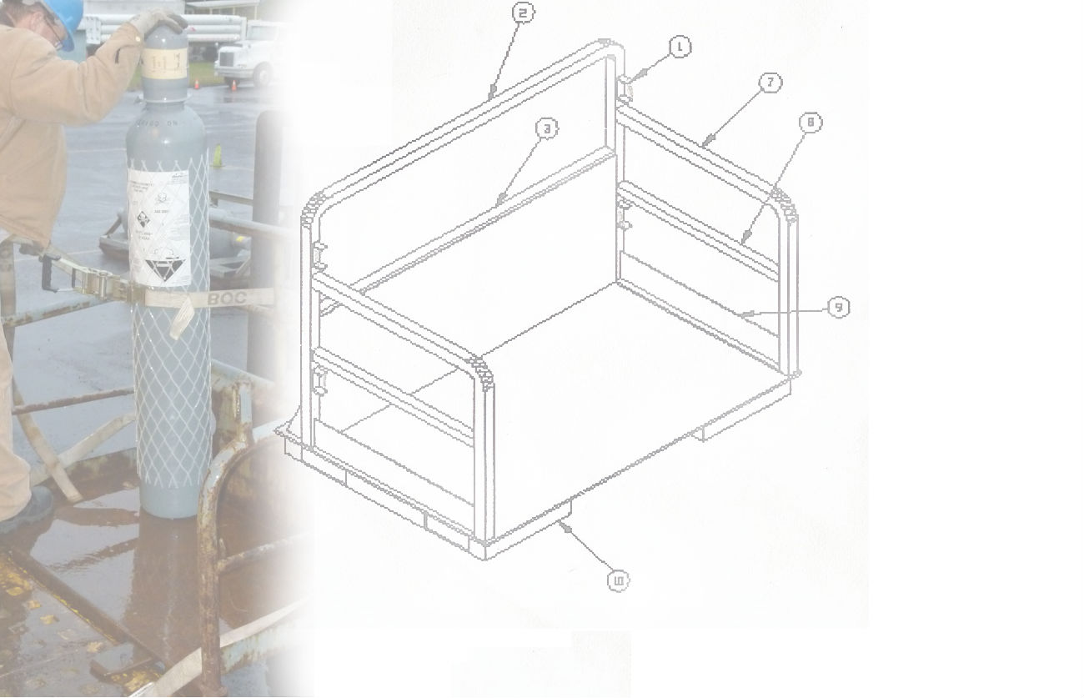
Pallet Design Project
2009-2010
Team Members:
Jon Dixon Matt Sacks Darrin Beam Nathan Murray

Slide 2
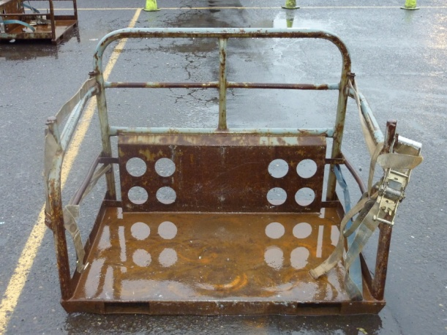
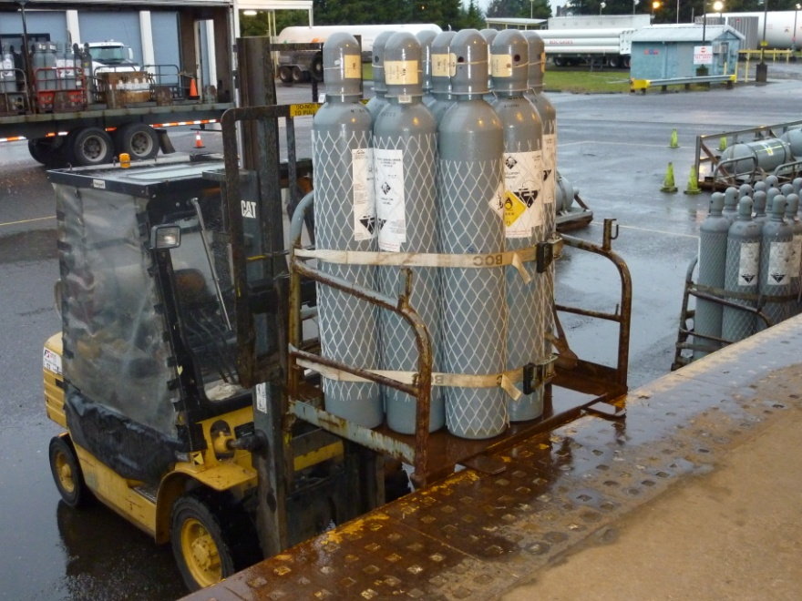
Project Overview
The Linde Group
  Industrial gas distributor
    Gases (HCl, Liquid Oxygen, etc)
Company Advisor
  Mike Dever, Operations Manager
Academic Advisor
  Chien Wern

Slide 3
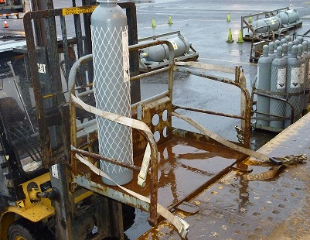
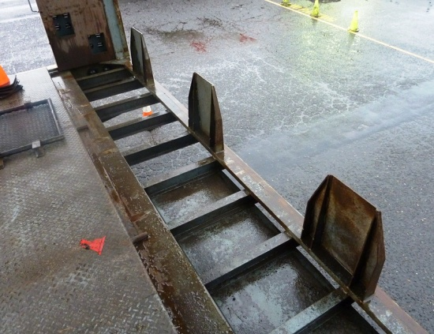
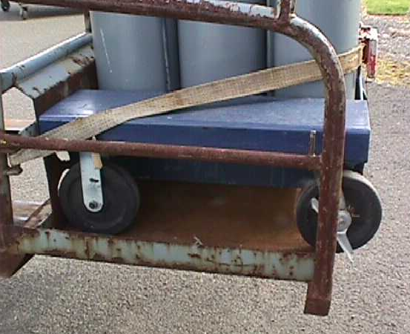
Product Design Specifications
  Pallet Design Specifications
  Reduce pallet weight from 200lbs
  Fit onto current freight trailers.
  Carries loose cylinders and cylinder manifold carts with payload up to 5000 lbs.
  Cost to remain similar to original
Pallet function with multiple loading and
Unloading configuration
Freight trailers are specially equipped with “spikes” for quick and easy loading
Trailer hold between 22 –24 pallets
Pallets must accommodate various loading configurations, one is a
cylinder manifold cart with high point loads

Slide 4
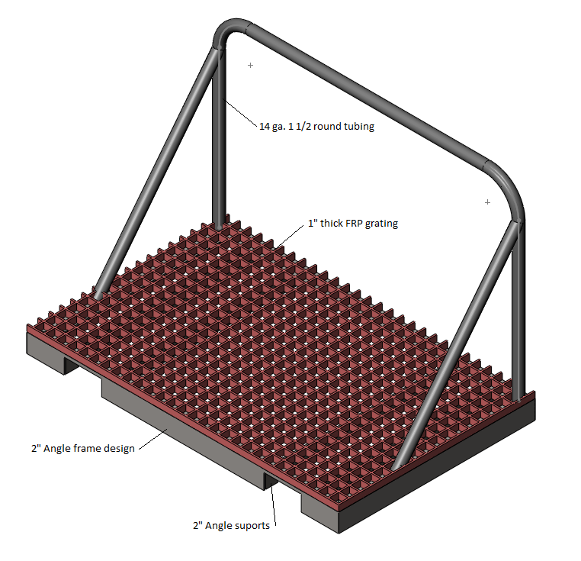
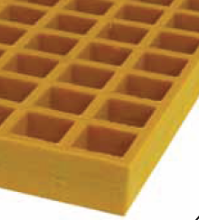

Prelimenary Designs
  Fiber Reinforced Plastic
    High Strength
    1” and 1 ½” Thicknesses
    Resistant to UV and Decay
    Typical Applications
      Platforms, Stairs
FRP platform application
FRP pallet design, included a steel base for support and round steel tubing upper frame

Slide 5
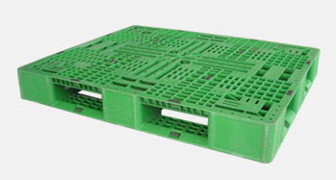
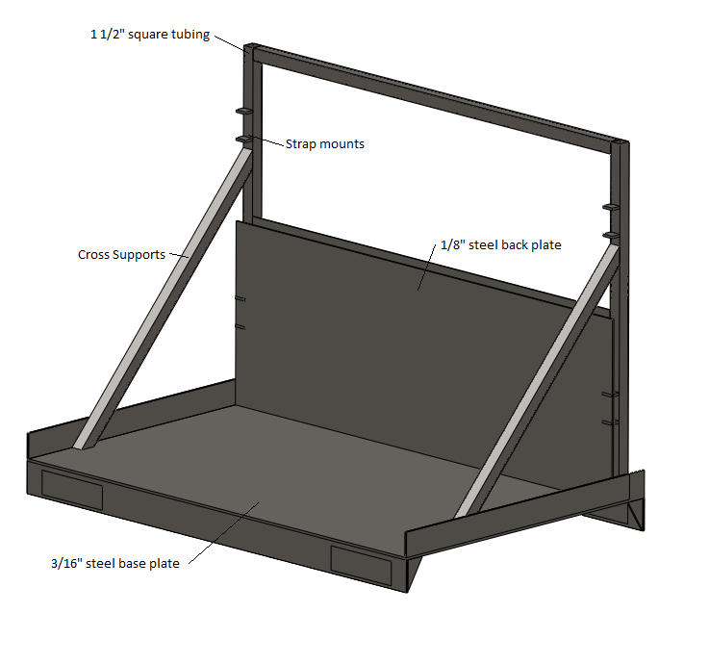
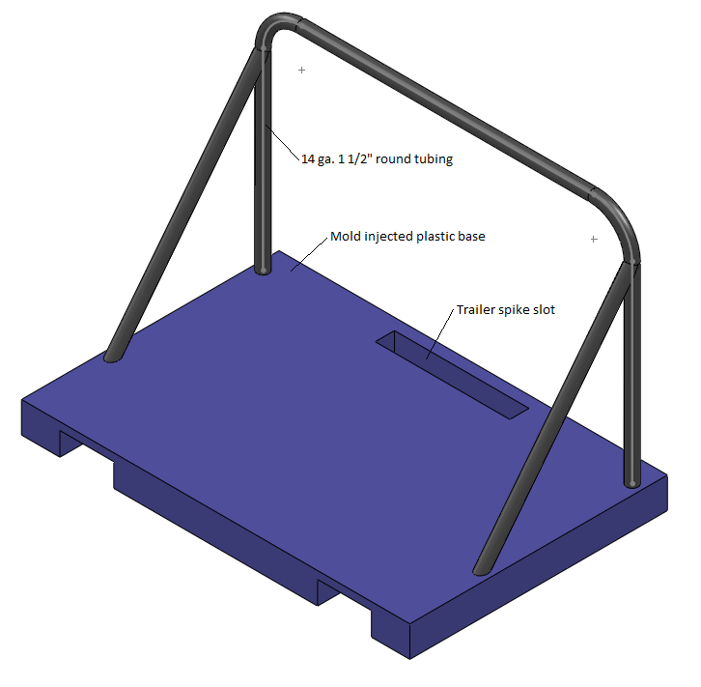
Prelimenary Designs
Mass produced mold Injected plastic pallet
Simple Steel Construction
Mold Injected Plastic Pallet

Slide 6
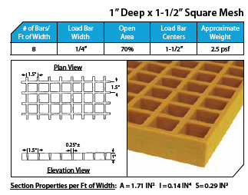
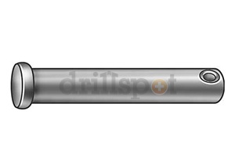
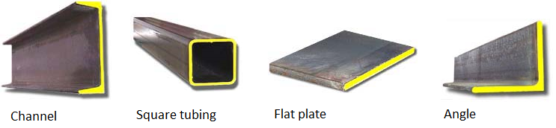
Research
Material
  Plywood
  Fiber-Reinforced Plastic
Strap mounting pins
  Type and Size
Steel Members
  Availability
  Costs
Pallet Paint
  Durability and Cost
Clevis Pin for strap attachment
Fiber-reinforced plastic grating
Structural steel material researched for selection on the pallet

Slide 7
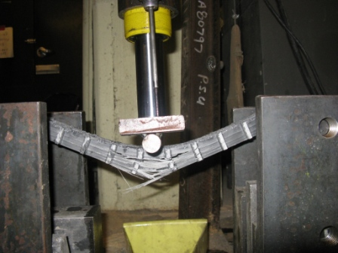
Research
3 Point Bend Test
  16” Span
  Max Load of 900 lbs
  6” Specimen Width
  Fiber-reinforced Plastic (FRP)
    Tested 1” and 1 ½” Thickness
    Failed Before Plywood
  ¾” Plywood
    Payload Greater than Fiber-Reinforced Plastic

Slide 8
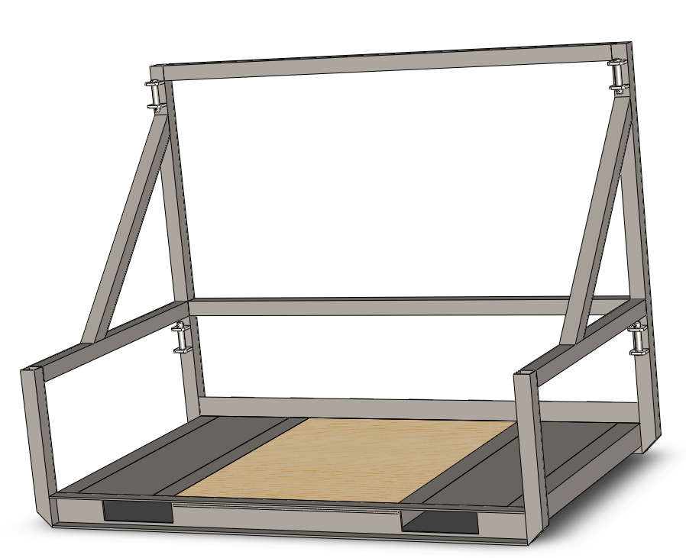
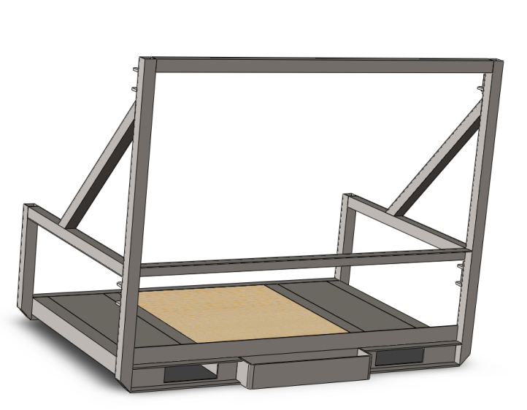
Final Design
Specifics:
  Composition of Preliminary Designs
  Steel Frame Construction
  Plywood Insert
  Modified Strapping Points with Larger Pins
  Reduced Side Rail Height
  Sprayed with a Durable Urethane Coating
Completed Pallet Assembly

Slide 9
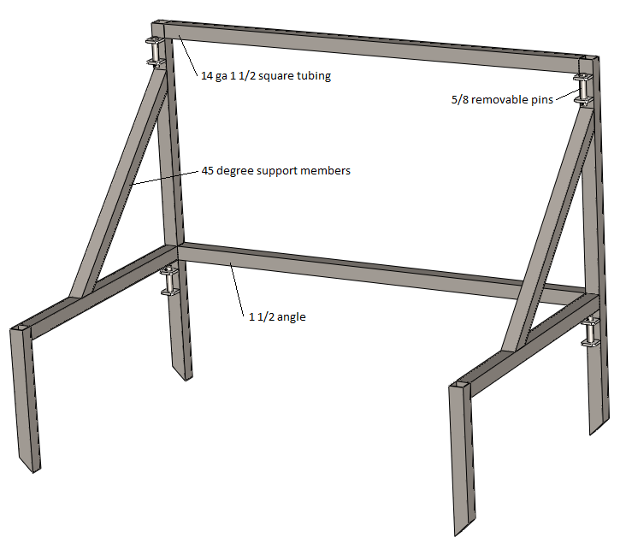
Final Design
Steel Frame
  1 ½” Square Tubing
  End Capped and Seal Welded
  45 and 90 Degree cuts
  Constructed Separately then Welded to the Base Assembly
  Members to be Capped and Seal Welded to Prevent Corrosion
Frame Assembly

Slide 10
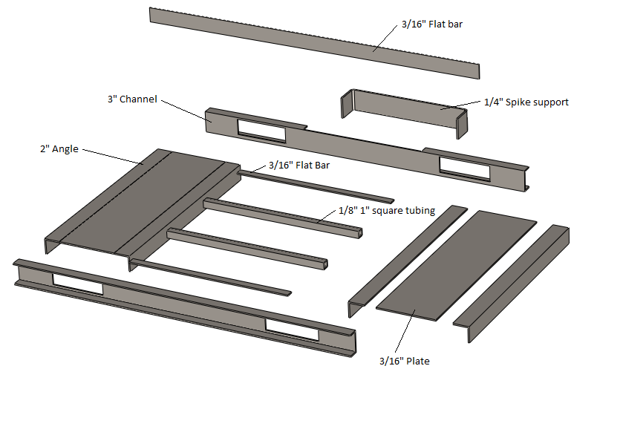
Final Design
Base Construction
    3” by 1 ½” Channel
    2” Angle
    Steel Plate
    All 3/16” Thickness
    1” Square Tubing Plywood Support
    Fork Spacing, Spike Slot, and Deck Height Dimensions Same as the Original
Exploded View of the Base Assembly

Slide 11
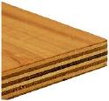
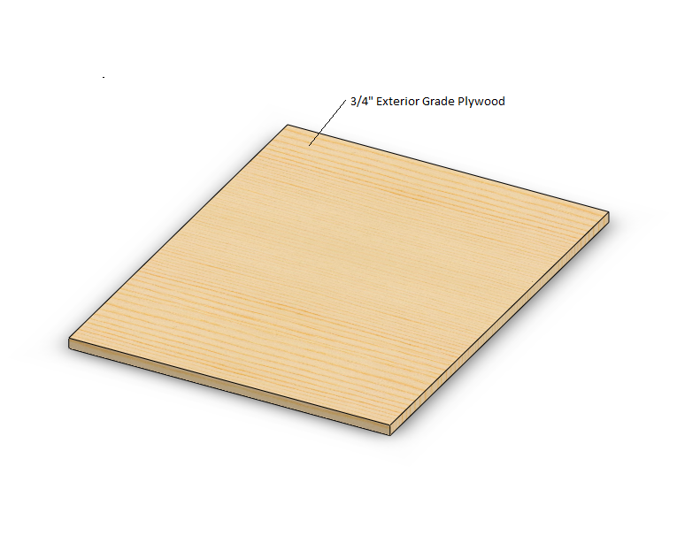
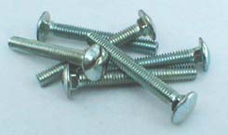
Final Design
Plywood Insert
  Exterior Grade
  ¾” Thickness
  Attached With 3/8” Carriage Bolts
  Easily Replaceable

Slide 12
Verification Methods
Criteria | Method of Verification
Weight Reduction | SolidWorks Mass Properties
 | Weigh Pallet Prototype
Cost -- Comparable to Original | Cost Analysis
 | Estimate from Fabrication Facility
Same Method of Attachment | Slot Dimensions Remain Unchanged
 | Load and Unload Pallet from Freight Trailer
Simplicity of Construction | Actual Fabrication Time
 | Estimate from Fabrication Facility
Must Hold Cylinders Securely | Various Member/Component Calculations
 | Physical Testing of a Loaded Pallet
Fit and Function | Comparison with Original Pallet
 | Key Dimensions Remain Unchanged

Slide 13
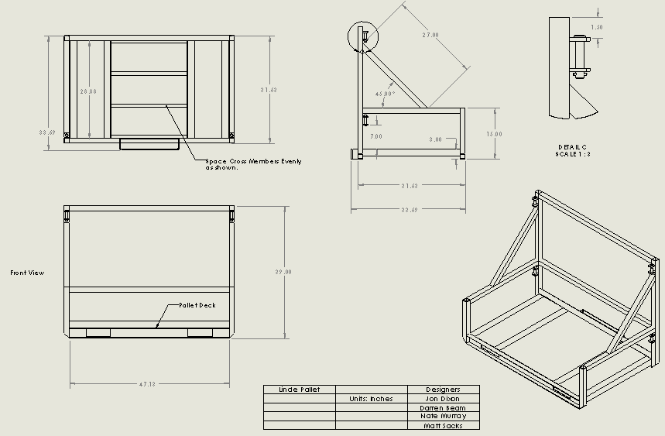
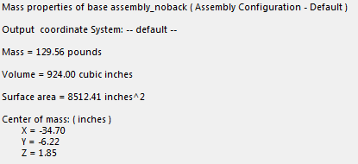
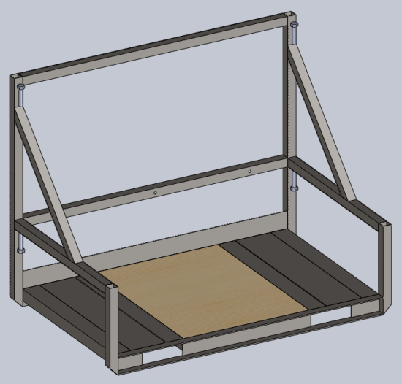
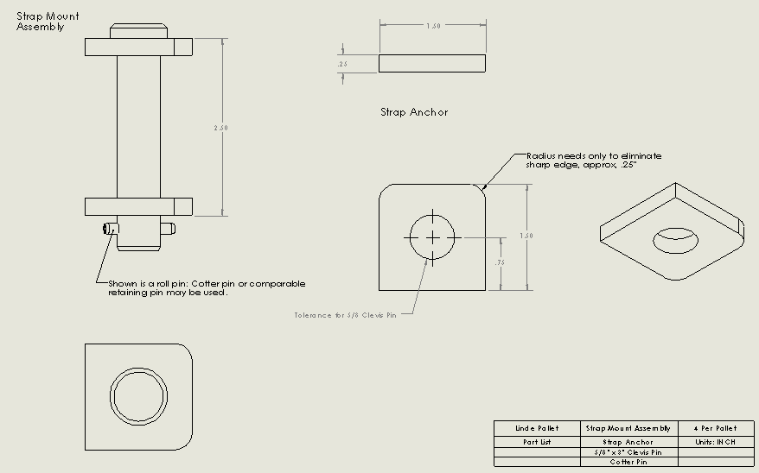
Evaluation
  SolidWorks
    Design
    Evaluate Mass Properties
    Part and Assembly Drawings
    Bill of Materials
    Reference

Slide 14
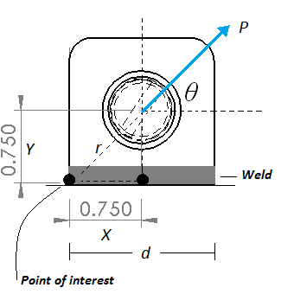
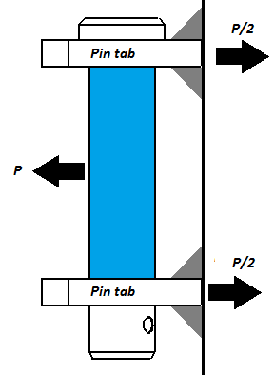
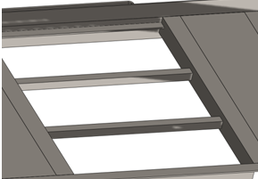
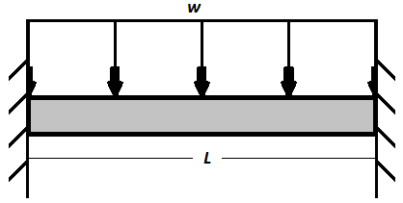
Calculations
  Pins and Pin Tabs
    Pin Shear
    Weld Stress
  Metal plate
  Plywood Span
  Plywood- supports
  Frame members

Slide 15
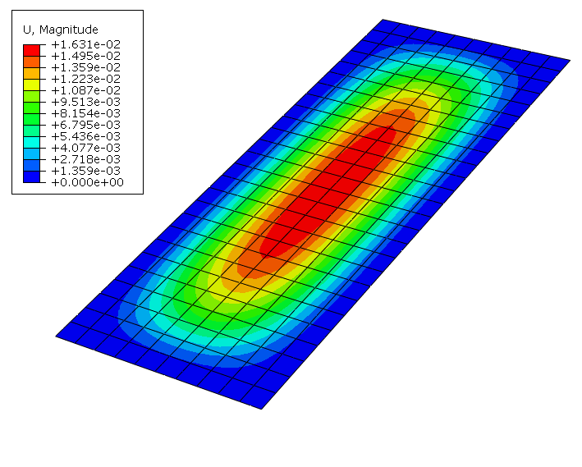
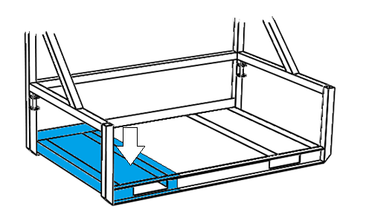
Finite Element Analysis
  Shell modeling with Abaqus
  Initial Analysis
    Clamped plate
    Similar dimensions to pallet
    Uniform load – 2000 lb
    Abaqus: Deflection of .0163 inches
    Plate calculations (eFunda.com): Deflection of .0158 inches

Slide 16
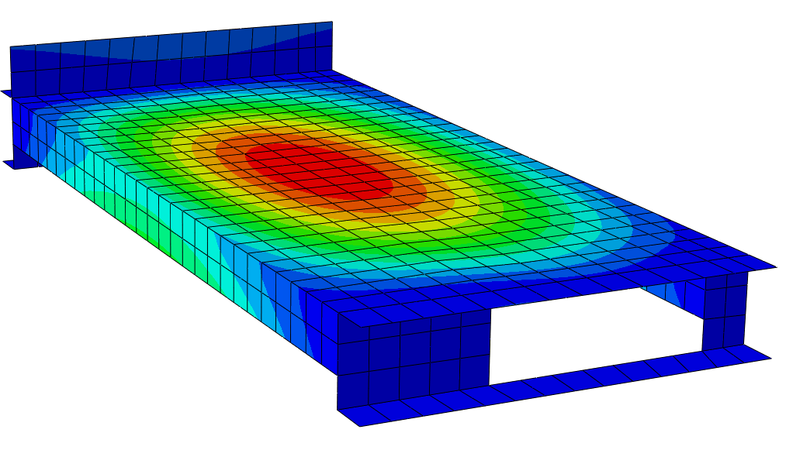
Finite Element Analysis
    Fully loaded pallet of cylinders
    Uniform pressure of 2000 lbs – downward.
    Maximum deflection of .0536 inches (red area)
    Maximum stress of 35,530 psi

Slide 17
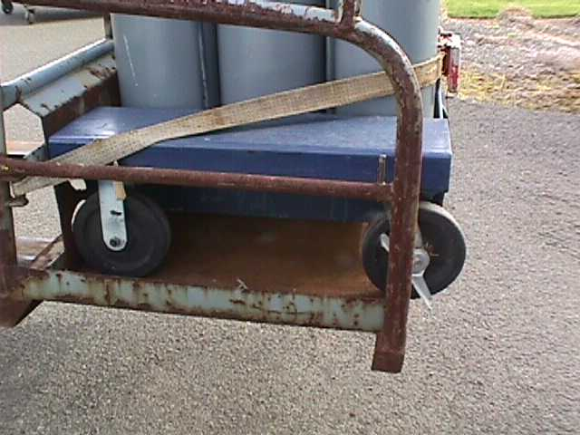
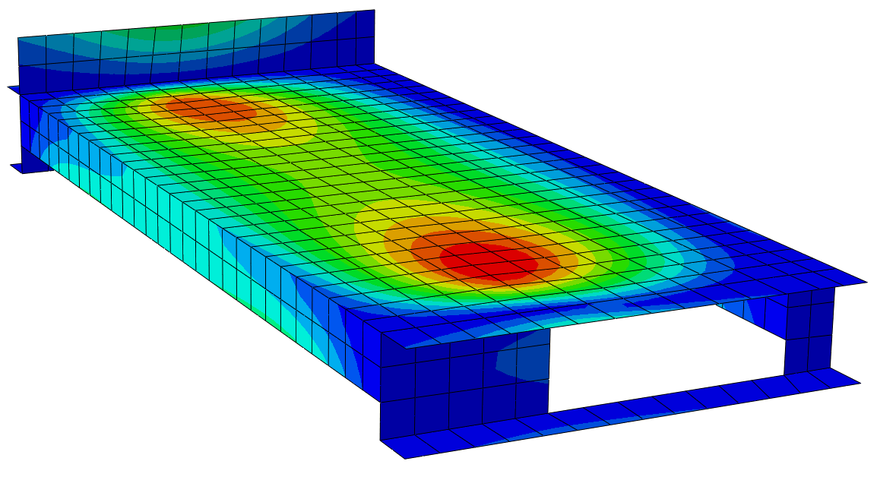
Finite Element Analysis
    Loading Cart
    500 lb point loads - each wheel
    Maximum deflection of .02 inches

Slide 18
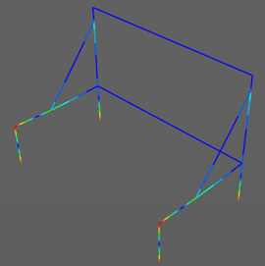
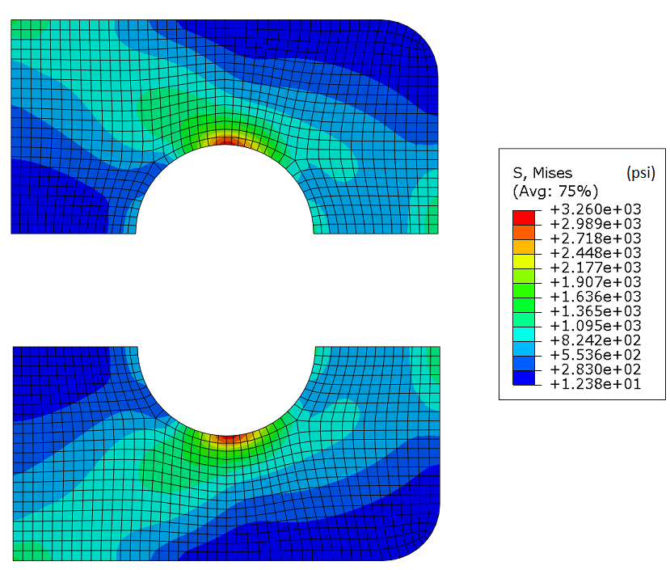
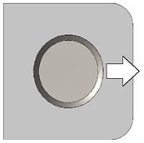
Finite Element Analysis
    Additional:
    Pin Tab and Frame Stress

Slide 19
Conclusion
Objective
  Cost
  Weight
Unexpected
  Deck height restriction
    Greater communication and understanding with customer

Slide 20
Questions?

