Slide 1
PORTLAND STATE UNIVERSITY
Maseeh College of Engineering and Computer Science Mechanical and Materials Engineering Department
2010 HUMAN POWERED VEHICLE
Final Presentation June 4th, 2010
2010 PSU-HPV RACE TEAM
MATT BRADLEY CHRIS HINOJOSA CAM LONG JESSE MCCORMACK BON UNG TAD BAMFORD LUAREN SHUMAKER
PSU FACULTY ADVISORS
DEREK TRETHEWAY, PhD FARYAR ETESAMI, PhD

Slide 2
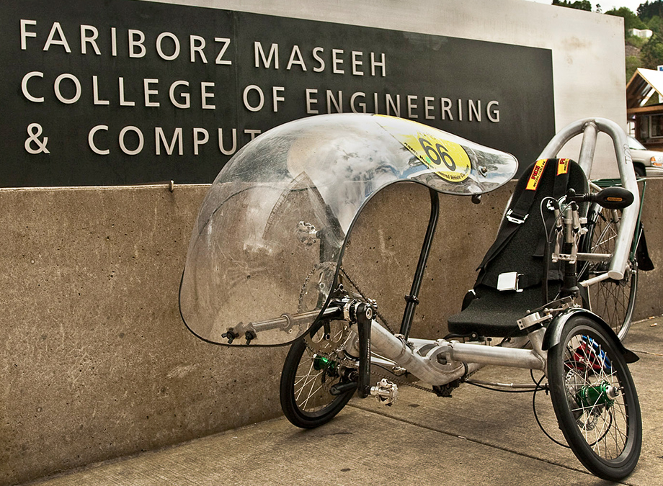
Motivation
Promote human transportation
Attract the attention of local community
Win the ASME HPVC
Make a vehicle that is…
  suited for everyday commuting
  intuitive
  one handed control
  comfortable
  aerodynamic
  safe to ride in traffic
Notes:
Once we had sufficient motivation we were ready for some brainstorming!

Slide 3
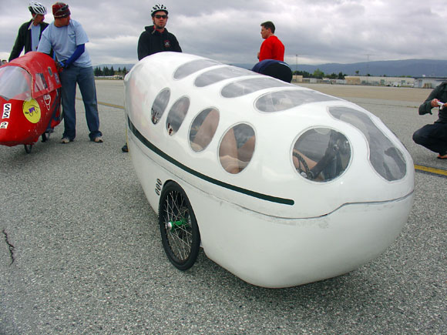
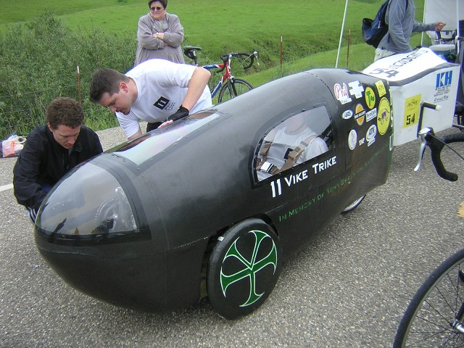
Design Process
Critiquing previous PSU entries
  Riding of previous prototypes
  HPV enthusiasts’ opinions
  Interviewing past teams
Top Level Considerations
  2 or 3-wheeled
Brainstorming designs
  3-D modeling
  Decision matrices
Vike Trike II
Vike Trike I
Notes:
We narrowed down our options with decision matrices and began analysis on these subsystems.

Slide 4
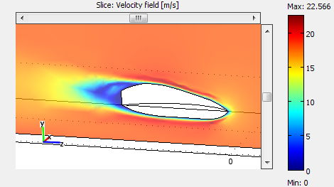
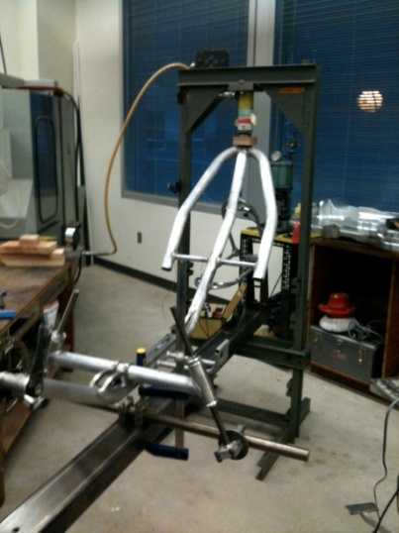
Design Process (cont.)
Analysis
  CFD modeling of fairing shapes
  FEA models of frame
Testing
  Material testing
  Frame stiffness
  Roll bar integrity
Notes:
I’m getting ahead of myself, I’ve started talking about how we tested the bike before I’ve told you how we built it.

Slide 5
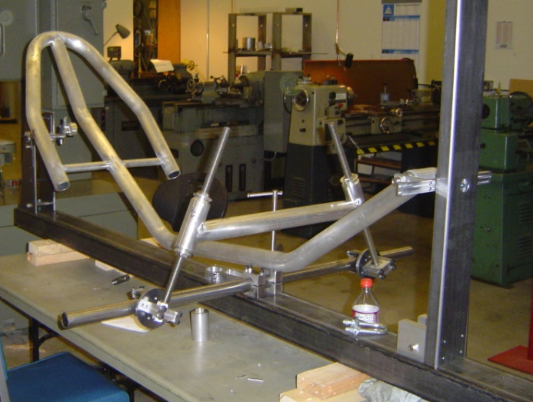
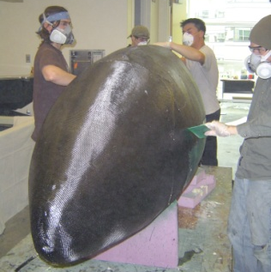
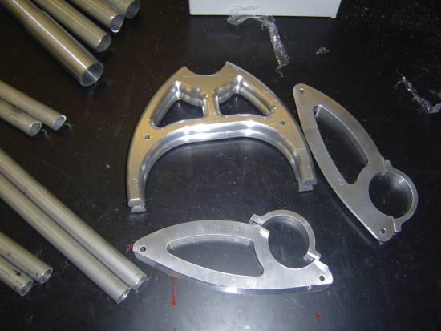
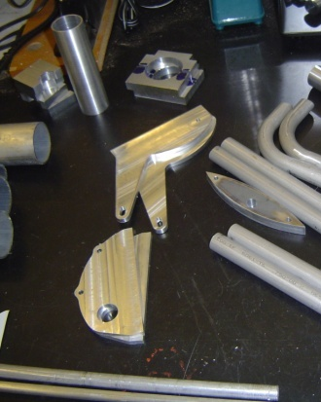
Manufacturing
Modular and adjustable frame jig
Custom components in-house
  +20 parts on Prototrak CNC
Fairing
  Formed mold
  CF lay-up
  Pressure cured
Notes:
Once we had the parts and frame secured on the jig we had it welded, heat treated. We took the bike, built it up, and were ready to tweak every aspect of the bike.

Slide 6
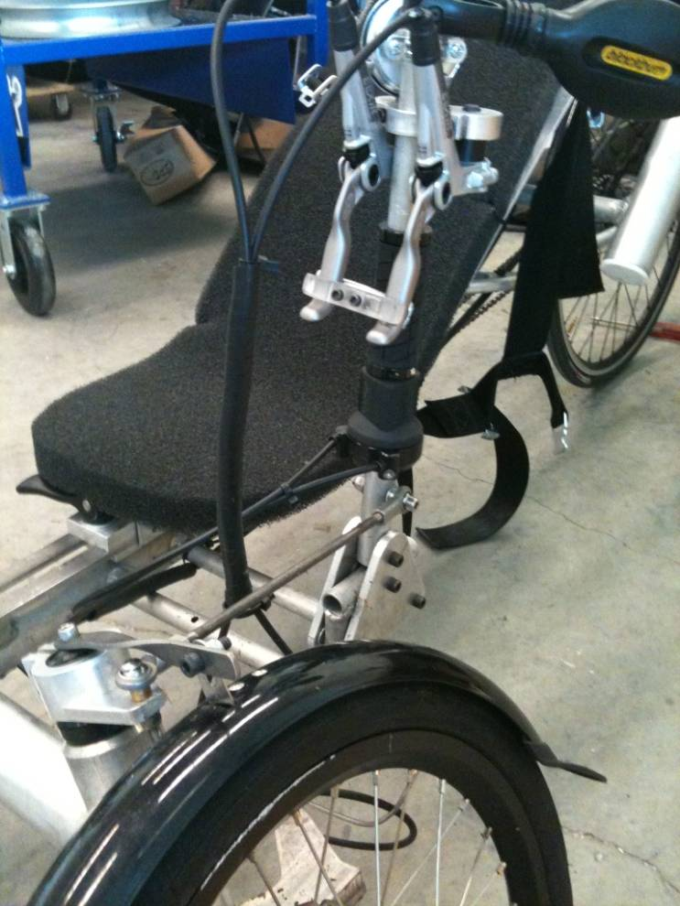
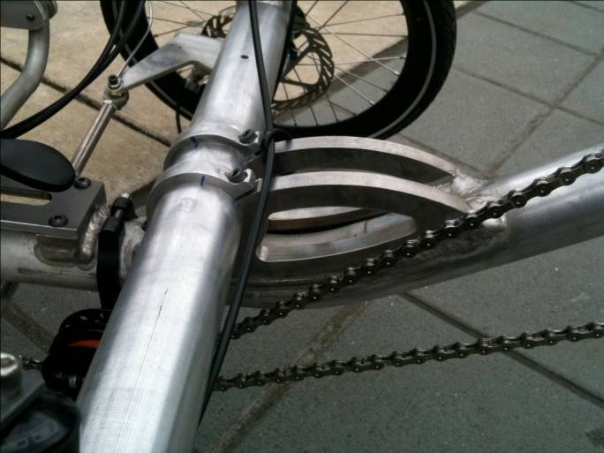
Optimization
  Adjustable steering angles
  Reinforced steering mechanism
  Brake levers coupled
Notes:
Before we finish up I just want to run over some key design features of the bike.

Slide 7
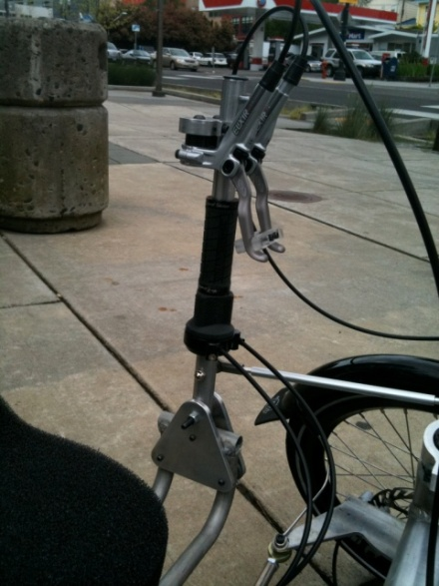
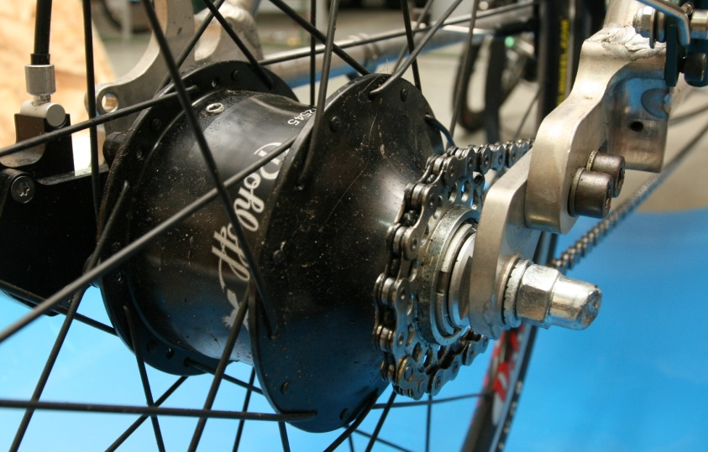
Key Design Features
One-handed controls
Internally geared hub
Simple chain routing

Slide 8
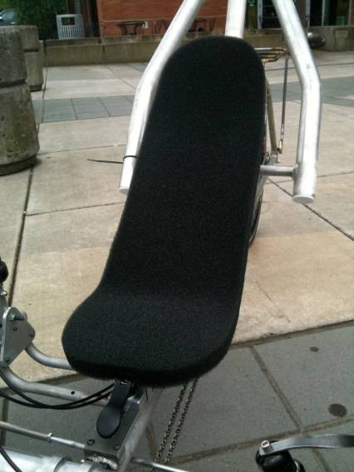
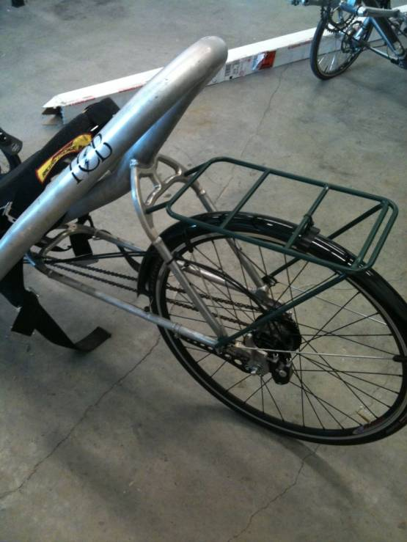
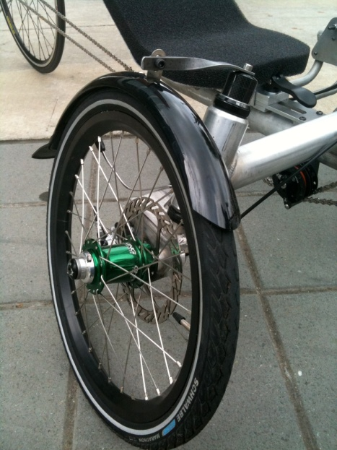
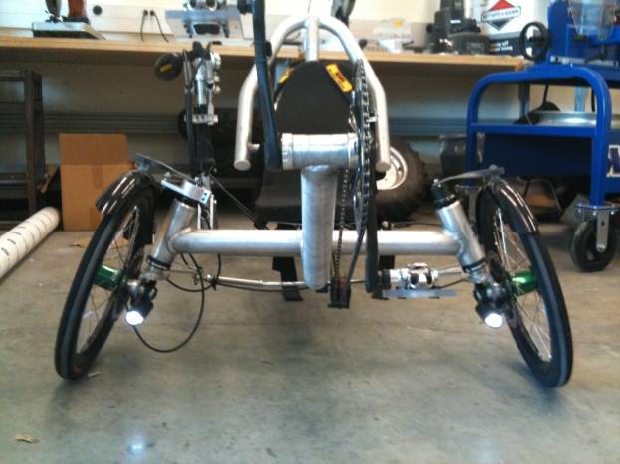
Key Design Features
Adjustable foam seat
Custom utility rack
Full fenders
Head/tail lights
Notes:
Last but not least, the results of blood, sweat, and tears!

Slide 9
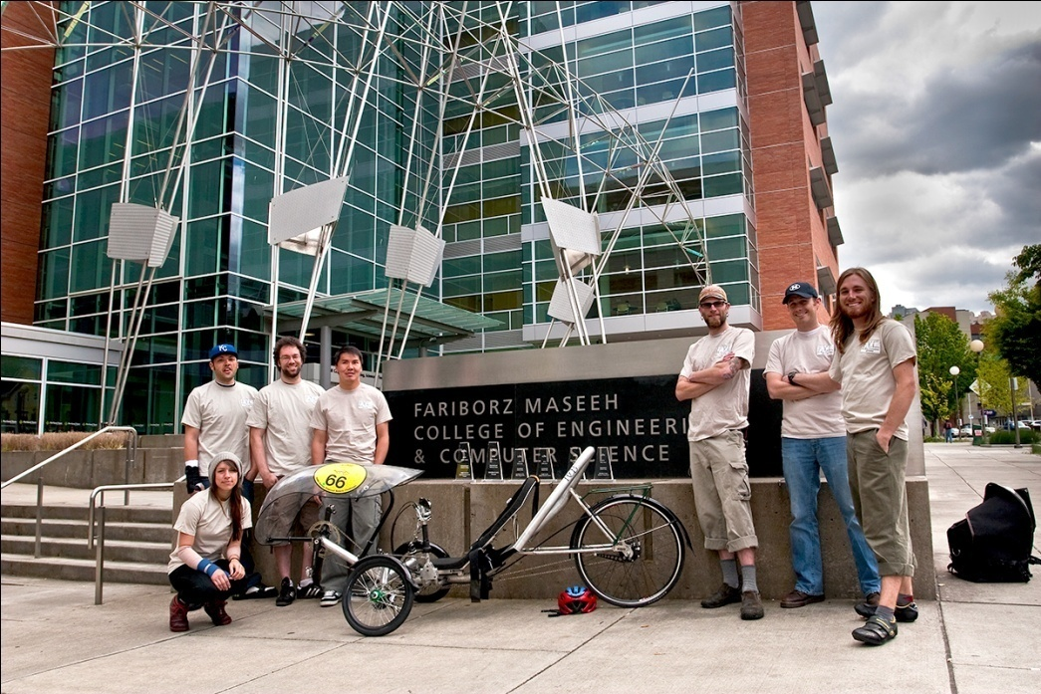
Results
ASME HPVC 2010
Second Place Overall
First Place in the Speed Endurance Event
Second Place in the Women's Drag Race
Second Place in the Men's Drag Race
Third Place in the Utility Endurance Event
Third Place in the Design Event
Team members and six trophies around the winning vehicle
50+ riding hours with no mechanical failures!
Notes:
100+ hours and No mechanical failures!

Slide 10
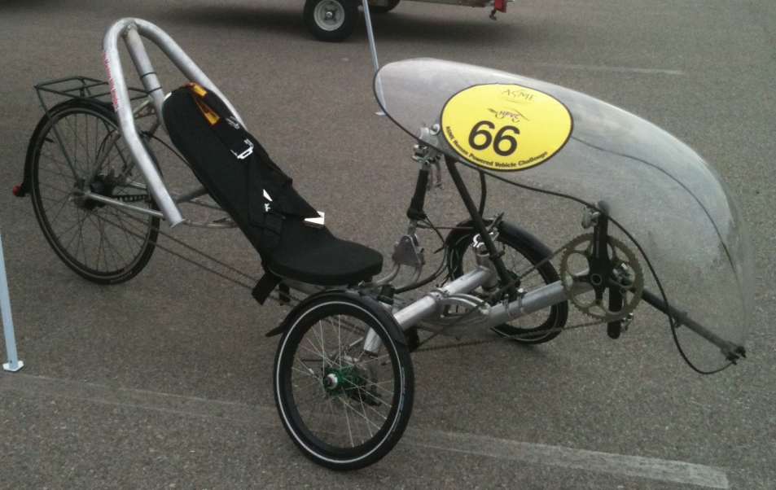
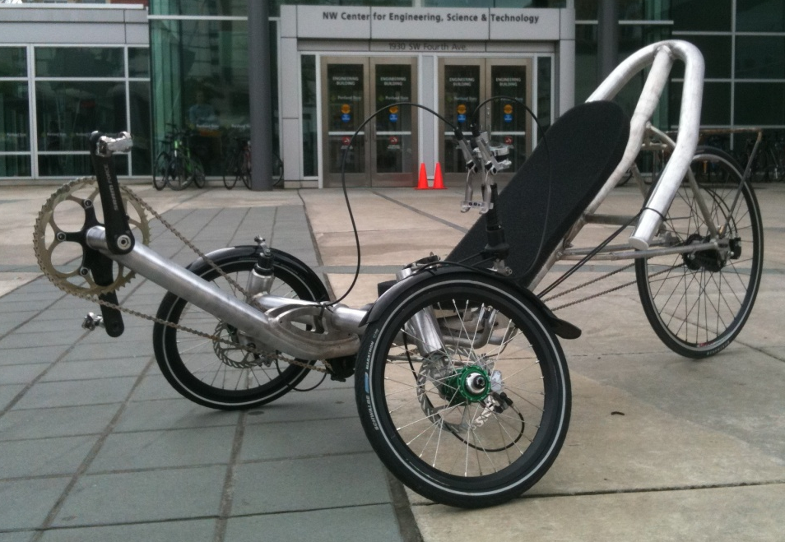
Questions?

Slide 11
Lessons Learned
  Stiffen fairing mold
  Design for manufacture
  The benefits of modular design
  Prototype vs. production model
Notes:
Symmetric parts
Adjustability vs. limiting DOF

Slide 12
PDS
Priorities: High = uuu Medium = uu Low = u
Priority | Requirement | Customer | Metric | Target | Target Basis | Verification
Performance
uuu | Top speed | Self | ft/s | >51.3 | Numerical Model | Physical testing
uuu | Avg Acceleration | Self | ft/s^2 | >0.855 | Numerical Model | Physical testing
uuu | Drag race Time | Self | s | <60 | Competition research | Drag Race
uuu | Weight (total) | Self | lbs | <40 | Acceleration | Physical testing
uu | Aerodynamics | Self | Cd | <0.1 | Research | Wind tunnel
uu | Turning Radius | ASME | ft | <25 | 2010 HPVC rules | Physical testing
uu | Steering Accuracy | ASME | degrees/100 ft | 0 | 2010 HPVC rules | Physical testing
uu | Frame Stiffness | Self | in | <0.5 | Efficiency | Design Analysis
uu | Braking | ASME | ft, stopping from 15mph | <20 | 2010 HPVC rules | Physical testing
u | Crash Recovery | Self | s | <15 | Competition research | Physical testing
u | Drive Train Geo. | Self | degrees | <25 | Efficiency | Design Analysis
Safety
uuu | Visibility (horizontal) | ASME | degrees | >180 | 2010 HPVC rules | Design analysis
uuu | RPS top load* | ASME | PSI/in | <Yield/<2 | 2010 HPVC rules | Design analysis
uuu | RPS side load* | ASME | PSI/in | <Yield/<1 | 2010 HPVC rules | Design analysis
uuu | Free from sharp edges | ASME | Pass/fail | pass | 2010 HPVC rules | Physical testing
uuu | Restraint Harness | ASME | pass/fail | pass | 2010 HPVC rules | Physical testing
uu | Frame Strength | Self | FOS | >1.5 | Student Engineers | Design analysis
uu | Visibility (vertical) | ASME | degrees | >60 | 2010 HPVC rules | Design analysis
uu | Seat Rail Slide Restraint | Self | lbs | >750 | Safety/Performance | Physical testing
u | Steering Limiters | Self | Pass/fail | pass | Controllability | Physical testing

Slide 13
PDS
Cost
uu | Budget Limitations | Self | dollar | <3113 | PSU available dollars | Accounting
u | Market Costs | Self | dollar | <3500 | Market Research | Market Research
Ergonomics
uuu | Entry and Exit | Self | s | <20 | Competition | Physical Testing
uu | Ventilation | Self | cfm |  | Rider preference | Design analysis
uu | Rider Position | Self | degrees | 135+/-5 | Efficiency | Physical Testing
u | Rider Comfort (padding) | Self | in | >1 | Rider preference | Physical Testing
Documents
uuu | PDS | PSU ME Dept | deadline | 8-Feb | Class syllabus | Submittal
uuu | Progress Report | PSU ME Dept | deadline | 8-Mar | Class syllabus | Submittal
uuu | Final Report | PSU ME Dept | deadline | june ? | Class syllabus | Submittal
uuu | 2010 HPVC Report | ASME | deadline | 19-Mar | 2010 HPVC rules | Submittal
Materials
uuu | Structure | Self | yes/no | yes | Ease of use | Design analysis
uuu | Drive train | Self | yes/no | yes | Ease of use | Design analysis
uu | Aesthetics | Self | points | 10 | Competition | Judges
Maintenance
uu | Reliability | Self | chain drops | 0 | Competition | Physical testing
u | Life in Service | Self | years | 1 | HPV Market | Design analysis
u | Tool Requirements | Self | common bike tool sizes | 100% | Ease of use | Market requirements
u | Replacement Components | Self | Bike parts, percentage | 100% | Commercial Market | Retail

Slide 14
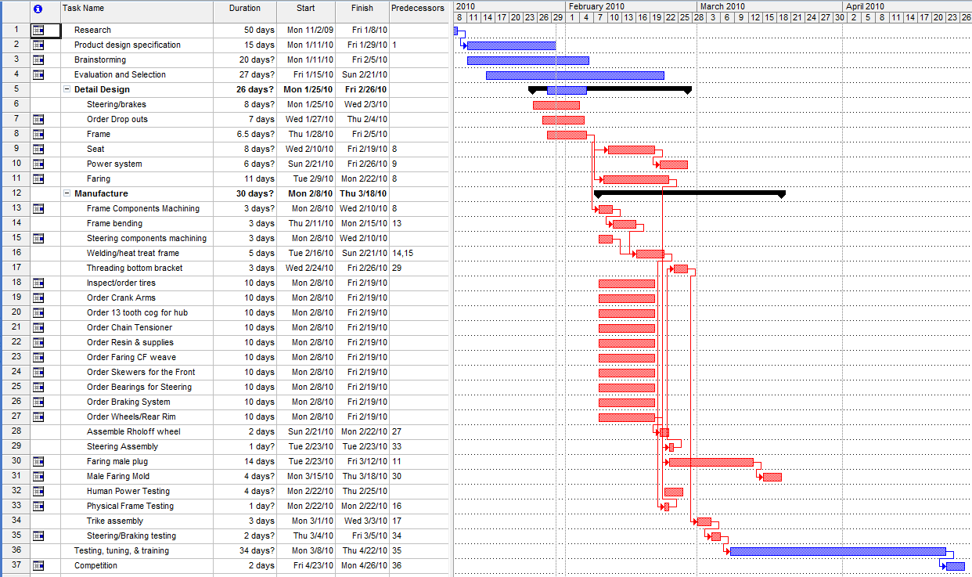
Gantt Chart

