Slide 1
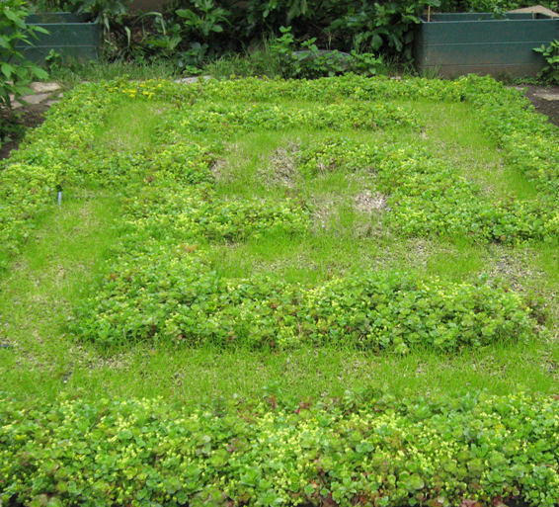
Final Presentation
Green Roof Test Module (GRTM)
Team Members:
  Amanda Pierce
  Jay Kamani
  Seth Moody
  Curtis BrandSmith
  Nicolas Johnson
Sponsors:
  CH2MHILL
  Oregon Pacific Development
  Columbia Green
  WDY Structural Engineers
  Pro-Gro
Advisor:
  Dr. David J. Sailor

Slide 2
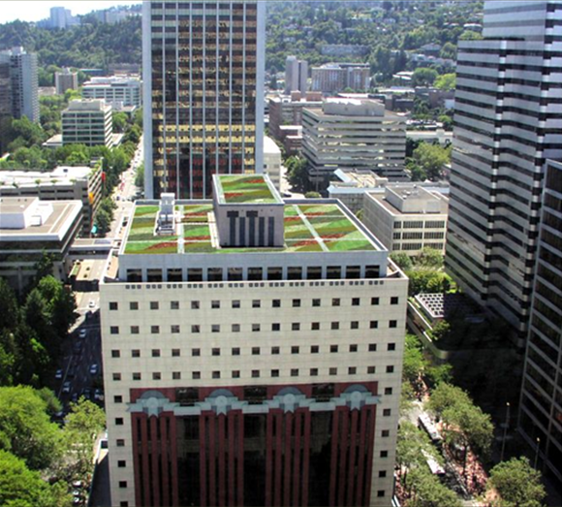
Project Overview
Objective 1: Design Optimized Green Roof
Objective 2: Design Mobile Monitoring System
Notes:
Design Optimized Green Roof – We are engineering the components of this green roof to fit certain design constraints. We will then be monitoring and testing this green roof through the use of an instrumentation package to make the proper measurements to ensure the green roofs performance. Once the project is complete, the hope is that the mobile green roof test module will be useful to the university and companies for getting site-specific data on green roof performance.

Slide 3

The Design Criteria
Insulation
Water Retention
Temperature Reduction
Notes:
INSULATION PROPERTIES – The addition of soil and plants to a roof will have some insulating effect, which will benefit building energy consumption. We attempted to quantify this as an effective “R-value” the standard used to measure the insulation of a material. Although “effective” R-value is a complicated concept and may vary on each day and season, our main concern was the Winter R-Value which we would like to be R-13.
WATER RETENTION – Rooftop water runoff is a problem in high density cities that receive large amounts of rainfall, Portland is one of these cities and green roofs can do a good job of absorbing some of that rainfall. As one of our main design characteristics we would like to reduce overall runoff of our test roof by 60% of what it would otherwise be.
TEMPERATURE REDUCTION – Typical ballast roofs which a green roof system might replace can reach temperatures of more than 150 F in the summer whereas a green roof might reach 100 or so F on a similar day, by reducing the overall roof temperature in the summer it would lessen the cooling load on the building and provide cooler air for rooftop machinery increasing their efficiencies.

Slide 4
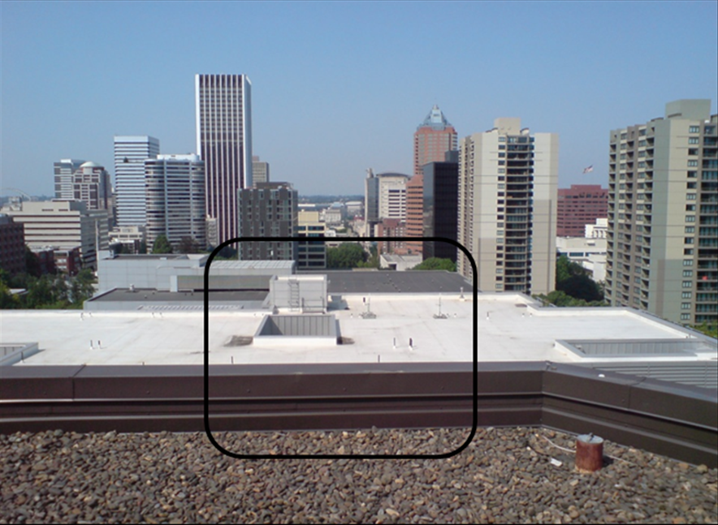
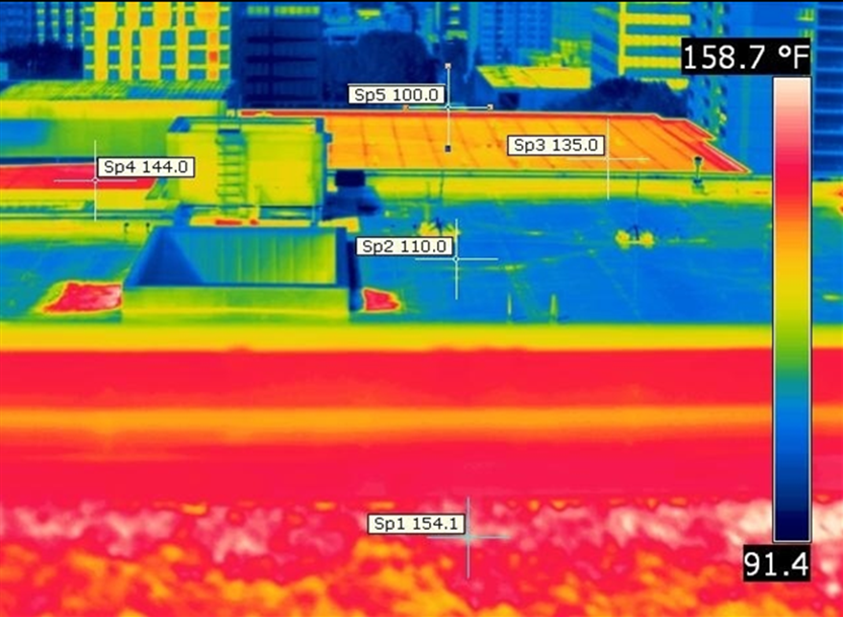
Notes:
Slide detailing the importance of temperature difference and how much it can vary from a typical ballast roof to a white roof and a green roof.
Thermal comparison, ambient air temperature at 98˚F of 4 different roof treatments.
Sp1 (CH2M Hill Center) = Low Albedo (<.10) typical washed rock ballast as roof membrane cover.
Sp2 (PSU Engineering Building) = High Albedo (.75) white roof.
Sp3 (City Development Center) = Low Albedo (.10 est.) dark roof, NE exposure.
Sp4 (City Development Center) = Low Albedo (. 10 est.) dark roof SW exposure.
Sp5 (Cyan Building) = High Albedo (.75) 1 month old green roof ( Low LAI, essentially bare GR soil)
Primary temperature differences are due to Albedo (reflectance), heat storage capacity, conductivity of materials and moisture content, which boosts evapo-transpirative cooling effect of plants and soil.

Slide 5
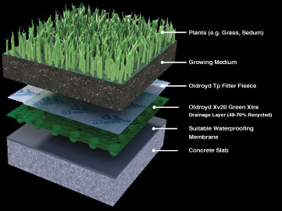
Insulation - Effective R-Value
R-Value Variation
  Sun
  Humidity
  Soil Moisture
Other Effects
  Radiation
  Convection
  Evaporative Cooling
Notes:
We chose to evaluate the insulation properties of our green roof with an effective R-Value. This has problems because the R-Value of a plant/soil system will change widely with exposure to direct sunlight, as heat is transferred into the soil the R-Value may go to infinity, with moisture and humidity as the soil’s conduction increases the R-value will decrease. So our effective R-Value tries to take into account these changes throughout the day and gives an average value.
Some other important aspects of the roof that are important to consider are the effects of radiation, acting as a shield from direct sunlight on the roof, the convective temperature differences, and the cooling benefits provided by the moisture being released by the plants and soil during the warmer parts of the day. To analyze these sorts of behaivors is beyond the scope of this project, but it’s important to acknowledge that they do have a role in a green roof system.

Slide 6
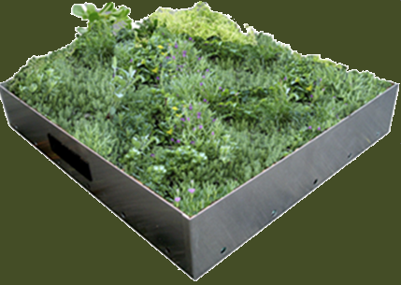
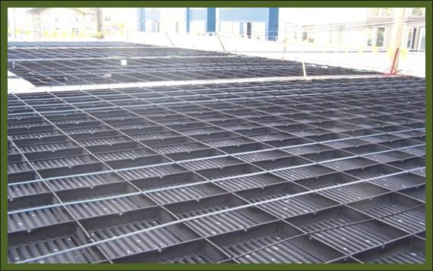

Objective 1: Green Roof Design
Green Roof Design
  Plants
  Soil
  Trays
Notes:
To meet the 1st goal the green roof system:
The green roof had an additional layer of insulation and 4 inches of soil to increase the R value.
Sedums were used to absorb excess water reducing the amount of storm water run off from the system.
Rye grass was used to increase the R value of the system using Evapotranspiration.

Slide 7
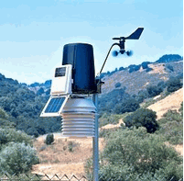
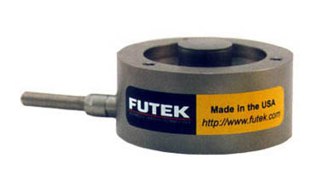
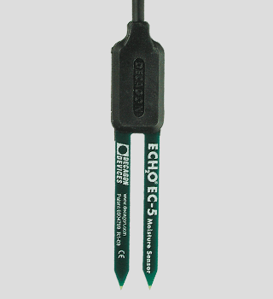
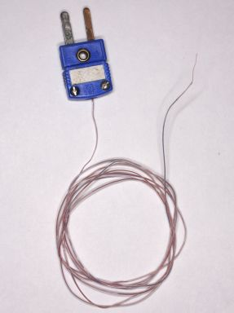
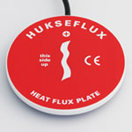
Objective 2: Instrumentation
Test Module
Precipitation , Soil Moisture & Water in/out
Davis Weather Station
Mass Balance System
Measure Temperature Difference and Heat Flux
T-Type Thermocouples
Measure Ambient & Surface Temperatures
Davis Weather Station
T-Type Thermocouples
Heat Flux Sensor
Soil Moisture Sensors
Notes:
To meet the 2nd goal of the project, a test system was built for validation of the system.
We looked at many options for the instrumentation package. With the Gerty testing unit, we found which sensors would work best for our project for the lowest cost possible.
To measure Precipitation, soil moisture and water in/out, we decided to used Davis WS, Mass balance system and soil moisture sensors.
To measure Ambient & Surface temperatures, we used Davis WS and T-type thermocouples
To measure temperature difference and heat flux, we used heat flux sensor and t-type thermocouples.

Slide 8
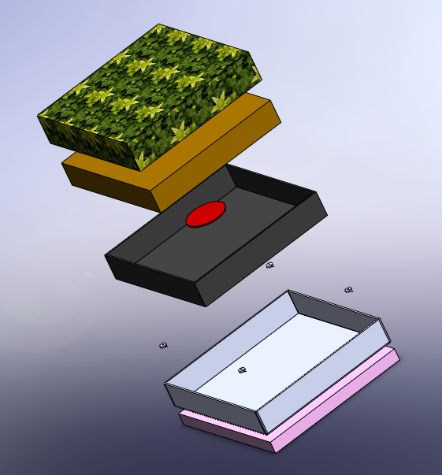
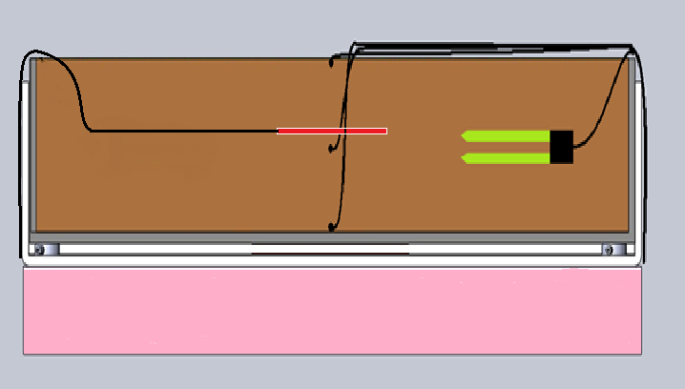
Instrumentation Components
A Davis weather station
Campbell data logger sensors
    Decagon moisture sensor
    Huskeflux heat flux sensor
    T-type thermocouples
    Futek load cells
Notes:
First of all, we have a davis WS, which measures ambient temperature and precipitation. We also have a Campbell’s data logger which collects data from decagon moisuture sensor, which is located in the middle, huskeflux heat flux sensor, which is also located in the middle. T-type thermocouples, one at the top, middle, and bottom and load sensors located at the bottom.

Slide 9
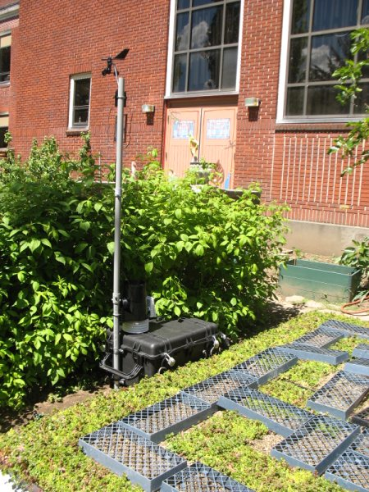
Monitoring
Local Weather Data
  Davis Weather Station 615
Water In/Out
  Mass Balance
  Soil Moisture Sensors
Soil Temperature
  T-Type Thermocouples
Notes:
The Davis 6152 model weather station was used to get rainfall data and air temperature. This station could also measure, humidity, wind speed and direction; however, we didn’t need this information for our project.
To validate that this green roof provides 60% reduction in storm water runoff, we had to monitor water in and out. So, we used load sensors at the bottom of the tray to determine the water mass of a 2’x2’ area of green roof. We also used soil moisture sensors to determine when system was saturated. This combination of load sensors and soil moisture sensors allows us to monitor the water entering and leaving the system, from which we can validate the 60% storm water retention criteria.
To validate that green roof surface temperature no greater than 10°C over ambient air temperature, T-type thermocouple were placed at the at the surface of the soil. Temperature value from that thermocouple was compared to ambient air temperature value obtained from Davis weather station to see if we met that criteria.

Slide 10
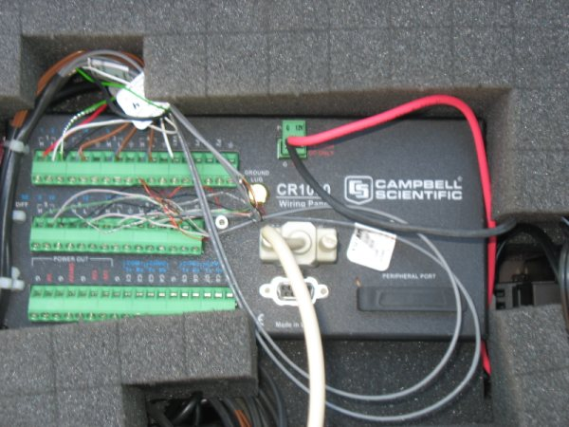
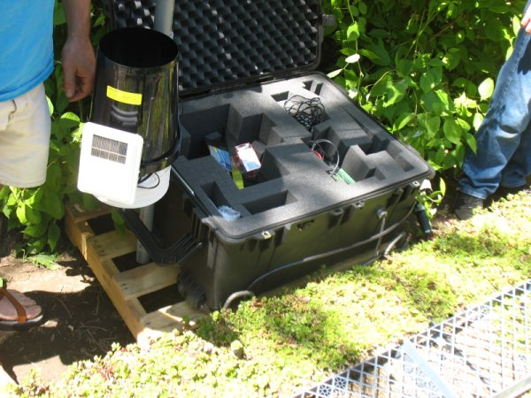
Monitoring
Soil Heat Flux
  Huxeflux
  R = ΔT/ q_{flux}
Notes:
Now, to validate our last criteria of average winter R value of 13, a heat flux sensor was placed at the middle of the soil layer. We used data from soil moisture sensor to calculate how much heat flux is stored in soil, and added that data to the measure data from heat flux sensor. Now, to measure R-value, we used use this equation; we already got value of heat flux. To get delta T, we placed thermocouples at the top of the surface and one at the bottom of the surface. With the heat flux and temperature measurements, we can determine the rooftop cooling effect for the summer months and the insulation properties for the winter months.
Load sensors sends data input to a summation box that will report a single value. Campbell data logger was used to record load summation data as well as the heat flux sensor data, soil moisture and thermocouples data.

Slide 11
Insulation Properties
Notes:
As stated previously, the insulation R-value can be a difficult concept. There are a lot of factors that influence the insulation values, but we chose the R-value as the metric by which we are measuring isolative values. It can change on a daily basis.
Our system was designed to increase the insulation value by R-13. The foam insulation that was added underneath the waterproof barrier adds an effective R-10. We had hoped that our system would add an insulation value of R-3 within the soil and plant mass during the winter months. Unfortunately, we were unable to test this system in the winter months, but we have done tests to give us an idea of how the R-value will change depending on air temperature and soil moisture.
The graphs show the average daily R-value along with the average daily temperature and average soil moisture content for each day. The graph shows that at this point the soil and plant mass are currently adding about R-2 insulation to the system. From the data we have collected, it can be seen that generally warmer days with low soil moisture values tend to have slightly lower average R-values than colder days with more soil moisture content. Since this part of the system was designed for the winter months when the daily temperatures will be much lower and have fairly high precipitation, we are hopeful that when the winter months arrive, the average effective R-value added to the to system will be above R-3 and satisfy this criteria.

Slide 12
Water Retention
Notes:
The amount of water that is held in the soil and diverted from the sewers is shown. When water enters the tray system in the form of rain, most of the water is absorbed by the soil and plants. When the soil becomes saturated with water and can hold no more water, the system begins to drain. Our purpose is to reduce the water coming out of the system by 60 %. It can be seen that days with little rainfall, the soil is absorbing all of the water and we have no water leaving the system. Some days have a fair amount of rainfall with little runoff. This is usually due to the fact that it may be sunny in the morning and the tray begins to dry out a little and then a significant amount of rainfall begins later in the afternoon or evening and runoff only begins to occur when the tray is saturated. When there is consistent heavy rainfall on days like 5/22, the system has not had an opportunity to dry out and almost all of the water entering the system is also leaving the system. Overall, we were expecting to reduce the runoff by 60% and over this 10 day period we found that the runoff was reduced by 54%. We came close to our goal. When monitoring is continued over a longer period of time, we may see an overall reduction that meets this goal of 60%.

Slide 13
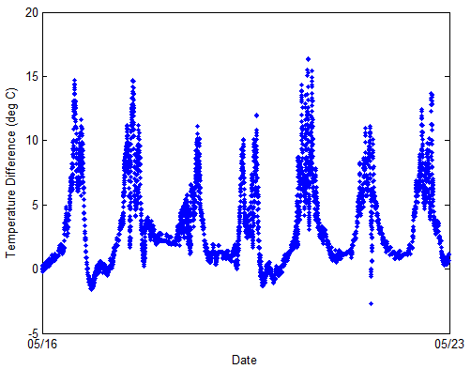
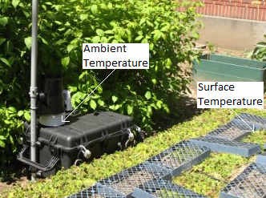
Temperature Reduction
Notes:
Because this green roof was not installed on an actual rooftop, it is a little difficult to prove this criteria for a rooftop. Since we installed the green roof at ground level, we would still expect a significantly higher temperature on the ground than in the surrounding air because the ground retains heat that it absorbs from sunlight. Because of this we believe that the green roof system is still representative of what could be expected from a rooftop.
The graph shows us that the difference between the green roof surface temp and the ambient air temp is as high as 15 degrees. Our goal was to have a system that was less than 10 degrees over the ambient temp, but we did not meet this goal. We will accept the value of 15 degrees over ambient, since this is still an improvement.

Slide 14
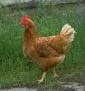
Challenges and Opportunities
Planning 3rd party involvement in a project
City Permits
Chickens
Notes:
When communicating with outside companies who are providing products or services, it is important to discuss all attributes of the project in the first meeting. Otherwise, confusion over timelines and responsibilities can becomes problematic. This provided us with experience in working with deadlines across multiple disciplines in the business world.
Getting a permit through the city can be a difficult and time consuming process. It is suggested to start early and make sure you talk to the right people. Fortunately for us, this allowed us to have the green roof installed at an educational facility where we can educate the youth on the advantages of green roof systems.
Because we had the installation at Sunnyside Environmental School, we had to contend with chickens for space. The chickens are free range at the school and they were trying to eat the grass seed that we planted. Since our system included a mass balance, the chickens also created spikes of data that had to be accounted for during the reduction of data. This provided us with the knowledge that in any given project can have strange and completely unexpected influences.

Slide 15

Questions
(GRTM)

