Slide 1
Volumetric Flow Sensor Group
Project Summary

Slide 2
Mission Statement
To develop a Volumetric Flow Sensor to measure the volume of gas flowing through a quadrant and into the combustion chamber of the Thermal Abatement System.

Slide 3
New Project Objective
Be able to demonstrate the ability to prove that Ultrasonic Technology works with a working sensor
Temperature design criteria to be ignored due to “lead time” of transducers that existed.

Slide 4
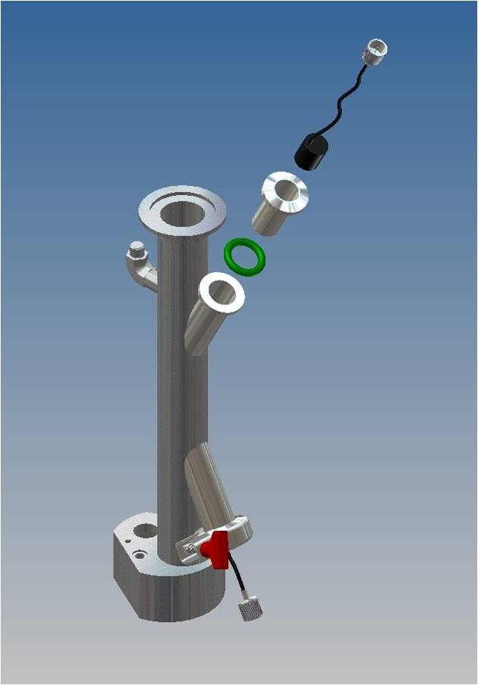
Sensor Housing Assembly
Based of standard vacuum seal flange assemblies
Uses a combination of standard and non-standard parts
Components made of 316L 304 stainless steel

Slide 5
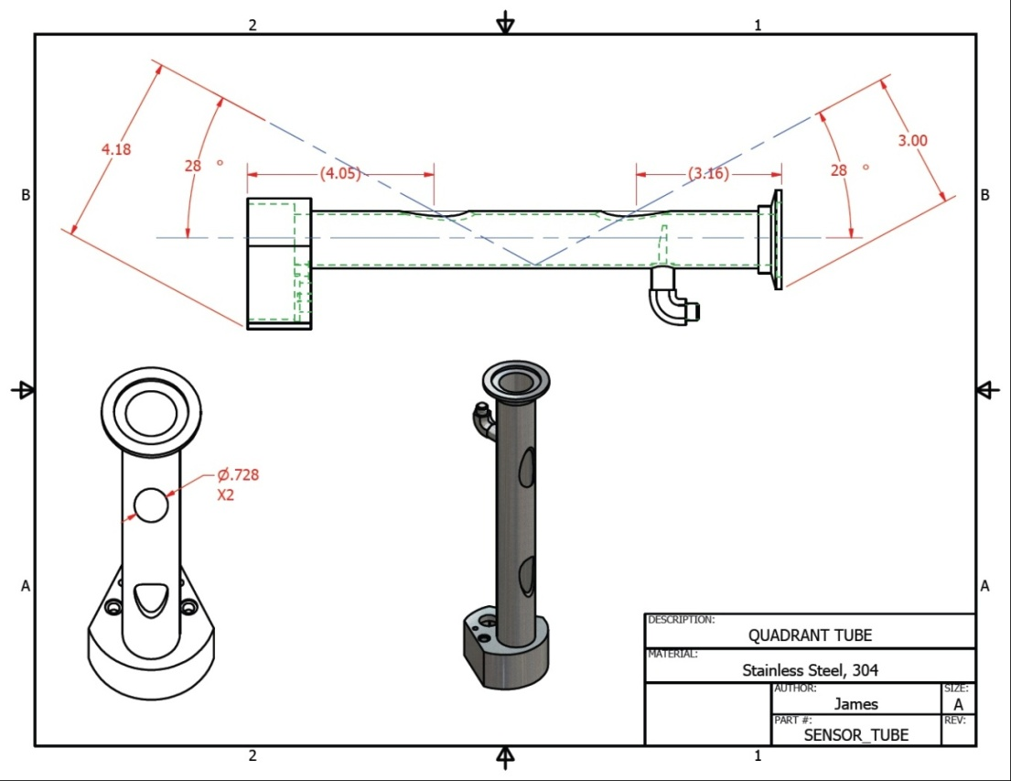
Modifications to quadrant

Slide 6
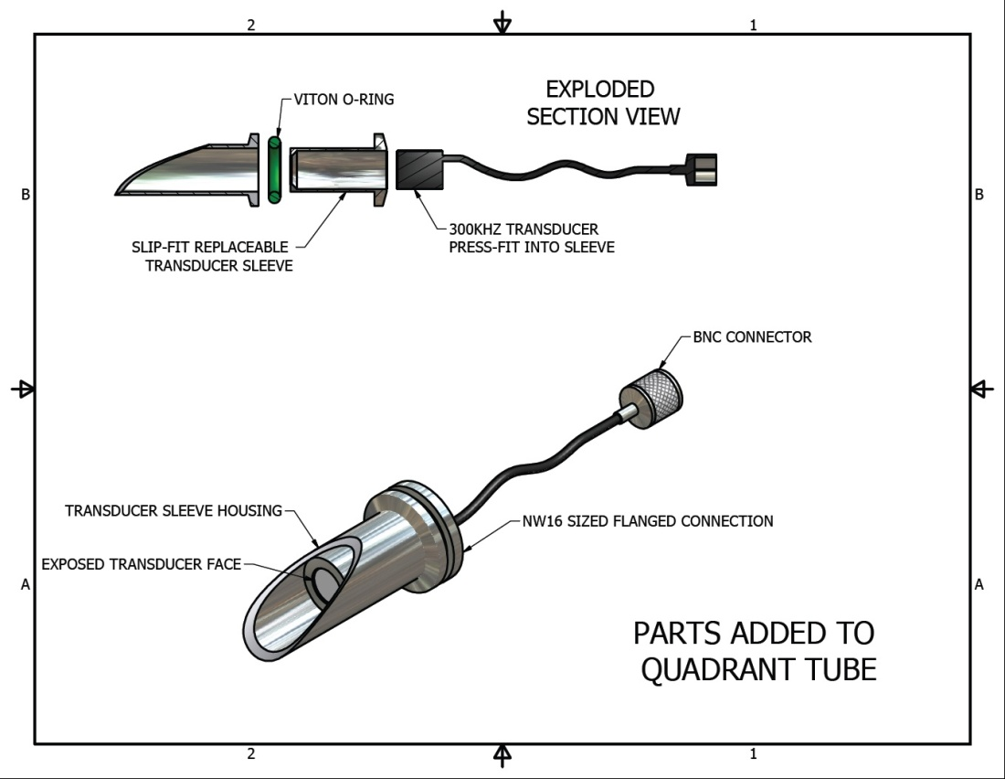
Sensor Housing

Slide 7
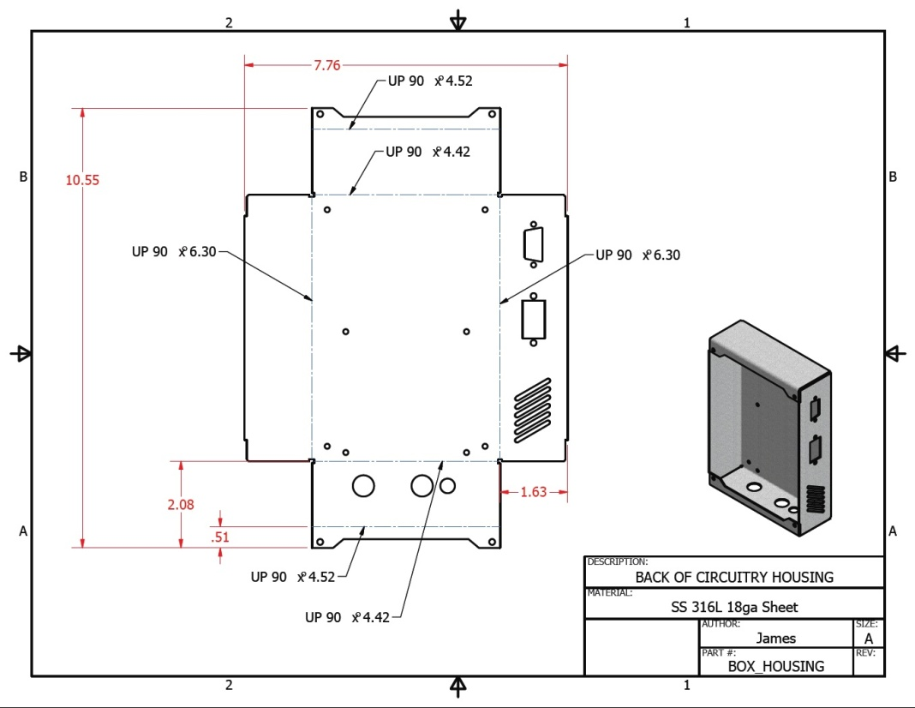
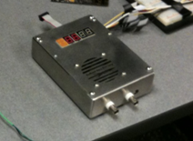
Circuit Box
Made of Stainless Steel, prototype design
Has provisions for RS-232, Power Switch, Power Input, BNC, LCD display, and cooling fan and vents

Slide 8
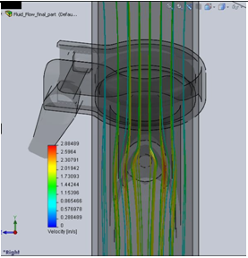
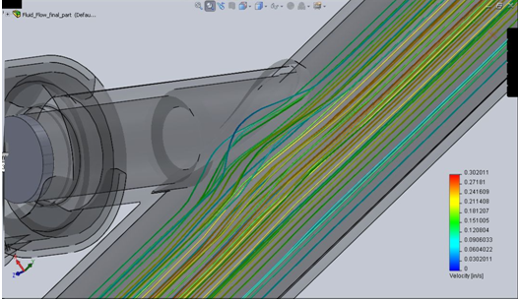
Flow properties
Reynolds number
minimum – 442 – maximum – 4416
Conclusion is that flow ranges from laminar to transitional turbulent flow
Flow is ‘semi-normal’ due to the oxygen inlet and transducer cavities

Slide 9
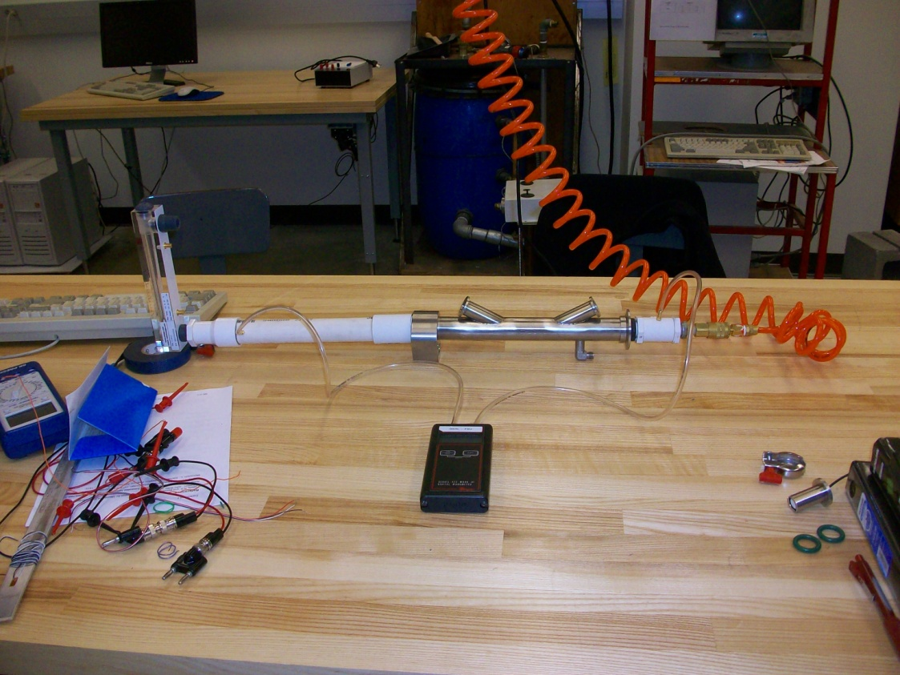
Evaluation – Pressure Drop
Differential Pressure meter used to measure pressure drop
‘Rotameter’ flow meter used to measure flow

Slide 10
Results – Pressure Drop
Pressure marginal, which was what was expected
Design condition of minimal pressure drop met

Slide 11
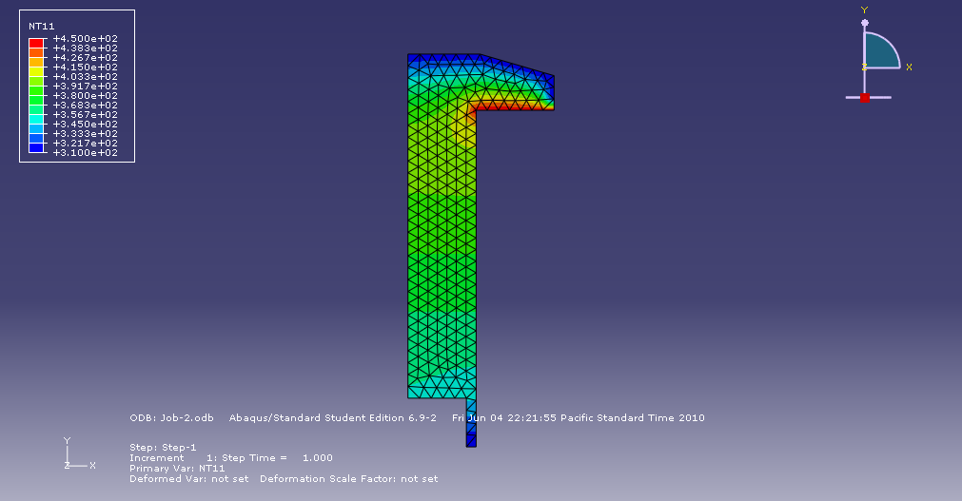
Future Design Considerations
Proposed Transducer Sleeve to be made from PEEK plastic
Sleeve will insulate radiating heat from Quadrant and Welded fitting
Could be custom made by a transducer company, lead time 6+ months
FEA model shows that upper most temperature would 70 C

Slide 12
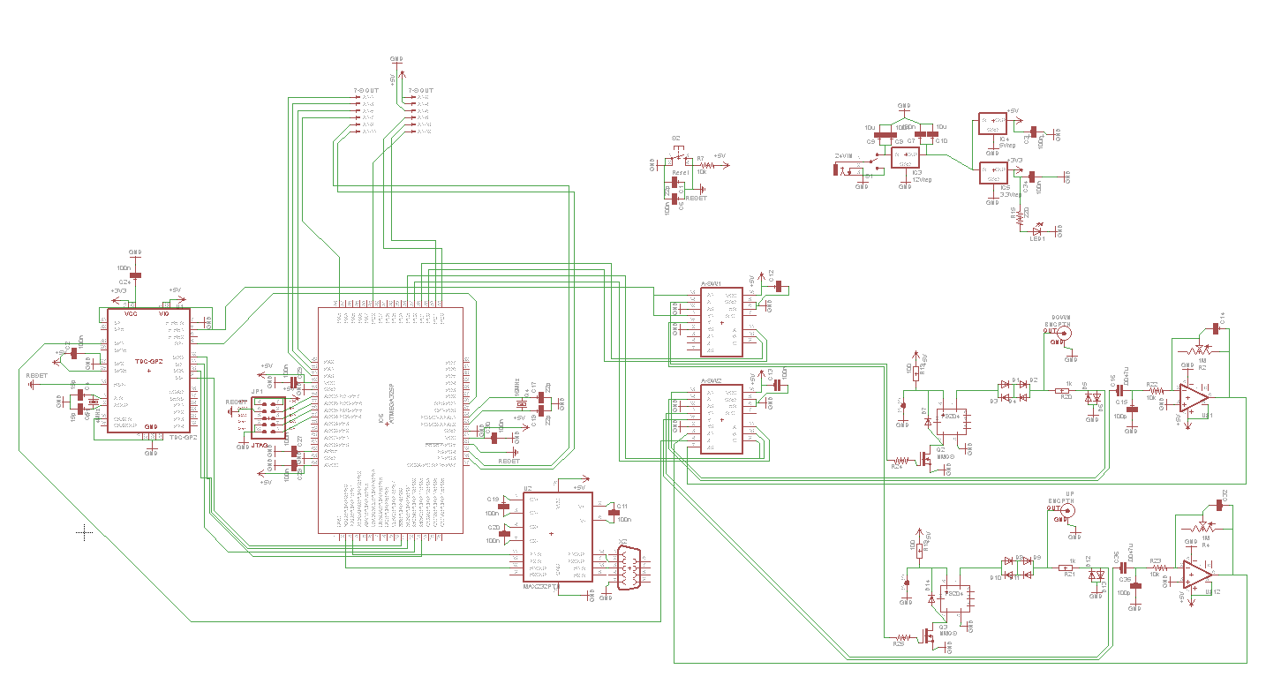
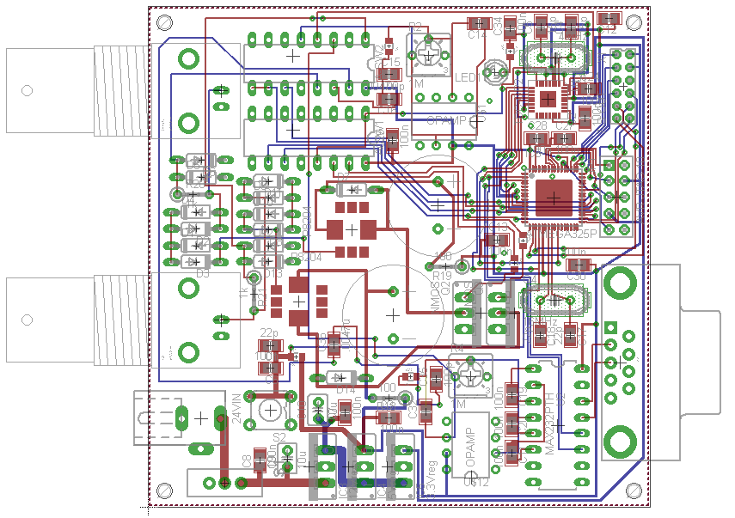
Main Electrical Design
This is the main PCB circuit schematic.
  MC and TDC had a few connection errors
  The analog switch IC’s do not function properly
  The DC transformer circuit does not function properly
Significant modifications were made to the PCB.

Slide 13
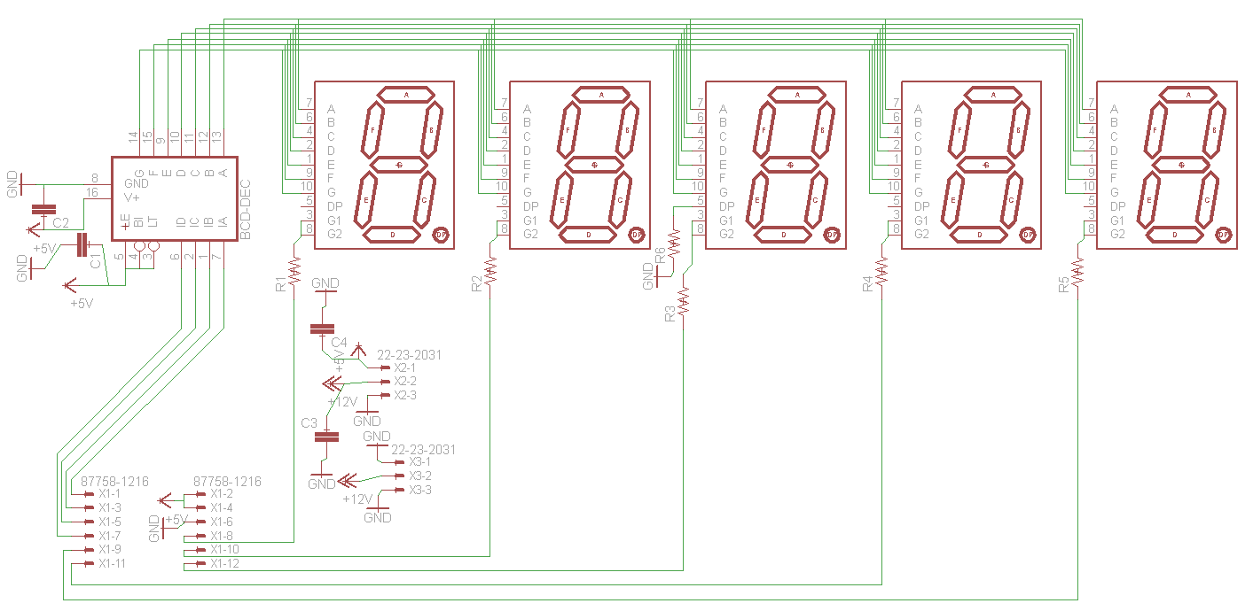
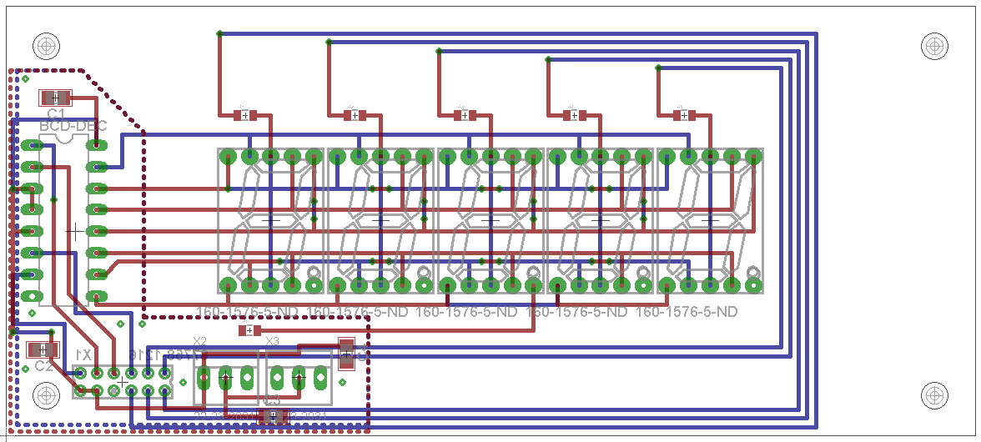
7-Segment Electrical Design
This circuit was straight forward, but design was put off due to the design of the electrical box and the main circuit. It functions properly, however new 7-segment displays will need to be purchased.

Slide 14
Electrical Results
Complications:
  High voltage DC transformer circuit does not work properly.
    Due to the low current on the primary side not causing a large enough voltage drop across the primary inductor. Higher current will be needed to produce 200+V on the secondary.
  Analog switch IC’s do not work properly.
    We are unsure as to why they were not working. We removed one from the PCB and tested it, it was working exactly as it should. The only difference is the resistors in the circuit, but we do not think that should have an adverse effect on the performance of the switches.
  Being that those two circuits don’t work, we were not able to test anything beyond that point. What wasn’t tested is:
    Time-of-flight of the pulse
    Whether the transducer would send and be able to receive within the walls of the pipe (due to not having the voltage required)
    Flow measurement and display of that flow (the display does work, however)
    The receiving circuitry was not tested.

Slide 15
What Do You Think?
Comments
Questions
Concerns

