Slide 1

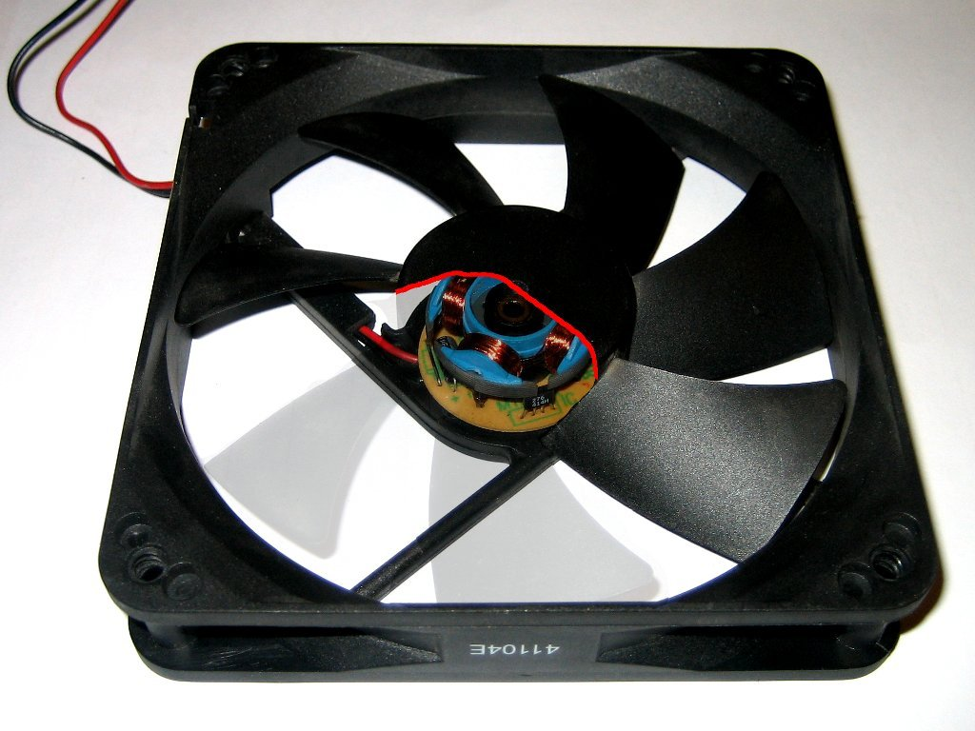

Intel Ultra Slim
Air-Moving Device
2010 Capstone Project
Portland State University
Intel Corporation

Slide 2

Advisors:
PSU: Chien Wern Intel: Jered Wikander
Team Members:
Tim Brodovsky
Joe Eccleston
Joe Frankovich
Paul Marshall

Slide 3

Intel Corporation
Why make an ultra-slim air moving device?
Why not make a traditional fan?
What does Intel want?

Slide 4
Intel Corporation
The device is no thicker than 3 mm
The device moves 0.075 ACFM of air
The device has a maximum pressure of 0.045 IWG

Slide 5
Our Approach
Passive
Active
Piezoelectric
Ionic
Tesla valve
Flapper valves
Check valves
?

Slide 6
Our Approach
Passive
Tesla valve

Slide 7
Our Approach
Modified Tesla valve design with a flat solenoid-magnet actuator
Valve works on the principle of diodicity (the ratio of the backward pressure drop to the forward pressure drop)
Valve compels fluid flow in one direction

Slide 8
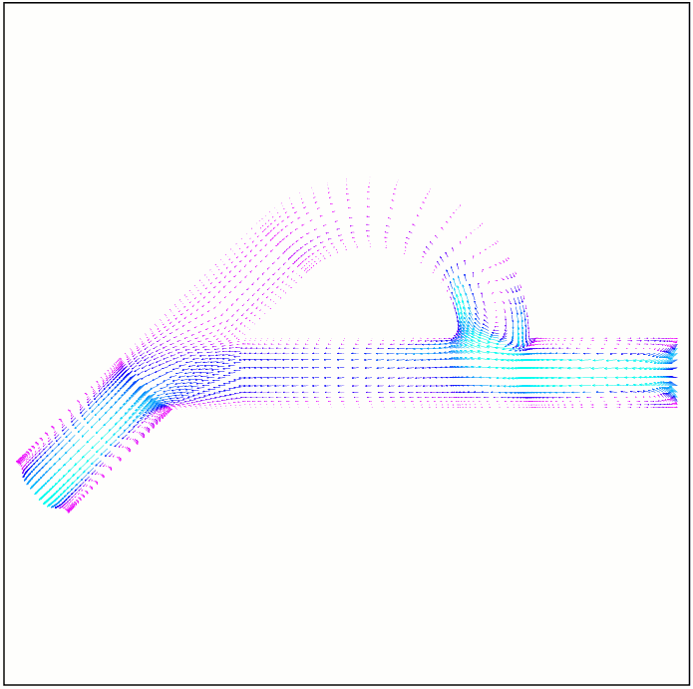
Our Approach
An example of a Tesla valve:
FLOW
Image from http://lettuce.me.washington.edu/micropump/animation/2/p.5atmvel.gif

Slide 9
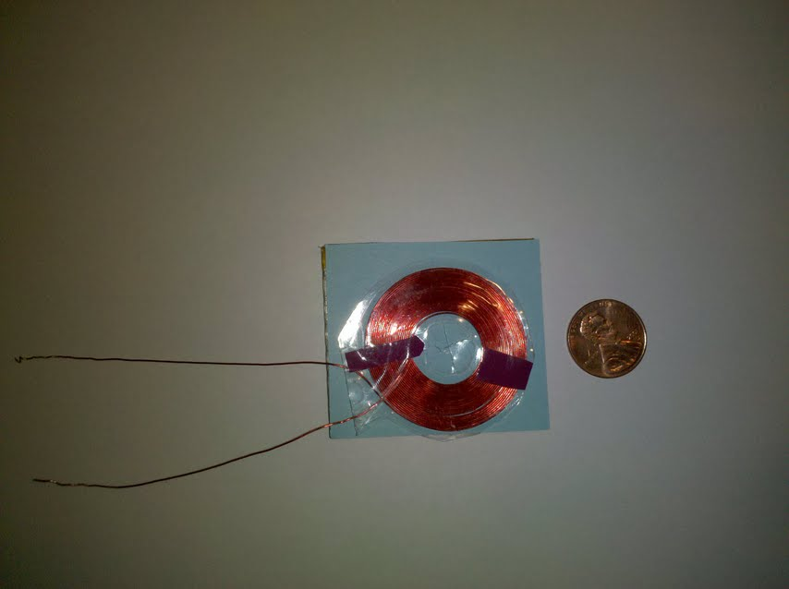
The result
51 mm
45 mm

Slide 10

The bottom line
Does it work?

Slide 11

Questions?

