Slide 1


FSAE Intake Manifold
Members:
Rob Brown
Scott Cone
Thuc Le
Brandon Wilen
David Winkleman
Advisor:
Dr. Turcic

Slide 2
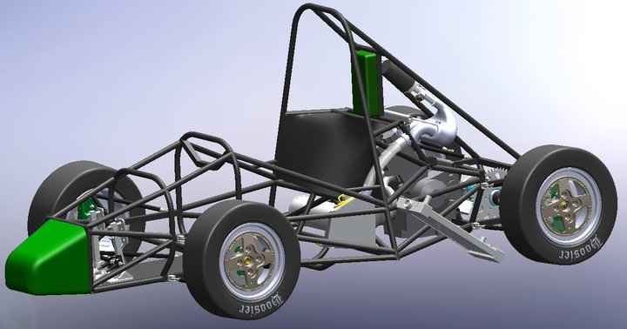
What is Formula SAE
The Formula SAE ® Series competitions challenge teams of university undergraduate and graduate students to conceive, design, fabricate and compete with small, formula style, autocross vehicles.

Slide 3
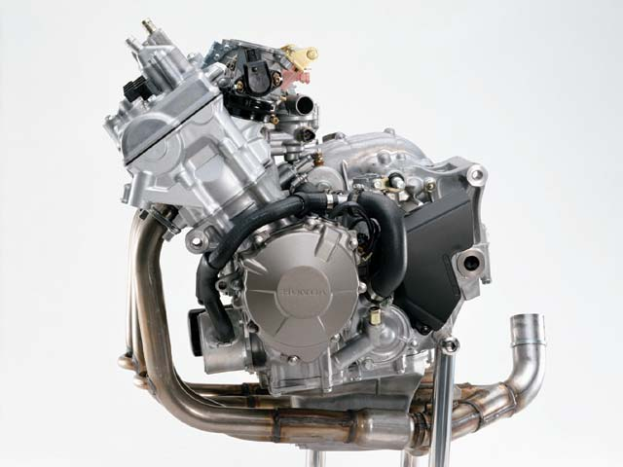
General Engine rules
B8.1.1 The engine(s) used to power the car must be four-stroke piston engine(s) with a displacement not exceeding 610 cc per cycle.
Current Viking Motorsports Engine CBR600 F4I

Slide 4
Intake Rules
B8.6.1 In order to limit the power capability from the engine, a single circular restrictor must be placed in the intake system between the throttle an the engine and all engine airflow must pass through the restrictor.
B8.6.2 Any device that has the ability to throttle the engine downstream of the restrictor is prohibited.
B8.6.3 The maximum restrictor diameters are - Gasoline fueled cars - 20.0 mm (0.7874 inch)
- E-85 fueled cars – 19.0 mm (0.7480 inch)

Slide 5
Design Goals of the
Capstone Team
Fit a Honda CBR600 F4I engine
Fit in current car chassis
Run through the RPM range of 12,500 with maximum power around 8000 RPM
5lbs lighter than last years intake
Maximize fluid flow from the intake restrictor to each open cylinder.
Withstand ambient temperatures of 120 degrees Fahrenheit
Appropriate Fuel Injector Selection

Slide 6
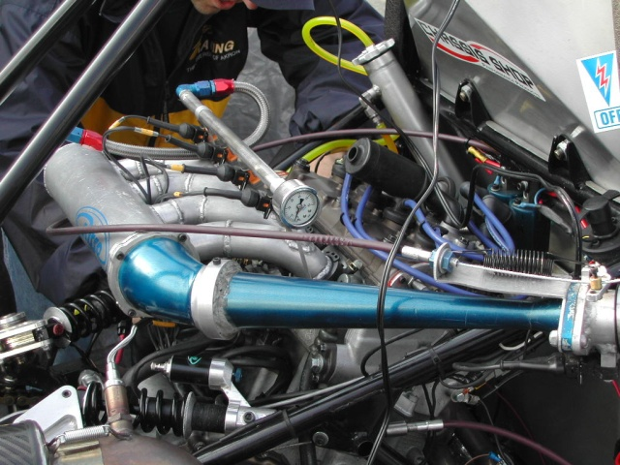
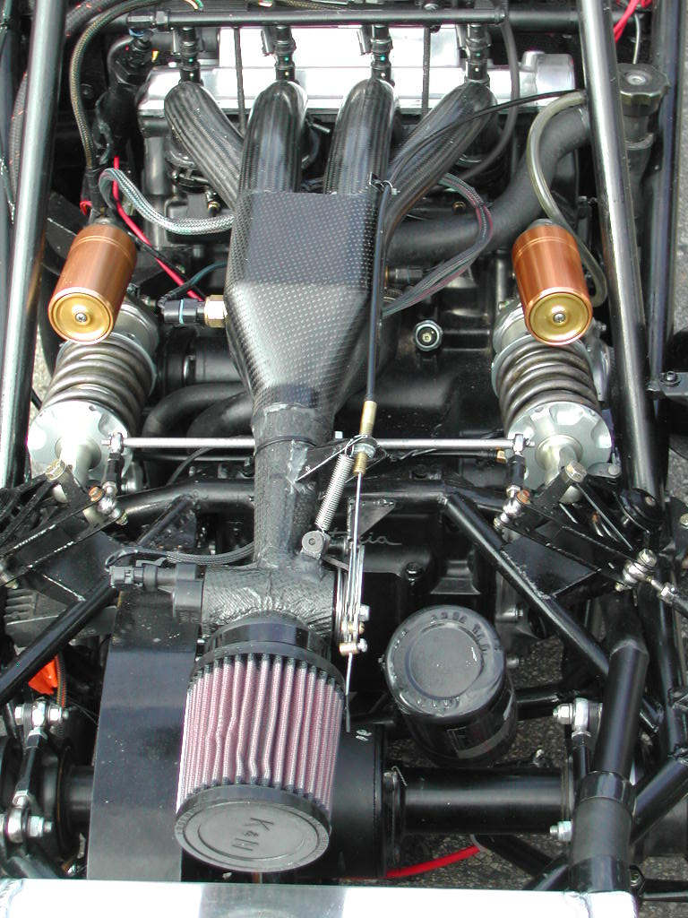
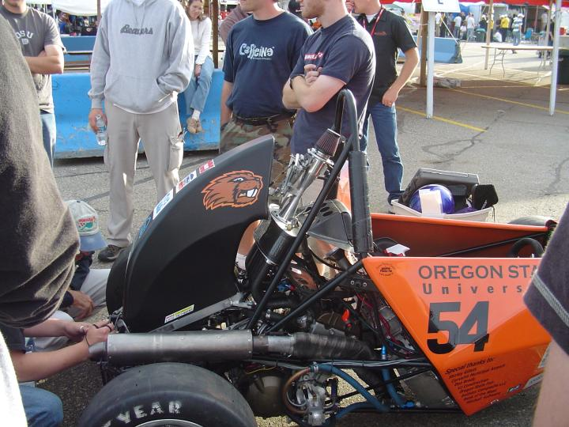
Plenum Design Options
Top Venturi Entrance
Side Venturi Entrance
Rear Venturi Entrance

Slide 7
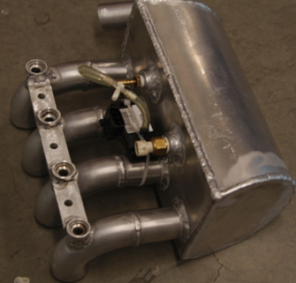
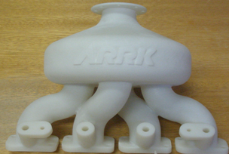
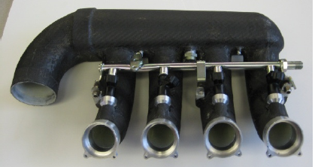
Material Selection
Options
Carbon Fiber wrapped
Fused Deposition
Welded Aluminum
SLS (Selective
Laser Sintering)

Slide 8
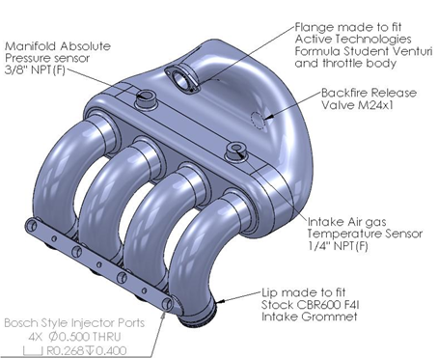
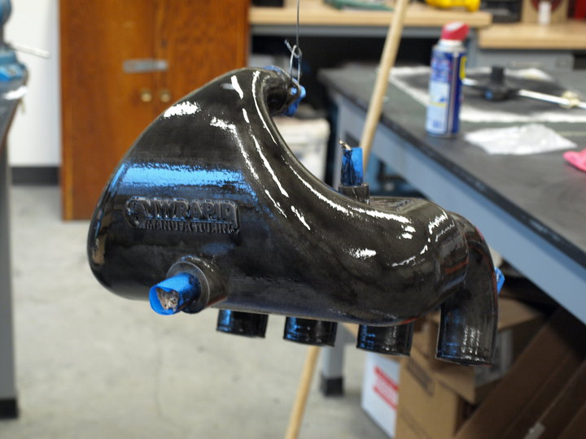
Final Design
Top Venturi Entrance Made of Selective Laser Sintered PA 2200 Fine Polyamide

Slide 9
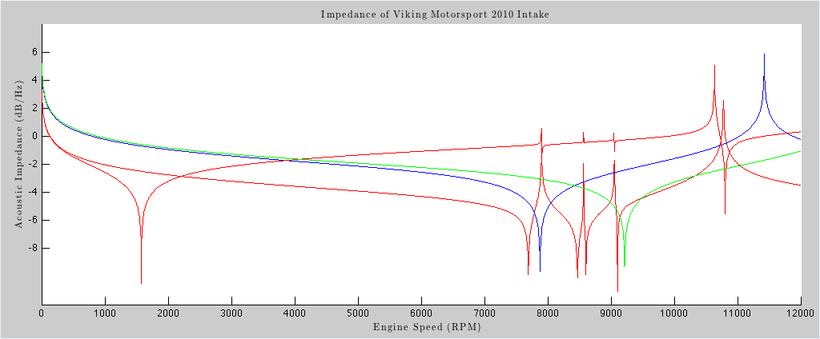
Detailed Design
(Impedance Transform)

Slide 10
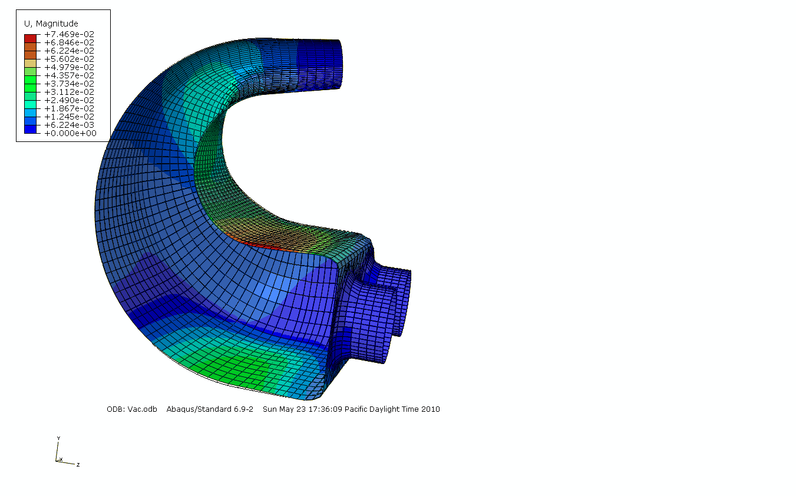
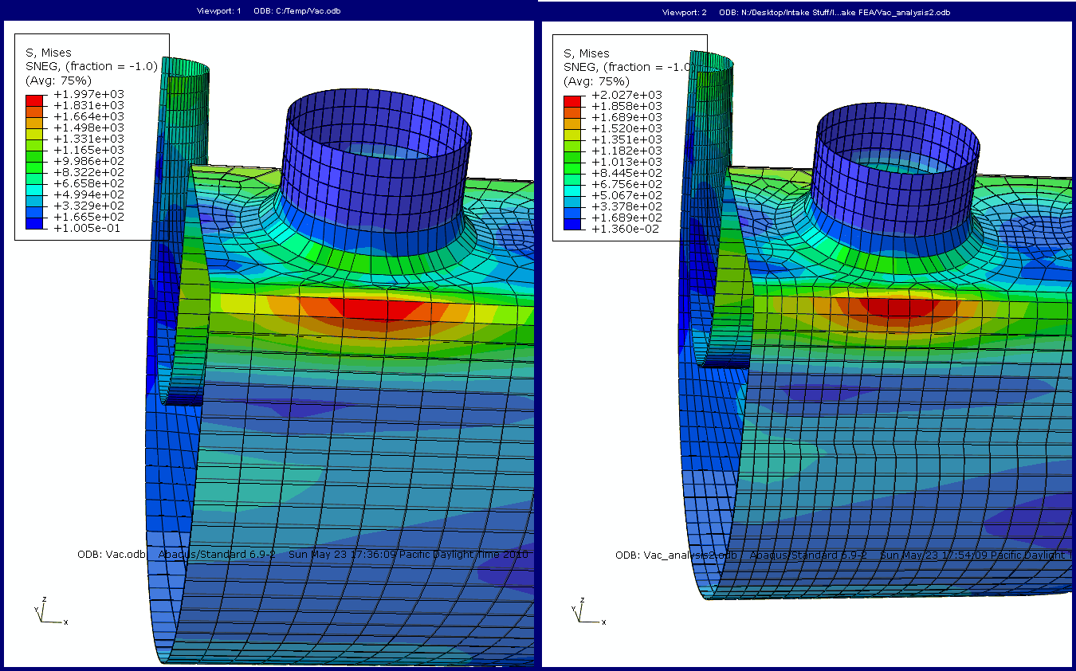
Finite Element Analysis
Using a wall thickness of .2 in we get a max deflection of .075 in and
max von mises stress of 2000 PSI leaving us with a F.O.S ~ 3

Slide 11

Sponsors

Slide 12
Questions?

