Slide 1
Final Design Presentation
Jesse Crutchfield
Eduardo Guerrero
Ronald Payne
Gerard Stabley
Jeremy Tucker
June 2nd 2010

Slide 2
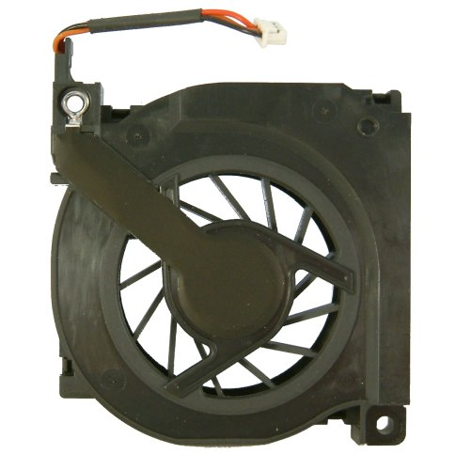
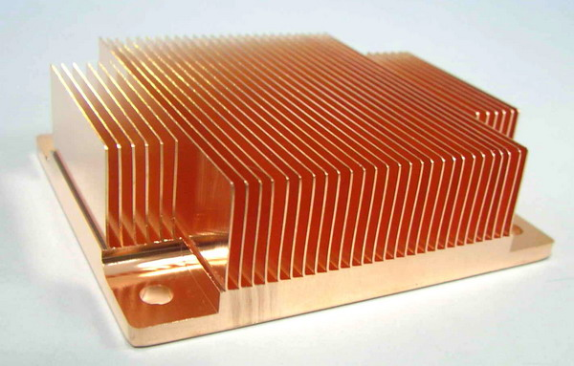
Objective
Design and produce a passive cooling solution to replace the actively cooled system of an MSI Wind netbook with:
    Similar cooling capability as the current active solution
    Minimal impact to the exterior case design

Slide 3

Customer
Primary customer is Intel Corporation
Interested in specific and general applications of a passive cooling solution

Slide 4
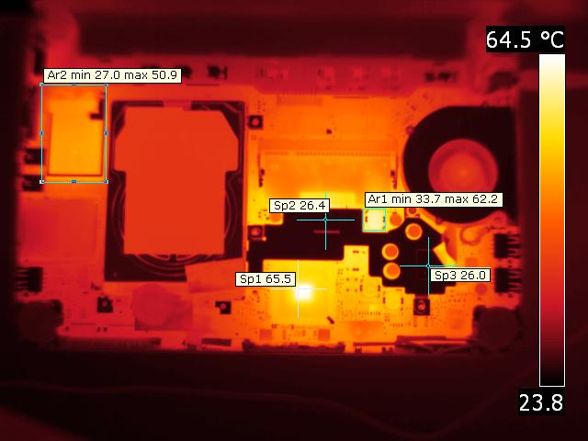
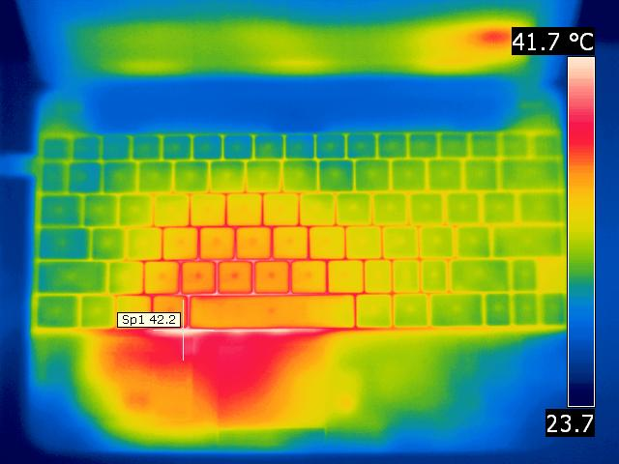
Performance Criteria
Meet baseline temperatures and power dissipation
    Skin temperatures
    Component temperatures
Performance Constraints
No power to be drawn from Netbook
Skin temperatures must not exceed safe limits
Netbook dimensions must remain close to original

Slide 5
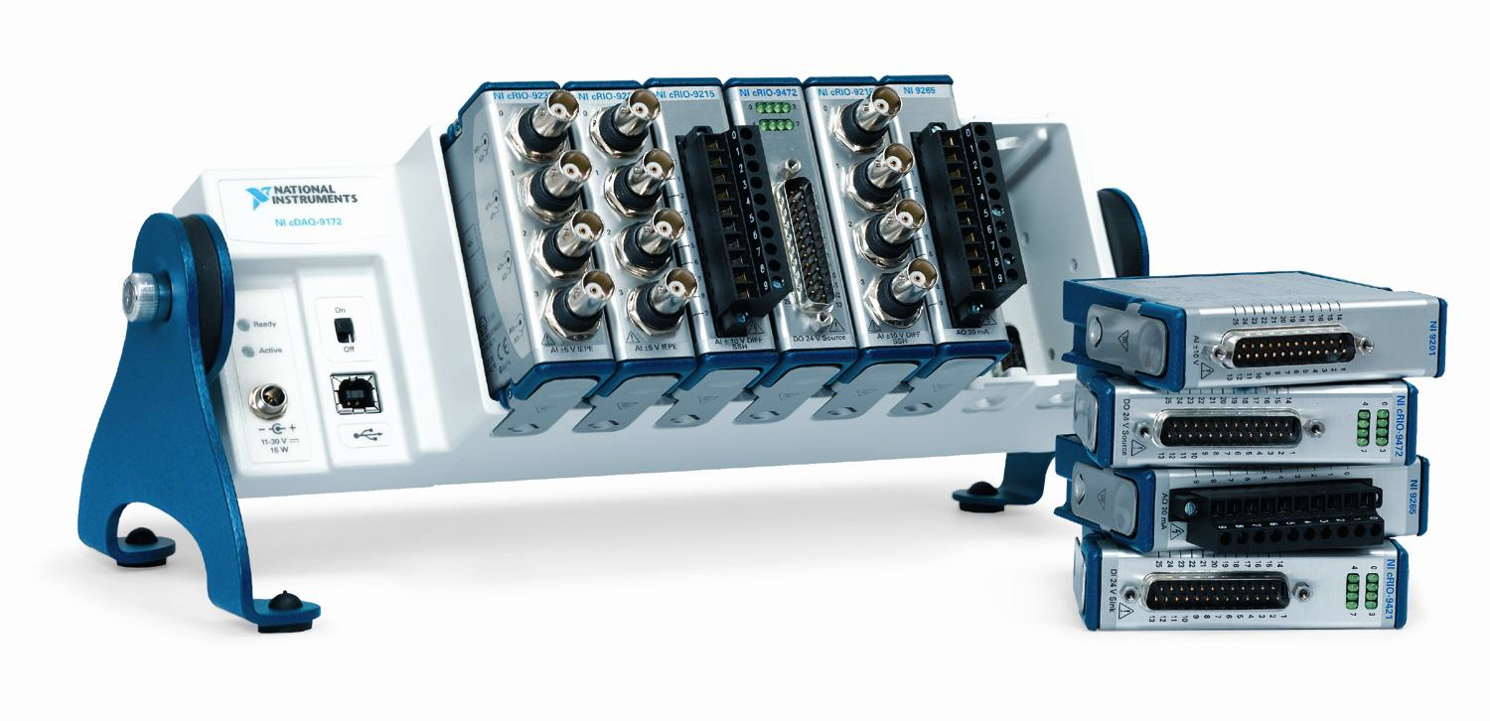

Design and Analysis
Infrared (IR) Thermography and thermocouples were used to collect temperature data
Solid Modeling and FEA were used in design conceptualization

Slide 6
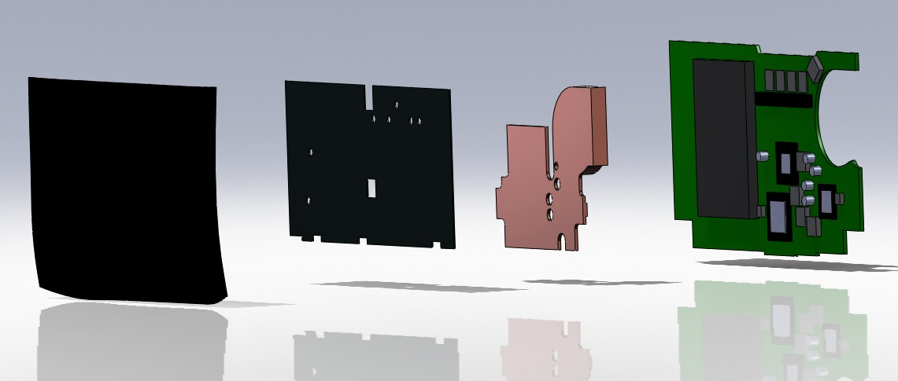
Final Design
Two part design
Graphite Heat Spreader
Copper Heat sink

Slide 7
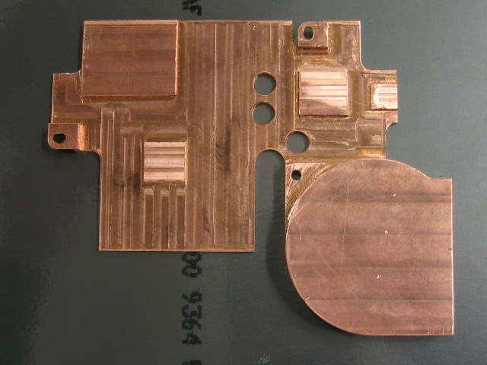
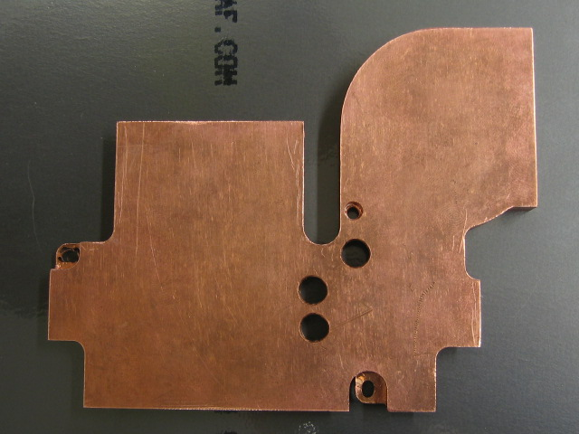
Final Design
Copper Heat Sink
Heat sink manufactured from Electrolytic tough pitch Copper, UNS C11000
Thermal conductivity of 388 W/m-K
Total mass of .4 kg (.88 lbs)
Thermally couples the primary heat sources on the motherboard

Slide 8
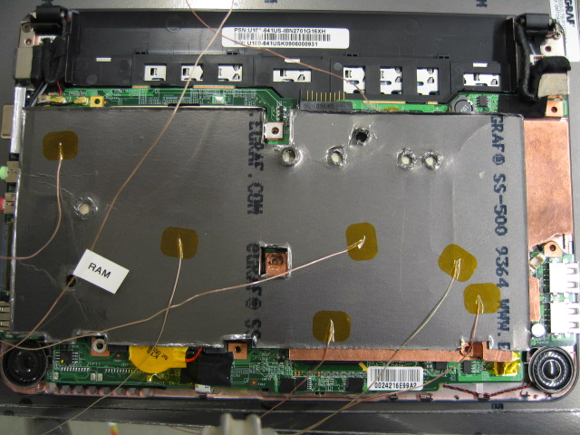
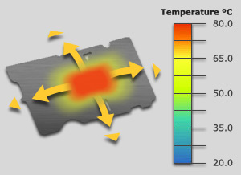
Final Design
Graphite Heat Spreader
Heat spreader manufactured from eGRAF graphite Spreadershield material
Anisotropic thermal conductivity: 500 W/m-K in the X and Y directions, 3 W/m-K in the Z direction
Total mass of .035 kg (.08 lbs)
Distributes heat across its large surface area, eliminating “hot spots”

Slide 9
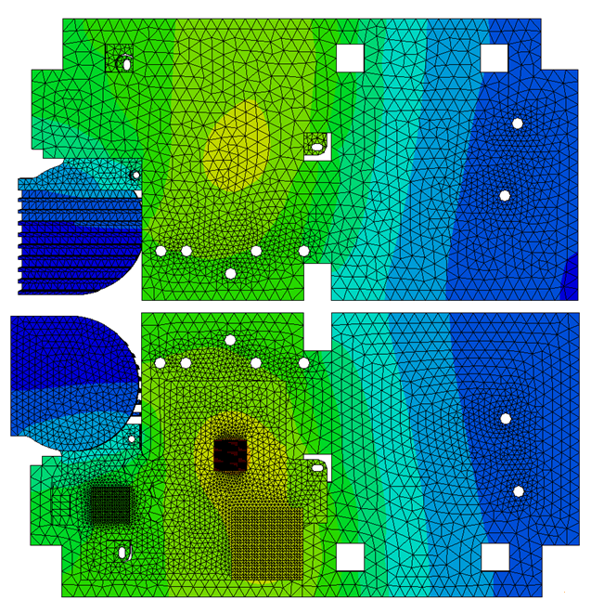
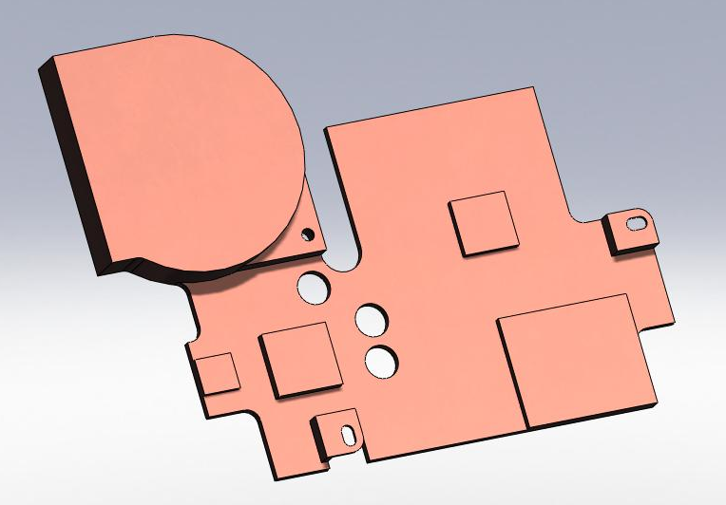
Design Optimization
  Solid modeling in conjunction with FEA analysis was used to optimize dimensions of both heat sink and heat spreader.

Slide 10
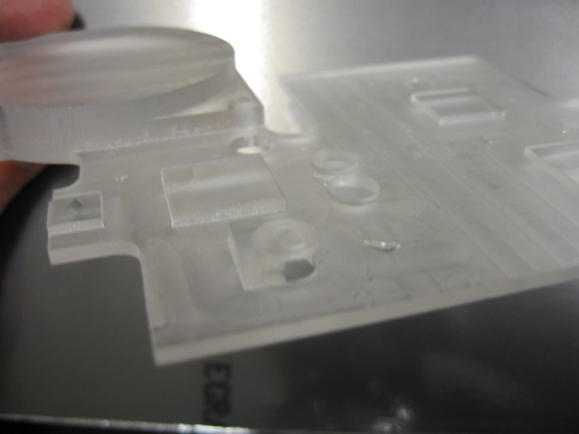
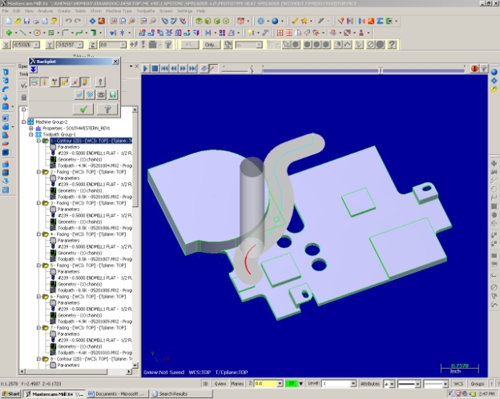
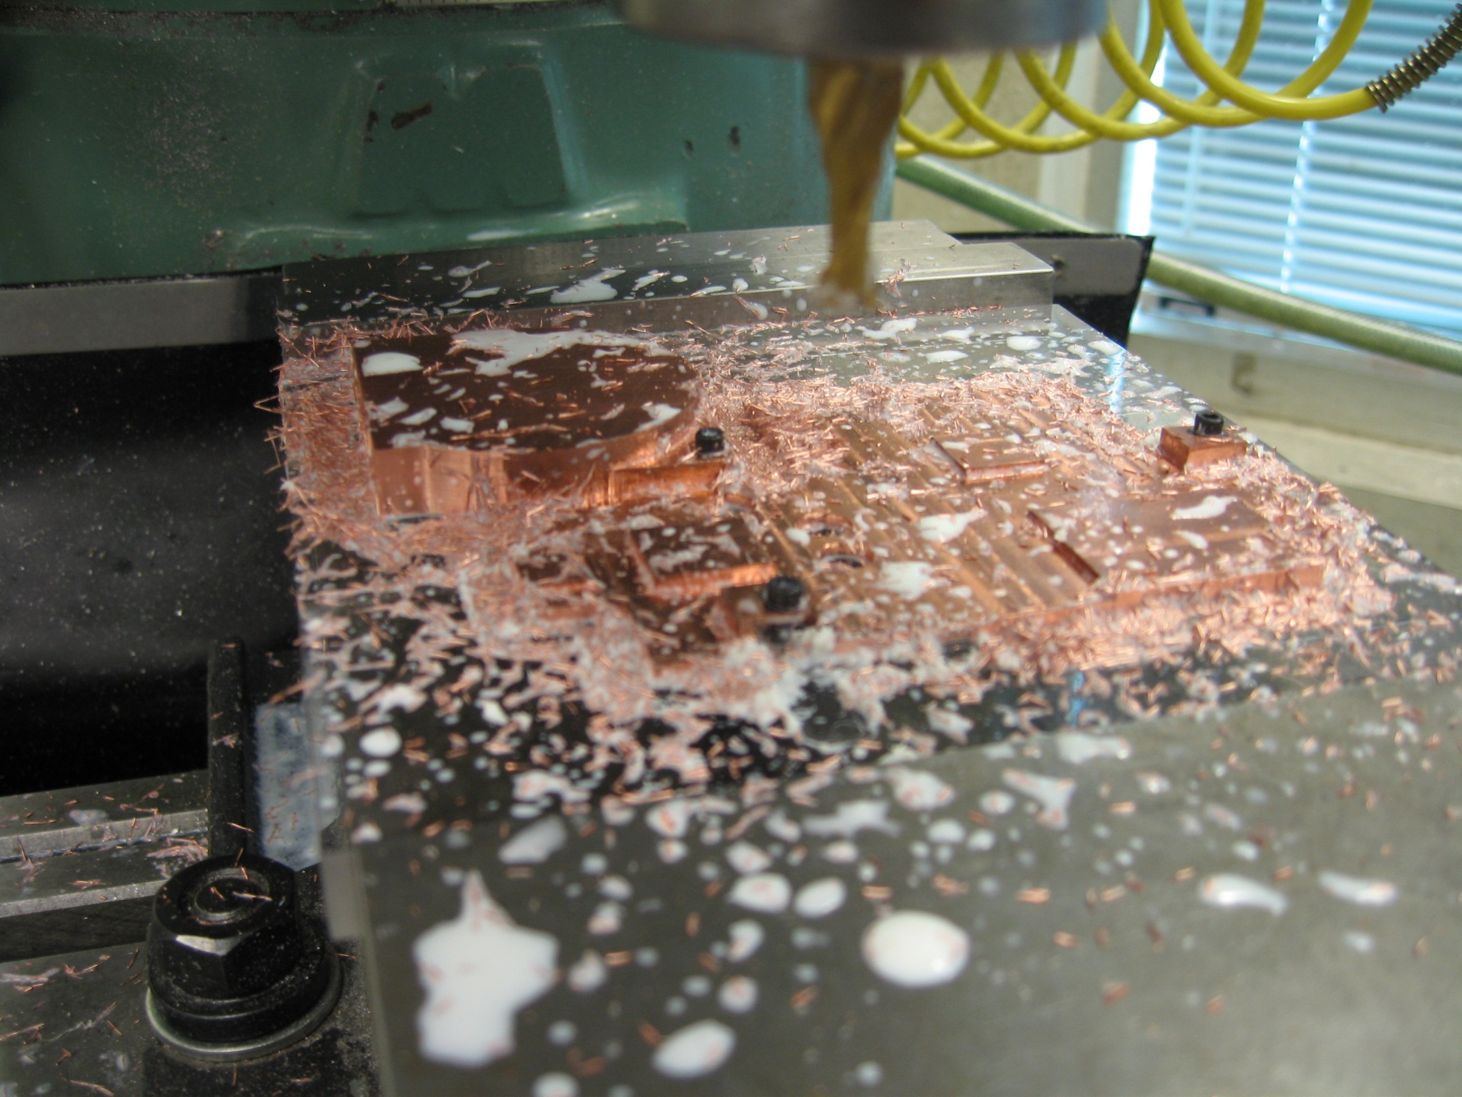
Manufacturing
Master CAM was used in conjunction with a 2-axis CNC mill to machine multiple plastic prototypes as well as the final copper heat sink.

Slide 11
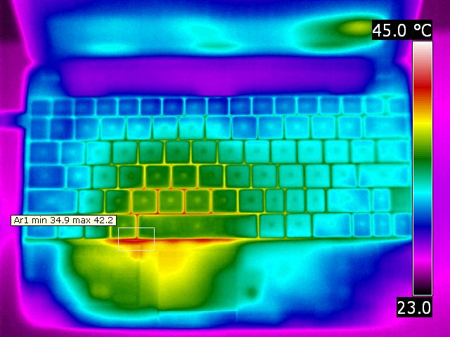
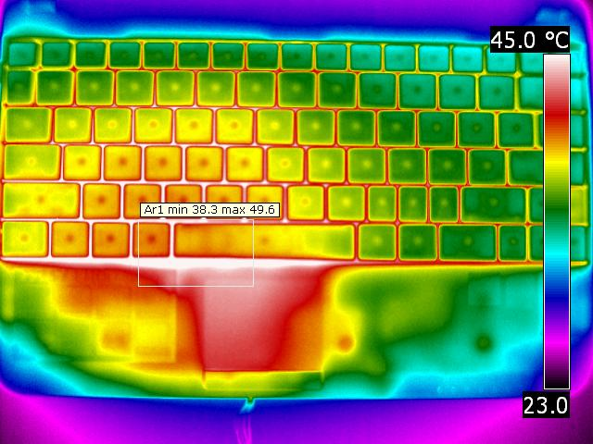
Design Evaluation
IR Thermography
Max skin temperature increased by 7.4°C on top surface and 11.4°C on bottom surface with passive cooling solution

Slide 12
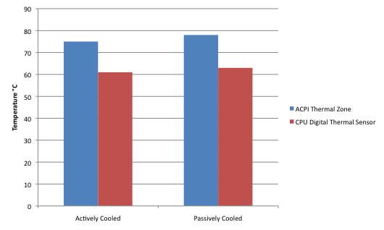
Design Evaluation
Digital Thermal Sensor
The on-board CPU temperature increased by 2°C, and the on-board GMCH temperature increased by 3°C, with the passive cooling solution.

Slide 13
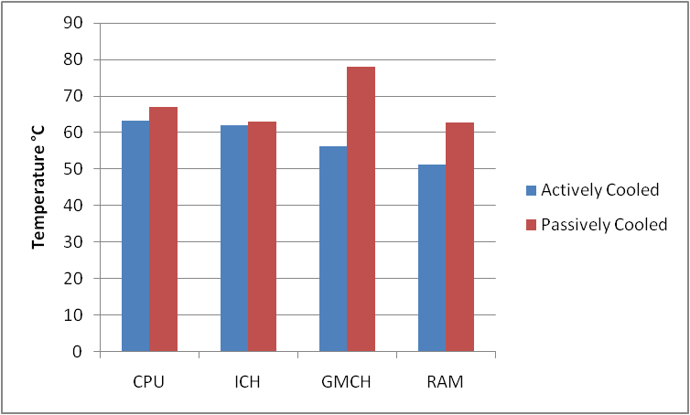
Design Evaluation
Thermocouples
CPU temperature increased by 3.8°C, and the ICH by 1.1°C, with the passive solution. The temperature of the GMCH and the RAM increased by 21.8°C and 11.4°C, respectively, with the passive solution.

Slide 14

Challenges
Heat Transfer Calculations
Required assumptions that may not reflect actual circumstances
No closed form solutions
No empirical correlations for our geometry
Dimensioning and Tolerancing
Designing parts that needed to mate with
existing hardware
Manufactured Acrylic Prototypes to determine
final dimensions

Slide 15
Conclusion
No change in netbook case dimensions and no visible change in outward appearance
Component and skin temperatures maintained within acceptable limits
No power consumed by cooling solution
Bottom line: Passive Cooling Solution Works

Slide 16



Acknowledgements
Dr. Raul Cal, PSU
Dr. Faryar Etesami, PSU
Jered Wikander, Intel
Chris Coleman, Tektronix
Michael Chuning, PSU
Matt Getz, GrafTech International Corp.
Phil Benos, MH&W International Corp.

