Slide 1
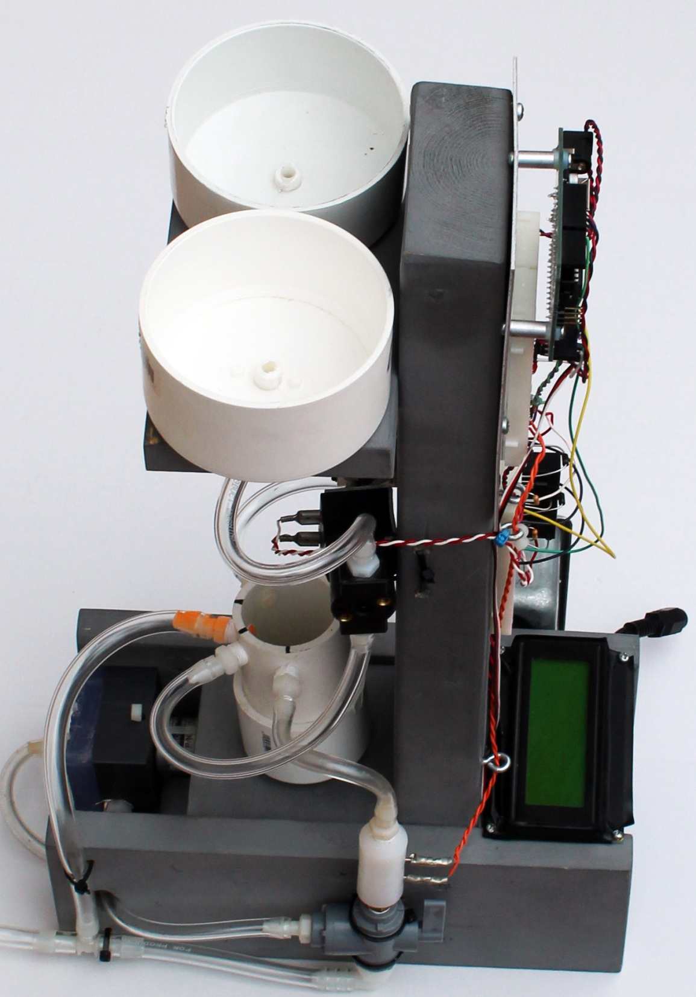
control of salinity
living with the lab
© 2012 David Hall

Slide 2
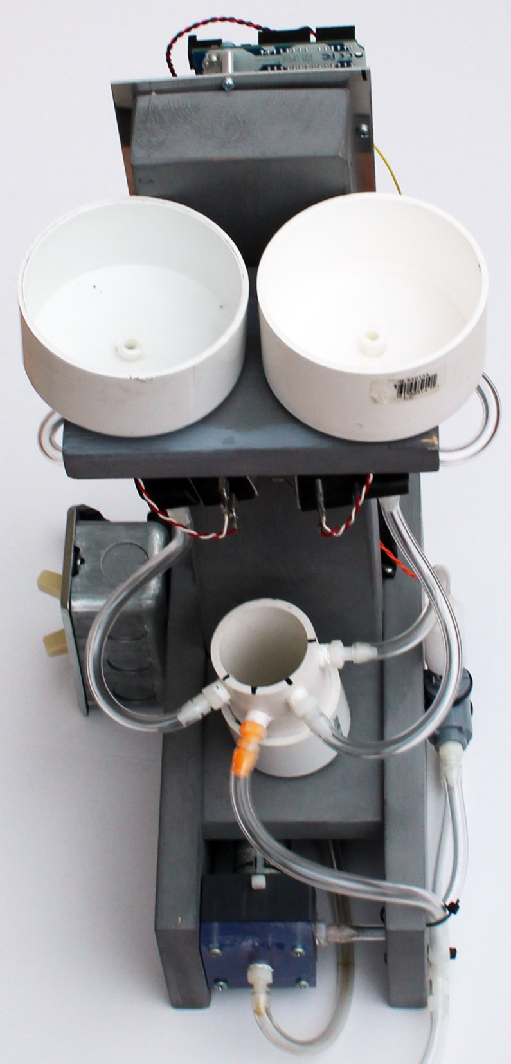
living with the lab
General Idea
The objective is to keep the salinity close to a setpoint which will provided by your instructor
The salinity sensor measures the analog voltage output of the salinity circuit
Opening DI solenoid valve decreases salinity
Opening salty solenoid valve increases salinity
salt water (1% NaCl)
DI water
0.05 wt % NaCl ≤ setpoint for salinity ≥ 0.15 wt% NaCl (your instructor will provide a setpoint, such as 0.09 wt% NaCl)

Slide 3
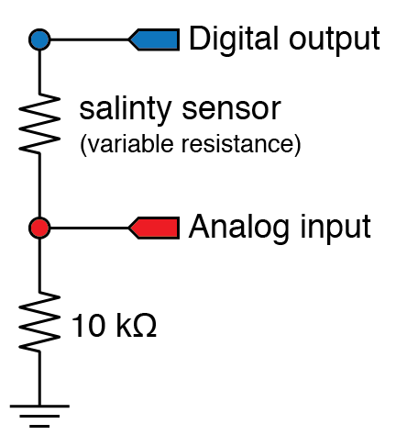
living with the lab
review of conductivity sensor wiring & programming
// Averaged salinity sensor reading
int power_pin = 3;
void setup() {
Serial.begin(9600);
pinMode(salinity_power_pin, OUTPUT);
}
void loop()
{
int input_pin = 2; // Analog input pin
int nave=20; // Number of readings to average
float reading_ave; // Average Value returned from function
reading_ave = salinity_reading( power_pin, input_pin, nave);
Serial.println(salinity_ave);
}

Slide 4
living with the lab
review of conductivity sensor wiring & programming
// -- Perform averaging of sensor readings
float salinity_reading_average( int power_pin, int input_pin, int nave ) {
int i;
float sum; // Use float for more precision and to prevent overflow of sum
sum = 0.0;
digitalWrite( power_pin, HIGH ); // Supply power to the sensor
delay(50); // Wait for sensor to settle
for ( i=1; i<=nave; i++ ) {
sum += analogRead( input_pin ); // Add reading to the running sum
delay(10); // Pause between readings
}
digitalWrite( power_pin, LOW ); // Turn off power to the sensor
return( sum/float(nave) );
}

Slide 5
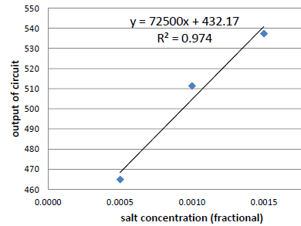
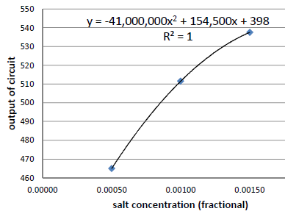
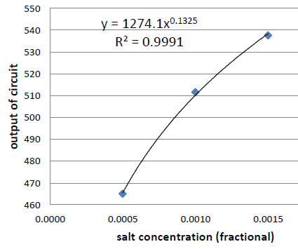
living with the lab
review of conductivity sensor calibration
Collect analog output of salinity circuit, with output numbers ranging from 0 to 1023 (the Arudino has a 10-bit ADC)
Perform linear regression to determine the expected output of the conductivity circuit as a function of salinity
Which fit is the best?
salt
concentration | Arduino
(fractional) | output
0.0000 | 2.5
0.0005 | 465
0.0010 | 511.5
0.0015 | 537.5
linear
polynomial
power

Slide 6
living with the lab
examine fits over possible salinity range
Consider how your fit behaves beyond 0.15 wt% salt since your salinity may increase well beyond 0.15% when salty water is added
Do you see any potential problems?
Which fit seems to be the best? Why?

Slide 7
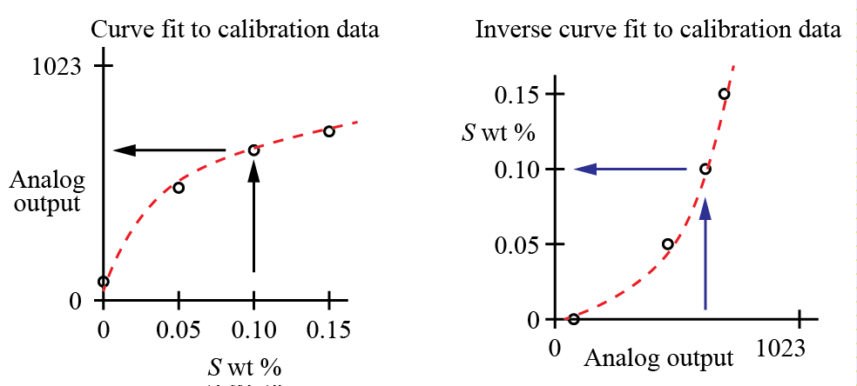
living with the lab
equations needed for salinity control sketch
Inverse equation can be obtained by
Algebraic rearrangement of the calibration curve fit, or
Performing another fit with x and y values swapped.
In either case, retain four or five digits in the curve fit coefficients

Slide 8
living with the lab
Control of Salinity
t₁ > t₂ since valve is left open an amount
of time proportional to the error
valve = open
valve = closed
salty water valve status
t₂
valve = open
valve = closed
t₁
DI water valve status
system lag
hysteresis
0.15
deadtime compensation
salinity (%wt NaCl)
error
upper control limit (UCL)
0.10
error
setpoint = 0.09
deadband
error
lower control limit (LCL)
0.05
random variation
of conductivity
system upset by
externally adding salty water
system upset by externally adding DI water
0.00
time

Slide 9
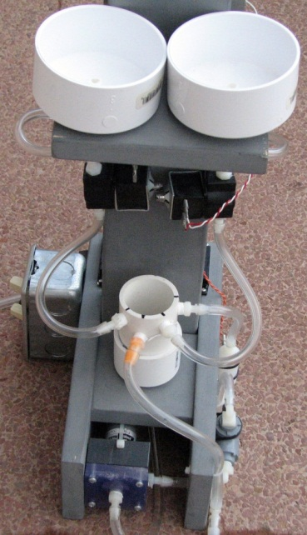
living with the lab
key points
The valve is left open an amount of time that is proportional to the error.
small error = valve is open a short amount of time
large error = valve is open a long amount of time
The DI valve is left open longer than the salty valve when correcting for the same magnitude of error (DI=0%, setpoint = 0.09%, salty = 1%).
The system has memory . . . it takes time for the salinity of the water to become uniform (mixing, water in pump and tubing). The lag time is called hysteresis.
Control is more stable if we wait for the system to stabilize after opening a valve. The deadtime compensation is set to allow the system to come to equilibrium before responding to error.
The upper and lower control limits are set so that random error will not cause the valves to open unnecessarily; these limits are often set three standard deviations of the error away from the setpoint. The difference between UCL and LCL is called the deadband.

Slide 10
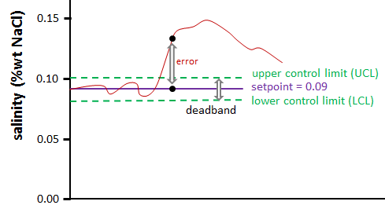
living with the lab
control strategy
The setpoint will be assigned by your instructor. Assume 0.09% NaCl here.
Compute the UCL, setpoint and LCL values for control of salinity. UCL and LCL depend on the size of the deadband.
For demonstration purposes, assume that the UCL and LCL are 0.01%NaCl from the setpoint:
Control strategy:
if analogS > UCL (or 510) then open the DI valve an amount proportional to the error
If analogS < LCL (or 495), then open the salty valve an amount proportional to the error
$$UCL=1274.1∙{\left(0.0009+0.0001\right)}^{0.1325}=510$$
$$setpoint=1274.1∙{\left(0.0009\right)}^{0.1325}=503$$
$$LCL=1274.1∙{\left(0.0009−0.0001\right)}^{0.1325}=495$$

Slide 11
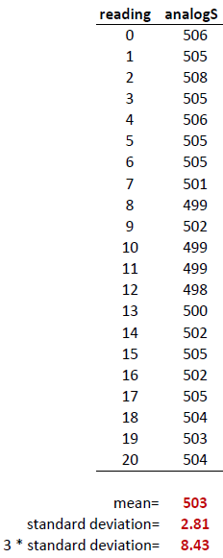
living with the lab
setting UCL and LCL by examining random error
A better way to determine UCL and LCL are by collecting analogS values for a salinity near the setpoint and then computing the standard deviation (σ) of the “error” of analogS values.
Using this approach, 99.7% of random error will fall between the LCL and UCL, which means that your solenoid valve will be triggered due to a false alarm only 0.3% of the time.
Example Readings to Illustrate Procedure
$$setpoint=1274.1∙{\left(0.0009\right)}^{0.1325}=503$$
$UCL=setpoint+3σ=503+8=51$1
$$LCL=setpoint−3σ=503−8=\text{495}$$

Slide 12
living with the lab
setting deadtime compensation
It takes time for your system to settle out after the salinity changes.
Assume the system whose response is depicted in the graph below is “upset” at 18 seconds due to a sudden addition of salty water.
At about 30 seconds, the salinity values stabilize (with continued random error at the new salinity level).
For this example, the deadtime compensation would be set to 12 seconds (30s - 18s).
This means that you would want to allow 12 seconds between salinity corrections.
deadtime = 12 s
time when salty water was added

Slide 13
living with the lab
strength of response to error
We will compute the amount of salty water that should be added to the current mixture to correct the salinity
Over correcting repeatedly causes the system to oscillate about the setpoint
a correction that is too strong was applied
0.15
error
upper control limit (UCL)
salinity (%wt NaCl)
0.10
setpoint = 0.09
lower control limit (LCL)
0.05
overshoot (undesirable)
a second correction is applied – this one is also too strong
0.00
time

Slide 14
living with the lab
apply a response proportional to error
We will compute the amount of salty water that should be added to the current mixture to completely correct the salinity
We will open the solenoid valve long enough to remove a percentage of the error
For example, if the salinity is 0.152% and the setpoint is 0.09%, then applying an 80% correction will lower the salinity to 0.102%, which is computed as correction = (.00152-(.00152-.0009)*.8)
We call the proportionality constant the gain; gain is a common term used when working with industrial controllers
0.15
error
80% of error
upper control limit (UCL)
salinity (%wt NaCl)
0.10
setpoint = 0.09
lower control limit (LCL)
0.05
0.00
time

Slide 15
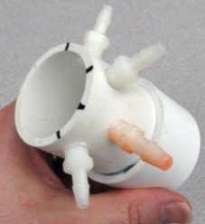
living with the lab
living with the lab
teams of 2
Class Problem
Assume that your fishtank system has a setpoint of 0.09% NaCl. Your instructor comes by your table and upsets your system by adding a good dose of DI water. The conductivity circuit returns an analog output that corresponds to a salinity of 0.04% NaCl (which is below LCL).
What is the target concentration if you have a gain of 0.80 (80%)?
Using this gain, how much salty water (1% NaCl) should be added?
How long should you leave the valve open if the flow rate is 0.2L/min?
Recommended assumptions:
The water leaves at the overflow is a mixture of water from the salty tank and the fishtank.
The most salty the overflow water can be is 1% NaCl, and the least salty it can be is 0.04% NaCl. Assume that 15% of the overflow water is 1% NaCl and that the rest is 0.04% NaCl.
Neglect density differences between incoming and outgoing water; that is, the mass of water that comes in from the salty tank is equal to the mass of water that leaves through the overflow.

Slide 16
living with the lab
living with the lab
sketch control structure
use your own data
$$setpoint=1274.1∙{\left(0.0009\right)}^{0.1325}=503$$
$UCL=setpoint+3σ=503+8=51$1
Compute setpoint, UCL and LCL
Measure salinity to get analogS (the analog output of the conductivity circuit)
If analogS > UCL or < LCL & if time since last correction > deadtime then . . .
Compute the %wt NaCl
Compute the target salinity based on your gain
Compute the time that your salty or DI solenoid valves needs to be left open
Open the DI or salty valve for the computed time
$$LCL=setpoint−3σ=503−8=\text{495}$$
$$salinity=3.6686{\left(10\right)}^{−24}∙{output}^{7.5472}$$
use your own data

Slide 17
living with the lab
living with the lab
to do for salinity control:
Bring fishtank, water bottles, multimeter & computer to class next time
Determine flow rate through your solenoid valve (mass per unit time)
Recalibrate your system
Determine your fits
salinity as a function of analogS
analogS as a function of salinity
Collect data around 0.10% NaCl to determine the standard deviation of the conductivity output so that the UCL and LCL can be determined
Determine the deadtime compensation (system response time)
Write your control sketch
THE END ☺

