Slide 1
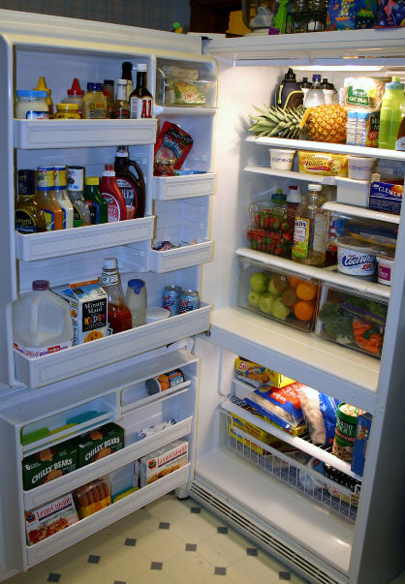
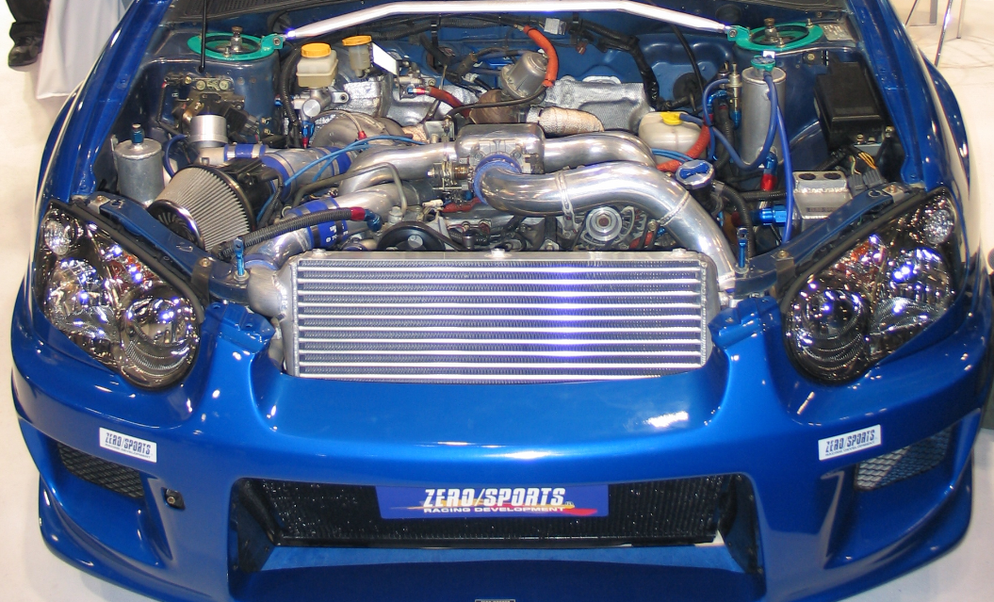
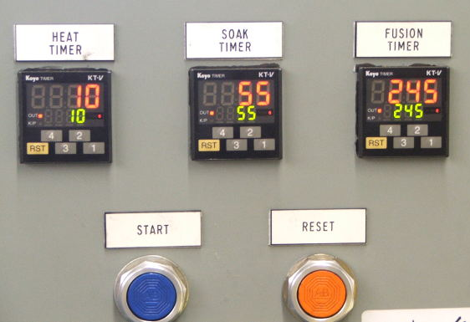
relays
living with the lab
refrigerators
a relay is a switch that is turned on or off using electricity
relays allow a low-power signal to control a large amount of power
relays are all around us
automobiles
turns on compressor when temp gets low
http://mrg.bz/DewCLX
industrial controls
http://mrg.bz/ryeosy
http://mrg.bz/OwnwHK
© 2011 David Hall

Slide 2
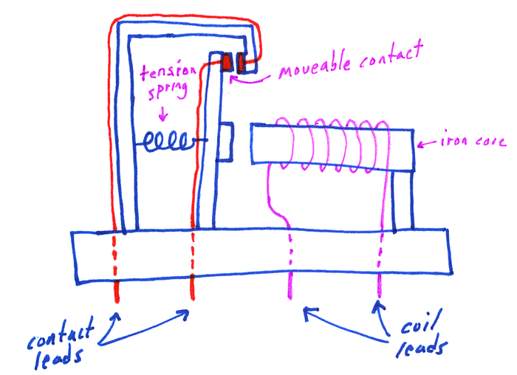
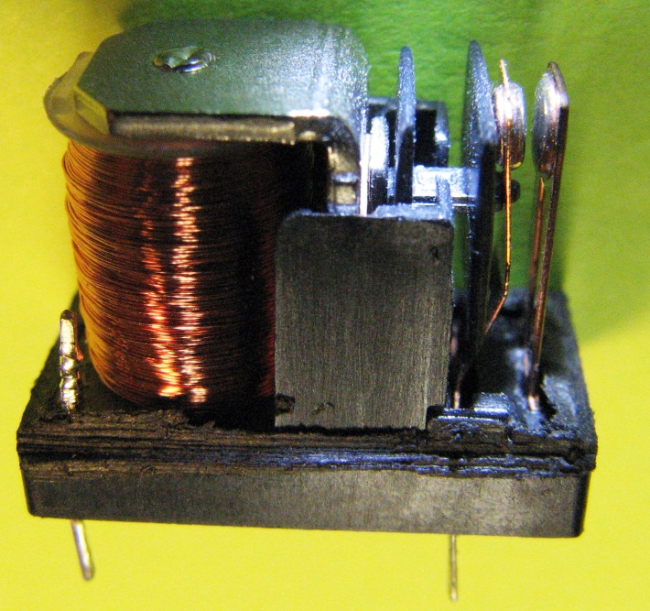
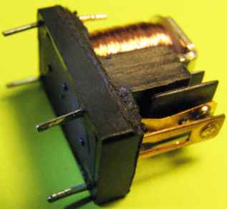
living with the lab
how relays work
passing a small current through the coil causes the iron core to become magnetized
this electromagnet attracts an iron mass on the moveable contacts causing the contracts to cause
iron mass on moveable contacts
iron core becomes an electromagnet
relay used in this class
contacts
coil
here, energizing coil pushes the right contact toward the left (stationary) contact.
coil leads
contact leads

Slide 3
living with the lab
coil
contacts
relay vocabulary
coil voltage – the voltage that must be applied across the coil leads to open or close the contacts
coil current – the amount of current drawn by the coil; this much current is required to close the contacts
small current
contact rating or contact current – the amount of current that can pass through the contact leads without damaging the relay
much larger current

Slide 4
living with the lab
coil
contacts
Is this a NO or NC relay (assuming no current is currently flowing through the coil)?
relay vocabulary
default state of contacts – the contacts can be either open (switch = off) or closed (switch = on) by default
the contacts of a normally open (NO) relay are open when no current is passed through the coil; passing current through the coil causes the contacts to close, allowing power to flow through the contact leads
the contacts of a normally closed (NC) relay are closed when no current is passed through the coil; passing current through the coil causes the contacts to open, preventing power from flowing through the contact leads

Slide 5
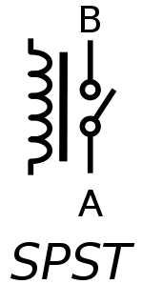
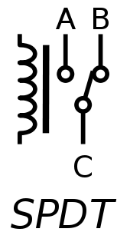
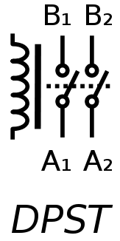
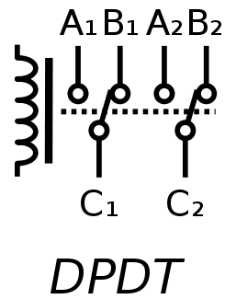
living with the lab
is this relay SP or DP?
relay vocabulary
number of poles – the number of separate circuits that can be switched by energizing the coil
SP = single pole (one circuit is switched)
DP = double pole (two circuits are switch)
throw – throw describes what happens to the contacts when the coil is energized
Single Throw – energizing the coil of a single throw (ST) relay closes the contacts if it is a NO relay; energizing the coil of a ST relay opens the contacts if it is a NC relay
Double Throw – energizing the coil of a double throw (DT) relay can either open or close the contacts, depending on how it is wired; a DT relay can be wired to either come on or go off when the coil is energized
relay diagrams from Wikipedia

Slide 6
living with the lab
what type of relay is this?
relay diagrams from Wikipedia

