Slide 1

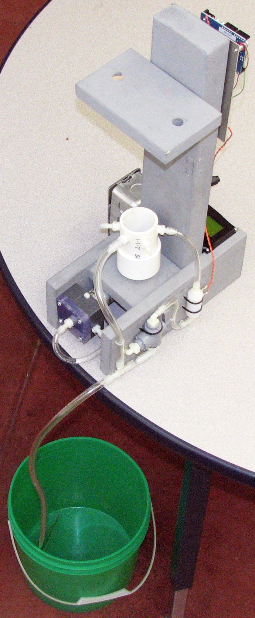
Calibration of Conductivity Sensors
living with the lab
EAS 199B

Slide 2

living with the lab
cal ∙ i ∙ brate [kal-uh-breyt]
-verb (used with object), -brat ∙ ed, -brat ∙ ing.
1. to determine, check, or rectify the graduation of (any
instrument giving quantitative measurements).
Calibration
Associate sensor output with salt concentration
Relate sensor output and salt concentration using an equation (linear regression)
The goal is to be able to compute the salt concentration based on sensor output

Slide 3
living with the lab
The Basic Idea
Adding salt to the water will increase the availability of Cl⁻ ions at the anode
More ions at the anode will increase the rate at which chemical reactions can occur
The “electrical resistance” of the salt water will decrease as more salt is added to the water
The analog voltage on the + side of the 10kΩ resistor will increase as more salt is added
Correlating this voltage with the salt concentration will allow us to “calibrate” the conductivity sensor
5V
e⁻
e⁻
10 kΩ
anode – oxidation
(loss of electrons)
cathode – reduction
(gain of electrons)
e⁻
e⁻
Cl⁻
Cl⁻
Na⁺
Na⁺
Cl₂
Na⁺
Cl⁻
OH⁻
e⁻
Cl⁻
Na⁺
Na⁺
e⁻
H
Cl
Cl⁻
Na⁺
Cl
Cl⁻
Na⁺
e⁻
H₂O
H
Cl⁻
Cl⁻
Cl⁻
H₂O
e⁻
ion migration
Na⁺
OH⁻
Cl⁻
Cl⁻
Na⁺
Na⁺
Na⁺
Cl⁻
Na⁺
Na⁺ is a spectator ion

Slide 4
living with the lab
The Circuit and Sketch
int salinity_power_pin = 4; // Digital I/O pin, Global variable
void setup()
{
Serial.begin(9600);
pinMode(power_pin, OUTPUT);
}
void loop()
{
int salinity_input_pin = 2; // Analog input pin
int salinity;
salinity = salinity_reading( salinity_power_pin, salinity_input_pin );
Serial.println(salinity);
}
// ---------------------------------------------------
int salinity_reading( int power_pin, int input_pin ) {
int reading;
digitalWrite( power_pin, HIGH ); // Turn on the sensor
delay(10); // Wait to settle
reading = analogRead( input_pin ); // Read voltage
digitalWrite( power_pin, LOW ); // Turn off the sensor
return reading;
}

Slide 5
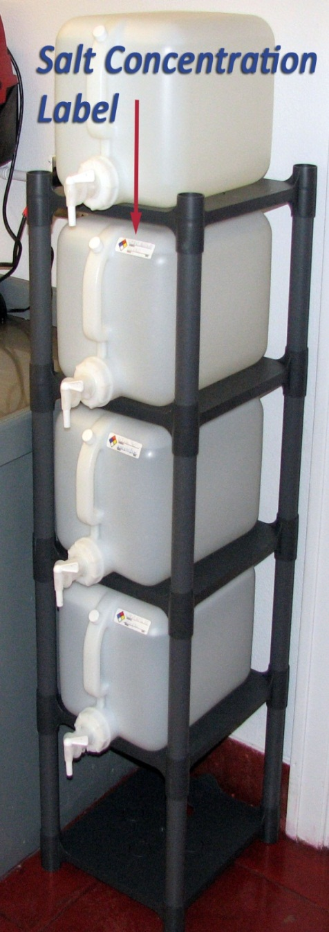
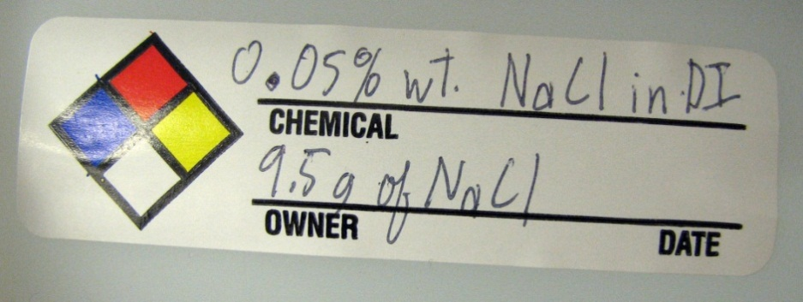
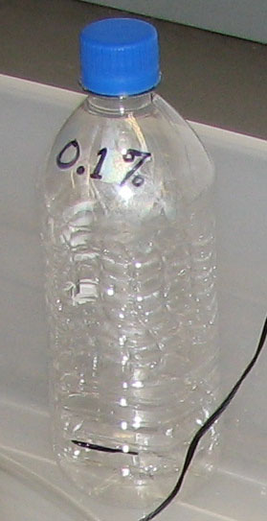
living with the lab
Salt Concentrations
Each group of students should put about 1.5 inches of water in four bottles
The four bottles should contain . . .
  DI water
  0.05% weight NaCl
  0.10% weight NaCl
  0.15% weight NaCl
Please take ONLY the amount that you will need to use TODAY
Be sure to label your water bottles
Swish a small amount of DI water around in your bottle to wash out impurities before filling with calibration water

Slide 6
living with the lab
Capture data during calibration

Slide 7
living with the lab
Calibration steps in the lab
Configure your flow loop as required for homework
Implement the conductivity sensor circuit on your breadboard
Flush tank with DI water.
  Pour enough DI water into your fishtank to fill the flow loop
  Turn on the pump to run the flow loop for about a minute to “wash out” the impurities.
  Turn the three-way valve toward the drain to flush the system
  Repeat to completely clean the system
Fill the system with DI water
Collect calibration data
  Wait for the system to come into equilibrium
  Copy a large (50 to 100) readings from the Serial Monitor to a text file or Excel
  Save the file with a name that allows you to identify it later
Fill the system with 0.05 wt% salt water. Flush once, and refill with 0.05 wt% salt water
Repeat steps 5a through 5c
Repeat steps 5 through 7 for 0.10 wt% salt water and 0.15 wt% salt water

Slide 8
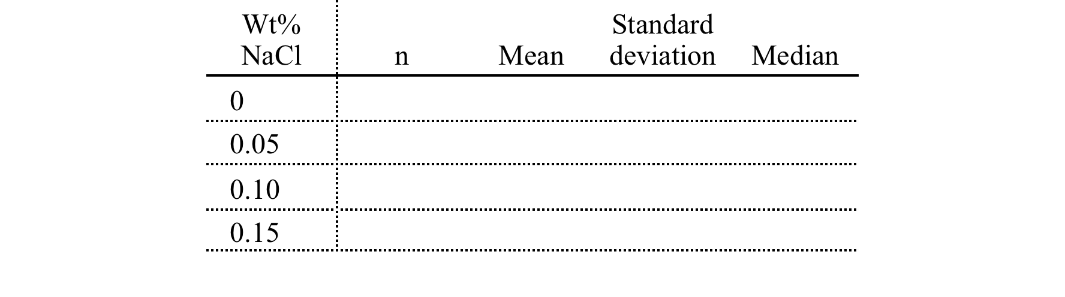
living with the lab
Analysis of calibration data
Use MATLAB to create a histogram of your data
Compute the mean, standard deviation and median of the data
Record the data in the following table

Slide 9
living with the lab
Steps
Configure your flow loop as required for homework
Implement the conductivity sensor circuit on your breadboard
Flush tank with DI water.
  Pour enough DI water into your fishtank to fill the flow loop
  Turn on the pump to run the flow loop for about a minute to “wash out” the impurities.
  Turn the three-way valve toward the drain to flush the system
  Repeat to completely clean the system
Fill the system with DI water
Collect calibration data for DI water
Fill the system with 0.05 wt% salt water. Flush once, and refill with 0.05 wt% salt water
Collect calibration data for 0.05wt% salt water
Repeat steps 6 and 7 for 0.10 wt% salt water and 0.15 wt% salt water
salt concentration (%wt) | output to LCD
0.00
0.05
0.10
0.15
collect this data

Slide 10
living with the lab
Fit Output of Sensor to Salt Concentration

