Slide 1
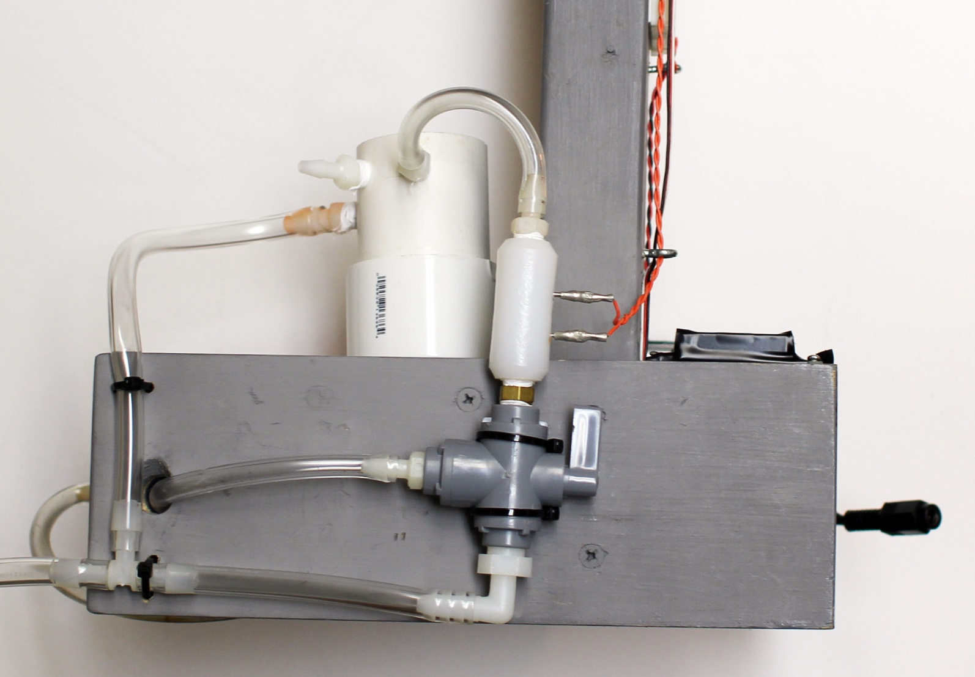
conductivity sensor implementation
living with the lab
© 2011 LWTL faculty team

Slide 2
living with the lab
conductivity measurement circuit
we use the same voltage divider circuit used earlier for the photoresistor circuit
$${∆V}_{conductivity sensor}+ {∆V}_{10kΩ resistor}=5 volts$$
what happens to the electrical resistance of the water as it becomes more salty?
digital output = 5V when HIGH (set high periodically to measure conductivity)
it decreases
if the resistance of the salt water decreases, then what happens to the voltage drop across the conductivity sensor?
it decreases
analog input (measures voltage across 10kΩ resistor)
if the voltage drop across the conductivity sensor decreases, then how does this influence the voltage drop across the 10kΩ resistor?
10 kΩ
it increases
so, increasing the salinity of the water causes the analog input read by the Arduino to (increase or decrease)?
0 to 1023

Slide 3
living with the lab
what happens when salt is added to water????
The ionically bonded NaCl molecules dissociate into Na+ and Cl- ions and become mobile
they are surrounded by polar water molecules (they are hydrated)
electrodes (no voltage applied)
O
Cl⁻
water
H H
O
Cl⁻
Na⁺
Cl⁻
O
H H
Na⁺
Na⁺
Na⁺
H H
Cl⁻
O
Cl⁻
O
H H
Cl⁻
Na⁺
Na⁺
Cl⁻
O
Cl⁻
Na⁺
H H
H H
Na⁺
Na⁺
Cl⁻
Na⁺
Cl⁻
Cl⁻
Cl⁻
Na⁺
Cl⁻
Na⁺
O
O
Cl⁻
Na⁺
Na⁺
H H
H H
Na⁺
Cl⁻
Cl⁻
O
O
Cl⁻
H H
Na⁺
H H
Cl⁻
Na⁺
Na⁺
O
O
Na⁺
H H
H H

Slide 4
living with the lab
applying voltage to induce electron flow
electrons are really not directly conducting through the water from one electrode to the other (like when electrons move through a copper wire)
5V
e⁻
e⁻
10 kΩ
anode – oxidation (loss of electrons)
cathode – reduction (gain of electrons)
e⁻
e⁻
reduction occurs at the negatively charged cathode:
Cl⁻
Cl⁻
Na⁺
Na⁺
Cl₂
Na⁺
Cl⁻
OH⁻
e⁻
Cl⁻
Na⁺
Na⁺
e⁻
H
$$2 H_{2}O(l)+2e^{−}→H_{2}\left(g\right)+2{OH}^{−}(aq)$$
Cl
Cl⁻
Na⁺
Cl
Cl⁻
Na⁺
e⁻
H₂O
H
Cl⁻
Cl⁻
Cl⁻
H₂O
e⁻
ion migration
Na⁺
OH⁻
oxidation occurs at the positively charged anode:
Cl⁻
Cl⁻
Na⁺
Na⁺
Na⁺
Cl⁻
Na⁺
Na⁺ is a spectator ion
$$2 {Cl}^{−}\left(aq\right)→{Cl}_{2}\left(g\right)+2e^{−}$$
It seems like an Na+ would accept an electron and be reduced . . . why not???

Slide 5
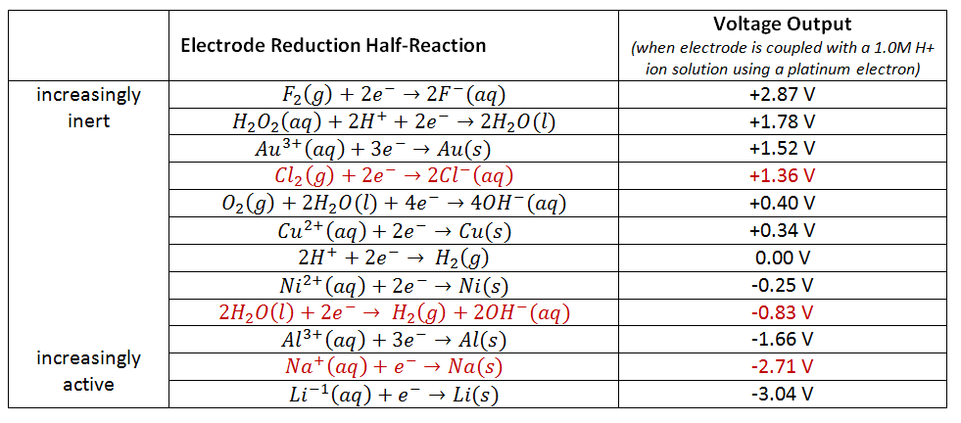
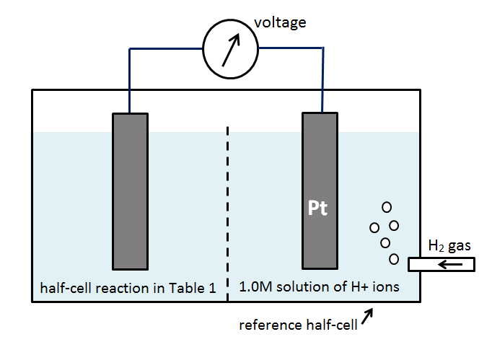
living with the lab
why is H₂O reduced and not Na⁺ ???
reactions further down in the table are less likely to occur
reactions with positive voltages will occur spontaneously
you must apply external voltage across the electrodes to make a reaction with a negative potential occur

Slide 6
living with the lab
the net reaction of conductivity system
the net reaction occurring in the system is . . .
we must apply at least 2.19 V to the conductivity circuit to drive the reaction
applying 5 V is sufficient, and higher voltages will increase the rate of oxidation & reduction reactions

Slide 7
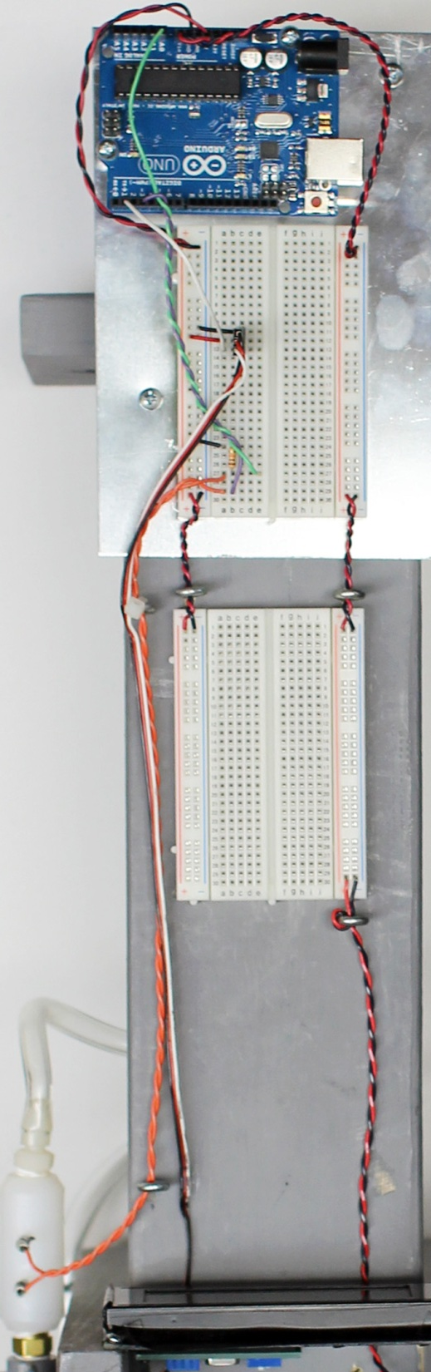
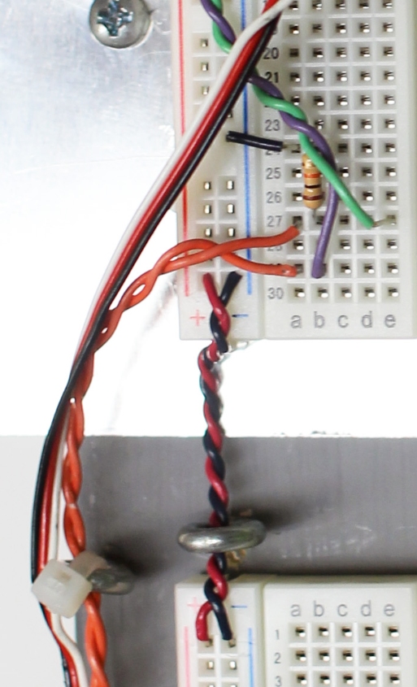
living with the lab
system wiring
digital output = 5V when HIGH (set high periodically to measure conductivity)
analog input (measures voltage across 10kΩ resistor)
10 kΩ

