Slide 1
Fish Tank Project
Platform Fabrication
EAS 199B Portland State University
Mechanical and Materials Engineering

Slide 2
Learning Objectives for these Slides
After this presentation you should be able to
  Describe the safety precautions necessary for working in the lab
  Follow the safety precautions necessary for working in the lab
  Follow the assembly instructions for the wooden platform
    http://web.cecs.pdx.edu/~eas199/B/howto/fishtank/platform/
  Complete the assembly of the wooden platform

Slide 3
Follow these Safety rules
Do not operate any machine unless you have
  Completed the hold-harmless form (Fall 2012)
  Been trained to operate the machine
  Been authorized to do so by the instructor or teaching assistant
When using rotating equipment such as milling machines, drills and lathes
  Securely tie long hair back to remove the possibility of it falling below your face
  Do not wear loose clothing
  Remove lanyards or jewelry hanging from your neck or wrist

Slide 4
Follow these Safety Rules, continued
When using any power tools like milling machines, drills and lathes
  Clamp the work piece in a vise or chuck before drilling or cutting
  Do not hold or restrain the work piece only with your hand
  Make sure safety guards are in place before turning on the machine
  Never leave a running tool unattended
When working in the lab
  Always wear approved eye protection
  Take common sense precautions and avoid “horse play”
  Keep the work area clean an organized
  Never use your own power tools
  Only use lab facilities for activities required for EAS 199A, 199B, 199C
  Report damaged equipment, unsafe activities and accidents to the instructor

Slide 5

Follow these Safety Rules, continued
Do not begin to fabricate your fish tank platform until you have carefully read the operating and safety instructions above and agree to operate the equipment in a responsible manner. You must sign the safety contract before beginning fabrication.

Slide 6
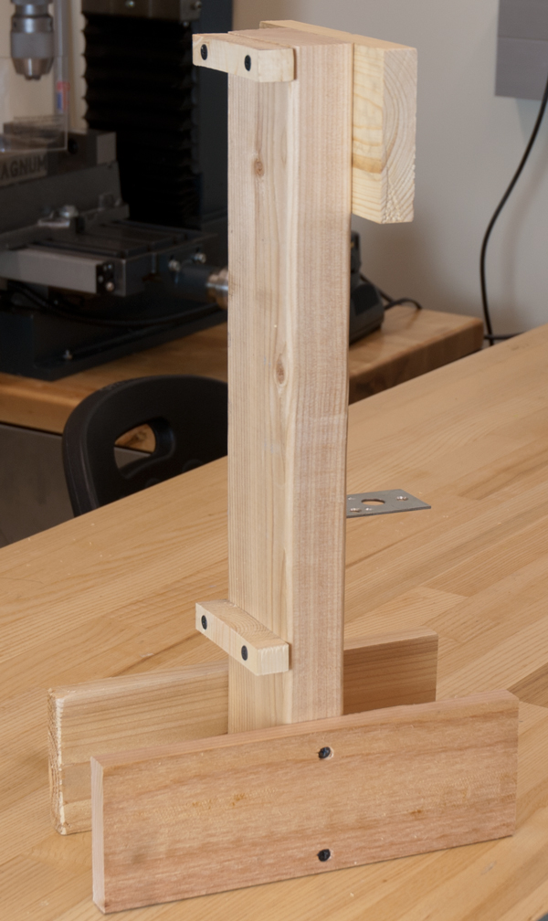
Start with the structure
Materials are provided
Finish fabrication today
Have painted by next week
See:
  http://web.cecs.pdx.edu/eas199/B/howto

Slide 7
Follow instructions for basic joint construction

Slide 8
Follow instructions for basic joint construction

Slide 9
To-do list for Class Meeting 2
Sign hold-harmless form
Sign-up your group members
Fabricate the fish tank platform
  See http://web.cecs.pdx.edu/~eas199/B/howto/
Prepare for next class
  Paint your fish tank platform — finished by next class meeting
  Read instructions for fabricating the salinity sensor
  Start homework
  Visit D2L web site
  Start purchasing items on your shopping list
    http://web.cecs.pdx.edu/~eas199/B/equipment/

