Slide 1
Fish Tank Project
Introduction
EAS 199B Portland State University
Mechanical and Materials Engineering

Slide 2
Learning Objectives for these Slides
After this presentation you should be able to
  Explain the scope of the fish tank project
    What your fish tank will be able to do at the end of the class
    Which skills the project will help you develop
  Know what items you need to purchase
    And where to find the list of items
  Know where to find fabrication instructions for the fish tank
  Know the basic components required for automated control of the fish tank
  Know how the fish tank project will be graded
  Know the role of task leaders in completing the project

Slide 3
What does a fish need?
Notes:
Things we won’t provide: nutrients, waste removal, adequate space
Fish tank project: controlled salinity and controlled temperature

Slide 4
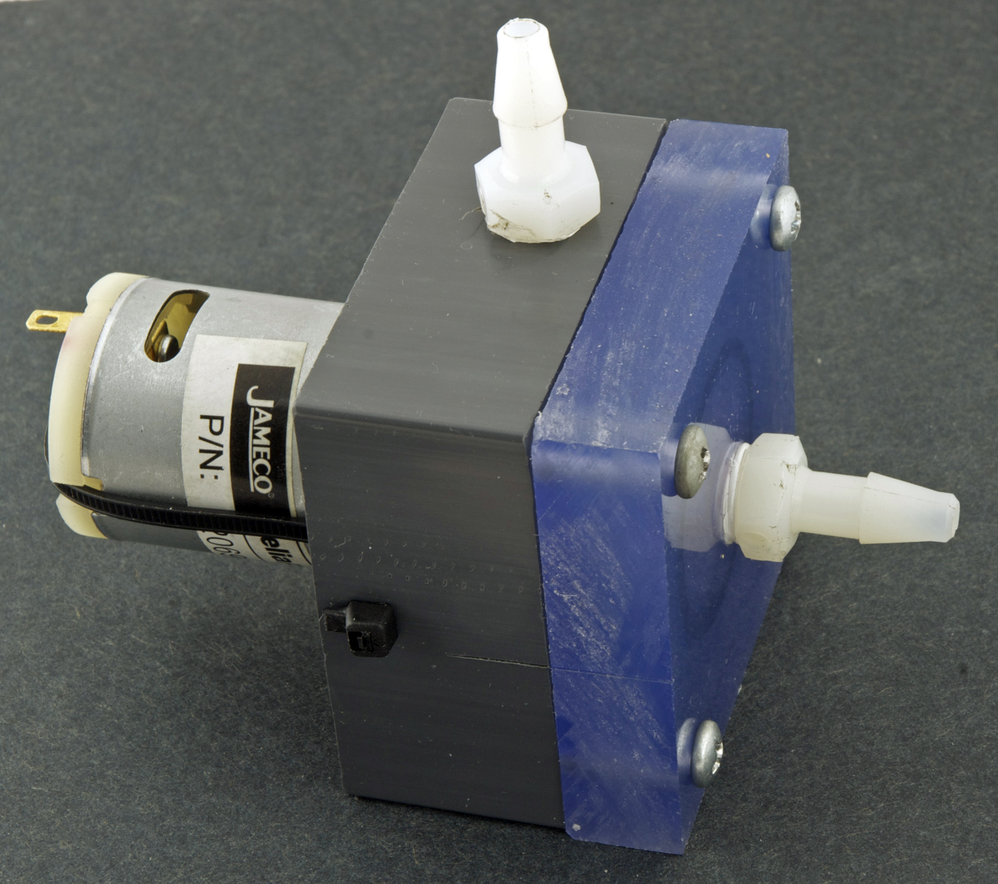
Fish tank project uses the pump from EAS 199A

Slide 5
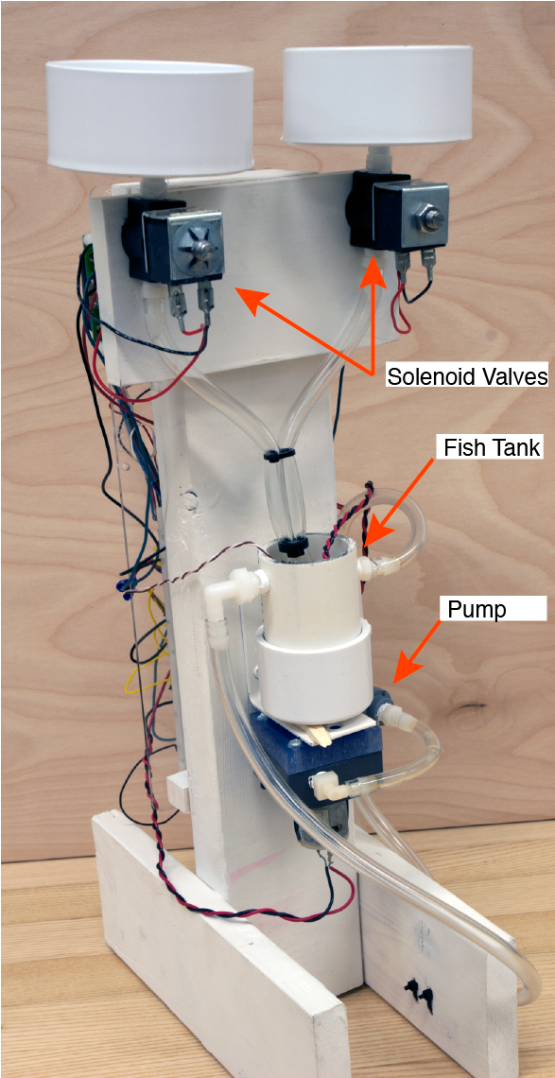
Schematic and photographic views of a completed fish tank

Slide 6
Fish tank development can be divided into 4 phases that will span all 10 weeks of the term.
Preliminary system fabrication
  Wooden platform
  Salinity sensor and assembly of flow loop
  Calibration of salinity sensor
Salinity control system
  Assembly of supply tanks and solenoid control circuit
  Programming the salinity control algorithm
Temperature control system
  Fabrication of thermistor sensor and heater
  Programming of temperature control
Integration of salinity and temperature control

Slide 7
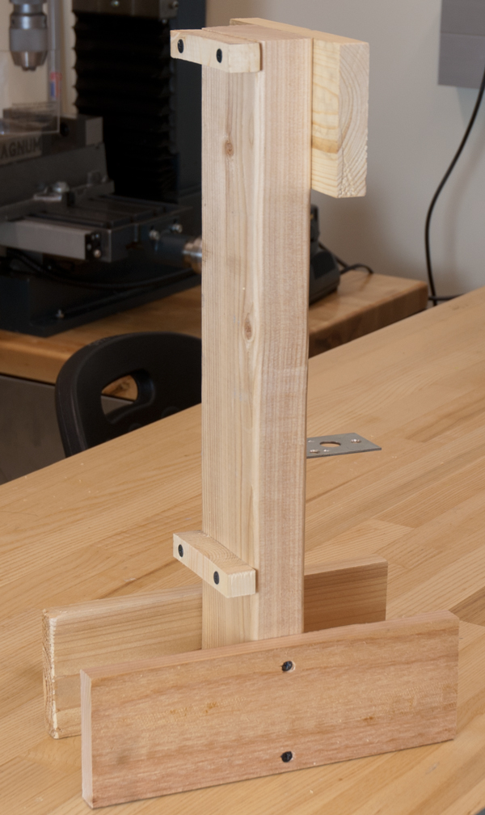
Start with the structure
Materials are provided
Start next class
Have painted by next week
See:
  http://web.cecs.pdx.edu/eas199/B/howto

Slide 8
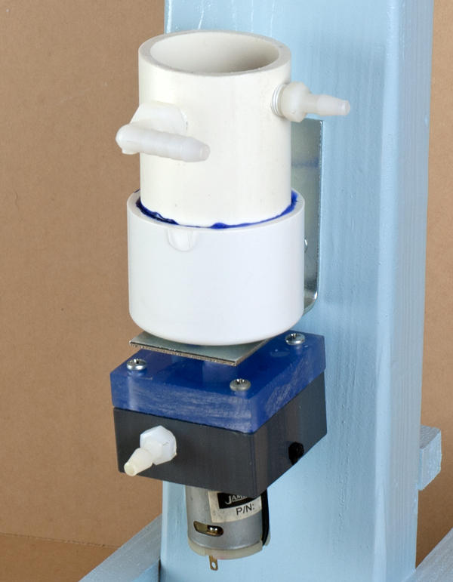
Make the fish tank and salinity sensor
Materials are provided
Make fish tank today
Have it painted by next week
See:
  http://web.cecs.pdx.edu/eas199/B/howto

Slide 9
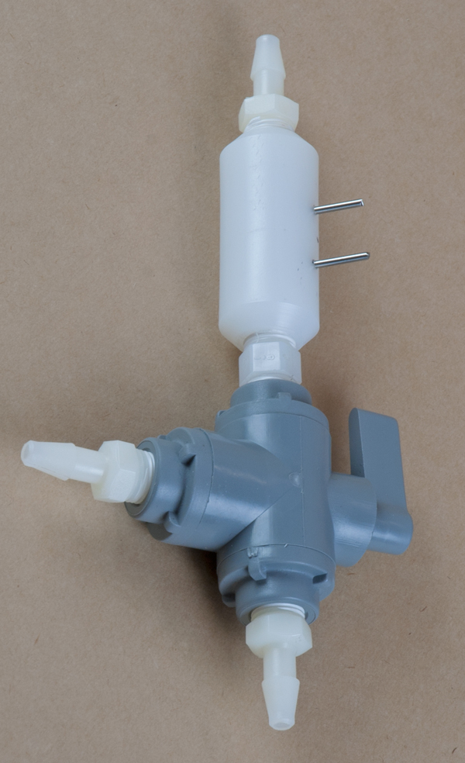
Make the fish tank and salinity sensor
Materials are provided
Make fish tank today
Have it painted by next week
See:
  http://web.cecs.pdx.edu/eas199/B/howto

Slide 10
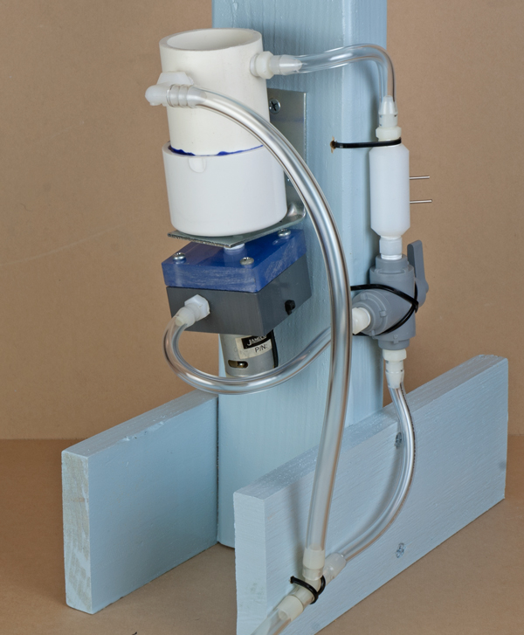
Assemble the flow loop

Slide 11
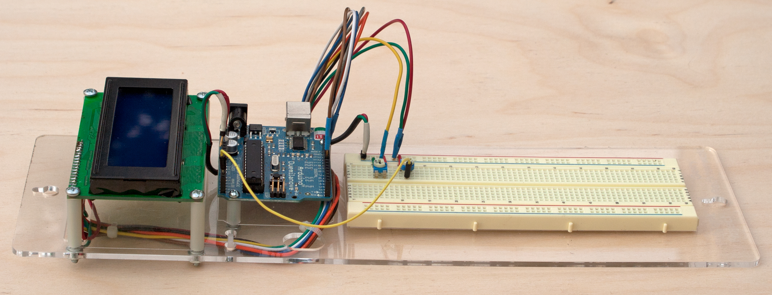
Assemble a wiring harness for the LCD panel

Slide 12
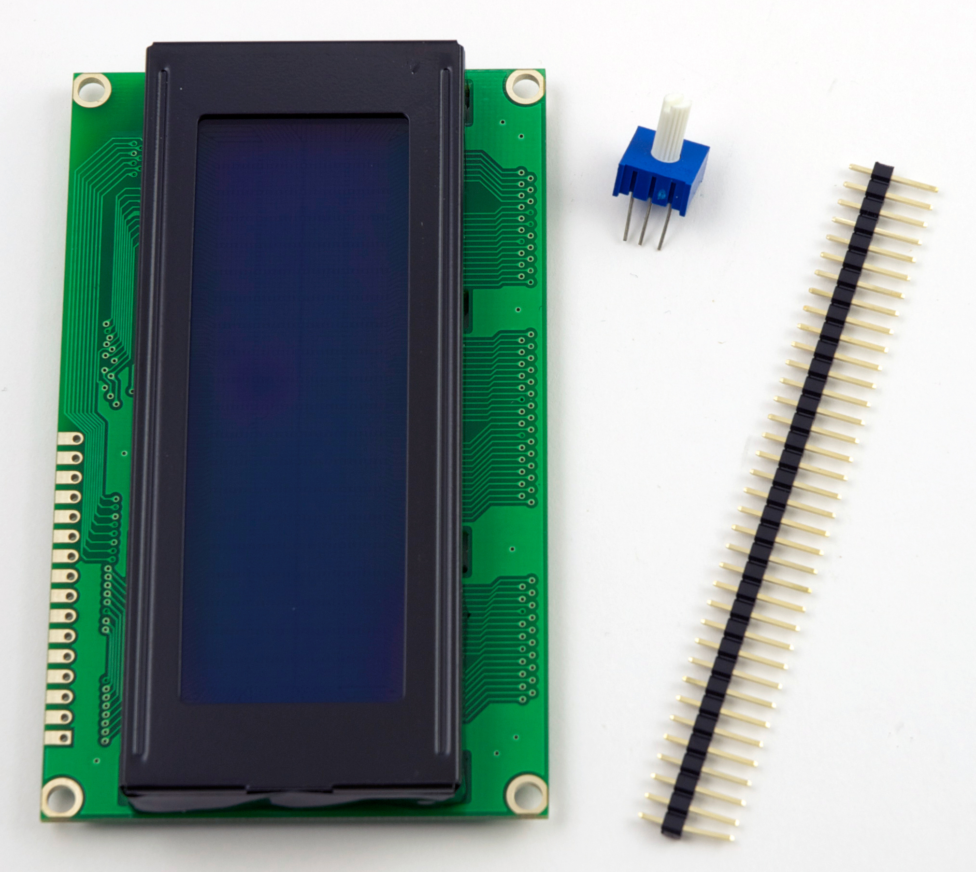
Each student buys an LCD panel from the bookstore

Slide 13
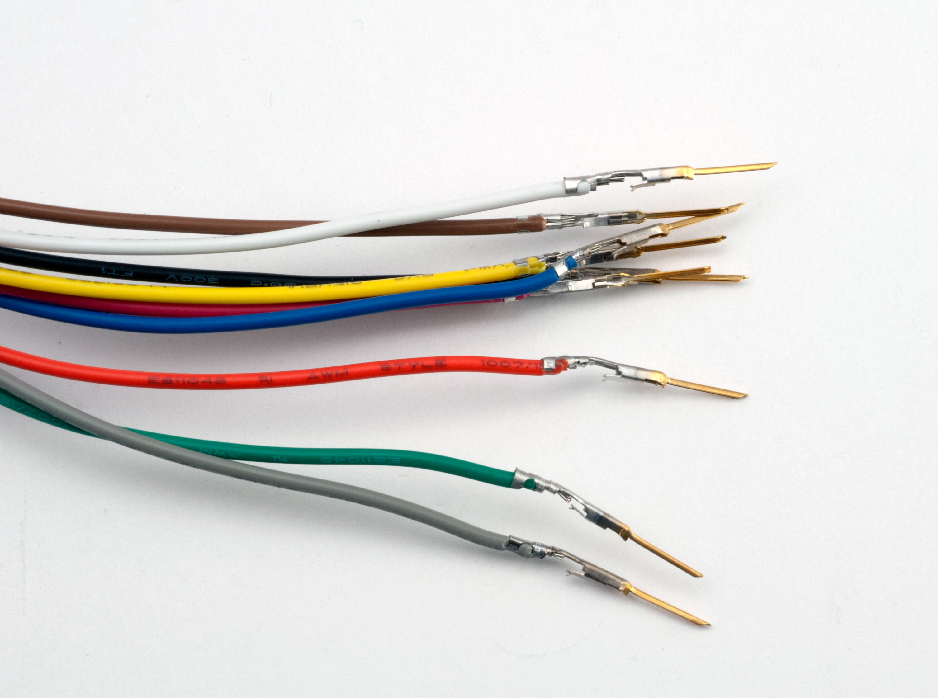
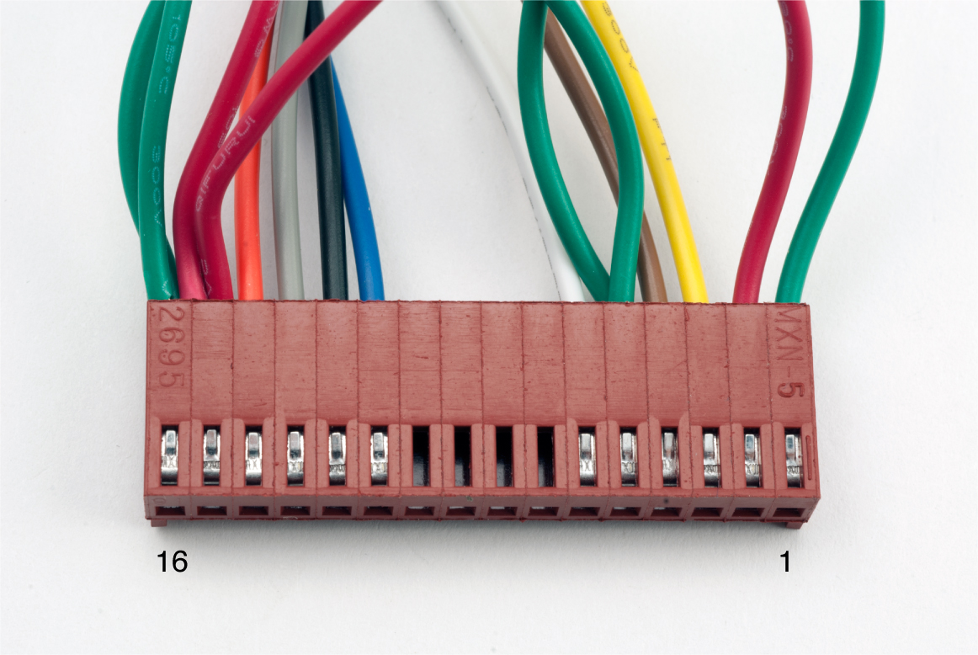
Each student assembles a wiring harness for the LCD panel

Slide 14
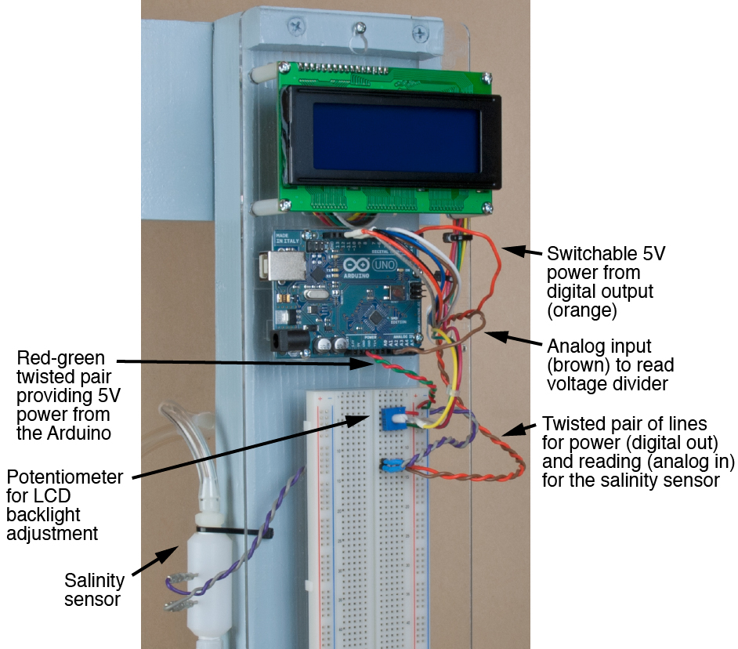
Use the LCD to display salinity readings

Slide 15
Student teams will calibrate their salinity sensors
Calibration: (from Wikipedia):
Calibration is a comparison between measurements – one of known magnitude or correctness made or set with one device and another measurement made in as similar a way as possible with a second device.
The device with the known or assigned correctness is called the standard. The second device is the unit under test, test instrument, or any of several other names for the device being calibrated.

Slide 16
Student teams calibrate their salinity sensors
What does “calibrate” mean?

Slide 17
Salinity sensor calibration will involve …
Making careful measurements!
Analyzing the statistics of the measurements
Introduction to MATLAB
Curve fit of averaged data
Forward and reverse calibration

Slide 18
After calibrating the salinity sensor you will be able to determine the salinity of water in the tank
Measure salinity
If salinity is greater than upper limit:
  Add fresh water: open valve, wait, close valve.
If salinity is less than lower limit:
  Add salty water: open valve, wait, close valve.
Wait for the system to mix
Return to step 1.

Slide 19
Add water from fresh and salty water supplies

Slide 20
Solenoids are controlled by cascade-control circuit

Slide 21
The fish tank requires two circuits:
5V for for Arduino and Controls
12V for the pump, solenoids and heater

Slide 22
Control algorithm requires planning and modeling of the system
Measure salinity
If salinity is greater than upper limit:
  Add fresh water: open valve, wait, close valve. How long?
If salinity is less than lower limit:
  Add salty water: open valve, wait, close valve. How long?
Wait for the system to mix. How long?
Return to step 1.

Slide 23
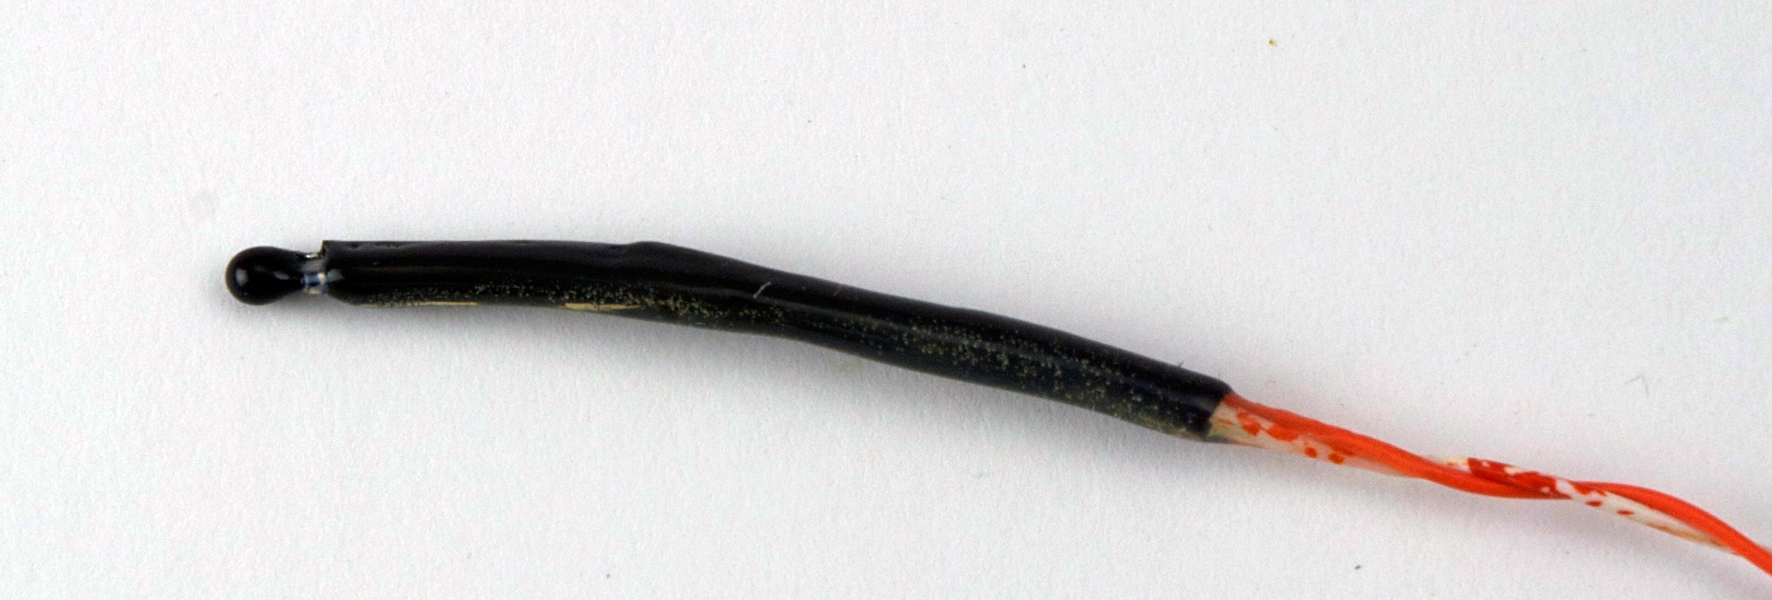
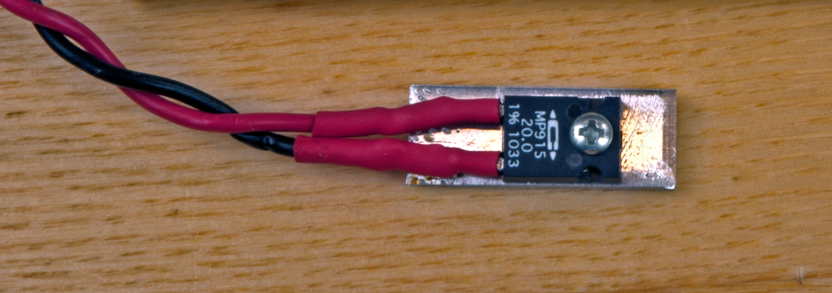
For temperature control we need to measure temperature and add heat
Thermistor for measuring temperature
Power resistor as an electric heater

Slide 24
Calibrate the thermistor

Slide 25
Control algorithm requires planning and modeling of the system
Measure temperature
If temperature is below than lower limit:
  Turn on the heater, wait, turn off the heater. How long?
Return to step 1.

Slide 26
Final system has both salinity and temperature control

Slide 27
Grading scheme for the project
5% | Fabrication of platform and flow loop
5% | Assembly of electrical power system
10% | Calibration of salinity sensor
15% | Dynamic control of tank salinity
10% | Calibration of thermistor probe
15% | Dynamic control of tank temperature
20% | Final system performance for dynamic, autonomous control of salinity and temperature, and display of system state
20% | Final presentation
100%

Slide 28
Rotate task leadership for the fish tank project
Fish tank has 8 grading checkpoints
Teams of 4 will designate a leader for each checkpoint
  Two checkpoints per student
Responsibilities of leader are
  Communicate with instructor
  Make sure project objectives are met (refer to rubrics)
  Make sure all members of the team are capable of answering questions about the current phase of the project
Pick your leadership assignments early

Slide 29
Learning objectives
By the end of this course you should be able to
Explain on/off and proportional feedback
Write Arduino codes to implement controls
Describe basic statistics of sensor measurements
Perform sensor calibration
Build cascade control circuits using transistors and relays
Use mass and energy balances to describe system performance

Slide 30
To-do list for Class Meeting 1
Form groups of four
Fabricate the fish tank
  See http://web.cecs.pdx.edu/~eas199/B/howto/
Prepare for next class
  Read instructions for fabricating the fish tank platform
  Start homework
  Visit D2L web site
  Make a shopping list
    http://web.cecs.pdx.edu/~eas199/B/equipment/

