Slide 1
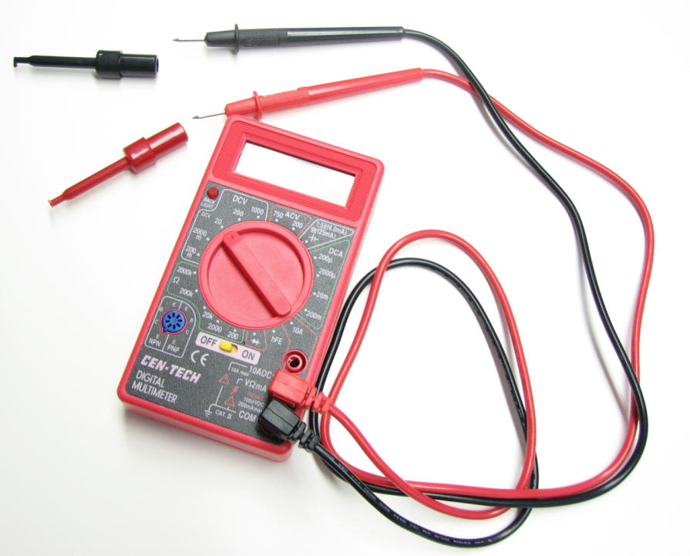
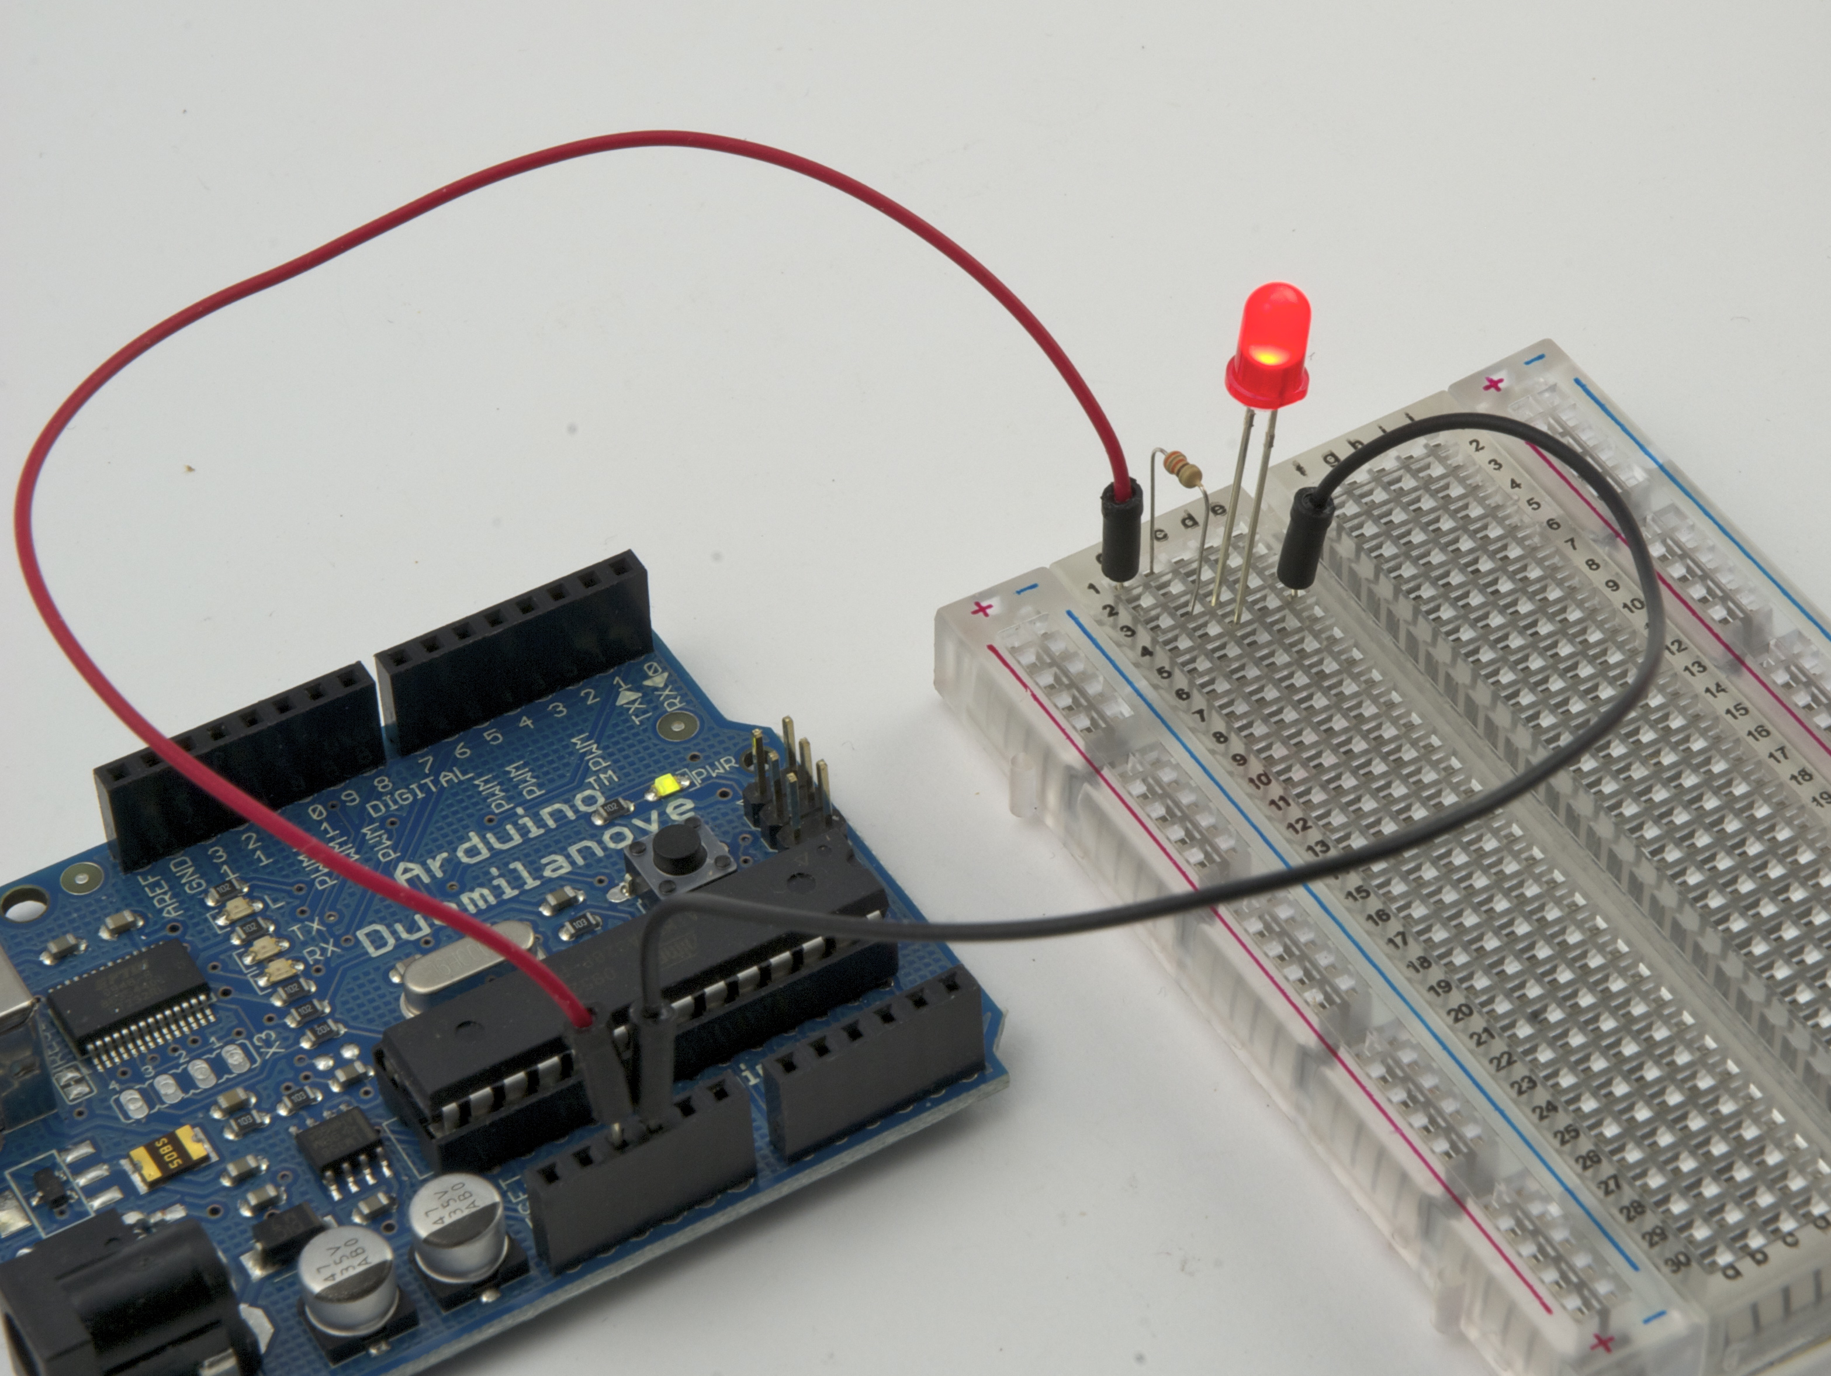
Using Your Arduino,
Breadboard and Multimeter
Work in teams of two!
EAS 199A Fall 2011

Slide 2
Your Multimeter
pincer clips – good for working
with breadboard wiring
probes
(push these onto probes)
leads
Turn knob to select the type of measurement.
You will use the multimeter to understand and troubleshoot circuits, mostly
measuring DC voltage, resistance and DC current.

Slide 3
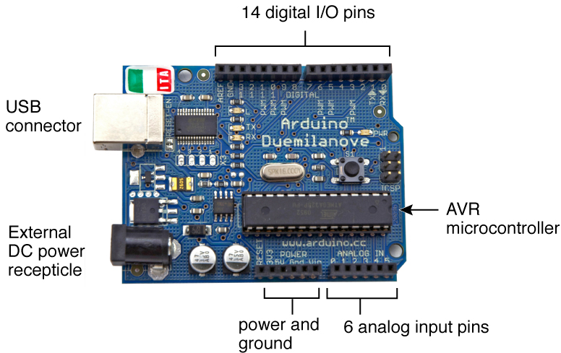
The Arduino Duemilanove
Duemilanove means “2009” in Italian
Power can be provided through the USB cable (+5V from
the computer) or externally (7-12V supply recommended)

Slide 4
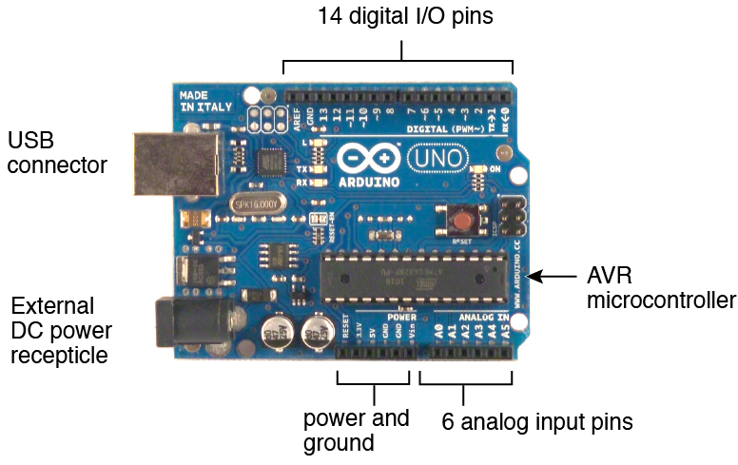
The Arduino Uno
The Arduino Uno was released in September 2010 as an update to the Duemilanove
Power can be provided through the USB cable (+5V from
the computer) or externally (7-12V supply recommended)

Slide 5
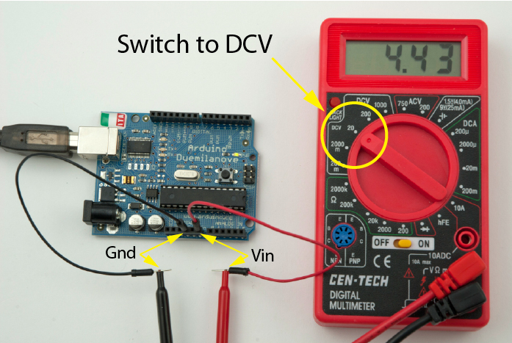
Measure Vin
Vin is the voltage of the power supply. The USB supplies a nominal 5V (4.43V was measured when this photo was taken)

Slide 6
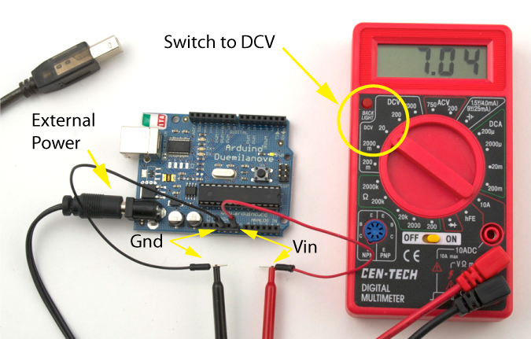
Change power source and measure Vin
In this photo, a 7V DC power supply was plugged into the power jack of the Arduino.

Slide 7
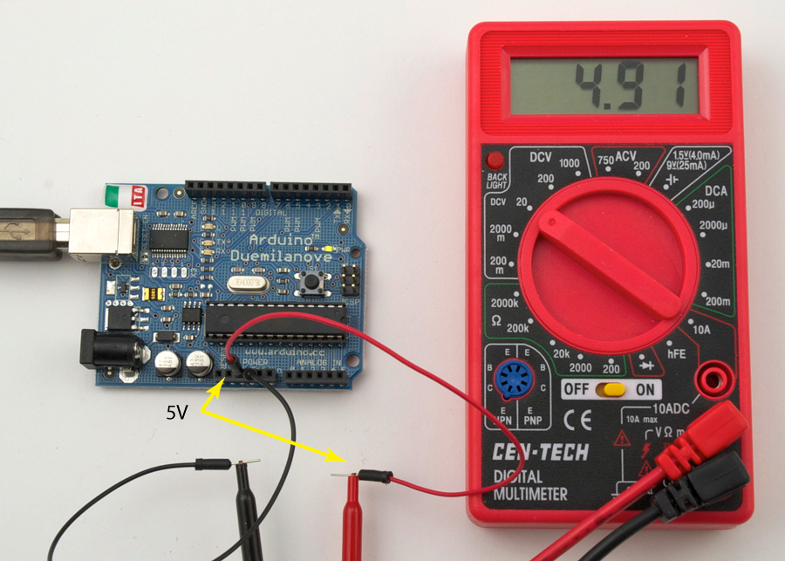
Check Voltage at 5V Power Pin
The on-board voltage regulator maintains the voltage on the 5V pin at about 5V
The measured voltage is close to 5V target.

Slide 8
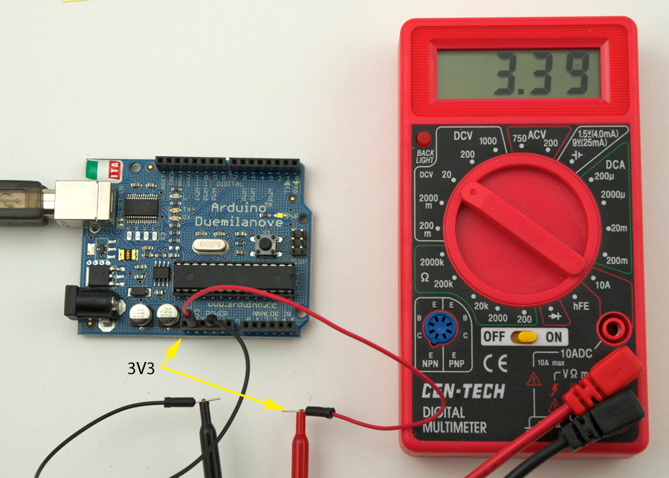
Check Voltage at 3.3V Pin
The FIDI chip on the Arduino, which helps the microcontroller talk with your computer
through the USB cable, also has an on-board voltage regulator that outputs 3.3V.
If you need less than
5V for a project, you
can use the 3.3V pin,
Which provides about
3.3V. The current
draw from the 3V3 pin
is limited to 50mA.
max power = V∙I
= 3.3V∙0.05A
= 0.165W
= 165mW

Slide 9
Select Resistors
Find the 330Ω and the 10kΩ resistors from your parts kit .
color | digit
black | 0
brown | 1
red | 2
orange | 3
yellow | 4
green | 5
blue | 6
violet | 7
gray | 8
white | 9
first
digit
gold = ±5%
silver = ±20%
tolerance
second
digit
number
of zeros
Example: 330Ω resistor:
3 = orange
3 = orange
Add 1 zero to 33 to make 330, so 1 = brown
So, 330 = orange, orange, brown
Now, find the 10kΩ resistor.

Slide 10
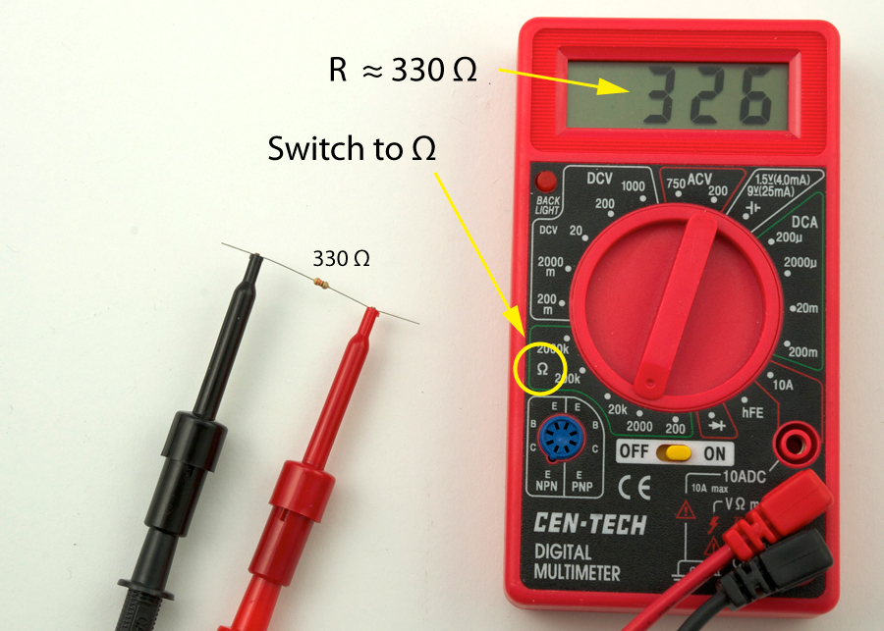
Check Resistance of Resistors

Slide 11
Building a circuit on a breadboard

Slide 12
LED circuit:
Two equivalent pictures

Slide 13
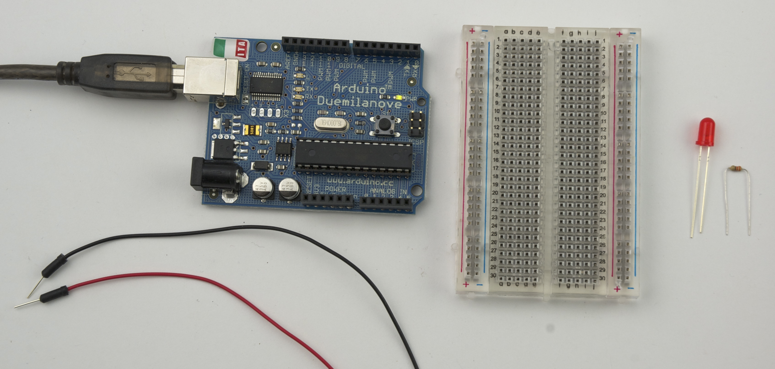
Building an LED Circuit
Supplies:
2 two jumper wires – colors don’t matter, but red is usually used for positive, and black is used for negative
LED
330 Ω and 10kΩ resistors
Arduino
Breadboard
USB cable from your computer)

Slide 14
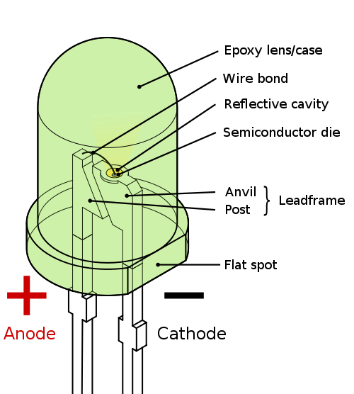
LEDs
LED = Light Emitting Diode
+ -
electronic symbol
Diagram from Wikipedia description of an LED
Electricity can only flow one way through an LED (or any diode).
The flat spot on the LED must be connected to ground (GND).

Slide 15
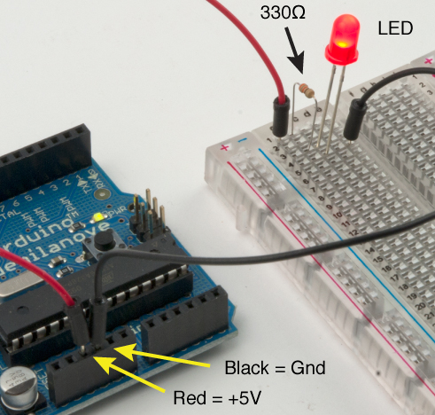
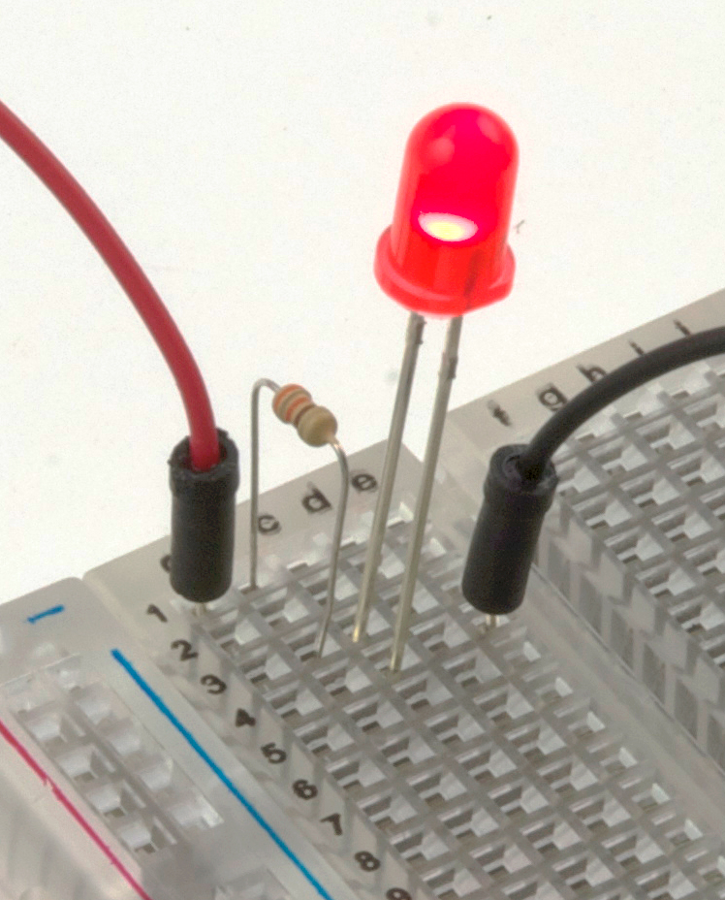
Building an always-on
LED Circuit
Short leg of LED connects
to ground wire

Slide 16
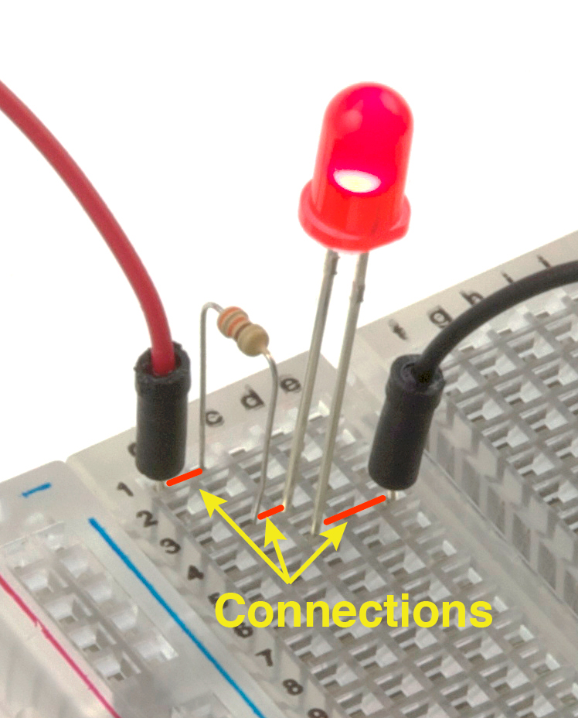
Breadboard LED circuit

Slide 17
The Circuit
These circuit diagrams
are equivalent
Symbol for ground (GND)

Slide 18
Replace the 330Ω Resistor
with the 10kΩ Resistor
What happens and Why??
ANSWER: The smaller resistor (330Ω) provides less resistance to current than the larger resistor (10kΩ). For the same applied voltage, increasing the resistance decreases the current.
Therefore, replacing the 300Ω resistor with the 10kΩ resistor reduces the current and causes the LED to glow less brightly.
What would happen if you forgot to put in a resistor? You would probably burn
up your LED.

Slide 19
Arduino program to blink an LED
Build the circuit on the breadboard
  A slight modification to always-on LED circuit
Write your first Arduino program
Use the digital (on/off) output to turn LED on and off

Slide 20
Connect the Power Wire to Pin 2
(Use P2 as a digital output)
Enter and run the following program:
void setup() {
// initialize pin as an output:
pinMode(2, OUTPUT);
}
void loop() {
// turn the LED on
digitalWrite(2, HIGH);
// wait 1 second = 1000 ms
delay(1000);
// turn the LED off
digitalWrite(2, LOW);
// wait for 500 ms
delay(500);
}

Slide 21
How the Program Works
void setup() {
pinMode(2, OUTPUT);
}
void loop() {
digitalWrite(2, HIGH);
delay(1000);
digitalWrite(2, LOW);
delay(500);
}
initialize pin 2 as an output
set pin 2 to HIGH (5V)
infinite loop
wait 1000 ms
set pin 2 to LOW (0V)
wait 500 ms
1000 ms
500 ms
HIGH = 5V and LOW = 0V (Always!!!!)
5V
voltage (V)
0V
time (ms)

Slide 22
Now Experiment on Your Own!
Try changing the time to 1.5 seconds on and 1 second off
Connect the resistor to digital pin 5 and change the program to match
Blink out SOS in Morse code (dot-dot-dot-dash-dash-dash-dot-dot-dot)
  three short pulses (0.25 seconds each) followed by . . .
  three long pulses (0.75 second each) followed by . . .
  three short pulses (0.25 seconds each) followed by . . .
  a brief pause (1 second)
  repeat a through d using an infinite loop
Show your instructor when you have completed exercise (3)

Slide 23
Find the each command in the
reference section of arduino.cc
(discuss each command with others at your table)
void setup() {
// initialize the digital pin as an output:
pinMode(2, OUTPUT);
}
void loop() {
digitalWrite(2, HIGH); // set the LED on
delay(1000); // wait for a second
digitalWrite(2, LOW); // set the LED off
delay(500); // wait for 500 ms
}

