Slide 1
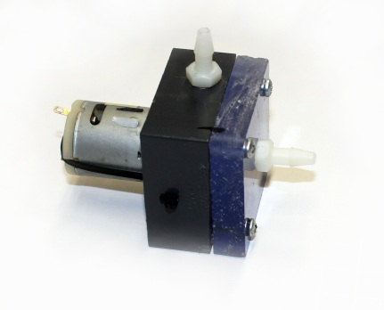
analysis of pump efficiency
living with the lab
kinetic energy
of exiting fluid
potential energy
change of fluid
h = head
head is measured from the top of the water in the bucket to the level of the exit . . . this height is used to compute the potential energy change of the fluid
electrical energy
put into pump
+
-
© 2011 LWTL faculty team

Slide 2
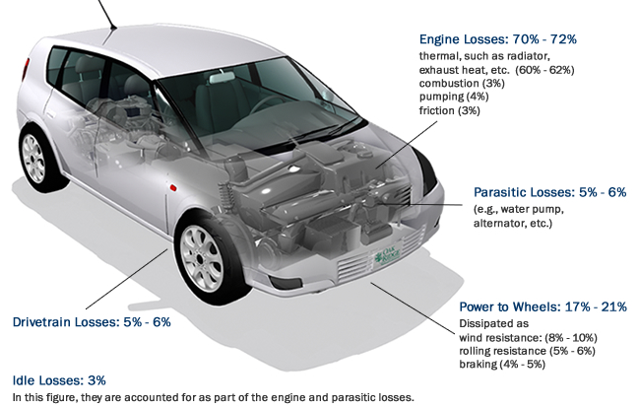
living with the lab
efficiency
efficiency is usually expressed as a percentage between 0% and 100%
an efficiency of 100% would mean that all the energy put into a system is converted into useful work
an efficiency of 0% would mean that no useful work is gained from a system
the engine itself is 28 to 30% efficient . . . that is, about 30% of the heating value of the fuel is converted into mechanical energy
www.fueleconomy.gov/feg/atv.shtml#HEVEVPHEV

Slide 3
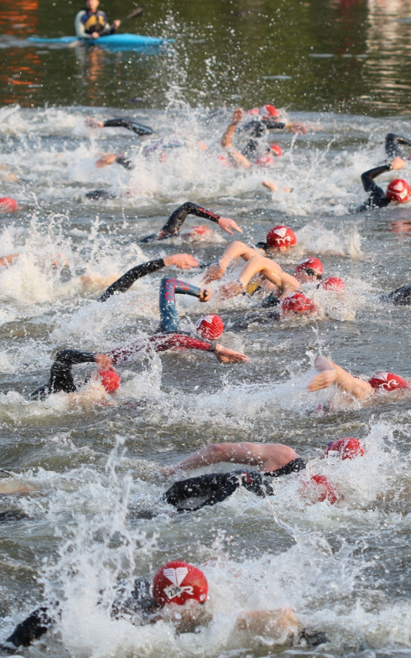
living with the lab
how efficient are you?
the human body converts around 20% to 25% of food energy into mechanical energy
a calorie is a unit of energy; if you eat a 100 calorie snack, then 20 to 25 of those calories could be used to physically make something happen (move yourself, lift something, . . .)
USA Triathlon Collegiate National Championship 2011 Tuscaloosa, Alabama

Slide 4
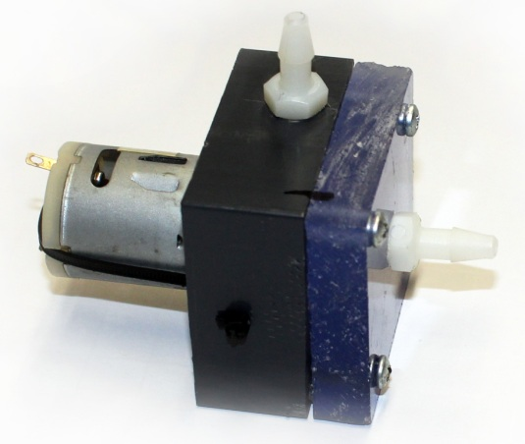
living with the lab
efficiency
we measure the efficiency of energy conversion processes
efficiency is defined as . . .
efficiency = $η= \frac{useful energy output of a system}{energy input to a system}∙100\%$
the pump converts electrical energy into fluid energy
at the exit tube, the fluid energy is evaluated as . . .
the potential energy of the fluid due to a change in elevation
the kinetic energy of the fluid at the exit of the tube

Slide 5
living with the lab
energy input to system
electrical energy input to electric motor =
power $∙$
time =
$V I t$
$$V I$$
$$t$$
$$watts ∙ seconds$$
$$\frac{J}{s} ∙ s = J$$
the efficiency is . . .
$$η= \frac{energy output}{energy input}∙100\%$$
$$η= \frac{energy output}{V I t}∙100\%$$
$I$= current
+
$V$= voltage
-

Slide 6
living with the lab
energy out of system
potential energy =
weight $∙$
height =
$$W h$$
$$Newtons$$
$$∙ meters$$
$$N ∙ m = J$$
$v$ = average velocity
W
kinetic energy =
$\frac{1}{2}$ $∙$ mass $∙$
$$\frac{1}{2}mv^{2}$$
$W$= weight of water
collected over time $t$
velocity² =
$$kilograms$$
$$∙{\left(\frac{meters}{second}\right)}^{2}$$
$$kg ∙ \frac{m}{s^{2}} ∙ m$$
$h$ = head
$$N ∙ m = J$$
the efficiency is . . .
$$η= \frac{energy output}{V I t}∙100\%$$
$$η= \frac{W h+ \frac{1}{2}m v^{2}}{V I t}∙100\%$$

Slide 7
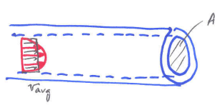
living with the lab
$$η= \frac{W h+ \frac{1}{2}m v^{2}}{V I t}∙100\%$$
using the efficiency equation
head or height that water is pumped (in) | electrical current needed to power pump (A) | voltage across pump leads (V) | length of time that water is collected (s) | mass of water collected over 20 seconds (g)
height 1 |  |  | 20
height 2 |  |  | 20
… height 8 (or more) |  |  | 20
we will measure
$$I$$
$$V$$
$$t$$
$$m$$
how do we find W?
$$W=$$
$$m∙g$$
$$=m∙9.81\frac{m}{s^{2}}$$
Newton’s 2nd Law
how do we find $v$?
$$v∙A=\frac{Vol}{t}$$
where $m=ρ∙Vol$
$$v=\frac{Vol}{A∙t}$$
$$=\frac{m}{ρ∙A∙t}$$
$$\frac{kg}{\frac{kg}{m^{3}}∙m^{2}∙s}=\frac{m}{s}$$

Slide 8
living with the lab
computing flow rate (Q)
the volume of water pumped per unit time is the flow rate Q . . .
$$Q=v∙A= \frac{volume pumped}{time}=\frac{liters}{min}$$
1 liter = 0.001 m³
Recall that you final analysis should include . . .
a plot of pump head versus (meters) flow rate (liters per minute)
a plot of pump efficiency (%) versus pump head (meters)

Slide 9
living with the lab
Class Problem A pump is connected to an electric motor. The motor is supplied with 1 A of current from a 12 VDC source. The apparatus is run steadily for 30 seconds, and the following measurements are recorded:
mass of fluid collected: 500 grams 1000 grams = 1kg
diameter of exit tube: 3/16 inch 1 inch = 25.4 mm
density of water: 1000 kg/m³ 1 L = 0.001 m³
height of fluid exit above reservoir: 30 inches 1 inch = 25.4 mm
Find:
(a) fluid velocity at exit in m/s
(b) flow rate in L/min
(c) system efficiency
Include ALL units in calculations. It would be very helpful to convert any US Customary units to SI units before beginning the solution to avoid complexity.

