Slide 1
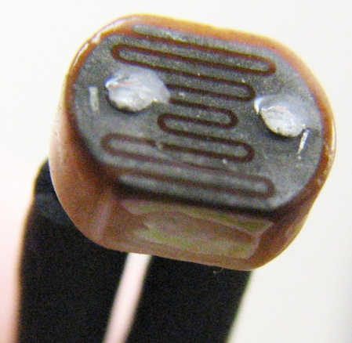
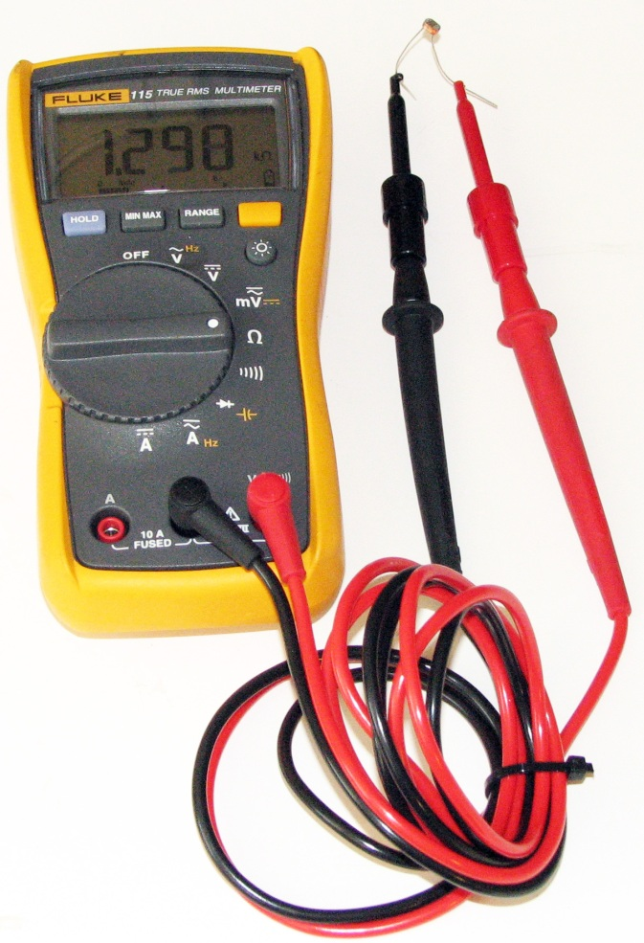
living with the lab
Using Photoresistors with an Arduino
Photoresistor
resistance changes dramatically with light level
© 2011 LWTL faculty team

Slide 2
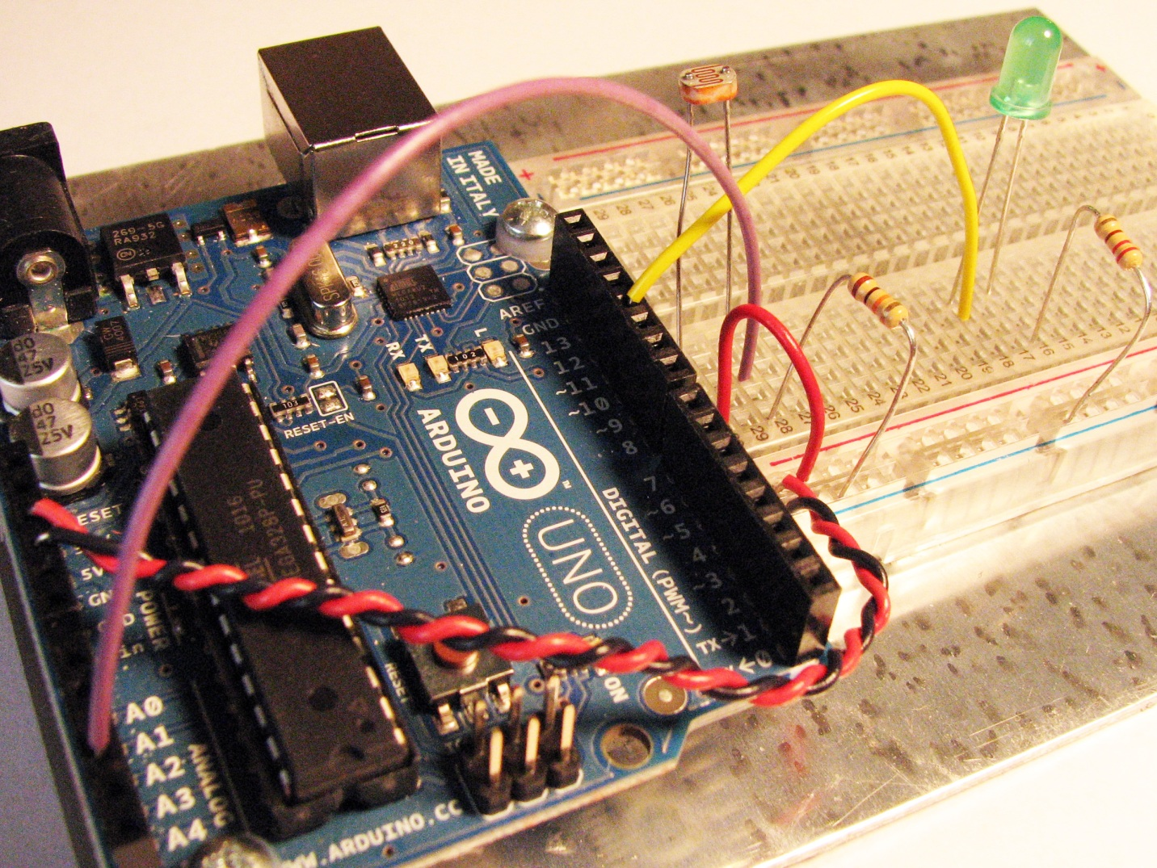
living with the lab
implement photoresistor and LED circuits
330Ω
digital pin 11
5V
photoresistor
analog input 3
10kΩ

Slide 3
living with the lab
enter and run the following sketch
int photo_pin = 3; // Analog input pin for photoresistor
int LED_pin = 11; // Digital output pin for LED
void setup() {
Serial.begin(9600); // Open serial communication w/ host PC
pinMode(LED_pin,OUTPUT); // Configure LED_pin for output
}
void loop() {
int val = 0; // Stores reading of analog input
val = analogRead(photo_pin); // Read voltage on photo_pin
Serial.println(val); // print value to serial monitor
if(val < 600) { // if statement used to control LED
digitalWrite(LED_pin,HIGH); delay(100);
digitalWrite(LED_pin,LOW); delay(100);
}
}

Slide 4
living with the lab
if statement details
if (x > 50)
{ // do something here }
comparison operators
x == y x is equal to y
x != y x is not equal to y
x < y x is less than y
x > y x is greater than y
x <= y x is less than or equal to y
x >= y x is greater than or equal to y
arduino.cc

