Slide 1
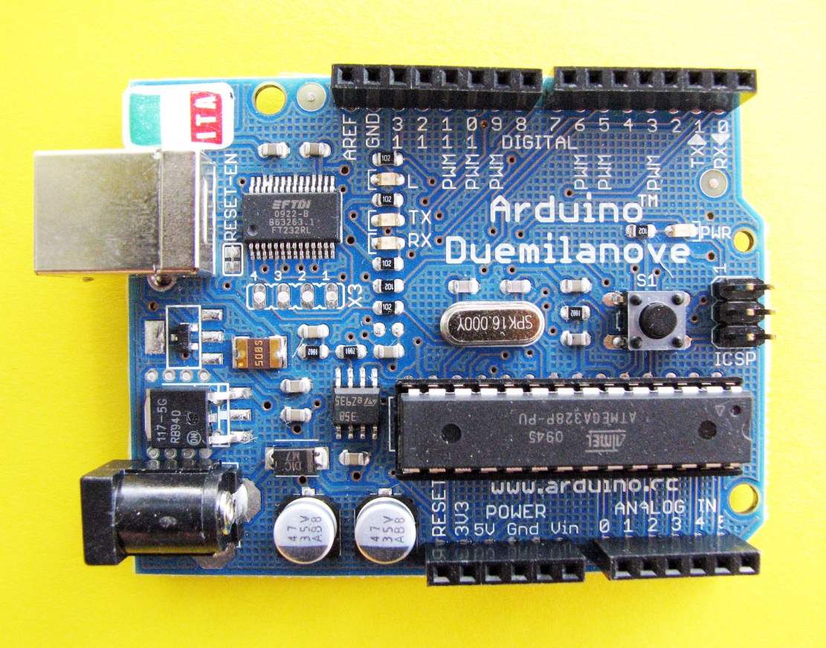
Analog and Digital Measurements
living with the lab
14 digital input / output pins
6 analog input pins
© 2011 LWTL faculty team

Slide 2
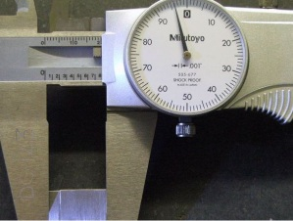
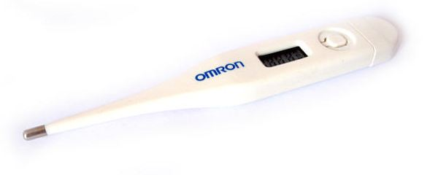
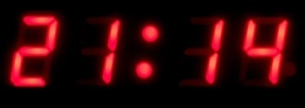
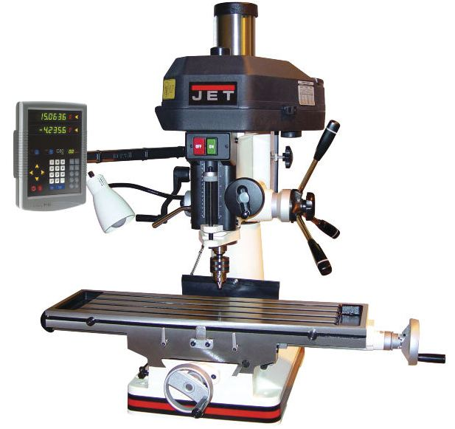
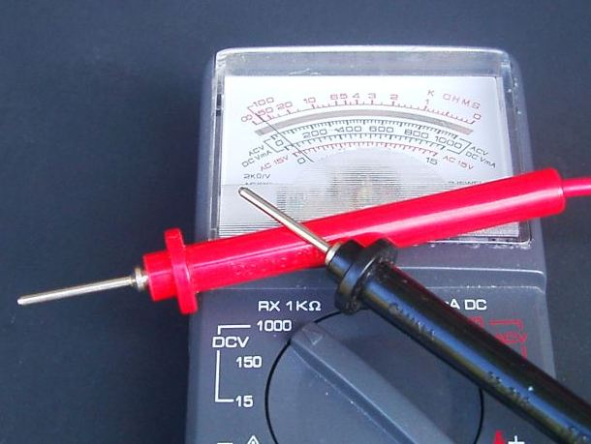
living with the lab
A digital system is a data technology that uses discrete (discontinuous) values. By contrast, analog (non-digital) systems use a continuous range of values to represent information. Although digital representations are discrete, they can be used to carry either discrete information, such as numbers, letters or other individual symbols, or approximations of continuous information, such as sounds, images, and other measurements of continuous systems.

Slide 3
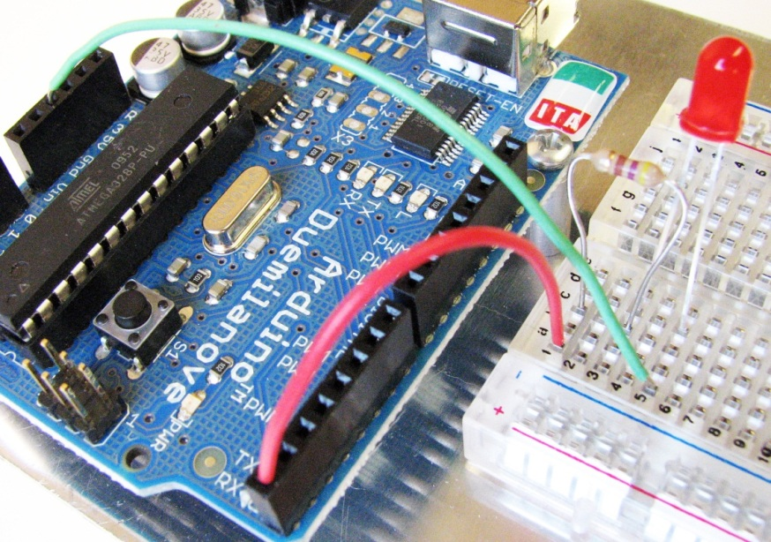
living with the lab
Inputs and Outputs
An input “receives” information or senses a voltage in the external world.
An output “delivers” information or makes something happen in the external world.
Below is an example from an earlier class where we made an LED flash on and off.
Are we using digital pin 0 as an input or an output?
digital output
void setup() {
pinMode(0, OUTPUT);
}
void loop() {
digitalWrite(0, HIGH);
delay(1000);
digitalWrite(0, LOW);
delay(500);
}

Slide 4
living with the lab
Receiving Input from an Arduino
digital input
analog input
int val;
val = digitalRead(7);
int val;
val = analogRead(5);
val is either 0 or 1
0 = voltage sensed at digital pin 7 is LOW (0V)
1 = voltage senses at digital pin 7 is HIGH (5V)
val is an integer between 0 and 1023
0 = voltage sensed at analog pin 5 is zero volts
1023 = voltage senses at analog pin 5 is five volts
Guess what val would be if the voltage sensed at analog pin 5 was 2.5V?
511

Slide 5
living with the lab
Digital Inputs
The Arduino reference indicates that digitalRead() will return . . .
a value of HIGH if the voltage at the digital input pin is greater than 3 volts
a value of LOW if the voltage at the digital input pin is less than 2 volts.
5
4
3
2
1
0
high
digitalRead()returns HIGH or 1
voltage (V)
ambiguous
digitalRead()may return a value of HIGH or LOW
low
digitalRead()returns LOW or 0
0 1 2 3 4 5 6 7 8 9
time (milliseconds)
LOW or HIGH???

Slide 6
living with the lab
Analog Inputs
The analog input pins on your Arduino have 10-bit resolution and consequently measure in (2)¹⁰ or 1024 increments.
$${\left(2\right)}^{10}=1024$$
The analogRead() functions returns a value between 0 and 1023, where 0 is zero volts and 1023 is 5 volts.
$$voltage=\text{analogRe}\text{ad} output∙\frac{5 volts}{1023}$$
smallest increment of voltage that can be read = 0.00488 volts

Slide 7
living with the lab
Examples
point 1
point 2
point 3
5
4
3
2
1
0
digitalRead()returns HIGH or 1
voltage (V)
digitalRead()may return a value of HIGH or LOW
digitalRead()returns LOW or 0
0 1 2 3 4 5 6 7 8 9
time (milliseconds)
data point from plot above | If a digital pin is used to sample voltage | if an analog pin is used to sample voltage
 | output of digitalRead() | hypothetical analogRead() output | voltage computed from analogRead() output
1
0
217
$$217∙\frac{5V}{1023}=1.061V$$
2
ambiguous
526
$$526∙\frac{5V}{1023}=2.571V$$
3
1
964
$$964∙\frac{5V}{1023}=4.712V$$

