Slide 1

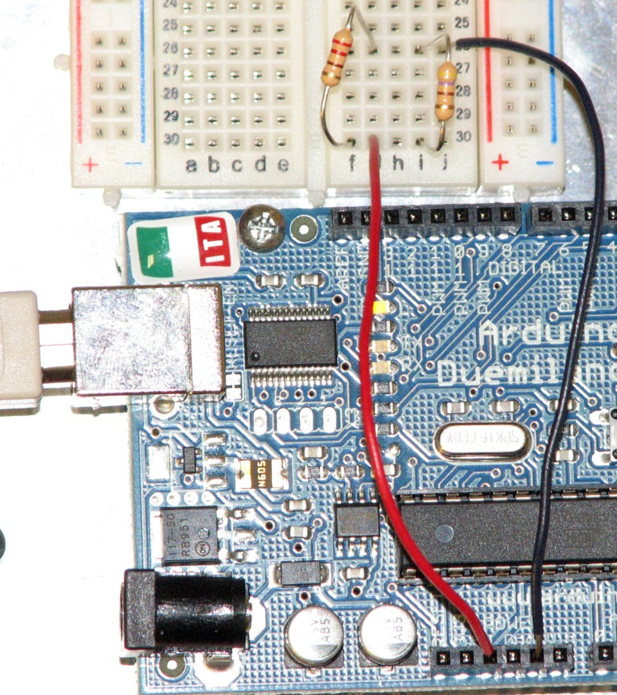
Currents Through Parallel Resistors
living with the lab
220Ω
470Ω
5V
Gnd
© 2011 LWTL faculty team

Slide 2
living with the lab
Select Resistors
Find the 220Ω and the 470Ω resistors from your parts kit.
color | digit
black | 0
brown | 1
red | 2
orange | 3
yellow | 4
green | 5
blue | 6
violet | 7
gray | 8
white | 9
first
digit
gold = ±5%
silver = ±20%
tolerance
second
digit
number
of zeros
Example: 470Ω resistor
4 = yellow
7 = violet
Add 1 zero to 47 to make 470, so 1 = brown
So, 470 = yellow, violet, brown
Now, find the 220Ω resistor.

Slide 3
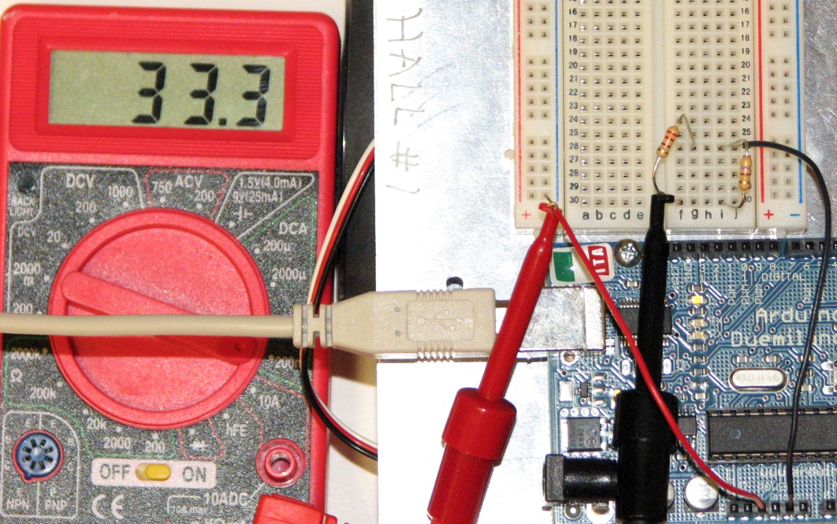



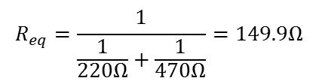
living with the lab
build the parallel circuit below
measure the total current from the power source
current flow
current flow
Compute the current after you make your measurement.
use Ohm’s law:
$$V=I∙R or I=\frac{V}{R}$$
$$R_{eq}=\frac{1}{\frac{1}{220Ω}+\frac{1}{470Ω}}=149.9Ω$$
$$I=\frac{V}{R_{eq}}=$$
$$\frac{5V}{149.9Ω}=0.033A$$
compare

Slide 4
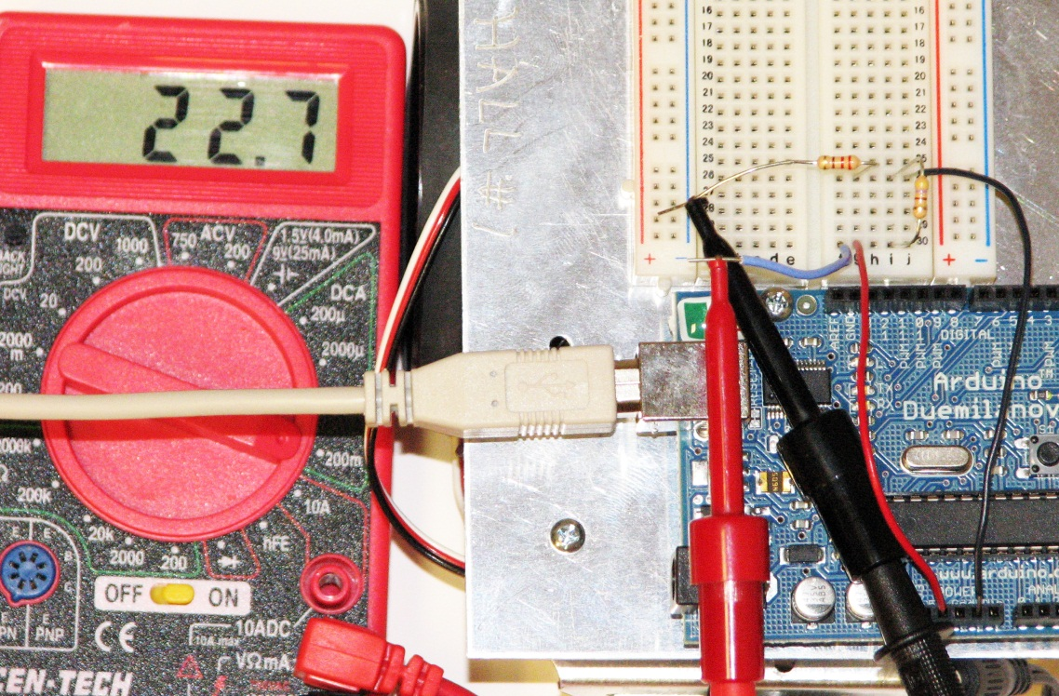


living with the lab
modify the parallel circuit as show
measure the total current through the 220Ω resistor
current flow
Compute the current after you make your measurement.
use Ohm’s law:
$$V=I∙R or I=\frac{V}{R}=$$
$$\frac{5V}{220Ω}=0.023A$$
compare

Slide 5
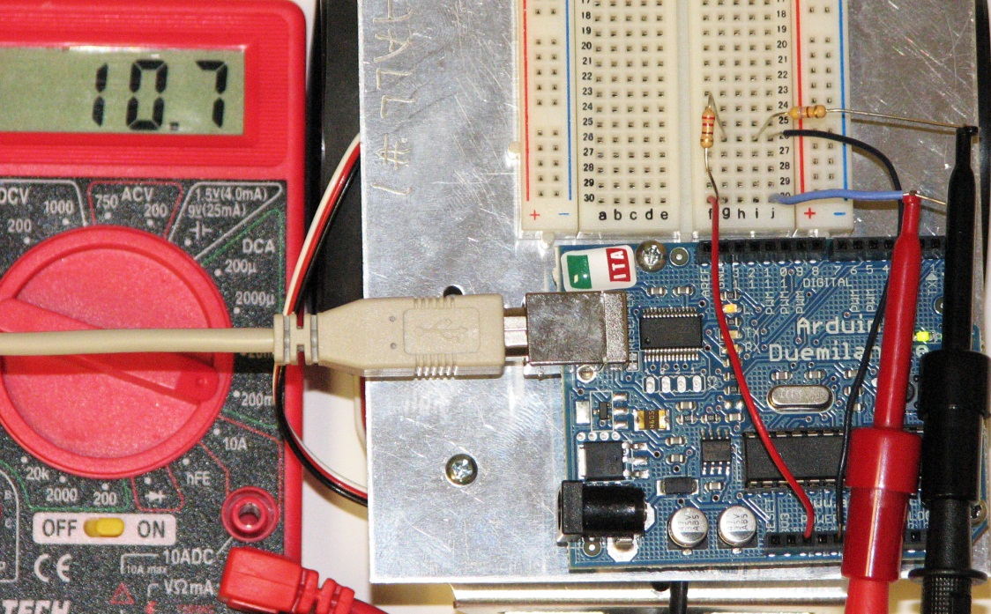


living with the lab
modify the parallel circuit as show
measure the current through the 470Ω resistor
Compute the current after you make your measurement.
use Ohm’s law:
$$V=I∙R or I=\frac{V}{R}=$$
$$\frac{5V}{470Ω}=0.011A$$
compare

Slide 6
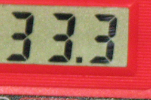
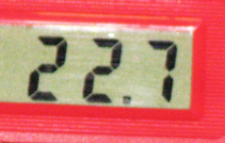
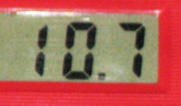
living with the lab
check for conservation of charge
~
~
more current goes through smaller resistor
I = 33 mA
I = 22.7 mA
Kirchoff’s Current Law (KCL)
The algebraic sum of currents entering a node is zero.
Current In = Current Out
I = 10.7 mA

