Slide 1
Robot Project
By Alan Cheng

Slide 2
The Goal of This Project
The goal of this project is to create a physical robot that can move physically in the environment, grab items and show emotions. The robot would need to have sensors and vision. It would be able to speak and to create sounds (pre-recorded). Also, the effects of a Darwinian vs Lamarckian Genetic Algorithm would be tested on this robot.

Slide 3


The Road Map
The robot base
The ESRA III robot
OpenCV and object detection
OpenCV and the ERSA III
Bluetooth and the robot
Future Improvements and Additions
Today’s Demo

Slide 4

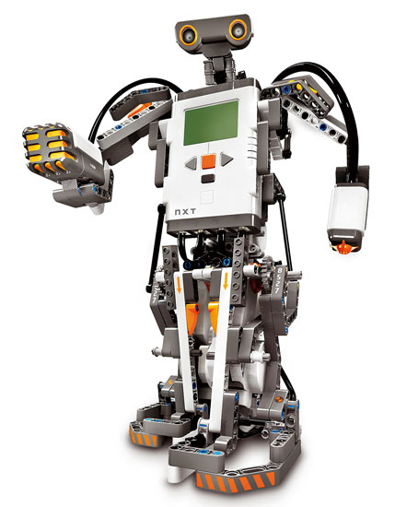
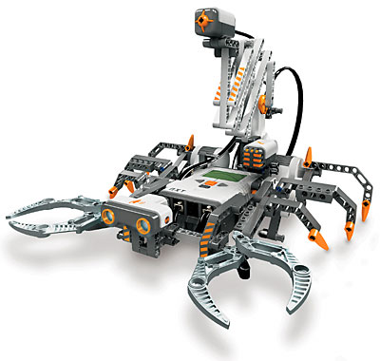
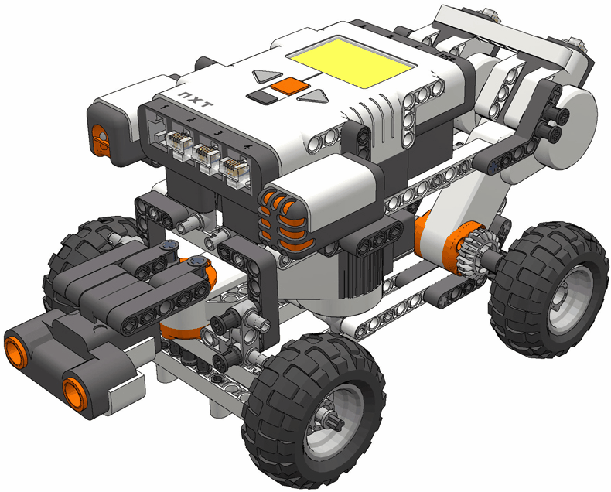
Top-Leveled Diagram for Robot

Slide 5
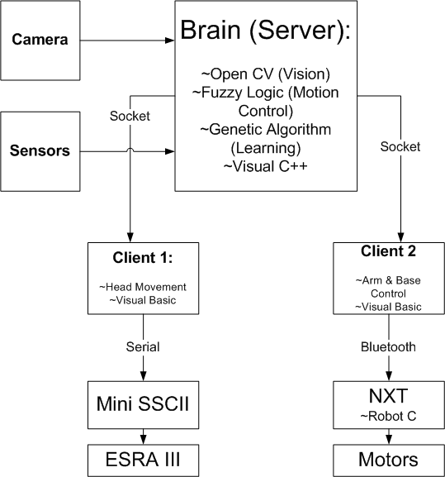
Software Diagram for Robot

Slide 6
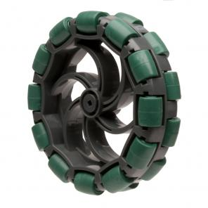
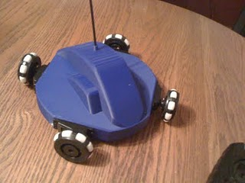
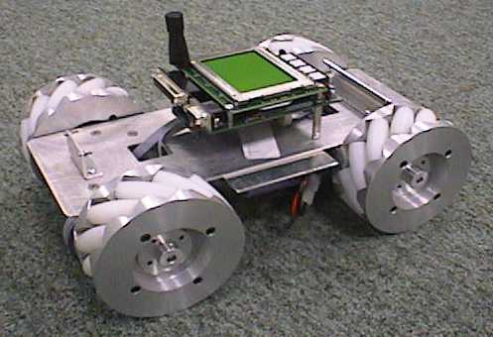
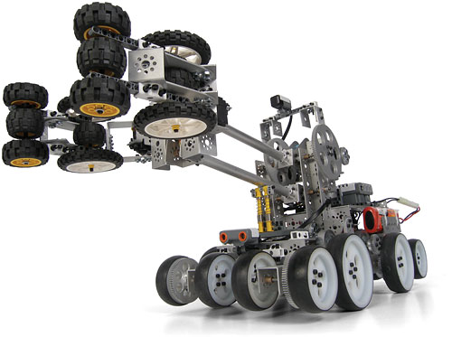
The Robot Base

Slide 7
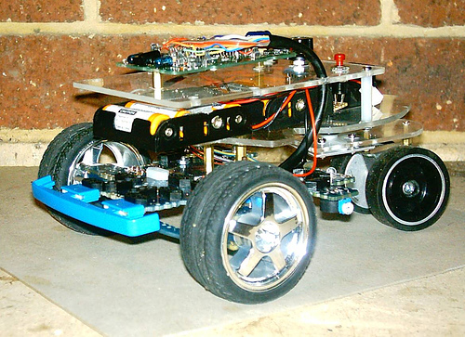
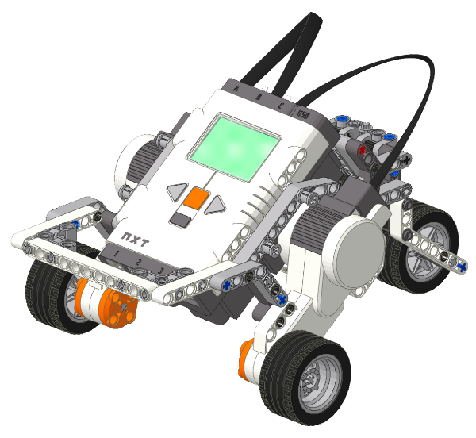
The Standard Base
A “standard” base normally contains two motors for the back wheels and two non-motor controlled wheels in the front.
http://www.hitechnic.com/blog/wp-content/uploads/TrikeBase.png
http://farm1.static.flickr.com/53/128493978_031324a051.jpg

Slide 8
The Standard Base(2)
Used in 2 wheel drive cars.
Pros (+’s)
  Easy to build and flexible on wheel placement.
  Easy to program
  Fast
Cons (-’s)
  Turning is slower
  Braking requires a good amount of friction

Slide 9
Omnidirectional Drive
Three types of wheels that can be used:
  Mecanum wheels
  Omni wheels
  Standard wheels
A base with mecanum wheels requires a standard placement of the wheels (like a car). However, this base can move left and right along with forward and back from the same position.

Slide 10
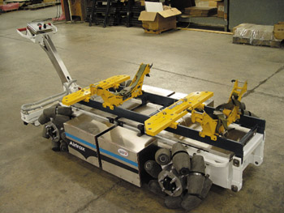
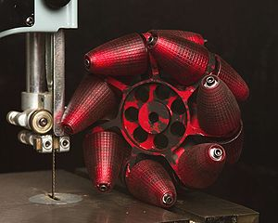
Omnidirectional Drive(2)
By moving the each pair (side-by-side position wheels) in opposite directions, it is able to move left and right.
http://en.wikipedia.org/wiki/File:MG_6646.resize.jpg
http://www.designnews.com/photo/58/58077-DNx040719N539B_C.jpg

Slide 11
Omnidirectional Drive(3)
Pros:
  Can move in all 8 cardinal directions from the same position (omnidirectional)
Cons:
  Wheels are harder to find
  Harder to program
Examples of Usage
  Einstein robot base
  Airtrax Inc.

Slide 12
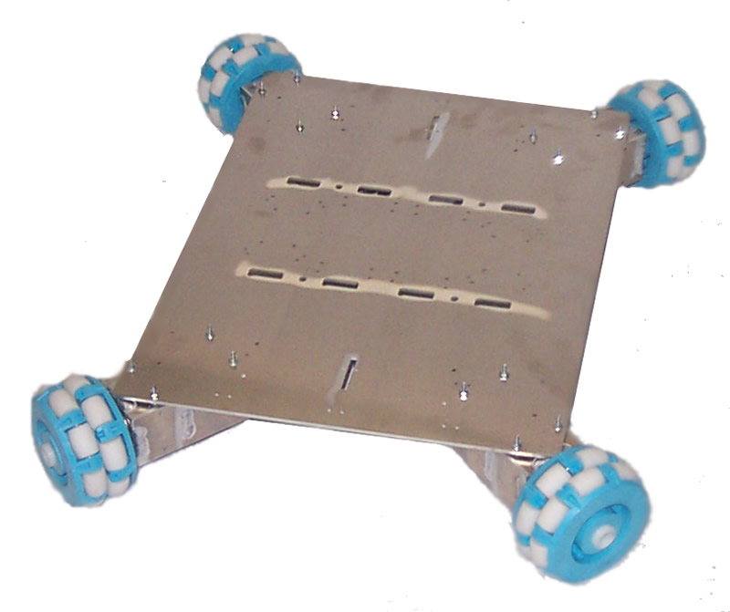
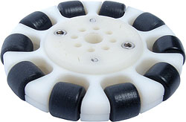
Omnidirectional Drive(4)
An omnidirectional drive using omni wheels has each wheel angled at 45 degrees on each corner.
http://shop.pitsco.com/store/detail.aspx?CategoryID=62&by=9&ID=5817&c=1&t=0&l=0
http://farm1.static.flickr.com/53/128493978_031324a051.jpg

Slide 13
Omnidirectional Drive(5)
Forward Backward

Slide 14
Omnidirectional Drive(6)
Left Right

Slide 15
Omnidirectional Drive(7)
Turning Left Turning Right

Slide 16
Omnidirectional Drive(8)
Diagonally up-left Diagonally up-right

Slide 17
Omnidirectional Drive(9)
Diagonally down-left Diagonally down-right

Slide 18
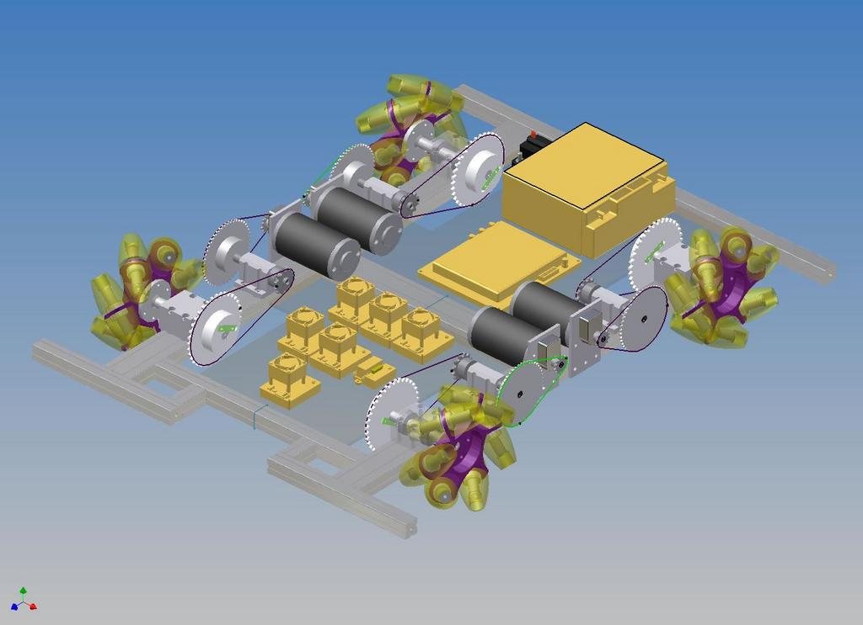
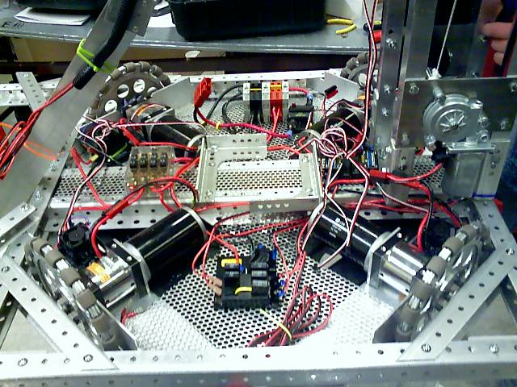
Omnidirectional Drive(10)
Pros:
  Omni-directional in 8-directions
  Fast
  Spinning is fast
Cons:
  Hard to build
  Hard to program

Slide 19
Why Use an Omnidirectional Drive?
The main reason I used it is because it can move in eight directions from the same position.
It can make the robot move fast in an theatre environment when speed is important.
The base was hardest part of building but was still manageable. Programming is harder but not very hard.

Slide 20
Materials Used So Far
Tetrix base set: ($399.00 from Pitsco)
  2 omni wheels
  2 DC drive motors
  2 motor mounts
  2 motor shaft hubs
  2 motor power cable
  1 Hitechnic DC motor controller
  RobotC 2.01
Lego Nxt 2.0 base set ($279.99 from Lego.com)

Slide 21
Materials Used So Far(2)
4 omni wheels ($39.95 for set of 2, Pitsco)
4 DC drive motors ($29.95 each, Pitsco)
4 DC motor mounts ($19.95 each, Pitsco)
4 motor shaft hubs ($7.95 each, Pitsco)
4 motor power lead ($1.95 each, Pitsco)
2 Hitechnic DC motor controller ($79.95 each, Lego Education) ~ I borrowed from PSU

Slide 22
RobotC 2.01
RobotC 2.01 was used for programming the robot. Additional programming languages maybe used later. RobotC 2.02 and IS out. Color sensor support is not added.
RobotC 2.01 has fixed bugs from 1.40, enhanced motor and sensor support, and many more…

Slide 23
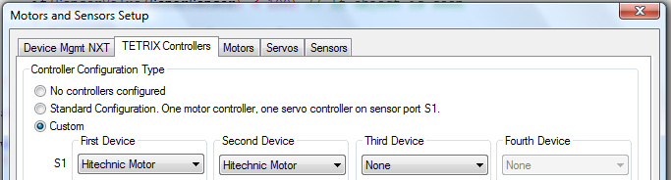
Setting the Tetrix in RobotC
Download RobotC firmware by going to Robot -> download firmware
Go to robot -> platform type -> Nxt & Tetrix
Go to robot -> motors and sensor setup

Slide 24
Setting the Tetrix in RobotC(2)
S (number) refers to the port the Hitechnic motor control is attached to.
Go to the sensor tab and define your sensors there. Then click ok.
A couple of lines referring to the motor and sensor setup should be at the top of the program.

Slide 25
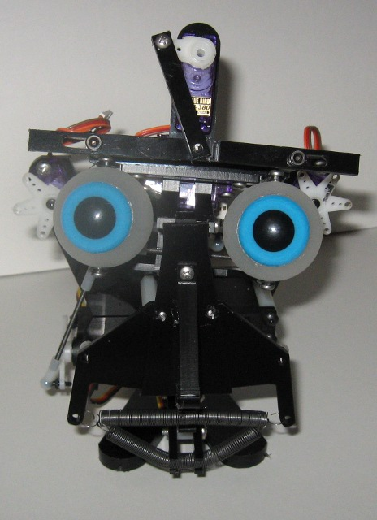
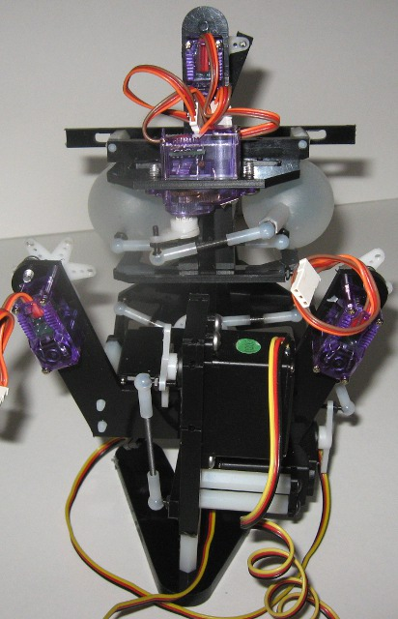
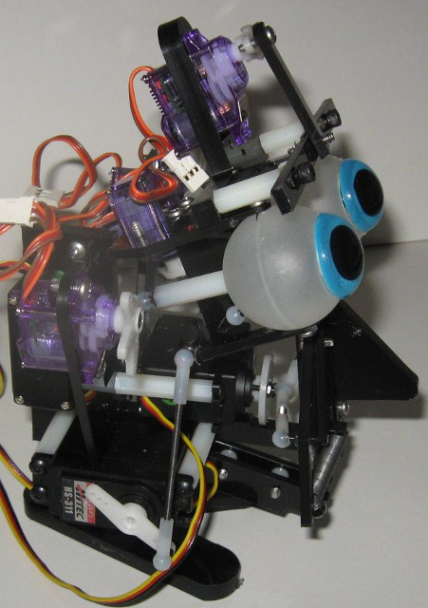
The ESRA III By Robodyssey

Slide 26
Robodyssey’s ESRA III
Robot kit used for displaying emotions.
3 Hitec servos and 4 Blue Bird servos (in version with eyebrows and ears)
Mini SSC controller is required to control the motors.
Visual Show Automation (VSA) is the program that programs the SSC controller.
Time it took to build the ESRA: 5 hours.
  You may need to drill in extra holes.
  Some extra small components (e.g. screws) may be needed. Base is flimsy.

Slide 27

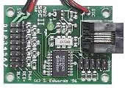
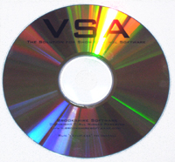
Parts Used
Robodyssey’s ESRA III with ears and eyebrows - $233.99
Mini SSC II Controller - $44.00
Visual Show Automation - $69.95
Mini SSC II Controller
www.robodyssey.net
Visual Show Automation
www.robodyssey.net
ESRA III
www.robodyssey.net

Slide 28
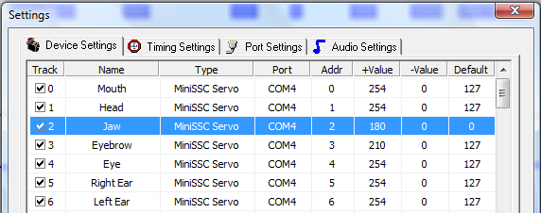
Using Visual Show Automation
Connect to ESRA to the computer
Go to Edit -> Settings (or F3)
This should appear:
The track corresponds to the port that to.
Change the port to COM (insert number)
You change the name or color here.

Slide 29


Programming in Visual Show Automation
In order to make an event (in other words make a motor move), click and drag the desirable length of the event in the corresponding track
->

Slide 30
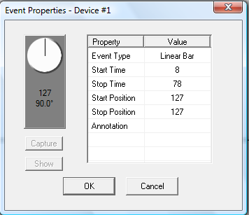
Editing the Event
After creating an event, double click on it.
The following window should appear.

Slide 31
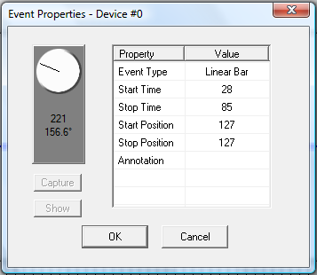
Editing the Event (2)
You can drag the “virtual servo display” and when released, the motor should move to that state. Remember to click on starting/stopping position and click capture or else the event wont do anything.

Slide 32
Adding Sound (speech) to the Program
Click or press F2
Input the correct file
If audio needs to be edited, I suggest Audacity. It’s free and can export in different extensions.
The motors will be partially synchronized.
Edited the events to fit the audio.

Slide 33
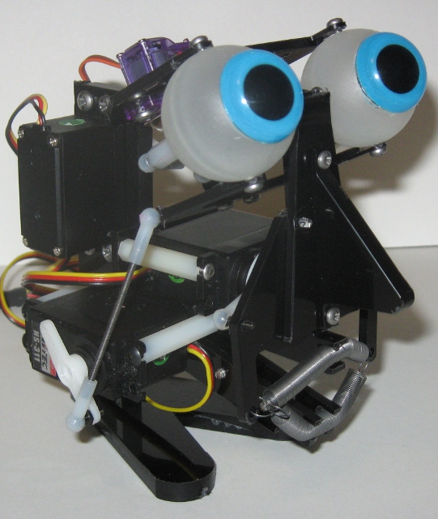
Running the Program
Press on the sidebar or press enter.
If the ESRA is connected to the computer, it should move.

Slide 34
My Opinions on the ESRA
Easy to assemble, however the instruction manual sometimes is unclear and not specific enough.
Visual Show Automation is very self explanatory. Only audio synchronization is harder because you can’t drag the audio (the wave) at all.
Overall, I think that the ESRA III and VSA is a great beginning to beginners.

Slide 35


OpenCV

Slide 36
OpenCV
OpenCv stands for Open Source Computer Vision
It is open source and free
Newest version is 2.1.
OpenCv was developed by Intel and is continued by Willow Garage
Uses C/C++
OpenCv is a library for C/C++
For Windows and Linux

Slide 37
Setting Up OpenCV in C/C++
First set up the OpenCV 2.10 library.
In order to set up OpenCV with Microsoft Visual Studio, first go to the project’s property -> configuration properties -> Linker -> Input. Click on additional dependencies and input “highgui210.lib cxcore210.lib ml210.lib cv210.lib”

Slide 38
Some General Use Functions
OpenCv already has some general use functions. Many general purpose functions are built into a library. This allows easier programming. We can load images and display them, make a trackbar, or even detect the border of object. All of the functions can be found in the OpenCV help file.

Slide 39
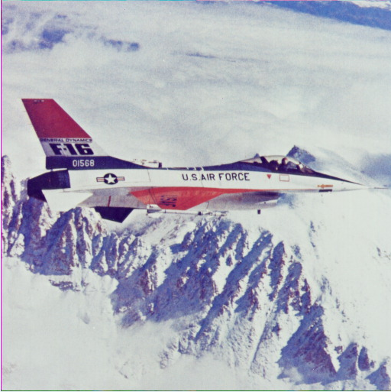
Some Simple Functions(2)
We’ll start with a simple program. One that’s loads and displays an image, then ends when a button is pressed.
The image chosen is airplane.jpg from the sample OpenCV pictures.
The Airplane Image

Slide 40
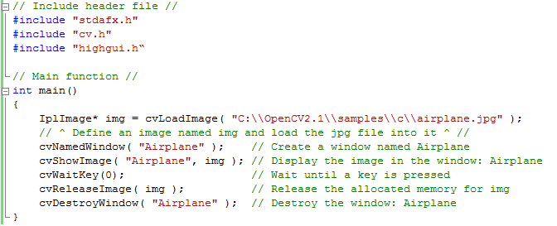
Some Simple Functions(3)
The Program:

Slide 41
IplImage
In order to load an image into an 2D array, we have to create the storage place for the image. IplImage creates a pointer to the 2D array. It is written as below:
IplImage* (name);

Slide 42
cvLoadImage
The next step is to load the image file. In the program, creating the empty image and storing the picture in there is combined together into one line. The layout for loading the image is as below:
cvLoadImage( “Location of the file ” );

Slide 43
cvNamedWindow
Then we create a window. This is where the image will be displayed.
cvNamedWindow( “ name of window ” );

Slide 44
cvShowImage
The image is then displayed. The pointer where the image is stored and the name of the window is required.
cvShowImage( “ name of the window ”, (name of pointer);

Slide 45
cvWaitKey
The program then waits until a key is pressed. We can use any ASCII number for any key instead of the default value 0. 0 means any key.
cvWaitKey( ASCII Number )

Slide 46
cvReleaseImage
This deallocates the memory allocated for creating the image. Without deallocating anything, it is more likely that the program will have a memory error and crash
cvReleaseImage( name of pointer )

Slide 47
cvDestroyWindow
This function destroys the window of the named name.
cvDestroyWindow( window name )

Slide 48
Object Detection
Contours is used in my program for object detection.
Image has to be converted into one-channel image (binary image).
Can find all noises though.
The border is counted as a contour.
Filter is necessary.

Slide 49
Goal of the Object Detecting Program
The goal of the object detecting program is to find the blue cup, and only the blue cup. Thus we can find the centroid of the cup and make a robot find and pick up the cup.

Slide 50
Flowchart of the Program
Read Text file for filter
Threshold the hue and saturation images
Filter contours
Draw contours and centroid
Capture the frame
No
Is space pressed?
Yes
Find contours
Convert to HSV
Separate to HSV 3 graylevel image
Calculate the shape features
END

Slide 51
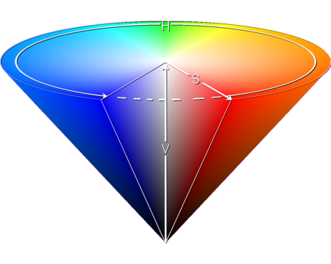
HSV – Hue, Saturation, Value
In order to detect the image’s color, we convert the RGB image to HSV. The hue value is the “pure” color. Saturation is the color’s strength (pure color to gray). Value is the brightness of the color. Thus, we can separate the image to get the grayscale of “pure” color, strength, and brightness.
The HSV color cone.
Source:
http://ilab.usc.edu/wiki/index.php/HSV_And_H2SV_Color_Space

Slide 52
cvCvtColor
The function cvCvtColor is used to convert the color to HSV. However, the H, S, and V is not split yet. We use cvSplit for this.
cvCvtColor( source, destination, type of conversion );

Slide 53
cvSplit
After the image is converted into HSV, we have to split the new image into three different parts. The hue, saturation, and lightness. We do this as:
cvSplit( source, destination1, destination2, destination3 );

Slide 54
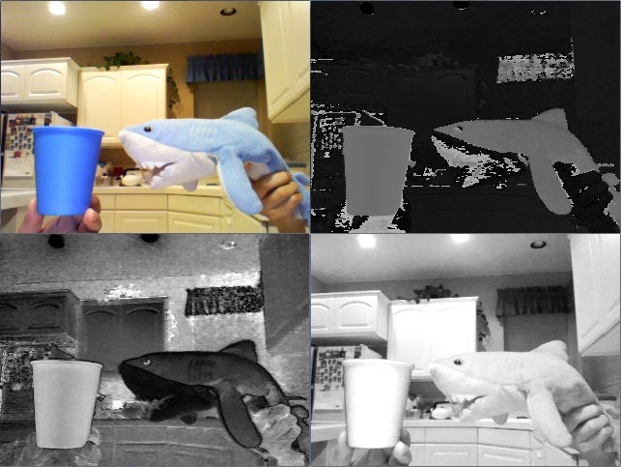
Conversion from RGB to HSV
Original
Hue
Saturation
Value

Slide 55
Thresholding
Thresholding is a way of converting grayscale image into binary image (black and white). The image is segmented such that the object will be in black and the background is set to white. We do this by a loop in the hue and saturation image which checks each pixel and sets those pixels with an unsatisfying hue and saturation value are set to white. Thus, the object could be found.

Slide 56
cvFindContours
This function is used to find contours in an image. It records the contours using chain codes. In chain codes, each direction has a different value. A contour is made up of those values. The source has to be one-channel (binary).
cvFindContours( source image, storage place, pointer to first contour (border), size of sequence head, finding(retrieving) method , chain code);

Slide 57
Chain codes
Chain codes are used in finding contours. It keeps the data on the shape of each contour. Each direction has its own value. Freeman’s Chain code is used in the program. There are 8 directions, each with its own encoding. However, the encoding varies from sources.
2
3
1
Start
4
0
5
A chain code would be: 6,1,0,7,2,3,4,5
The order may vary due to the starting point
7
6

Slide 58
cvDrawContours
After finding the contours it is easier to see, debug, and to apply a filter if you could see the outlines of the contours. cvDrawContours does this for us. It draws the outline of all the contours. We use the function as following:
cvDrawContours( image to draw on, pointer to first contour, color of the external contours, color of the internal contours, thickness of the line, type of line );

Slide 59
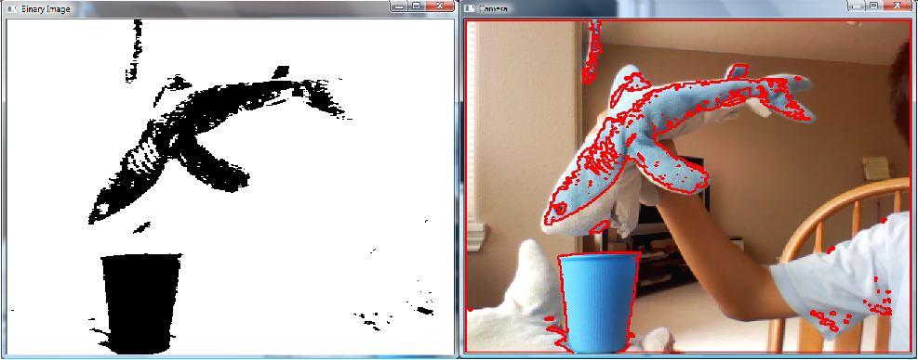
Contour Finding Pictures
The contours drawn in the picture match those black spots in the binary image

Slide 60
The Filter
Since cvFindContours detects and finds all contours, there will be much noise. Therefore, it is necessary to have a filter to reduce the number of contours so that only the important contours are drawn. Here are some techniques:
Filter by the size
Filter by the aspect ratio of the object (length/width or vice versa)
Filter by extent (object area/bounding box area)

Slide 61
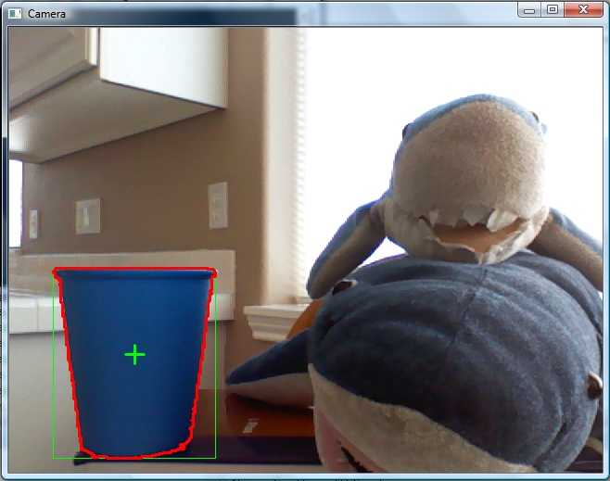
The Filter(2)
Filter by the circularity.
Because of the filter, the cup is detected and neither of the sharks are.

Slide 62



Finding the Centroid
We find the centroid using something called moments. Moments is the following equation:
We can substitute values ij to get the right order of the moments. We find the center by first substituting i=1, j=0, and dividing it by the area (i=0, j=0) to get the x coordinate. This gets us the center of the x axis. Then we substitute i=0, j=1, to get the y coordinate. This gets us the center of the y axis.

Slide 63
Calculating the Object Area
There is a function for calculating the area named cvContourArea. It works in the format:
cvContourArea( contour sequence, starting and ending points of the area );

Slide 64
The Aspect Ratio
We find the aspect ratio by finding the length and width and dividing them to get the ratio.
We first declare a 2d box around the contour. This variable we declare contains the measurements for the length and width of the box.
Length
Width

Slide 65
Percentage of Coverage (Extent)
We can calculate this using the same 2d box. This time we multiply height and width and then divide this by the cvContourArea. This is also called the extent. The equation is:
(Object area)/(Bounding box area)

Slide 66
Circularity
Circularity is calculated by the formula P²/4πA where P is the perimeter and A is the area. Circularity is the ratio of the area of the shape and the area of the circle with the same perimeter. The less circular the shape, the higher the value.
Compactness: > 2.0
Compactness: 1.0

Slide 67
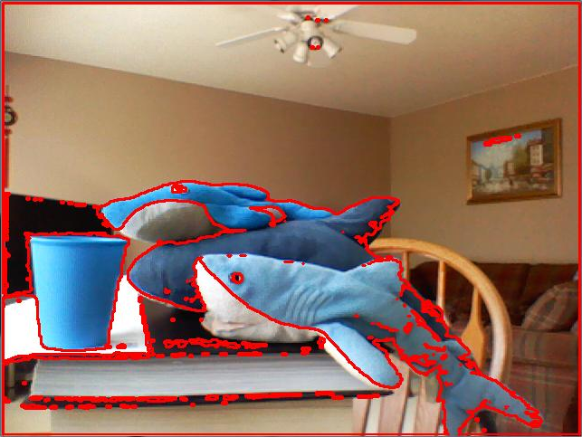
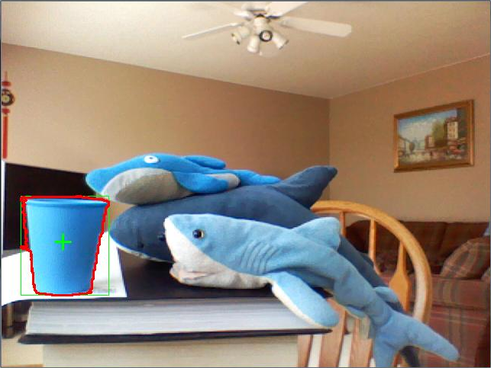
Using Shape Features as Filters
Filter with Area, Extent, and Compactness
No Filter

Slide 68

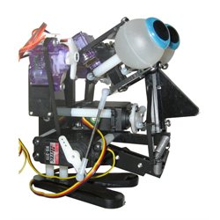
OpenCV With ESRA III

Slide 69
Using OpenCV with the ESRA III
As an example for using OpenCV with the ESRA III, a simple goal for a program was made. The goal was to have the ESRA III track a blue cup with its eyes.
It required usage of serial port communication with the Mini SSC II and OpenCV

Slide 70
OpenCV Blue Cup Finding
The same blue cup detection program was used.
Only the centroid is used
The x – y coordinates determine the movement of the eyes.
Fuzzy-Logic is used

Slide 71
Communicating with the ESRA III
We could communicate directly using C++ but that is more difficult.
Visual Basic is used to communicate with the Mini SSC II using serial ports.
Winsock is used to communicate with C++ and Visual Basic

Slide 72
Microsoft Socket Communication
This communication type can communicate with many other software.
Works as a server/client.
The server starts up the winsock server.
The client(s) send data to the server or other clients.
The server can use this data.
A server must be out to use winsock.

Slide 73
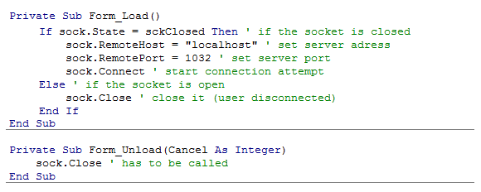
Microsoft Socket Communication(2)
Code from Visual Basic (The server):

Slide 74
Microsoft Socket Communication(3)
The Form_Load function is called when the program opens.
The Form_Unload function is called when the program closes.
The program gets data as:

Slide 75
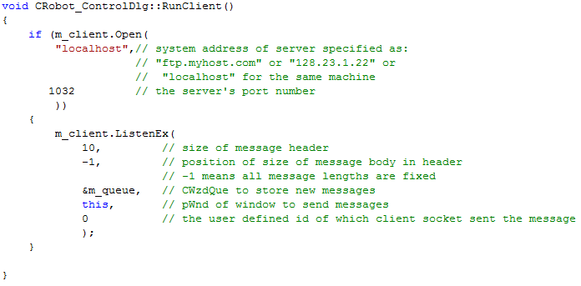
Microsoft Socket Communication(5)
C++ function to open the client:

Slide 76
Microsoft Socket Communication(6)
Information is sent to the client by:
Sprintf stores the double values into the string strCentroid.
m_server.SendEx sends this string.

Slide 77
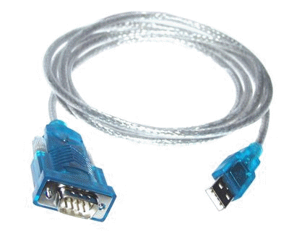
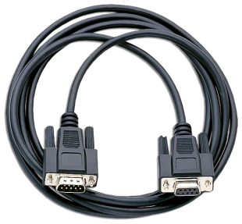
Communicating Via Serial Port
After receiving the data from the C++ program, the MiniSSC II then receives the commands through the com port.
We use Visual Basic’s MSComm for this.

Slide 78

MSComm Code
Setting up the connection:
Sending data:

Slide 79
Needing for a Better Algorithm
When the program was tested, the robot motion was a lot unsmooth, therefore it was necessity to have a better algorithm. Fuzzy Logic was chosen for the algorithm to be used.

Slide 80
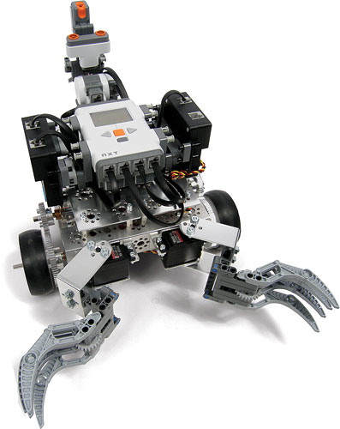
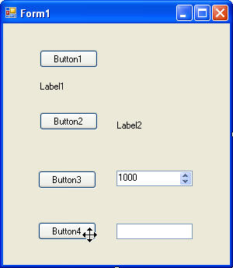
Bluetooth Control With the Robot

Slide 81
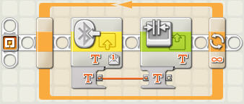
Bluetooth
Wireless communication
NXT has bluetooth support
Visual Basic can use bluetooth via the serial port

Slide 82
Visual Basic’s Serial Port
Visual Basic serial port commands can be used to communicate with the Lego NXT.
Each communication with bluetooth has a com port number (i.e. com 7). The com port number is always higher than those of the USB/serial port.

Slide 83
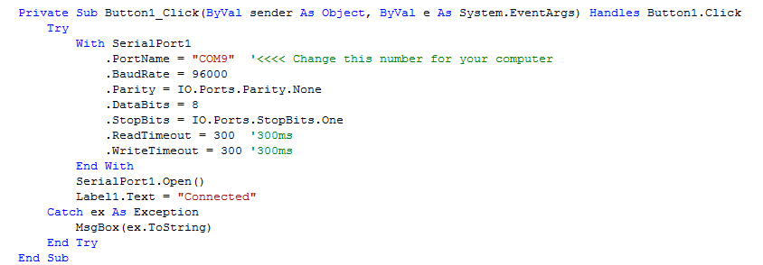
Code for Serial Port Communication
Code for connecting with the NXT via Serial Port:

Slide 84
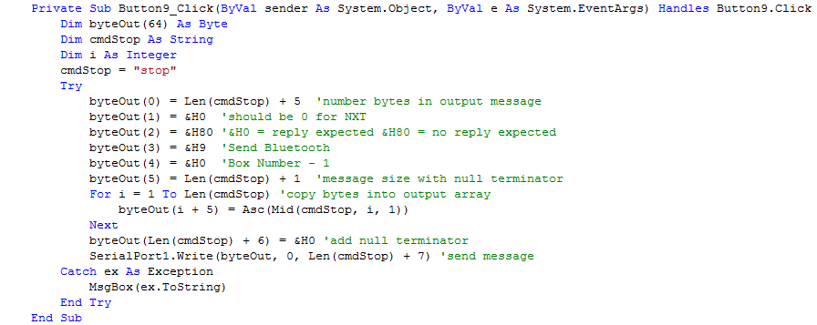
Sending Data through NXT
The data sent through bluetooth is a 1 or 4 letter message stating which direction to move:

Slide 85
Receiving the Data
The RobotC software is used for this. The program is based off of the sample bluetooth receive program. However, lots were omitted out and the robot moves according to the command. This is done through a switch – case statement.

Slide 86
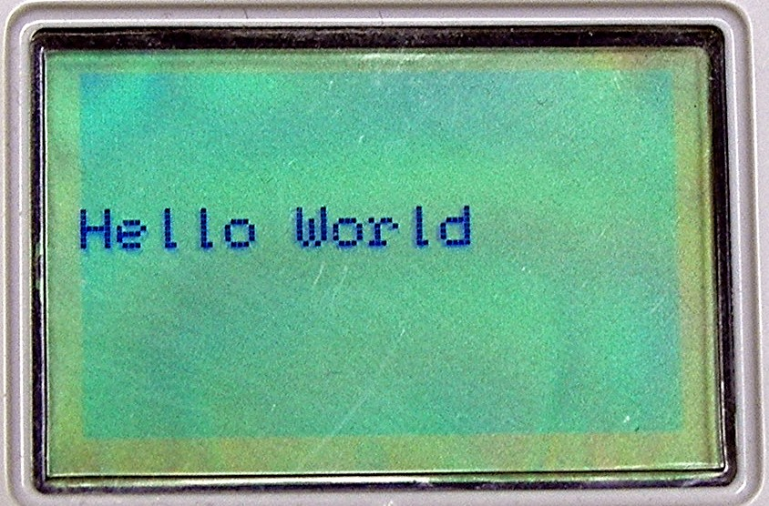
Receiving the Data RobotC Code
Receiving the data:

Slide 87
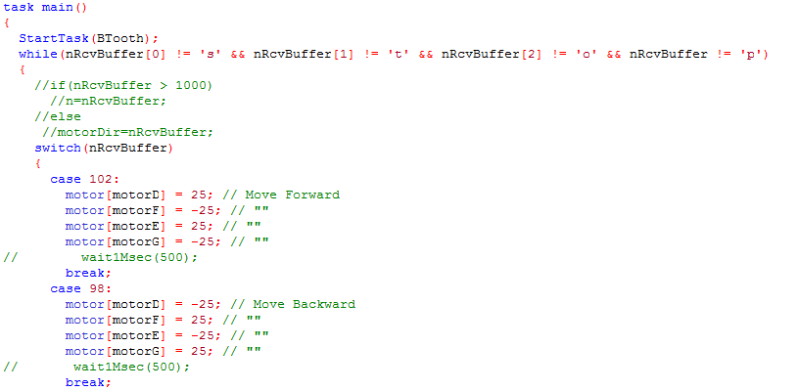
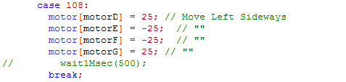
Switch – Case Excerpt

Slide 88
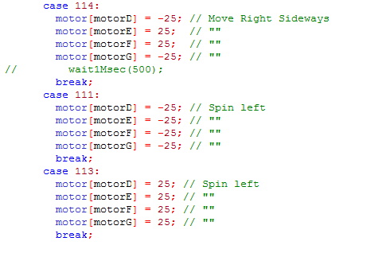

Switch – Case Excerpt (2)
In this main routine, the program only exit upon the command of stop from the button in the Visual Basic Program

Slide 89
Genetic Algorithm:
Darwinian vs Lamarckian

Slide 90
Genetic Algorithm
Genetic algorithm is an evolutionary algorithm which models a form of evolution. These could be:
  Darwinian Evolution
  Lamarckian Evolution

Slide 91
Genetic Algorithm Process
Each genetic algorithm have the following steps in a similar way:
  Initialize Population
  Calculate Fitness
  Selection Using Fitness
  Genetic Operatorss
  Repeat Unless Condition is Satisfied
  End
With child chromosomes

Slide 92
Genetic Operators
Fitness Value
A fitness value represents how much an organism is suited to the environment.
Genetic operators are used to create the offspring from two parents. Some of these operators are:
  Crossover
  Mutation

Slide 93
Crossover Operator
A crossover is done by taking a random point and swapping the left (or right) side of the parent chromosomes. This creates the chromosomes of the children.
Crossover point
10101
11001
10101
01011
01011
11001
11001
11001
01011
11001
Parents
Children

Slide 94
Mutation Operator
A mutation operator is done when a random position in a chromosome is selected and the value is inversed.
10110001011
10110000011
Mutation Point

Slide 95
Darwinian GA: The Theory
Darwin’s theory of natural selection is the evolution theory that is believed to be correct. It still holds for today.
This theory generally states that an animal species evolves by breeding ones with the most successful traits. In a population of animals, the unsuccessful ones will die leaving the better ones left. This then produces more suitable children for the environment.

Slide 96
Darwinian GA: An Example
In detail, let’s say that there is a group of animals. The animals least suitable to the environment would most likely be least fit and have a lower fitness value. Ones that are more suitable would have a higher fitness value. When predators come, the ones that are least fit are most likely killed (some might survive), leaving only better ones to reproduce. Therefore, the successful traits are passed to their offspring.

Slide 97
Darwinian GA: The Process
The Process:
Initialize Population
With newly generated offspring
Calculate Fitness
No
Select Chromosomes
Is the problem satisfied?
Apply Operators
Yes
END

Slide 98
Lamarckian GA: The Theory
Lamarck’s theory of evolution was false according to the scientists at his time.
In simple words, Lamarck’s theory stated that an organism can pass on characteristics that it acquired during its lifetime to its offspring.

Slide 99
Lamarckian GA: Some Examples
An example of this evolution is that, for example, there are a group of giraffes which eat from trees. When the trees get taller, the giraffes will grow longer necks and have offspring with slightly longer necks.
A counterexample would be that if someone’s arm was cut off, his/her child would not be born with only one arm.

Slide 100
Lamarckian GA: The Process
The process:
Initialize Population
With newly generated offspring
Calculate Fitness
Repair Chromosomes
Recalculate Fitness
No
Select Best Chromosomes
Apply Operators
Is the problem satisfied?
Yes
END

Slide 101
Lamarckian GA: A Comeback
This falsely proven Lamarckian theory seems to have no hope, but fortunately, scientists have discovered that this theory occurs in nature.
In 2009, scientists working at Tufts University tested mice which were genetically modified to have bad memory. These mice were then given an enriched environment (toys, exercise, interaction). They improved in memory and then had offspring with better memory, but only lasted for 6 months and eventually went away.

Slide 102
Lamarckian GA: 1-Celled Organisms
In 1988, a group of scientists took E-coli and placed it in a different environment. This E-coli was not able to consume sugar lactose, and when the E-coli was placed in a room with only sugar lactose as food, the E-coli altered its genes. Although it was similar to Lamarckism, it was called adaptive mutation.
Another group of researchers used yeast. Yeast is able to gain new genetic materials, and when the yeast cells with a specific prion protein Sup 35 were mated with cells that did not have Sup 35, some of the offspring were born with the prion Sup35.

Slide 103
A Comparison of Both Theories
Similarities:
Both goes through a process of:
  Having a population
  Calculating Fitness
  Selecting the Best Chromosomes
  Apply Genetic Operators
Both can be used for a genetic algorithm

Slide 104
A Comparison of Both Theories (2)
Differences:
Darwinian:
  Chromosomes are not altered until offspring are born.
  It is not smart in a way that an outside force only helps calculate the fitness.
Lamarckian:
  Outside forces helps repair the chromosomes.
  Chromosomes are altered before offspring
  Fitness is calculated twice in a generation for each chromosome.

Slide 105
Darwin GA: Maze Program Example
Let’s start out with another example. This time, it is for a program.
In this program, the goal is to create a simulated robot which will evolve each generation to solve a maze. Eventually, the robot would get to the end, unless the maze was impossible to solve

Slide 106
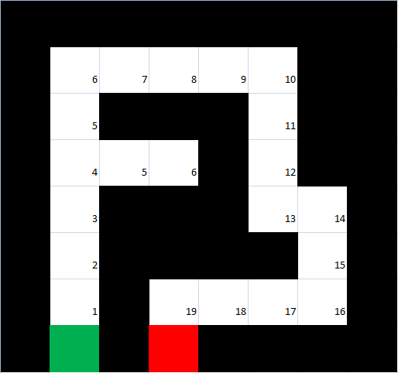
Darwin GA: Maze Program Example
~The Maze

Slide 107
Darwin GA: Maze Program Example
~The Maze (2)
In the maze, a red square represents the starting point.
A green square represents the goal.
A black square represents a wall.
A empty square represents a movable square.
The numbers represent the Manhattan distance from the goal.

Slide 108
Darwin GA: Maze Program Example
~The Chromosome Coding
For the chromosomes, it is necessary to have a coding for each of the directions:
  Forward = 1
  Left = 2
  Right = 3
  Backwards = 4
Turning is not required since an omnidirectional drive is used.

Slide 109
Darwin GA: Maze Program Example
~Initializing the Population
Now we finally get to the beginning of the program. The first step is to initialize a population.
Another thing we do in the initialization is to create to maze and place it into a 8 by 8 maze. We do this by creating a for loop filling in numerical values into the array. The coding is as below:
  7 is the start
  8 is the goal
  9 is a wall

Slide 110
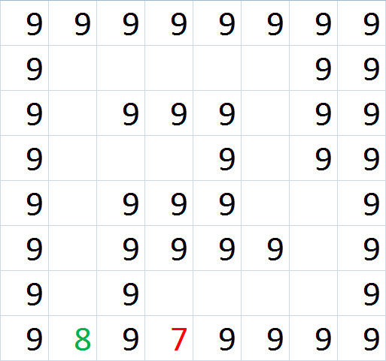
Darwin GA: Maze Program Example
~Initializing the Population (2)
Numeric coding of the maze
9 = wall
7 = starting point
8 = goal

Slide 111



Darwin GA: Maze Program Example
~Initializing the Population (3)
The code for initializing the shape of the maze:

Slide 112

Darwin GA: Maze Program Example
~Initializing the Population (4)
The code for initializing the chromosome placement array:

Slide 113
Darwin GA: Maze Program Example
~Initializing the Population (5)
We also create 2 other copies of the array, one for keeping track of the order the place the chromosome values, and one for calculating distance traveled.
After the array was created, the chromosomes were made. This is done by creating a for-loop which assigns random movement values (1-4) into a integer array of 21 (the number of unused space in the maze).
Each chromosome is part of a vector with 1000 chromosomes (the population).

Slide 114

Darwin GA: Maze Program Example
~Initializing the Population (6)
The code for generating the chromosomes:

Slide 115
Darwin GA: Maze Program Example
~Calculating the Fitness
The next major function of the genetic algorithm is to calculate the fitness of each chromosome. This is done by simulating the maze.
The maze is initialized by first reset setting the state of all arrays. Then, we fill in the maze with the chromosome values (see next page) using one of our defined maze arrays as a guide. We have a variable for the robot which is initialized at the starting position. We move according to the number (1-4) of the cell.

Slide 116

Darwin GA: Maze Program Example
~Calculating the Fitness (2)
The number represents the order that the chromosome values are placed into the array.
The values of the chromosome is placed from left to right

Slide 117
Darwin GA: Maze Program Example
~Calculating the Fitness (3)
The code for finding the start and end of the maze:

Slide 118
Darwin GA: Maze Program Example
~Calculating the Fitness (4)
The code for filling in the maze:

Slide 119
Darwin GA: Maze Program Example
~Calculating the Fitness (5)
If the robot crashes a wall, the process is terminated. The process is also terminated if the robot detects that it is in an endless loop, or if the robot gets to the goal. and the fitness is calculated by e – n where e is the number of empty cells and n is the number of cells traveled. It is never possible to get a fitness of zero since there is two unused spaces being the dead end.
The process is looped until all chromosomes are tested.

Slide 120


Darwin GA: Maze Program Example
~Calculating the Fitness (6)
The function for checking the movement of the robot:

Slide 121

Darwin GA: Maze Program Example
~Calculating the Fitness (7)
The function for checking the movement of the robot(2):

Slide 122
Darwin GA: Maze Program Example
~Selecting the Best Chromosomes
The next main function is the selection of the best chromosomes. This is simply done by sorting the vector until the lowest fitness values (20, 21, etc) at the bottom and the highest fitness values (2, 3, etc) at the top. Therefore, we select the top half or third to get the best chromosomes.

Slide 123

Darwin GA: Maze Program Example
~Selecting the Best Chromosomes (2)
The code for sorting the chromosomes
Sort() is a function in an included standard library
We select the in the genetic operator function.

Slide 124
Darwin GA: Maze Program Example
~Mating and Looping
After we select the chromosomes, we them randomly mate them. Thus, we then apply the crossover and mutation operators. We create the next generation from this.
As the final step in the process, it will loop until the condition is solved, being getting to the end. In simple words, the fitness value has to equal 2.

Slide 125

Darwin GA: Maze Program Example
~Mating and Looping (2)
The code for the mating function
The variable mutation was defined before.

Slide 126

Darwin GA: Maze Program Example
~Mating and Looping (3)
The code for the mutation function:

Slide 127
Darwin GA: Maze Program Example
~The Running of a Generation
Let’s simulate this process. We’ll use this chromosome.
333112111242244444434
Note that the goal sequence is:
333112111222244444434
We first fill in the maze.

Slide 128

Darwin GA: Maze Program Example
~The Running of a Generation (2)
Original Chromosome
We now fill in the maze with:
3
2
4
3
4
4
3
3
4
1
1
1
1
1
2
2
2
4
4
4
4
333112111242244444434

Slide 129

Darwin GA: Maze Program Example
~The Running of a Generation (3)
The next step is to see how far the robot (blue square) goes.
Now we calculate the fitness by first seeing how far it went: 10
21-10 = 11 which is the fitness value

Slide 130
Darwin GA: Maze Program Example
~The Running of a Generation (4)
Afterwards we now calculate the other fitness values and select the best chromosomes. Then we apply the genetic operators (shown before).

Slide 131
Maze Program Example
~Lamarckian GA
We can also use Lamarckian GA for this purpose. Everything will be kept the same, besides that there would be two more functions. One repair the function, and another recalculating the fitness (can be copied from the first fitness calculation).
We repair the chromosomes by seeing where the robot crashed and randomly giving it another value. This can help a lot as in the previous example, where if we had generated a 2, then the robot would get to the end. But can also be worse when it calculates a 3 and make an endless loop, creating a fitness of 21.

Slide 132
Maze Program Example
~Lamarckian GA (2)
For example, going back to the previous maze where I had a chromosome sequence of:
333112111242244444434
If the 4 happened to randomly generate a 2 for replacement, then the fitness would be a 2, which means that the robot reached its goal.
However, if we generate a number 3, then the chromosome would be ruined, having a fitness of 21.

Slide 133
Darwinian vs Lamarckian:
Genetic Algorithm Maze Data
When comparing the genetic algorithms, I took the same maze as described previously. I took the same initialization of population, fitness calculation, sorting, and genetic operators. However, I added a normal repair chromosome function. Three trials were done for both algorithms

Slide 134
Darwinian vs Lamarckian:
Genetic Algorithm Maze Data (2)
When we look at the graph (below), we see a definite difference between the two algorithms. The Darwinian GA took almost three times more generations than Lamarckian GA, with 33 generations as to Lamarckian GA’s 12 generations.

Slide 135
Darwinian vs Lamarckian:
Genetic Algorithm Maze Data (3)
When looking at the three trials, we notice that Lamarckian GA is more of a downhill rather than Darwinian’s bumpy spikes.

Slide 136
Darwinian vs Lamarckian:
Genetic Algorithm Maze Data (4)
In conclusion, Lamarckian’s algorithm, although it might not be biologically correct, out performs Darwinian’s algorithm by almost up to three times less the number of generations for a simple purpose. It clearly does better then Darwinian’s algorithm in everyway, with no draw backs. This makes Lamarckian’s genetic algorithm better than the traditional Darwinian’s genetic algorithm in programming.

Slide 137
Later Additions and Improvements
Most Important: Include and add genetic algorithm to the robot for movement, emotions, etc.
Just as Important: Have more examples for comparing Lamarckian and Darwinian GA
Include Lamarckian genetic algorithm to the robot.
Attach a camera on the robot
Add speech and emotion to the program

Slide 138

The End
That’s it

