Slide 1
EPISTEMIC LOGIC

Slide 2
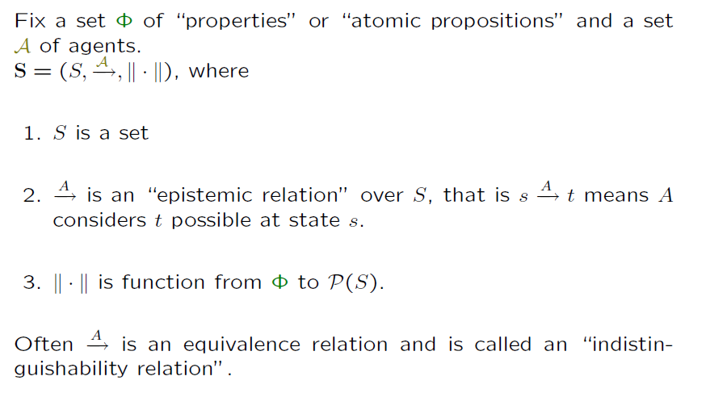
State Model (AKA Epistemic Model)
We introduce epistemic models
Epistemic relations
This function assigns sets of states to formulas
Epistemic relations are equivalence relations

Slide 3
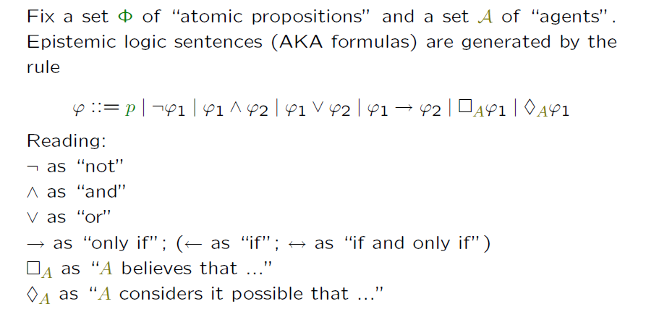
The language of Epistemic Logic
Syntax of Epistemic logic sentences (formulas)
Now that we have extended concept of model we can also extend formally the concept of logic
Model is first, model is the main concept in these logics.
First we talked about possibility and necessity
Next we talked about knowledge
Now we talk about belief.

Slide 4
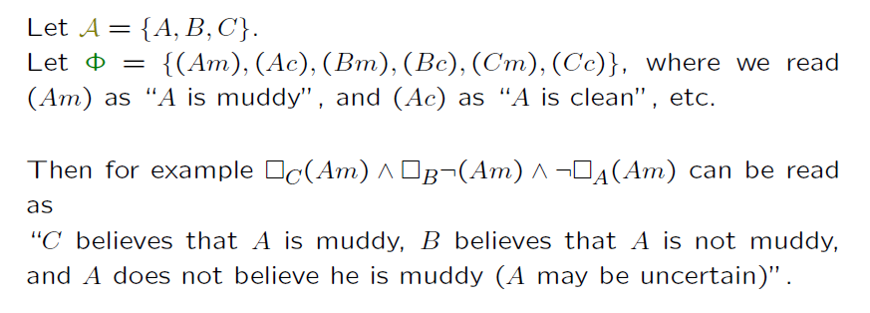
Epistemic Language for Muddy Children
Now modal operators have subscript A for agent A
Syntactically this can be similar to other language of logic
But the most important is to know in what logic are we in, model and axioms.

Slide 5
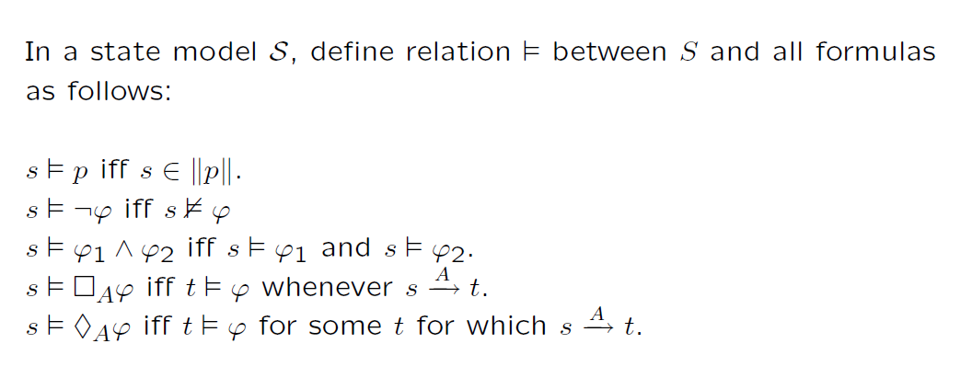
Semantics for this language
We use entailment as usually
Now modal operators have subscript A for agent A

Slide 6
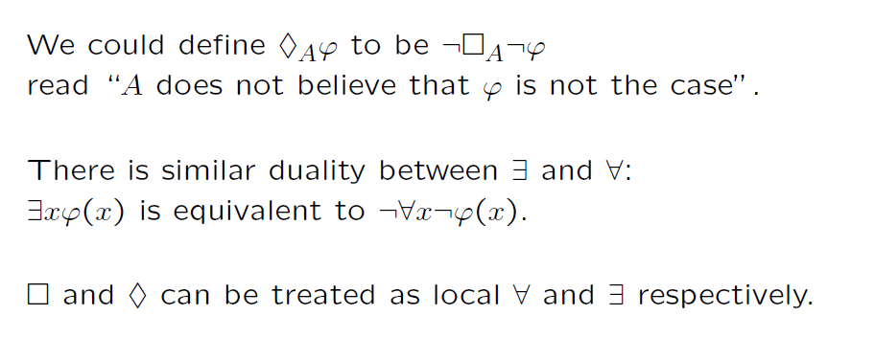
Duality of modal operators is similar to classical logic quantifiers
This duality is useful in proofs and formal reductions done automatically, but it is more convenient in hand transformations to keep both formulas as it helps to understand “what I am actually doing now?”

Slide 7
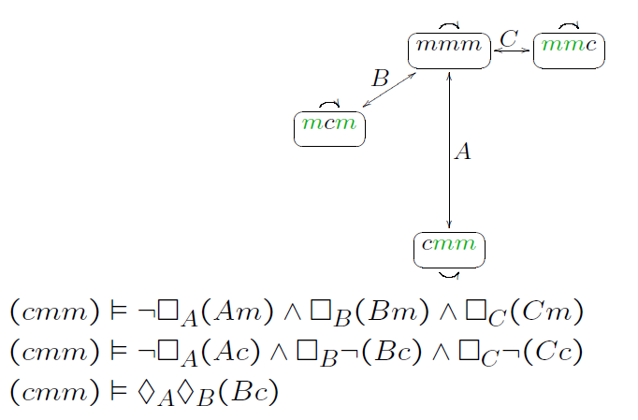
Back to Muddy Children: Examples Concerning Semantics for Epistemic Language
The rules below describe facts that we already discussed informally:
What is entailed by cmm

Slide 8
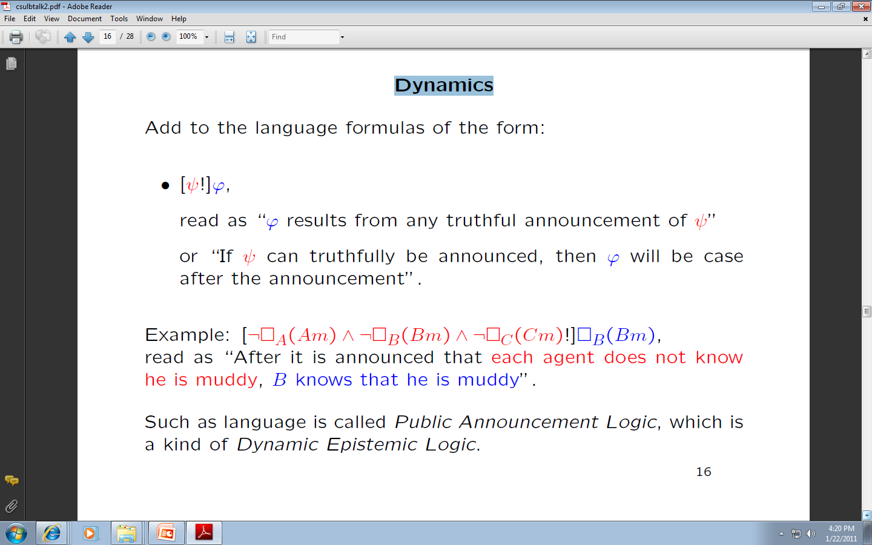
Adding Dynamics to epistemic logic
We are back to Muddy Children
Such a language is called Public Announcement Logic
It is a kind of Dynamic Epistemic Logic.

Slide 9
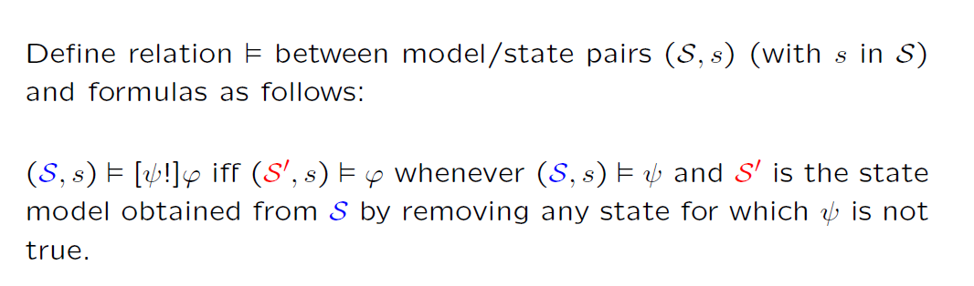
Semantics with Dynamics
We define an entailment relation for dynamic logic

Slide 10
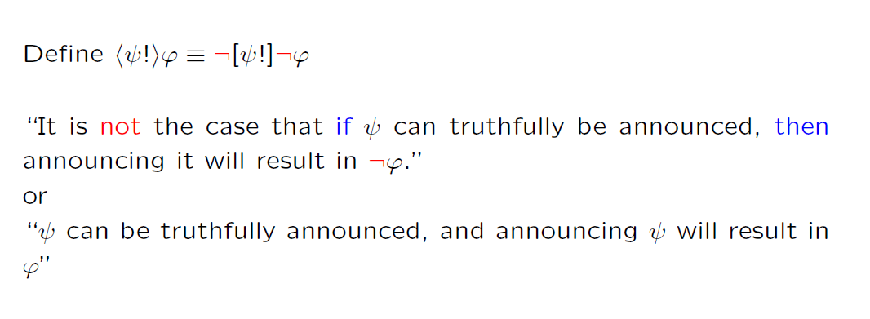
Duality for Actions
We define the rule for duality of actions

Slide 11
Now we will show more examples of logics
For this, we need a new example

Slide 12
The Sum and Product Problem

Slide 13
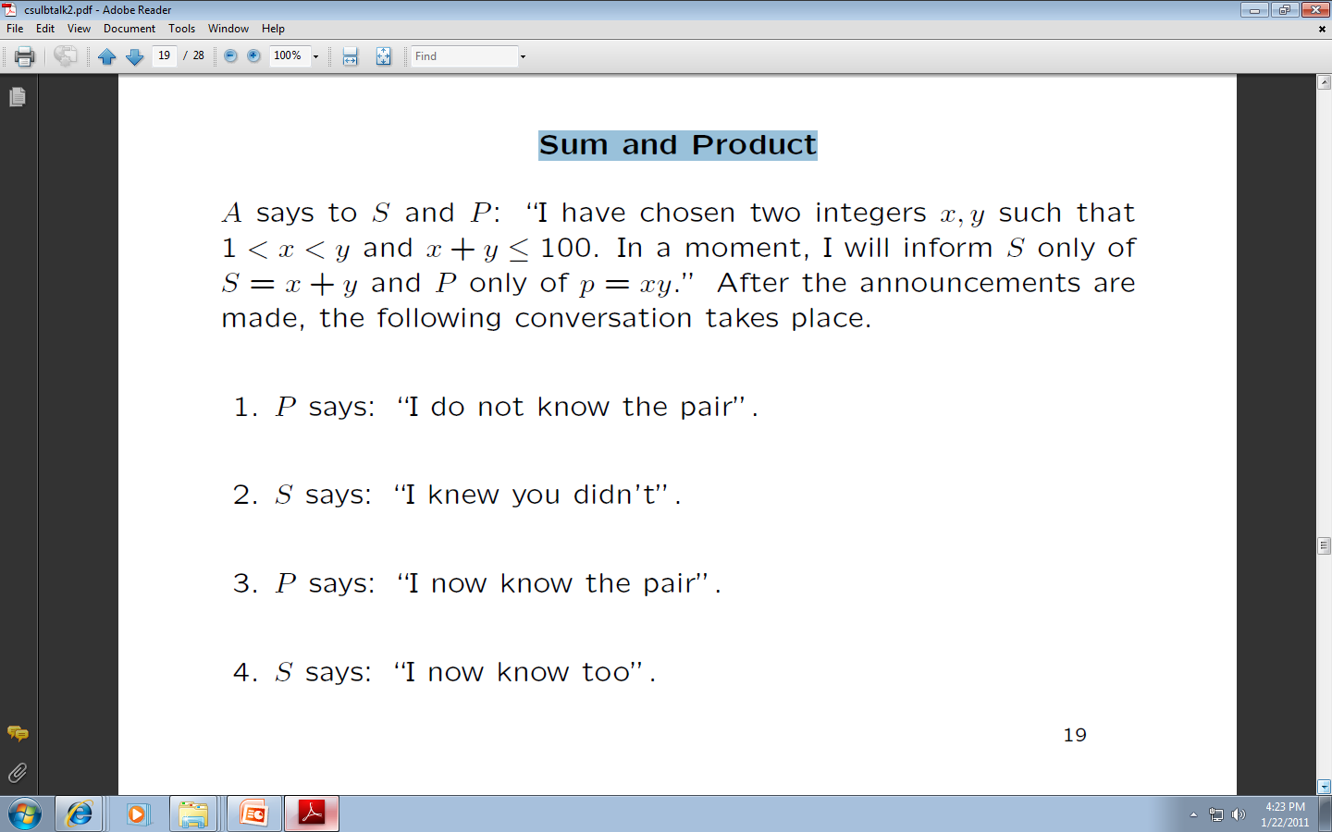
Sum and Product problem
Answer 2
S
Answer 4
0
A
P
Answer 1
Answer 3
S and P are supposed to find pair x,y

Slide 14
Let us try for small numbers… P1 thinks.
 | 2 | 3 | 4 | 5 | 6 | 7 | 8 | 9 | 10
3 | 6
4 | 8 | 12
5 | 10 | 15 | 20
6 | 12 | 18 | 24
7 | 14 | 21 | 28
8 | 16 | 24 | 32
9 | 18 | 27 | 36
11 | 12 | 13 | 14
P1 would tell if the product were unieque. Like for (2,4), (2,8),,,,
Pairs
Non-unique after P1:
2,6
2,9
2,12
2,14
2,15
3,4
3,6
3,8
3,10
3,12
3,14
3,15….
 | 2 | 3 | 4 | 5 | 6 | 7 | 8 | 9 | 10
10 | 20 | 30 | 40
11 | 22 | 33 | 44
12 | 24 | 36 | 48
13 | 26 | 39 | 52
14 | 28 | 42 | 56
15 | 30 | 45 | 60
16
11 | 12 | 13 | 14

Slide 15
Let us try for small numbers… S1 thinks.
 | 2 | 3 | 4 | 5 | 6 | 7 | 8 | 9 | 10
3 | 5
4 | 6 | 7
5 | 7 | 8 | 9
6 | 8 | 9 | 10 | 11
7 | 9 | 10 | 11 | 12 | 13
8 | 10 | 11 | 12 | 13 | 14 | 15
9 | 11 | 12 | 13 | 14 | 15 | 16
11 | 12 | 13 | 14
P1 excludes this pair in P1
Pairs
Non-unique after P1:
2,6
2,9
2,12
2,14
2,15
3,4
3,6
3,8
3,10
3,12
3,14
3,15….
 | 2 | 3 | 4 | 5 | 6 | 7 | 8 | 9 | 10
10 | 12 | 13 | 14 | 15 | 16 | 17
11 | 13 | 14 | 15 | 16 | 17 | 18
12 | 14 | 15 | 16 | 17 | 18 | 19
13 | 15 | 16 | 17 | 18 | 19 | 20
14 | 16 | 17 | 18 | 19 | 20 | 21
15 | 17 | 18 | 19 | 20 | 21 | 22
16
11 | 12 | 13 | 14

Slide 16
Formal solution to P and S problem

Slide 17
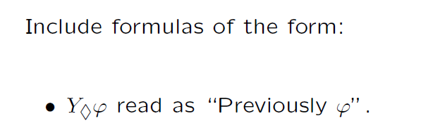
Adding Previous-Time Operator
It is “possible” type of operator of type Y
Such a language is called Temporal Public Announcement Logic

Slide 18
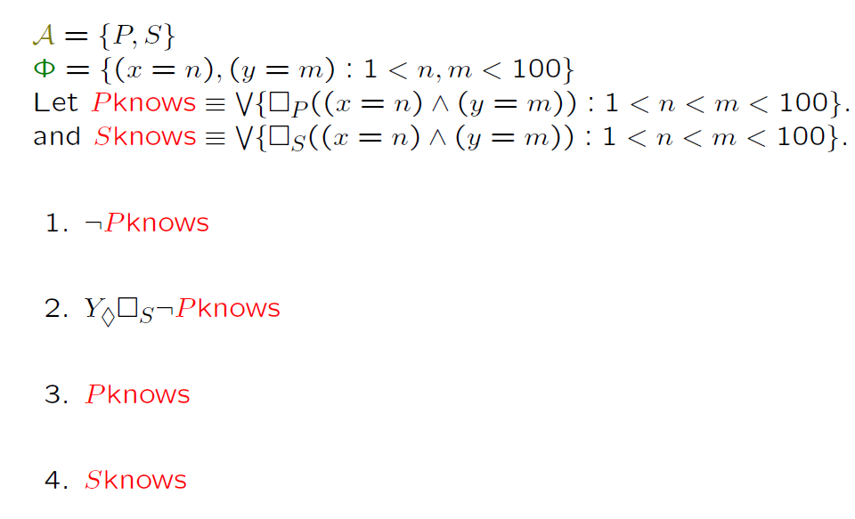
Language for Sum and Product
Agents are P and S
Necessary for S
Or means any of them
Now that we have the new operator, we can formulate language for the Sum and Product problem

Slide 19
Translation to formulas
Previously it was necessary for S that P did not know

Slide 20
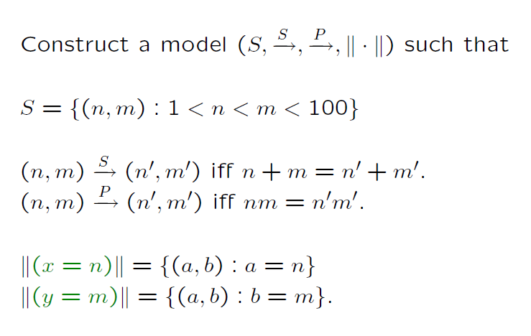
Formulation of a Model for the “Sum and Product” problem
Now we have to construct the model
Definition of set S
Meaning of relations S and P, what S and P know
Definitions of equalities

Slide 21
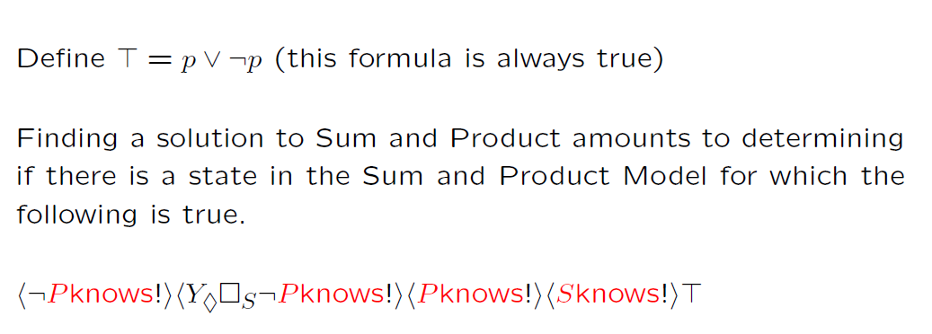
Formula for Sum and Product Conversation
We want to find the state that this formula is always true
Remember our notation

Slide 22
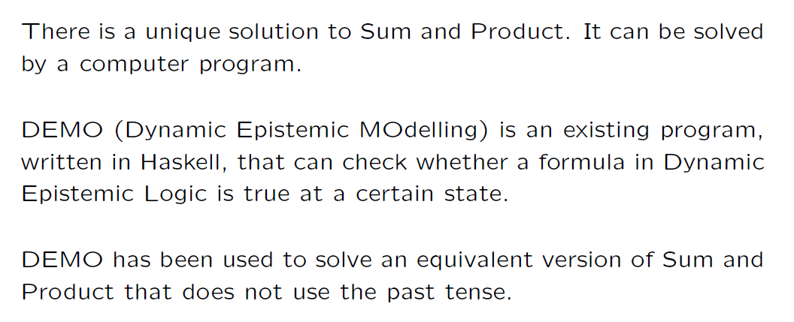
Model Checker Program DEMO already exists
DEMO software written in Haskell
Inventing such problems and solving them is an active research area

