Slide 1
Information Flow
CS 591: Introduction to Computer Security
James Hook

Slide 2
Program analysis
What if we try to track information flow within a program?
We have access control for files, processes and users
what about variables?

Slide 3
History
Denning and Denning, 1977
Paper articulates approach
Volpano, Irvine, and Smith, 1996
Solve open problems in Denning and Denning
Sabelfeld and Myers, 2003
Survey paper; basis of this presentation
Pottier and Simonet, Flow Caml, 2005
Implementation

Slide 4
Explicit flows
x := 17
l := h
h := l
Convention:
l will be a “low” variable
h will be a “high” variable

Slide 5
Implicit flows
How can we write l:=h?
Assume l and h are Booleans
if h then l:= true else l:= false
l := true; if not h then l:= false else skip
l := false; while h do l:= true

Slide 6
Simple “while” language
Sabelfeld and Myers Figures 2 and 3
C ::= skip | var := exp | C1; C2 | if exp then C1 else C2 | while exp do C

Slide 7
Type system
Judgment forms:
Every variable in exp is at or below level
|- exp: level
Every assignment in C is at or above pc
[pc] |- C
Typical Rule
|- exp : low
----------------
[low] |- l := exp
Rule structure:
a (possibly empty) set of antecedents is written above the line; consequent below.
If the antecedents can all be established then the consequent is established.

Slide 8
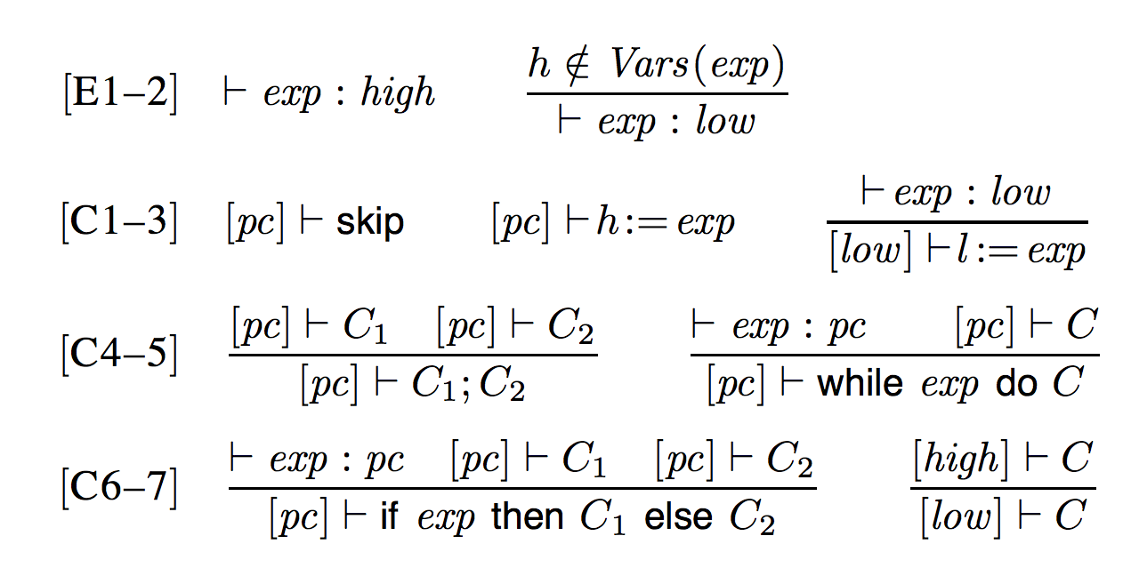
Inference Rules

Slide 9
What is a flow?
A variable of confidential input does not cause a variation of public output

Slide 10
Direct examples
Allow “write up”
by C2
[low] |-
h := not l

Slide 11
Direct examples
No “write down”

h ∉ Vars(not h)
by E2
|- not h : low
by C3
[low] |-
l := not h
Type checking fails!

Slide 12
Simple Program
Multiplication by repeated addition
{a,b >= 0} x := a; r := 0; while (x>0) do x := x -1; r := r + b {r = a*b}
Direct Flows:
a -> x b -> r
Indirect Flow:
x -> r

Slide 13
Simple Program
Multiplication by repeated addition
{a,b >= 0} x := a; r := 0; while (x>0) do x := x -1; r := r + b {r = a*b}
What if x is high?

Slide 14
Simple Program
Multiplication by repeated addition
What if x is high?
|- x>0 : pc
[pc] |- x := … ; r :=
[pc] |-
while (x>0) do x := x -1; r := r + b

Slide 15
Simple Program
Multiplication by repeated addition
What if x is high?
|- x>0 : high
[high] |- x := … ; r :=
[high] |-
while (x>0) do x := x -1; r := r + b

Slide 16
Simple Program
Multiplication by repeated addition
[high] |- x := … [high] |- r :=
|- x>0 : high
[high] |- x := … ; r :=
[high] |-
while (x>0) do x := x -1; r := r + b

Slide 17
Simple Program
Multiplication by repeated addition
Can’t assign to low in high context (Rule C3 does not apply here)
Must use C2, so r must be a high variable
[high] |- r := r + b

Slide 18
Simple Program
Multiplication by repeated addition
{a,b >= 0} x := a; r := 0; while (x>0) do x := x -1; r := r + b {r = a*b}
Direct Flows:
a -> x b -> r
Indirect Flow:
x -> r
If x is high; type system forces r to be high

Slide 20
Exercise
h := not l
h := if l then false else true
if l then h := false else h := true
h := true; if l then h := false else skip
l := not h
l := if h then false else true
if h then l := false else l := true
l := true; if h then l := false else skip

Slide 21
Theoretical results
Volpano, Irvine and Smith (JCS ‘96) showed Soundness
“If an expression e can be given a type τ in our system, then Simple Security says … that only variables at level τ or lower in e will have their contents read when e is evaluated (no read up)….
On the other hand, if a command c can be given a type [τ] |- c then Confinement says … that no variable below level τ is updated in c (no write down).”

Slide 22
Effects beyond Assignment
The Sabelfeld and Myers presentation focuses on Assignment
Denning and Denning considered several other effects
Exceptions
Input/Output
Termination
An Information Flow language must track all computational effects in the language

Slide 23
Information Flow Languages
Two serious implementations of information-flow languages
Jif = Java + Information Flow
Andrew Myers and others, Cornell
http://www.cs.cornell.edu/jif/
FlowCaml
Vincent Simonet
http://cristal.inria.fr/~simonet/soft/flowcaml/

Slide 24
FlowCaml
An ML-style language with type inference
Windows executable flowcaml gives an interactive type checker
Note: It does not execute the programs, batch compiler flowcamlc compiles them

Slide 25
Declaring values
let x = 1;;
let x1 : !alice int = 42;;
let x2 : !bob int = 53;;

Slide 26
Anonymous functions and lists
let succ = function x -> x + 1;;
let half = function x -> x lsr 1;;
let l1 = [1; 2; 3; 4];;
let l2 = [x1; x2];;

Slide 27
Defining functions
let rec length = function
[] -> 0
| _ :: tl -> 1 + length tl;;
let rec mem0 = function
[] -> false
| hd :: tl -> hd = 0 || mem0 tl
;;

Slide 28
Demo

Slide 29
Does it work?
In practice it is not broadly adopted
Technical issue is the complexity of managing policy
I suspect there are social issues as well … the technical issues are not show stoppers

Slide 30
Recall
Consider an example (in no particular language)
Assume H is high and L is Low
H = readHighDatabase()
L = readLowUserInput()
If f(H,L) then printLow “Success” else printLow “Fail”

Slide 31
But!!!
Consider an example (in no particular language)
We do this every day!
H = readHighDatabase(“passwd”)
L = readLowUserInput()
If checkPassword(H,L) then printLow “Success” else printLow “Fail”

Slide 32
Password checking paradox
Why shouldn’t we allow someone to write the password program?
Why should we?

Slide 33
Policy
The password paradox is solved by explicit policy
Similar issues arise with crypto algorithms
LoCypher = encrypt (HighClear, goodKey)
Cf.
LoCypher = encrypt (HighClear, badKey)

Slide 34
FlowCaml and Policy
FlowCaml solves the policy problem by dividing the program into two parts:
Flow caml portion (.fml), with all flows checked
Regular caml portion with an annotated interface
The downgrading of encryption or password validation queries is not done within the flow-checked portion

Slide 35
Policy
Zdancewic uses other techniques, including explicit downgrade assertions for confidentiality
Basic philosophy: uniform enforcement with explicit escape mechanism
Focus analysis on the exceptions

Slide 36
Further reading
Dorothy E. Denning and Peter J. Denning, Certification of Programs for Secure Information Flow, http://www.seas.upenn.edu/~cis670/Spring2003/p504-denning.pdf
Dennis Volpano, Geoffrey Smith, and Cynthia Irvine, A Sound Type System for Secure Flow Analysis, http://www.cs.fiu.edu/~smithg/papers/jcs96.pdf
Steve Zdancewic, Lantian Zheng, Nathaniel Nystrom, and Andrew C. Myers, Secure Program Partitioning, http://www.cis.upenn.edu/~stevez/papers/ZZNM02.pdf
Andrei Sabelfeld and Andrew C. Myers, Language-based Information-Flow Security, http://www.cs.cornell.edu/andru/papers/jsac/sm-jsac03.pdf
Peng Li and Steve Zdancewic, Downgrading Policies and Relaxed Noninterference, http://www.cis.upenn.edu/~stevez/papers/LZ05a.pdf

