Slide 1
Lecture 9:
Assurance & Evaluation
CS 4/591: Introduction to Computer Security
James Hook

Slide 2
Note
These slides still have some references to the chapters on Assurance by Elizabeth Sullivan in the Bishop text
That material is not assigned

Slide 3
Objectives
Introduce Assurance as a concept/goal
Introduce methods to increase assurance
Introduce frameworks for Certification

Slide 4
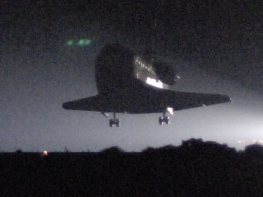
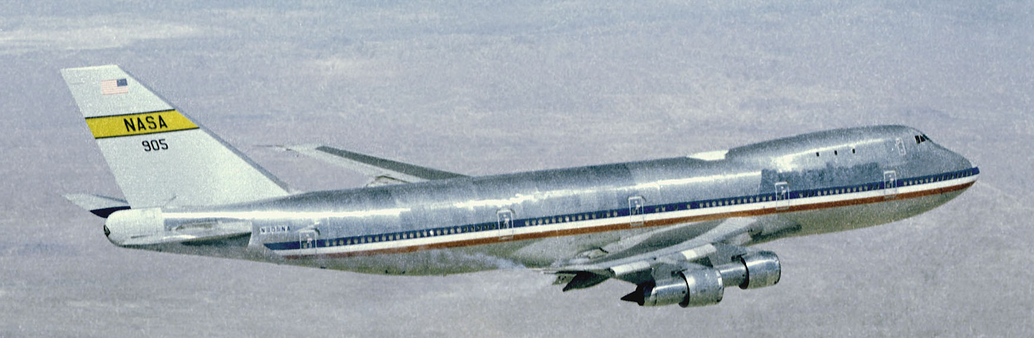
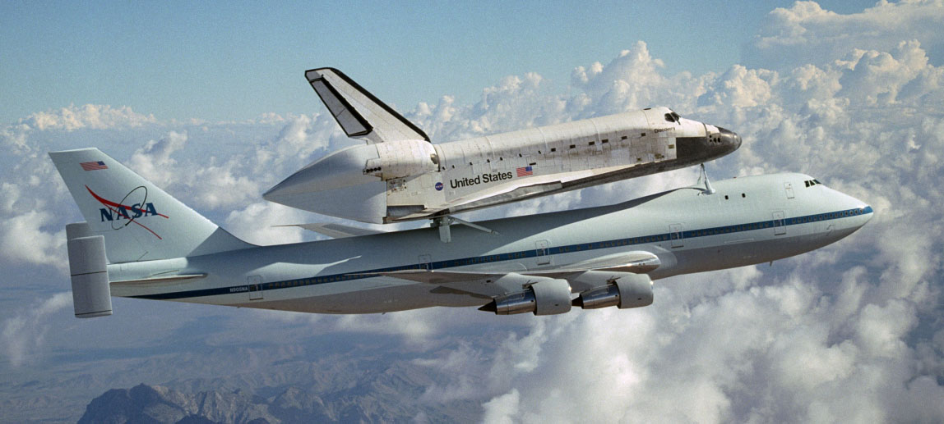
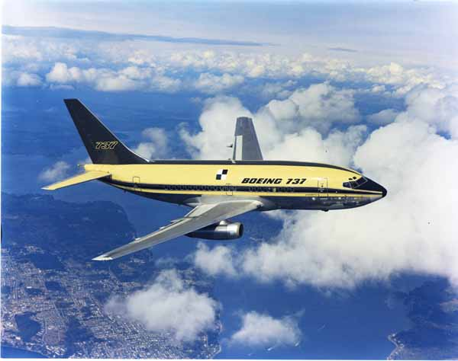
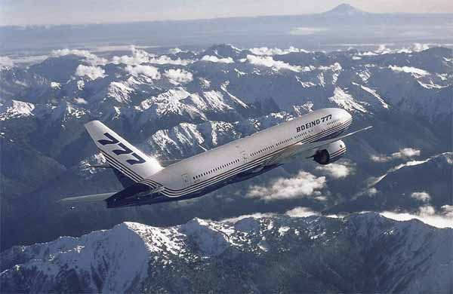
Why do you trust an Airplane?
Which of these do you trust more? Why?
NASA images from web site: http://www.dfrc.nasa.gov/Gallery/Photo/
Boeing images from web site: http://www.boeing.com/companyoffices/gallery/flash.html

Slide 5
Discussion points:
Who’s flying?
  How many hours have they been awake?
How long have the airframes been in service?
Risk/benefit: If you want to go into space you don’t have a lot of choices
  Best to limit to “apples to apples”

Slide 6
Trusting Commercial Aircraft
Specification integrity
  Clear scope of project; goal of aircraft
Design integrity
  State of the art engineering analysis of design
  Extensive modeling (physical and simulation) based on established best-practices of a mature engineering discipline
  FAA review
Manufacturing integrity
  Extensive process controls and tests for all components
  Rigor appropriate to risk (entertainment system vs. autopilot)

Slide 7
Trusting Commercial Aircraft
Operational integrity
  Maintenance is performed by certified mechanics
  Maintenance performed on schedule
  Maintenance includes diagnostic measurements confirming conformance to design specifications
  Pilot is licensed to fly
  Pilot inspects aircraft prior to flight (and she’s on the plane!)
  Pilot does not perform maintenance (Separation of duty)
Feedback
  Independent investigation of failures
  If design defects or manufacturing defects are identified the entire fleet can be grounded or repaired

Slide 8
Are all Aircraft Trustworthy?
Federal regulations reflect risk
Crudely: Level of assurance increases as potential cost of failure increases
Commercial aviation is “high assurance”

Slide 9
Can you trust systems that include software?
Some modern aircraft are “fly by wire”
How do we trust them?
FAA
  Lots of testing
  Lots of review
  Lots of process-based controls of both
Techniques that work for high assurance embedded systems are hard to scale

Slide 10
Trusting Information Systems
How can we trust an information system?
What can we trust it to do?
Can we trust a mechanism to implement a policy?
How well does the analogy to aviation apply?

Slide 11
The Analogy
Key factor of trust of commercial airplanes is that we trust the engineering processes used to design, build, maintain, and improve them
Assurance techniques for information systems are predicated on software engineering practices
  Is our discipline a sufficiently mature engineering discipline to earn the trust that the public has placed in us?

Slide 12
Ross Anderson on Assurance
“Fundamentally, assurance comes down to the question of whether capable, motivated people have beat up on the system enough. But how do you define enough? And how do you define the system? How do you deal with people who protect the wrong thing, … out of date or plain wrong? … allow for human failures?”

Slide 13
Software Engineering
Taxonomy of failures and design methods presupposes Software Engineering Principles
  Classic lifecycle view of SE posits:
    Requirements
    Design
    Implementation
    Integration and Test
    Operation and Maintenance

Slide 14
Design Assurance (broad)
Requirements: statements of goals that must be satisfied
For Security assurance, requirements should determine the security policy, or the space of possible security policies (security model), for the system
  E.g. What is the access control mechanism? What are the subjects? What are the objects? What are the rights?
  Is the access control policy mandatory? Discretionary? Originator controlled?
The tools introduced in class to date provide a vocabulary for expressing security models, policies, and mechanisms

Slide 15
Policy Assurance
Evidence that the set of security requirements is complete, consistent and technically sound
  Complete:
    Logic: complete means every sentence is either true or false
    Security: every system state can be classified as “safe” or “unsafe”
  Consistent:
    Logic: there is no sentence that is both true and false, or, equivalently that the sentence “false” is not a theorem
    Security: no system state is both “safe” and “unsafe”.
  Technically sound:
    Logic: a rule is sound if it does not introduce inconsistencies
    ? I think the author intends a necessarily informal notion that the model is appropriate to the situation

Slide 16
Policy Assurance Examples
The original BLP papers show that the model is complete and consistent
The Volpano, Irvine and Smith paper shows that the Denning and Denning Information Flow Security concepts can be made sound
  That analysis is necessarily incomplete (halting problem)
Many Policy Assurance arguments are carried out using
  “rigorous mathematics” (I.e. pencil and paper proofs)
  some use theorem provers (machine checked proofs)

Slide 17
Design Assurance (strict)
Design is sufficient to meet the requirements of the policy
  What is a design?
    Architecture
    Hardware software components
    Communication mechanisms
    Use-cases?
    Threat profile?

Slide 18
Implementation Assurance
Evidence establishing the implementation is consistent with the requirements and policy
  Generally this is done by showing the implementation is consistent with the design, which is consistent with requirements and policy…
Considerations
  Design implemented correctly
  Evidence that appropriate tools and practices used to avoid introducing vulnerabilities (e.g. code insertion/buffer overflow)
  Testing
  Proof of correctness
  Documentation

Slide 19
Operational Assurance
Evidence the system sustains the security policy requirements during installation, configuration, and day-to-day operation
Text mentions documentation
Usability testing is also key
  Human-Computer Interaction studies are underutilized in mainstream assurance practices!
Ross Anderson: usability is “the spectre at the feast”

Slide 20
Structure of An Assurance Argument
Software Engineering Process View is typically used to organize assurance argument
Software is viewed to have a “life cycle”
  Inspired by biology

Slide 21
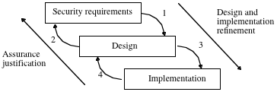
Life Cycle

Slide 22
Life Cycle Assurance
Conception
  Initial focus is on policy and requirements
Manufacture
  Select mechanisms to enforce policy
  Give evidence that mechanisms are appropriate
Deployment
  Prepare operational plans that realize policy goals
  Provide mechanism for distribution and delivery that assures product integrity
  Support appropriate configuration
Fielded Product Life
  Update and patch mechanism
  Customer support
  Product decommissioning and end of life

Slide 23
Assurance
Myth or Reality?
Are we behaving like good engineers and avoiding the Failures of Past?
  Or are we alchemists promising to make gold out of manure?
If we really cared about code insertion attacks would we use C for routine programming 18 years after the Morris worm?

Slide 24
Confounding Issue
In Software Engineering which matters more:
  People
  Tools
  Process
All evidence of which I am aware says people matter more than tools or process
Given this, can we achieve assurance by mandating tools and process?

Slide 25
Anderson: Incentives
Security Engineering
  Incentives: If people don’t want to protect a system it’s hard to make them
  Policy: People often end up protecting the wrong things, or protecting the right things in the wrong way
  Mechanisms: US export controls led to …DVDs being shipped …that were intrinsically vulnerable.
  Assurance of architecture: Does this address the exploitable bugs, such as stack overflows, race conditions, etc.

Slide 26
Incentives
Who is at risk if it fails?
  The developers?
  The certifying agency?
  The operating agency?

Slide 27
Quis Custodiet?
Quis custodiet ipsos custodes?
  Who shall watch the watchmen?

Slide 28
Anderson (cont)
“Government agencies’ … dream is to be able to buy commercial off-the-shelf (COTS) products, replace a small number of components …, and end up with something they can use with existing defense networks. … There is little concern with usability … This wish list is unrealistic given not just the cost of high assurance, but also the primacy of time-to-market, …, and the need for frequent product versioning to prevent the commoditization of markets.”

Slide 29
Anderson scenario
Paddy, IRA terrorist: 1,000 hours per year
  Finds 1 exploitable bug
Brian, GCHQ + NSA: 10,000,000 hours per year
  Finds 10,000 bugs
Probability Brian found Paddy’s bug?
  Less than 1%

Slide 30
Evaluation
lo
hi
assure-o-meter

Slide 31
Evaluation
Context:
  DoD identifies computer security as important in ‘70s (Anderson 1972)
  Recognizes trend toward networking: computing is communication
  Economic forces dictate they purchase products built outside of the DoD
  Need: Procurement guidelines for DoD to purchase security critical software

Slide 32
First Step
James Anderson’s “Computer Security Planning Study” provides a blueprint
Needs analysis:
  Multi-level operation
  Systems connected to the world
  On-line operation
  Networks
Vision
  Security engineering
  Secure components (hardware & software)
  Handbook of Computer Security Techniques

Slide 33
Issues
How to accelerate maturation of a discipline?
Desire: codify best practices
What if current practice is insufficient?
  Legislate what we think best practices should be!

Slide 34
First Attempt
Trusted Computer Systems Evaluation Criteria (aka “Orange Book”)
Classify systems in a scale:
  C1, C2, B1, B2, B3, A1

Slide 35
Orange Book
C1: Discretionary access control by groups of users
C2: Discretionary access control by single users; object reuse; audit
  “Carefully configured commercial systems”

Slide 36
Orange Book (cont)
B1: Mandatory access control.
  MAC labels; BLP-like policy enforced
B2: Structured protection
  B1 +
  formal model of policy,
  proof of consistency,
  tools for administration and configuration management
  TCB structured and interface clearly defined
  Cover channel analysis
  Trusted path from User to TCB
  Severe testing (penetration testing)

Slide 37
Orange Book (cont)
B3: Security domains
  As B2 +
  TCB
    minimal
    Mediates all requests
    Tamper resistant
    Able to withstand formal analysis and testing
  Real-time monitoring and alerting
  Structured techniques used in implementation
A1: Verification design
  As B3, but formal techniques are used to prove equivalence between TCB spec and security policy

Slide 38
Orange Book evaluations
Orange book evaluators worked for the government
  Government is an interested party here (purchaser)
Evaluations took a lot of time
  Products, even if successfully certified were generations behind current technology
  Both production and certification was very expensive
Orange book evaluation led to paralysis
  Producers and consumers were both frustrated

Slide 39
Orange Book issues
Applied in broad domains
  Eventually expanded to “rainbow series”
Each level increased
  Sophistication of threat model
  Sophistication of required mechanisms
  Sophistication of analysis
Increasing any one dimension is hard, doing 3 simultaneously is nearly impossible

Slide 40
Crypto Standards
Bishop/Sullivan outline a success in certification standards for crypto [FIPS 140-1]
Domain was narrow
Evaluation was informative to developers (evaluators found real bugs)
  Adding value is key!
Perceived as a success

Slide 41
Son of Orange Book
Common Criteria attempts to “fix” Orange book issues
Separates conflated dimensions
  Identify a Target of Evaluation (ToE)
  Identify a Security Target (ST)
  Identify a Protection Profile (PP) reflecting threat context and domain-specific requirements
  Classify development by “Evaluation Assurance Level”

Slide 42
Evaluation Assurance Level
EAL 1: functionally tested
EAL 2: structurally tested
EAL 3: methodically tested and checked
EAL 4: methodically designed, tested and reviewed
EAL 5: semiformally designed and tested
EAL 6: semiformally verified design and tested
EAL 7: formally verified design and tested

Slide 43
Common Criteria
International standard
EAL 1 -- 5 transferred across borders
EAL 6 and 7 are not

Slide 44
Follow up
NIST: National Institute of Standards
  Founded to make fire fighting equipment interoperable across municipal boundaries
  Now tasked with standards that support commerce
NSA: National Security Agency
  Signals Intelligence
  Protect all sensitive information for DoD
  Make the Internet safe for commerce (expanded interpretation of mission in last decade)

Slide 45
NIST and NSA
Both agencies are involved in CC and Crypto certification
NIST is the agency designated with to evaluated Engineering Assurance Levels 1 - 5 and FIPS crypto
NSA is the agency designated to evaluate EAL 6 and 7 and DoD crypto

Slide 46
NSA’s Crypto levels
Type 1: Used for classified information. Tamper resistant. No tempest radiation. Uses NSA certified algorithms.
Type 2: NSA endorsed for telecommunications. Not for classified data. Government proprietary algorithms.
Type 3: NIST certified FIPS crypto
Type 4: Registered with NIST but not certified

Slide 47
Issues
Sullivan and R Anderson present two perspectives on the result
  “Orange Book” over promised for formal methods
  Organizations failed to deliver most trusted products
    Good engineers thought they weren’t solving the real problems
  Common Criteria attempt to avoid some Orange Book faults
    Still: some science, some science fiction (EAL 6 and 7)
  Can post-hoc analysis ever work?

Slide 48
DoD practice
Practice is less strict than the dogma
New “COTS strategy” appears to bypass CC and Orange Book
Evaluation has become a barrier to procurement
  If I ask for too much assurance and my procurement is delayed I fail at my mission

Slide 49
Looking Forward
Good luck on the exam!
Remember to hand in your term paper proposal at exam
Have fun with Professor Binkley!

Slide 50
Thank you!

