Slide 1
Lecture 3:
History and Policy
CS 591: Introduction to Computer Security
James Hook

Slide 2
Military Security
Protection of information has been part of warfare throughout recoded history
“World War II and the Cold War led to a common protective marking scheme for … documents” [Ross Anderson 8.3.1]
  Top Secret (many lives lost)
  Secret (lives lost)
  Confidential (operational failure)
  Open

Slide 3
Batch Computing
Early computers were simple, small machines, with little persistent state
To run a job for a user, an operator would:
  Mount the removable media (disks and tapes) requested by the user
  Completely initialize the computer by pressing an “Initial Program Load” button that read the boot loader from the card deck supplied by the user
  Execute the operating system loaded by the boot loader, found on the removable media

Slide 4
Secure batch computing
To make this style of batch computing secure it was only necessary to focus on
  the physical security of the room,
  insure that the state was initialized, and
  handle all removable media according to the rules for handling classified documents

Slide 5
Cold War Computing
The cold war relied on aircraft capable of dropping nuclear bombs
Aircraft need to know about weather
Global weather prediction was one of the most important computational tasks in the cold war

Slide 6
Computers Communicate
Weather prediction needs input from weather stations
The batch model of military computing had to be abandoned
The security perimeter of the weather prediction system was no longer the computer room

Slide 7
Practice beyond Policy
The weather system evolved to collect data from around the globe and give reports to pilots at Strategic Air Command centers
Recognizing that this practice was outside of policy doctrine, the Air Force commissioned a study on Computer Security
James P. Anderson wrote the report: Computer Security Technology Planning Study (1972)

Slide 8
Anderson’s study
Forward looking study focused on driving forces:
  Time shared computing
  Communication and Networking

Slide 9
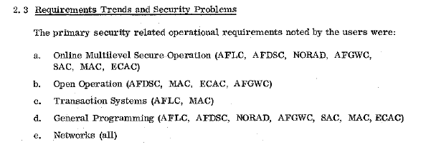
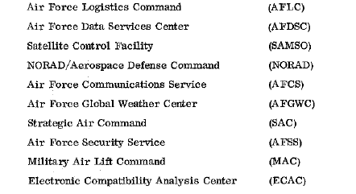
Anderson’s study

Slide 10
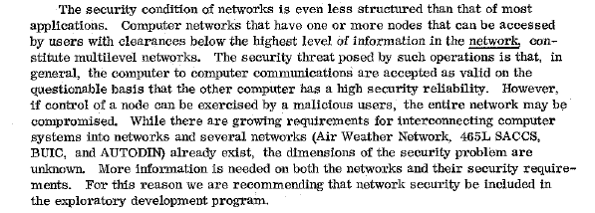
Anderson on networks

Slide 11
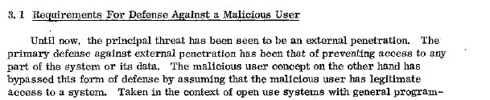
The Insider Threat

Slide 12
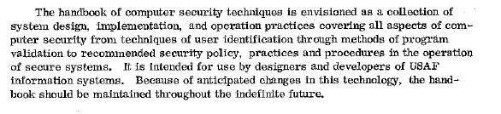
The Handbook

Slide 13
DoD Security Research
With publication of Anderson’s report significant research funds were allocated to Computer Security
Two goals:
  Solve aspects of the Security Problem as articulated by Anderson
  Give guidance to military procurement officers on how to acquire secure computing systems

Slide 14
DoD Research dominates ‘70’s
Although not all security challenges were related to defense, defense sponsored research dominates publications in 70’s and 80’s
In that period Confidentiality was stressed
The neglect of Availability would bite on September 11, 2001

Slide 15
Policy

Slide 16
Objectives
Explore what a security policy is; develop a vocabulary to discuss policies
Examine the role of trust in policy

Slide 17
What is Policy?
Anderson [Text, 8.2]:
  “…a document that expresses clearly and concisely what the protection mechanisms are to achieve. It is driven by our understanding of threats, and in turn drives our system design. …”

Slide 18
Anderson: Policy refined
“Security Policy Model: succinct statement of the protection properties which a system , …, must have.
  Written down on a page or less
  Community consensus
  May be basis of formal mathematical analysis”

Slide 19
Anderson (cont)
“Security target: a more detailed description of the protection mechanisms that a specific implementation provides, and how they relate to a list of control objectives. …
  The security target forms the basis for testing and evaluation of a product.”

Slide 20
Anderson (cont)
“Protection Profile: like a security target but expressed in an implementation-independent way to enable comparable evaluations across products and versions.
  Requirement for evaluation under Common Criteria (discussed later)”

Slide 21
Bishop: Policy
Statement that articulates the security goal
In the state machine model it identifies the authorized or secure states (which are distinct from the unauthorized or nonsecure states)
A secure system is one in which the system can only enter authorized states
  Note: The policy doesn’t make the system secure; it defines what secure is

Slide 22
SANS institute
A policy is typically a document that outlines specific requirements or rules that must be met. … For example, an "Acceptable Use" policy would cover the rules and regulations for appropriate use of the computing facilities.
A standard is typically collections of system-specific or procedural-specific requirements that must be met by everyone. For example, you might have a standard that describes how to harden a Windows NT workstation for placement on an external (DMZ) network. …
A guideline is typically a collection of system specific or procedural specific "suggestions" for best practice. They are not requirements to be met, but are strongly recommended. Effective security policies make frequent references to standards and guidelines that exist within an organization.

Slide 23
Policy?
So what is it?

Slide 24
Understanding Policy
Policy (or security policy models) can be understood by decomposing them into different facets, including
  Confidentiality
  Integrity
  Availability

Slide 25
Confidentiality
Protection of information from a set of principles
Anderson refines confidentiality (others don’t)
  Secrecy: … mechanisms used to limit the … principals who can access information …
  Confidentiality: … obligation to protect ... other’s … secrets …
  Privacy: … ability and/or right to protect your personal information … and/or to prevent invasions of your personal space …

Slide 26
Confidentiality Scenario
If an instructor wishes to keep class grades confidential from the students which of the following can the instructor do?
  Email the grade file to the class mailing list
  Email an encrypted grade file to the class mailing list
  Email summary statistics (mean, median, max, and min) to the class mailing list
What is information? What is data?

Slide 27
Integrity
Dictionary (http://www.m-w.com/dictionary/integrity)
  1 : firm adherence to a code of especially moral or artistic values : INCORRUPTIBILITY
  2 : an unimpaired condition : SOUNDNESS
  3 : the quality or state of being complete or undivided : COMPLETENESS

Slide 28
Integrity
If the users of a system trust the file system does it have integrity?
Is it reasonable for integrity to be based on user perception?
If the public loses confidence in voting machines can even a perfect DRE machine have integrity?

Slide 29
Assurance
Assurance aims to provide evidence of integrity
We trust the integrity of the bank because we trust the accounting practices used by banks
We also trust the bank because
  The bank is audited for compliance with these trusted practices
  The bank’s data is scrutinized for signatures of fraud

Slide 30
Integrity
Although we may desire an absolute notion of integrity we must accept the perception of trust in the general case
If we do not have complete assurance the best we can demand is that no agent can refute integrity

Slide 31
Availability
A resources is available to a set of principles if they can access it to perform their mission
What is access?
Quality of service is not always binary

Slide 32
Setting the bar on access
Organizational context is critical
For a person, access sufficient to perform their job function
  Avionics system: micro-/milli second (some military airframes are aerodynamically unstable; avionics system is required to keep them in the air)
  Air Traffic control: 100s of milliseconds
  Airline reservations: 10s of seconds
  [These numbers are notional]

Slide 33
Access and Quality of Service
Behavior of service under load may be important
  Graceful degradation
  QoS threshold
When is it better to do a few things quickly than all things slowly?

Slide 34
Dimensions of Policy
Policy defines security objective:
  Confidentiality: Protect Information and Resources I from X
  Integrity: …in a manner trusted by Y
  Availability: …to be accessible to Z
Mechanisms can be evaluated to determine if they help meet the objective

Slide 35
Does this model match reality?
Example: PSU Acceptable Use Policy
  You have probably all attested to having read and understood this policy
What facets focus on
  Confidentiality: what is I? who/what is X?
  Integrity: I? X?
  Availability: I? X?
What facets are outside of this model?

Slide 36
PSU Computer & Network Acceptable Use Policy
This acceptable use policy governs the use of computers and networks at Portland State University (PSU). As a user of these resources, you are responsible for reading and understanding this document. …
Portland State University encourages the use and application of information technologies to support the research, instruction, and public service mission of the institution. PSU computers and networks can provide access to resources on and off campus, as well as the ability to communicate with other users worldwide. Such open access is a privilege and requires that individual users act responsibly. Users must respect the rights of other users, respect the integrity of systems and related physical resources, and observe all relevant laws, regulations, and contractual obligations.

Slide 37
PSU AUP (cont)
Acceptable use terms and conditions:
  The primary purpose of electronic systems and communications resources is for University-related activities only.
  Users do not own accounts on University computers, but are granted the privilege of exclusive use. Users may not share their accounts with others, and must keep account passwords confidential.
  Each account granted on a University system is the responsibility of the individual who applies for the account. Groups seeking accounts must select an individual with responsibility for accounts that represent groups.
  The University cannot guarantee that messages or files are private or secure. The University may monitor and record usage to enforce its policies and may use information gained in this way in disciplinary and criminal proceedings.
  Users must adhere strictly to licensing agreements and copyright laws that govern all material accessed or stored using PSU computers and networks.
  When accessing remote systems from PSU systems, users are responsible for obeying the policies set forth herein as well as the policies of other organizations.
  Misuse of University computing, networking, or information resources may result in the immediate loss of computing and/or network access. Any violation of this policy or local, state, or federal laws may be referred to appropriate University offices and/or, as appropriate, law enforcement authorities.

Slide 38
PSU AUP (cont)
Conduct which violates this policy includes, but is not limited to the following:
  Unauthorized attempts to view and/or use another person’s accounts, computer files, programs, or data.
  Using PSU computers, accounts, and/or networks to gain unauthorized access to University systems or other systems.
  Using PSU computers, accounts, and/or networks for: threat of imminent physical harm, sexual or other harassment, stalking, forgery, fraud, generally offensive conduct, or any criminal activity.
  Attempting to degrade performance of University computers and/or networks.
  Attempting to deprive other users of University technology resources or access to systems/networks.
  Using University resources for commercial activity such as creating products or services for sale.
  Copying, storing, sharing, installing or distributing software, movies, music, and other materials currently protected by copyright, except as permitted by licensing agreements or fair use laws.
  Unauthorized mass e-mailings to newsgroups, mailing lists, or individuals, i.e. “spamming” or propagating electronic chain letters.
  Unauthorized “broadcasting” of unsolicited mail, material, or information using University computers/networks.

Slide 39
Policies and the world
What about
  Obey the law
  Organizational consequences

Slide 40
Policy model vs reality
Consider password policies (e.g. Sans model policy http://www.sans.org/resources/policies/)
What dimension of security do password polices primarily address?

Slide 41
Policy informed by experience
Most organizations have a policy that has evolved
Reflects understanding of threat environment (or at least threat history)
Can reveal critical assumptions

Slide 42
Policy vs. Mechanism
Policy says what is allowed and what isn’t
Mechanism is an entity or procedure that enforces some part of the policy
Discuss
  List some mechanisms
  Facets of policy for which mechanisms are appropriate
  Facets of policy for which mechanisms are unlikely to be appropriate

Slide 43
Security Model
A security model is a model that represents a particular policy or set of policies
Abstracts from the policy
  We will see various security models:
  Bell LaPadula for Confidentiality
  Clark-Willson Integrity
  Chinese Wall Model

Slide 44
Families of Policies
Military Security Policy (Governmental)
  Primary goal: confidentiality
Commercial Security Policy
  Primary goal: integrity
  Common mechanism: transactions; transaction-oriented integrity security policies
  When you buy a book from Amazon you want to get exactly what you ordered and pay for it exactly once

Slide 45
Assumptions and Trust
All policies have assumptions
Typically something is trusted:
  Hardware will faithfully execute the program
  Patch is uncorrupted from vendor
  Vendor tested patch appropriately
  Vendor’s environment similar to system being patched
  Patch is installed correctly

Slide 46
Trust
What are some assumptions of
  the PSU AUP?
  The sans password policy?

Slide 47
Conclusions
Policy declares security goal
Policy can be understood in terms of security components:
  Confidentiality
  Integrity
  Availability
Policy is based on assumptions about the environment
It is critical to understand what entitie the policy “trusts”

Slide 48
BLP take 2
Bell-LaPadula Model
  Military style classification of information
  Confidentiality
  Reading:
    Bell retrospective
    RA: Chapter 8
Background
  What is a lattice?

Slide 49
Bell Retrospective
Note: This presentation and Bishop largely follow “unified exposition”
How did the *-property evolve?
Where did current security level come from?

Slide 50
Bell Discussion
What was the motivating example of a “trusted subject”
  Explain the concept
  How must the BLP model be adapted?
Bell’s paper changes mode in Section 5
  transitions from description of BLP to reflections on impact
  Will return to these topics periodically

Slide 51
Systems Built on BLP
BLP was a simple model
Intent was that it could be enforced by simple mechanisms
File system access control was the obvious choice
Multics implemented BLP
Unix inherited its discretionary AC from Multics

Slide 52
BLP in action
Bishop describes Data General B2 UNIX system in detail
  Treatment addresses:
    Explicit and implicit labeling (applied to removable media)
    Multilevel directory management
      Consider challenges of a multilevel /tmp with traditional UNIX compilation tools
    MAC Regions (intervals of levels)

Slide 53
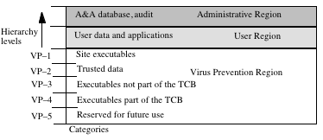
MAC Regions
IMPL_HI is “maximum” (least upper bound) of all levels
IMPL_LO is “minimum” (greatest lower bound) of all levels
Slide from Bishop “05.ppt”

Slide 54
Discussion
When would you choose to apply a model this restrictive?

Slide 55
Criticisms of Bell LaPadula
BLP is straightforward, supports formal analysis
Is it enough?
McLean wrote a critical paper asserting BLP rules were insufficient

Slide 56
McLean’s System Z
Proposed System Z = BLP + (request for downgrade)
User L gets file H by first requesting that H be downgraded to L and then doing a legal BLP read
Proposed fix: tranquility
  Strong: Labels never change during operation
  Weak: Labels never change in a manner that would violate a defined policy

Slide 57
Alternatives
Goguen & Meseguer, 1982: Noninterference
  Model computation as event systems
  Interleaved or concurrent computation can produce interleaved traces
  High actions have no effect on low actions
    The trace of a “low trace” of a system is the same for all “high processes” that are added to the mix
  Problem: Needs deterministic traces; does not scale to distributed systems

Slide 58
Nondeducibility
Sutherland, 1986.
  Low can not deduce anything about high with 100% certainty
  Historically important, hopelessly weak
  Addressed issue of nondeterminism in distributed systems

Slide 59
Intranstitive non-interference
Rushby, 1992
  Updates Goguen & Meseguer to deal with the reality that some communication may be authorized (e.g. High can interefere with low if it is mediated by crypto)

Slide 60
Ross Anderson on MLS
“… the contribution of the MLS model is not all positive. There is a tactical problem, and a strategic one.
“The tactical problem is that the existence of trusted system components … has a strong tendency to displace critical thought. …
“… MLS systems, by making the classification process easier but controlled data sharing harder, actually impair operational effectiveness.”
  [Comments at end of 7.6 in first edition]

Slide 61
Looking forward
Integrity Policies
    Read: Anderson Chapter 9, Brewer and Nash
    Expect significant revision of slides
    Topics will include Biba model (Chapter 8), BMA (Chapter 9), Chinese Wall (Chapter 9), and may include Inference problem (Chapter 9)
  Next + 1
    Read Anderson Chapter 10
      Clark-Wilson model
      May add additional reading on this?

