Slide 1
Confinement
CS 491/591: Introduction to Computer Security
James Hook

Slide 2
Plan
Confinement Problem (Lampson)
Isolation
Virtual Machines
Sandboxes
Covert Channels

Slide 3
The Confinement Problem
Lampson, “A Note on the Confinement Problem”, CACM, 1973.
This note explores the problem of confining a program during its execution so that it cannot transmit information to any other program except its caller. A set of examples attempts to stake out the boundaries of the problem. Necessary conditions for a solution are stated and informally justified.

Slide 4
Discussion
Reactions?
What is a “customer”?
What is a “service”?
What does Lampson’s motivating scenario look like?

Slide 5
Possible Leaks
0. If a service has memory, it can collect data, wait for its owner to call it, then return the data
The service may write into a permanent file
The service may create a temporary file
The service may send a message to a process controlled by its owner [via ipc]
More subtly, the information may be encoded in the bill rendered for the service…

Slide 6
Possible Leaks (cont)
5. If the system has interlocks which prevent files from being open for writing and reading at the same time, the service can leak data if it is merely allowed to read files which can be written by the owner.

Slide 7
Leak 5 (cont)
The interlocks allow a file to simulate a shared Boolean variable which one program can set and the other can’t
Given a procedure open (file, error) which does goto error if the file is already open, the following procedures will perform this simulation:
procedure settrue (file); begin loop1: open (file, loop1) end; procedure setfalse (file); begin close (file) end; Boolean procedure value (file); begin value : = true; open (file, loop2); value := false; close (file);
loop2: end;

Slide 8
Leak 5 (cont)
Using these procedures and three files called data, sendclock, and receiveclock, a service can send a stream of bits to another concurrently running program. Referencing the files as though they were variables of this rather odd kind, then, we can describe the sequence of events for transmitting a single bit:
sender: data : = bit being sent; sendclock : = true receiver: wait for sendclock = true; received bit : = data; receive clock : = true; sender: wait for receive clock = true; sendclock : = false; receiver: wait for sendclock = false; receiveclock : = false; sender: wait for receiveclock = false;

Slide 9
Leak 6
By varying its ratio of computing to input/output or its paging rate, the service can transmit information which a concurrently running process can receive by observing the performance of the system. …

Slide 10
One solution
Just say no!
Total isolation: A confined program shall make no calls on any other program
Impractical

Slide 11
Confinement rule
Transitivity: If a confined program calls another program which is not trusted, the called program must also be confined.

Slide 12
Classification of Channels:
Storage
Legitimate (such as the bill)
Covert
I.e. those not intended for information transfer at all, such as the service program’s effect on the system load
In which category does Lampson place 5?

Slide 13
Mitigation
Lampson proposes a mitigation strategy for 5
Confined read makes a copy (this can be done lazily on a conflicting write)

Slide 14
Root Problem:
Resource sharing enables covert channels
The more our operating systems and hardware enable efficient resource sharing the greater the risk of covert channels

Slide 15
Lipner’s Comments
1975 paper discusses how confidentiality models and access control address storage and legitimate channels
Discussion?
How does Lipner think BLP fits in?

Slide 16
Lipner’s Contribution
Identifies time as “A difficult problem”
“While the storage and legitimate channels of Lampson can be closed with a minimal impact on system efficiency, closing the covert channel seems to impose a direct and unreasonable performance penalty.”

Slide 17
Resources
Lampson, A note on the Confinement Problem, CACM Vol 16, no. 10, October 1973.
http://doi.acm.org/10.1145/362375.362389
Lipner, A Comment on the Confinement Problem, Proceedings of the 5th Symposium on Operating Systems Principles, pp 192 -196 (Nov. 1975)
http://doi.acm.org/10.1145/800213.806537

Slide 18
Timing Channel: Kocher
CRYPTO ‘96: Timing Attacks on Implementations of Diffie-Hellman, RSA, DSS, and Other Systems

Slide 19
Kocher attack
Let s[0] = 1 For k = 0 upto w - 1 If (bit k of x) is 1 then Let R[k] = (s[k] * y) mod n Else Let R[k] = s[k] Let s[k+1] = R[k] * R[k] mod n EndFor Return R[w-1]
Computes R = y^x mod n
Given multiple observations of y, n and time deduce x

Slide 20
Timing channel
Let s[0] = 1 For k = 0 upto w - 1 If (bit k of x) is 1 then Let R[k] = (s[k] * y) mod n Else Let R[k] = s[k] Let s[k+1] = R[k] * R[k] mod n EndFor Return R[w-1]
Premise: multiplication mod n takes longer than the assignment

Slide 21
Basic attack:
Prework:
Study the computation of
u * v mod k
measure timings for real values (they will probably not be uniform)
Attack
Collect data on (y, n, run time)
Guess a bit of x (start with bit 0)
Use guess of x to calculate predicted runtimes for algorithm (simulating all intermediate values)
If prediction is no better than random guess again
If prediction is better than random guess the next bit

Slide 22
Isolation
Virtual machines
Emulate computer
Process cannot access underlying computer system, anything not part of that computer system
Sandboxing
Does not emulate computer
Alters interface between computer, process

Slide 23
Virtual Machines
“Third Generation” of Computers
First introduced in mid-1960’s
Mainstream in early 1970’s
IBM 360/67, Honeywell 6000, etc.
Sources:
Formal requirements for Virtualizable Third Generation Architectures, Popek and Goldberg, CACM, vol 17 number 7, July 1974

Slide 24
Virtual Machines
Original Concept
VMM (sometimes called a Control Program or Hypervisor) provided virtualization
CP-67, VM/370
Family of simple operating systems ran as clients of the VM
Single process DOS/360
Multi-tasking OS/360
Time sharing TSS/360, TSO

Slide 25
Virtual Machine
“A virtual machine is taken to be an efficient, isolated duplicate of the real machine. … Virtual Machine Monitor (VMM) … a VMM has three essential characteristics:
Provides an environment for programs which is essentially identical with the original machine
Programs run in this environment show at worst only a minor decrease in speed
The VMM is in complete control of system resources”
Popek and Goldberg, 1974

Slide 26
Criteria
Not all attempts at “3rd Generation” machines succeeded in supporting Virtualization
PDP-10 required more emulation
Popek and Goldberg articulated virtualization criteria

Slide 27
Definitions
Assumptions:
The machine has at least two modes: user and supervisor
The machine has some kind of fault (trap) mechanism
An instruction is privileged if it faults (traps) when executed in user mode
An instruction is sensitive if it reveals hidden state of the underlying machine (particularly state about state of privilege)
Popek and Goldberg give a more elaborate definition with two types of sensitivity, control sensitivity and behavior sensitivity
Example: an instruction that reveals the physical address of a page in virtual memory is behavior sensitive

Slide 28
P&G Main Theorem
A virtual machine monitor may be constructed if the set of sensitive instructions for that computer is a subset of the privileged instructions

Slide 29
Virtualization for Security
Schaefer, Gold, Linde and Scheid, Program confinement in KVM/370, 1977, http://doi.acm.org/10.1145/800179.1124633
Adapt the VMM to include reference monitor to protect security critical resources

Slide 30
Sandbox
Environment in which actions of process are restricted according to security policy
Can add extra security-checking mechanisms to libraries, kernel
Program to be executed is not altered
Can modify program or process to be executed
Similar to debuggers, profilers that add breakpoints
Add code to do extra checks (memory access, etc.) as program runs (software fault isolation)

Slide 31
Example: Limiting Execution
Sidewinder
Uses type enforcement to confine processes
Sandbox built into kernel; site cannot alter it
Java VM
Restricts set of files that applet can access and hosts to which applet can connect

Slide 32
Additional Resources
R. Wahbe, S. Lucco, T. Anderson, and S. Graham, Efficient Software-based Fault Isolation, http://www.cs.cornell.edu/home/jgm/cs711sp02/sfi.ps.gz
Christopher Small, MiSFIT: A Tool for Constructing Safe Extensible C++ Systems, http://www.dogfish.org/chris/papers/misfit/misfit-ieee.ps

Slide 33
Virtualization Returns
Intel’s Vanderpool architecture brings Virtual Machines back to the mainstream
Intel Virtualization Paper
(Some figures that follow are taken from the paper)

Slide 34
Applications of Virtualization
Workload isolation
Workload consolidation
Workload migration

Slide 35
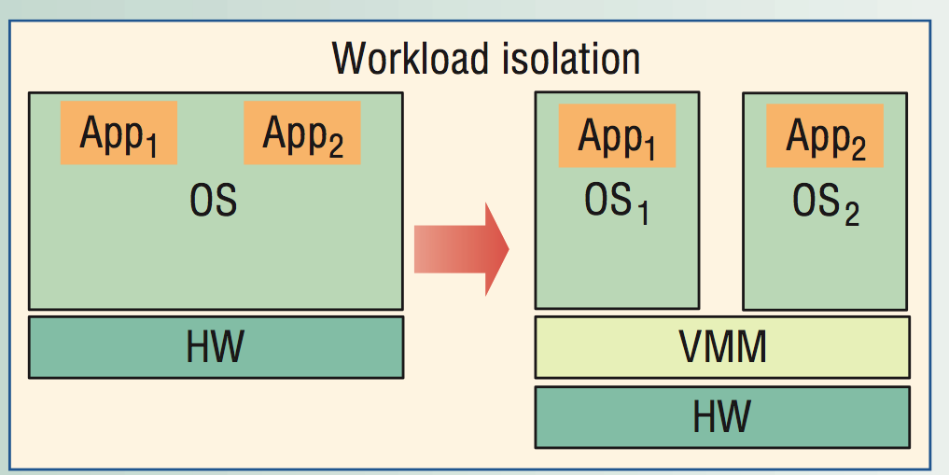
Isolation

Slide 36
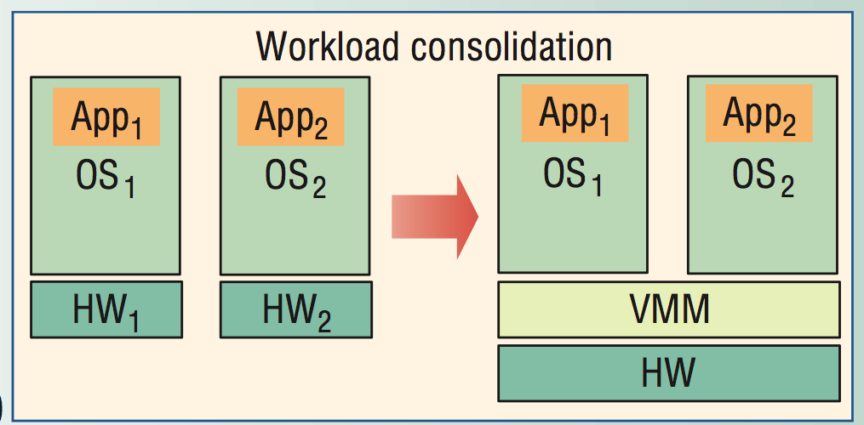
Consolidation

Slide 37
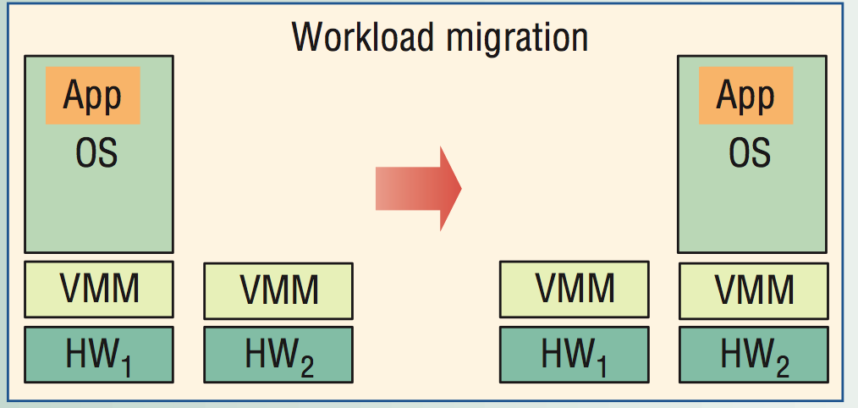
Migration

Slide 38
Virtualizing Intel architectures
As is, Intel architectures do not meet the two requirements:
Nonfaulting access to privileged state
IA-32 has registers that describe and manipulate the “global descriptor table”
These registers can only be set in ring 0
They can be queried in any ring without generating a fault
This violates rule 2 (all references to sensitive data traps)
Software products to virtualize Intel hardware had to get around this.
Vmware and Virtual PC dynamically rewrite binary code!
Xen requires source changes (paravirtualization)

Slide 39
Intel solutions
VT-x, virtualization for IA-32
VT-i, virtualization for Itanium
Changed architecture to meet the criteria

Slide 40
Ring aliasing and ring compression
Solution is to allow guest to run at intended privilege level by augmenting privilege levels.
See Figure 2(d).

Slide 41
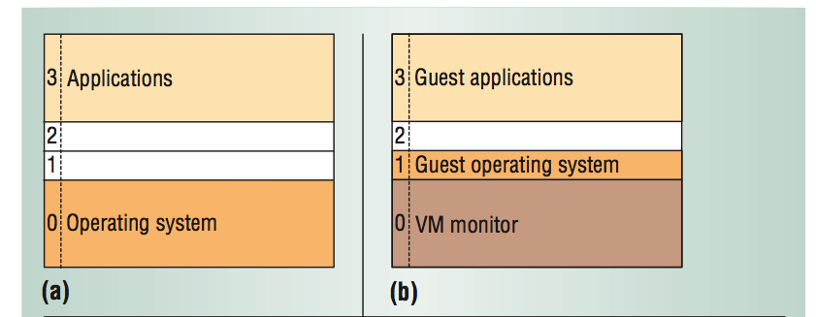
Nonvirtuallized and 0/1/3
(a) is typical of x86 operating systems
(b) and (c) give two strategies for virtualization in software

Slide 42
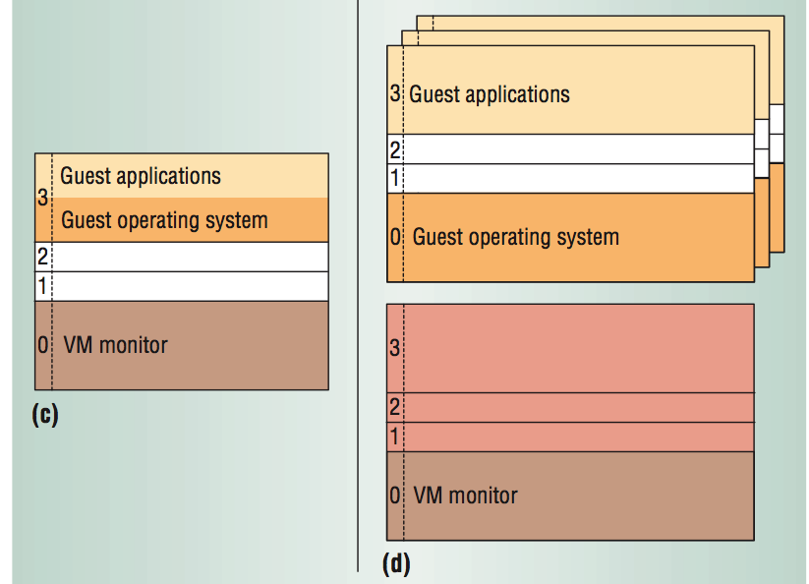
0/3/3 and VT-x

Slide 43
Nonfaulting access to privileged state
Two kinds of changes
Make access fault to the VM
Allow nonfaulting access, but to state under the control of the VMM

Slide 44
Dark Side
Malware and Virtual Machines
SubVirt: Implementing malware with virtual machines,
King, Chen, Wang, Verbowski, Wang, Lorch
Describes the construction of a “virtual-machine based rootkit” and potential defenses.

