Slide 1
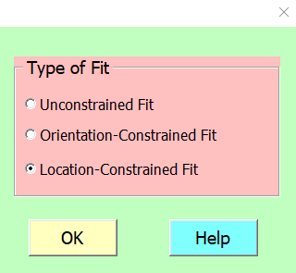

Location-Constrained Fits

Slide 2
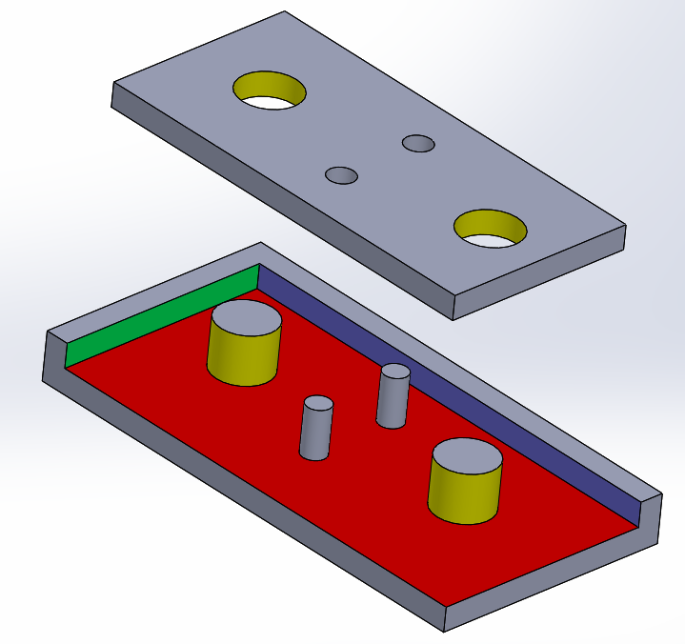
Location-Constrained Fits
Identify the fit features
Identify the contact surfaces
Determine the contact surface priority

Slide 3
3 Contact Surfaces
2 Fit features

Slide 4
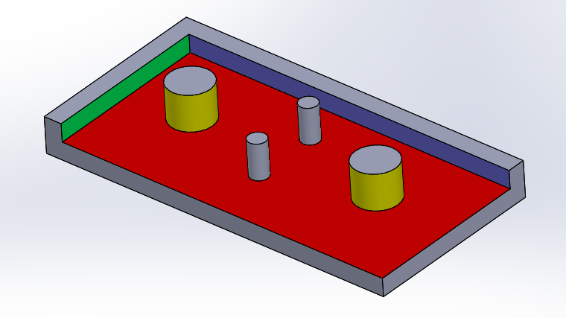
Fit Features
2nd fit feature
1st fit feature
The 1st or primary fit feature is usually the one with the tighter fit. However, any order is acceptable
Notes:
Unlike the contact surfaces, the order in which fit features are specified does not make a difference – Any order is acceptable. However, it is common to specify the fit features with tighter fits first.

Slide 5
Contact Surfaces
Contact features are planar surfaces which are required to make closest contact for the fit to be acceptable
A fit can have up to 3 fit-related contact surfaces.
Contact surfaces have order or priority in a fit

Slide 6
Contact surface
Contact Surfaces
Contact surface
Contact surface

Slide 7
Contact Surfaces
Contact surfaces are planar surfaces which are required to make closest contact for the fit to be acceptable
Primary Contact Surface (PCS) makes the fullest contact subject to no constraints
Secondary Contact Surface (SCS) makes the 2nd fullest contact subject to PCS constraint
Tertiary Contact Surface (TCS) makes the 3rd fullest contact subject to PCS and SCS constraints

Slide 8
Contact Surfaces
The design dictates the contact surface priority
Primary contact surface is usually obvious and easy to identify. Surfaces pushed together by fasteners are the most common
Unless the design dictates, the choice of the secondary and tertiary contact surfaces is made arbitrarily. The convention is to use the larger surface as the secondary.

Slide 9
Tertiary Contact Surface
Priority of Contact Surfaces
Primary Contact Surface
Secondary Contact Surface

Slide 10
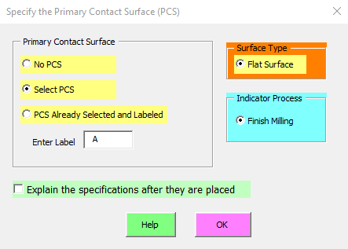
Dialog window for selecting the Primary Contact Surface (PCS)

Slide 11
TCS
Contact Surfaces
PCS
SCS

Slide 12
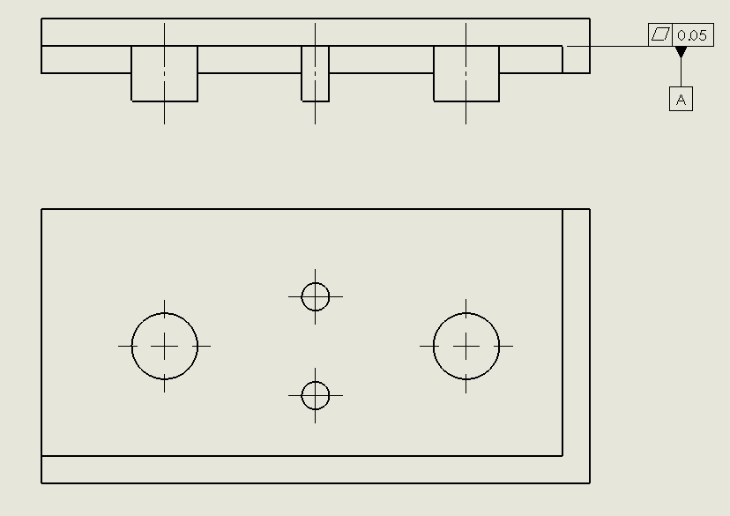

Result after selecting the primary contact surface

Slide 13
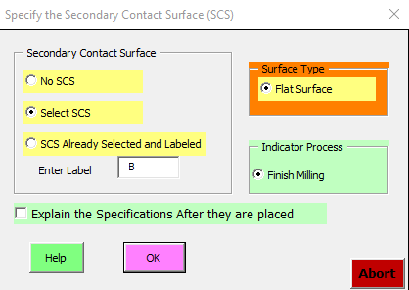
Dialog window for selecting the Secondary Contact Surface (SCS)

Slide 14
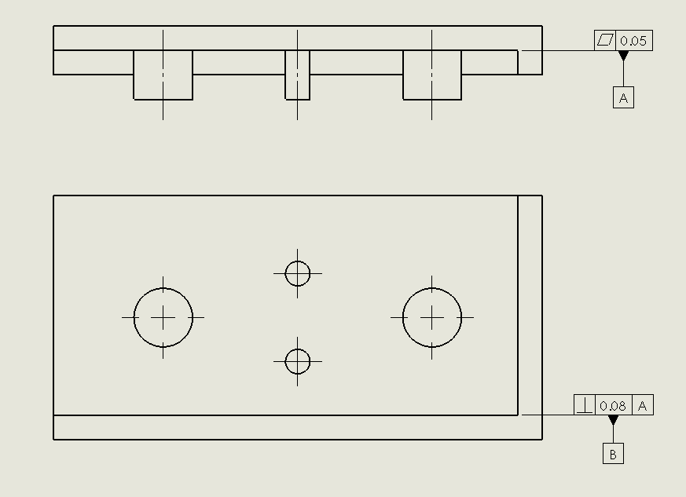
Result after selecting the secondary contact surface

Slide 15
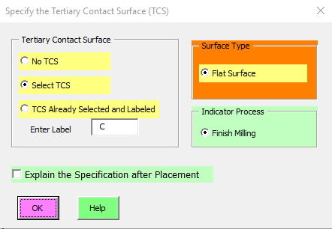
Dialog window for selecting the Tertiary Contact Surface (TCS)

Slide 16
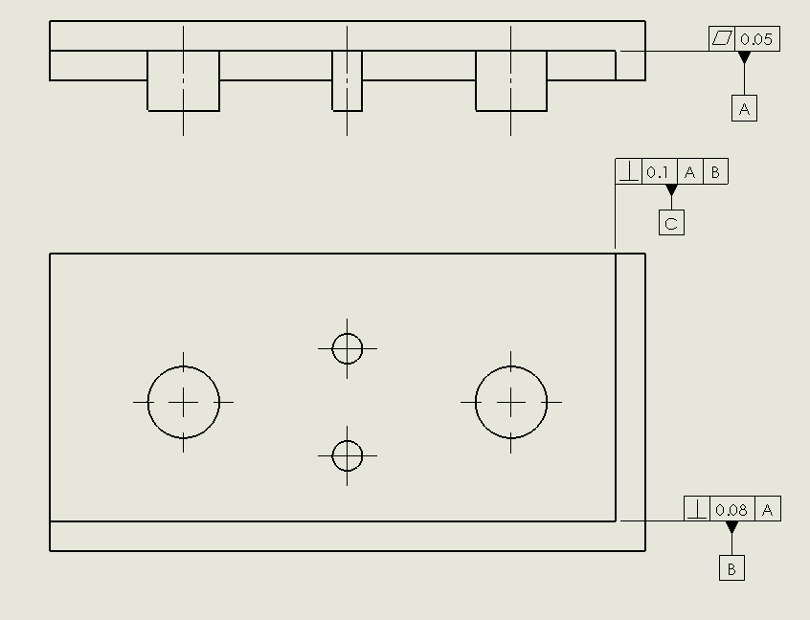
Result after selecting the Tertiary Contact Surface

Slide 17
Fit Features
Primary fit Feature (PFF)
Secondary Fit Feature (SFF)

Slide 18
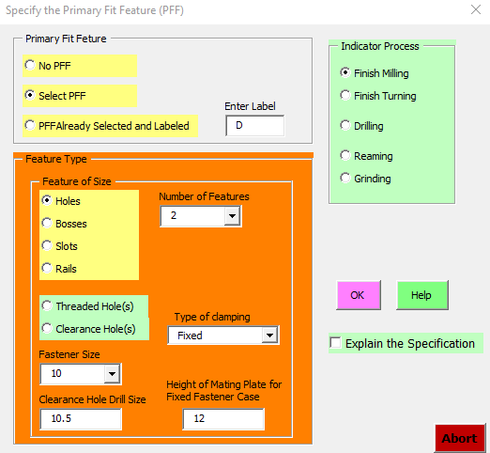
Dialog window for selecting the Primary Fit Feature (PFF)
Notes:
This is the dialog window for the first or the primary fit feature. The fit feature is a pattern of two bosses. The bottom part of the Feature Type selection is for fastener fit features which will be covered later.

Slide 19
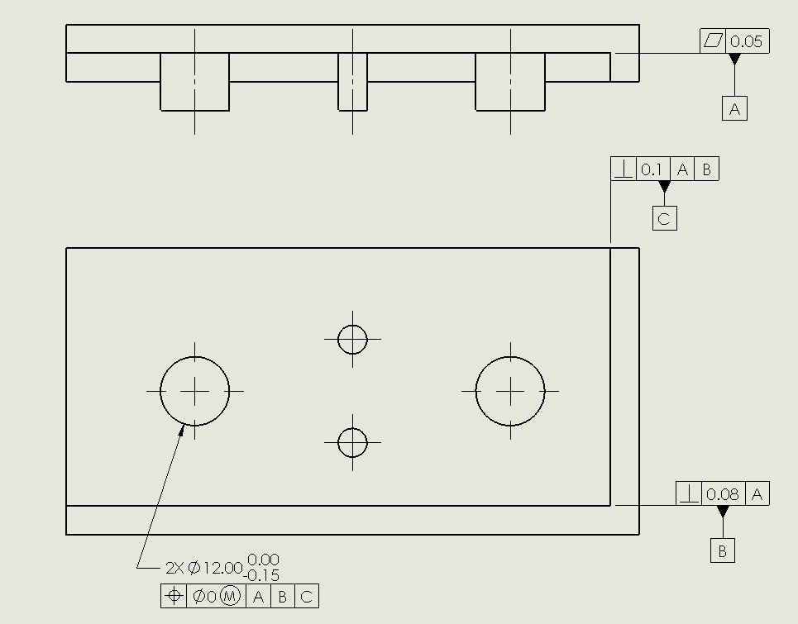
Result after selecting the primary fit feature

Slide 20
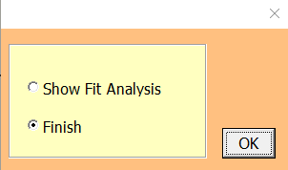
Dialog window after PFF selection and pressing ESC
What about the Secondary Fit Feature?
Notes:
After selecting the three contact surfaces along with the primary fit feature the program indicates that the task is finished. This might be puzzling because we have not done the second pattern of fit features yet. This will be explained shortly.

Slide 21
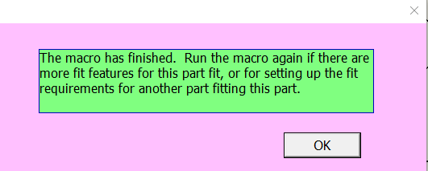
Final dialog window after pressing OK

Slide 22

Obviously the fit is not finished – the smaller bosses have not been toleranced for fit.
This is because the total number of fit features and contact surfaces in any tolerance statement must be 4 or less. In this example we have 5 total CS and FF
PCS
TCS
PFF
SCS

Slide 23
We need to run the program only once if we have:
  3 CS + 1 FF
  2 CS and 2 or less FF
  1 CS and 3 or less FF
  0 CS and 4 or less FF
If there are more FF run the program again for each additional FF

Slide 24
If there are more fit features, run the program again once for every additional fit feature
New FF
PCS
TCS
SCS
Exactly the same contact features as in the first statement
Notes:
Since we have 3 contact surfaces and 2 fit features we must run the program again selecting exactly the same three contact surfaces but this time with the new pattern of fit features.

Slide 25
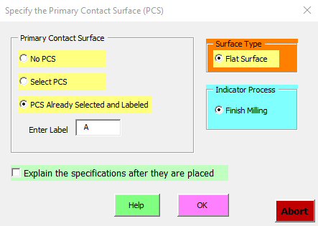
Continue with the fit of the pattern of smaller bosses by running the program again.
Since PCS is already selected there is no need to reselect it

Slide 26
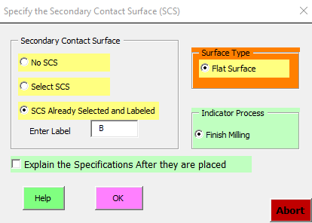
Since SCS is already selected there is no need to reselect it

Slide 27
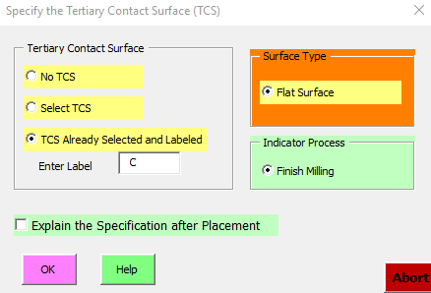
Since TCS is already selected there is no need to reselect it

Slide 28
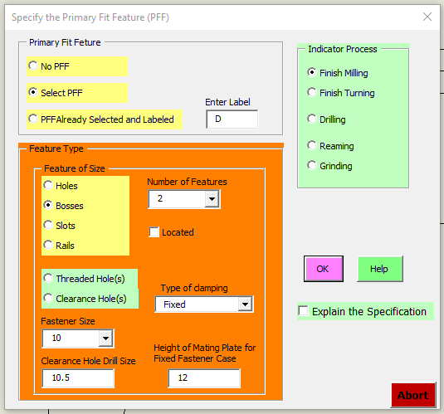
Select the new FF in the dialog window for the PFF

Slide 29
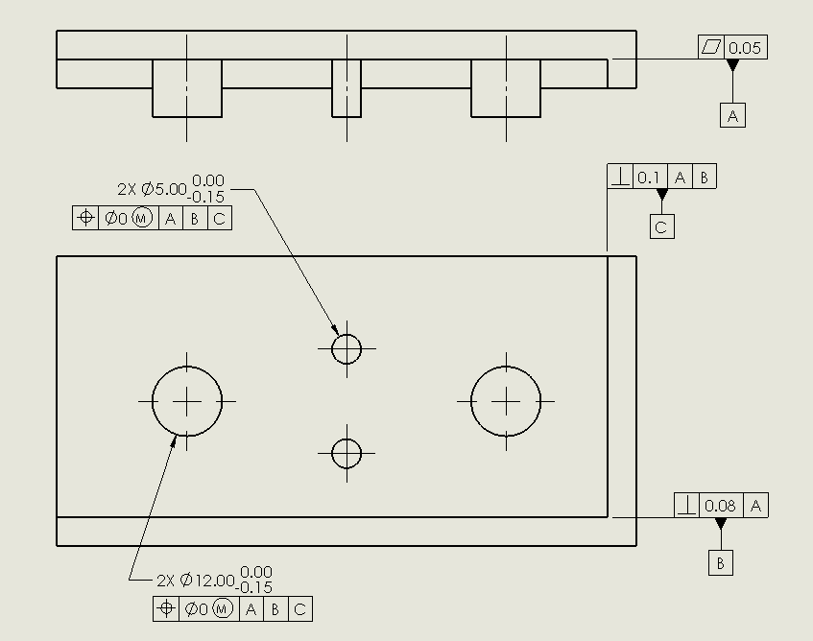
The part is now fully toleranced for fit

Slide 30
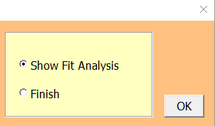
See the fit analysis which is usually done after both parts are toleranced

Slide 31
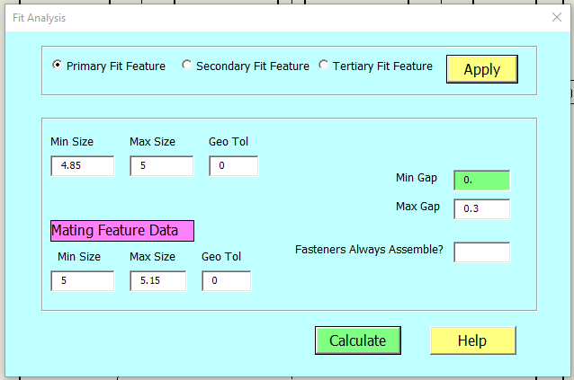

Slide 32
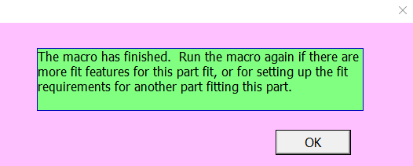

Slide 33
Apply the same procedure to the mating part with holes

Slide 34
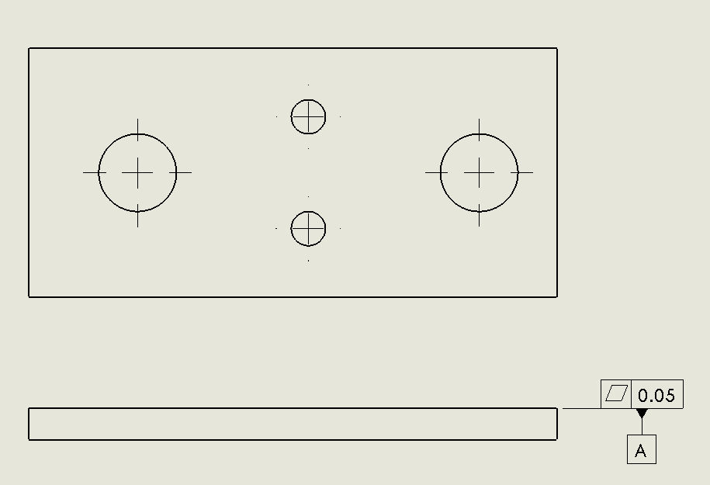
Result after selecting the primary contact surface

Slide 35
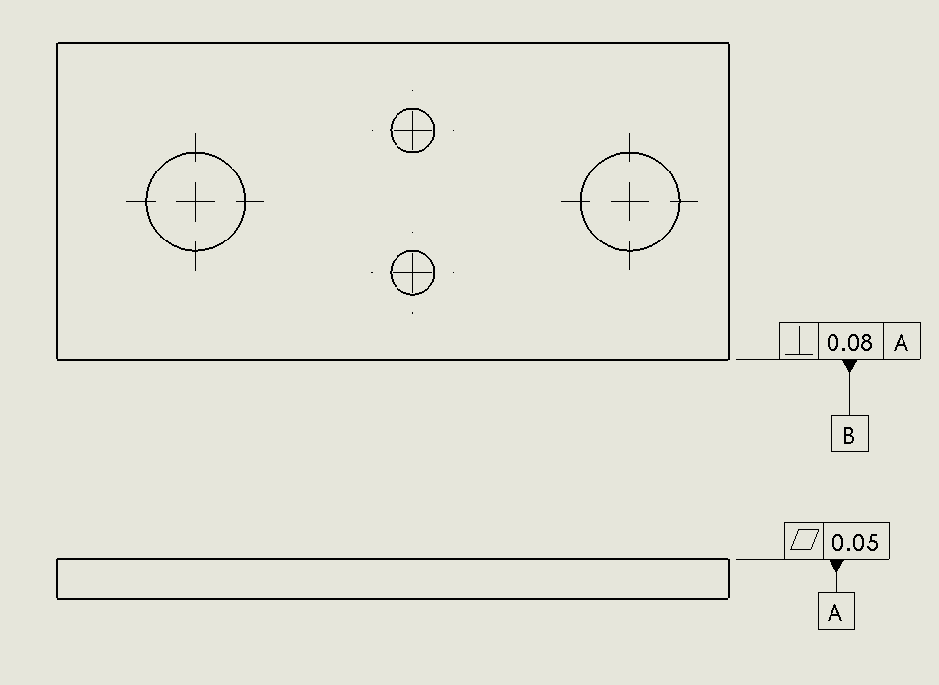
Result after selecting the secondary contact surface

Slide 36
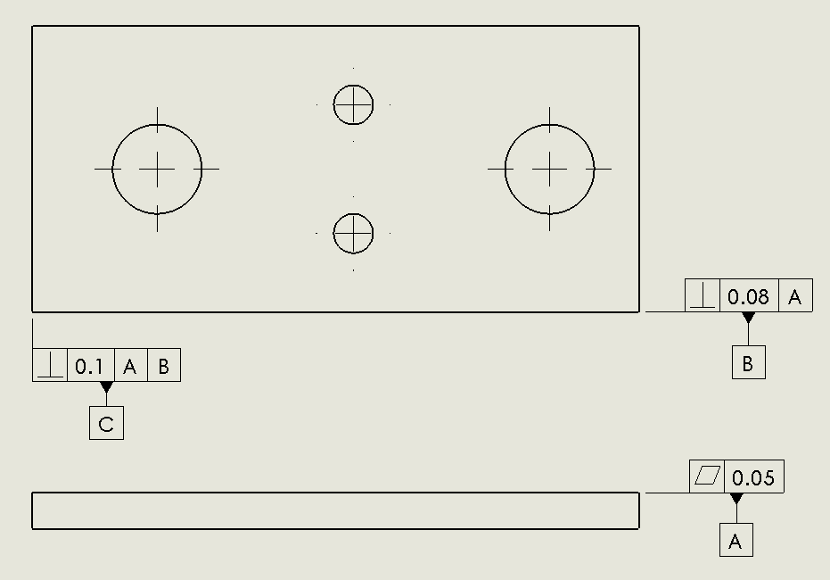
Result after selecting the Tertiary Contact Surface

Slide 37
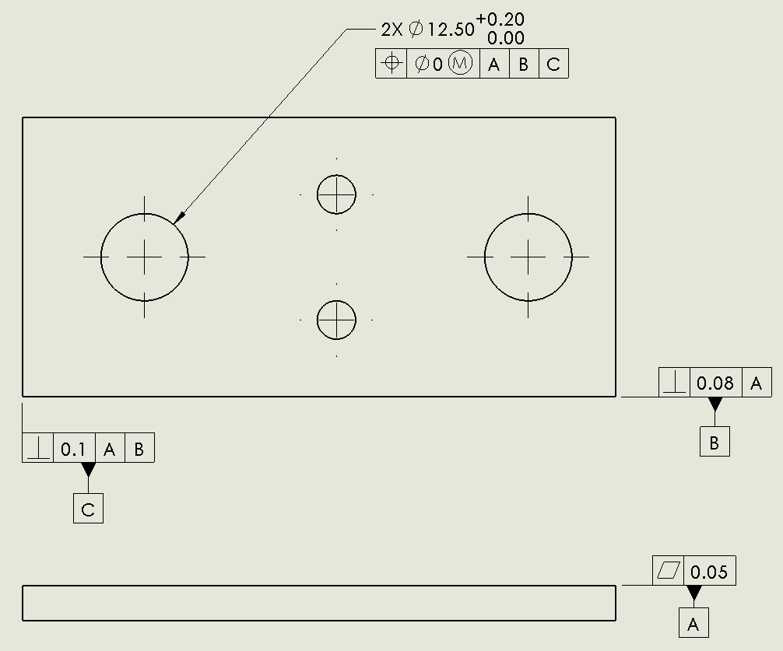
Result after selecting the primary fit feature

Slide 40
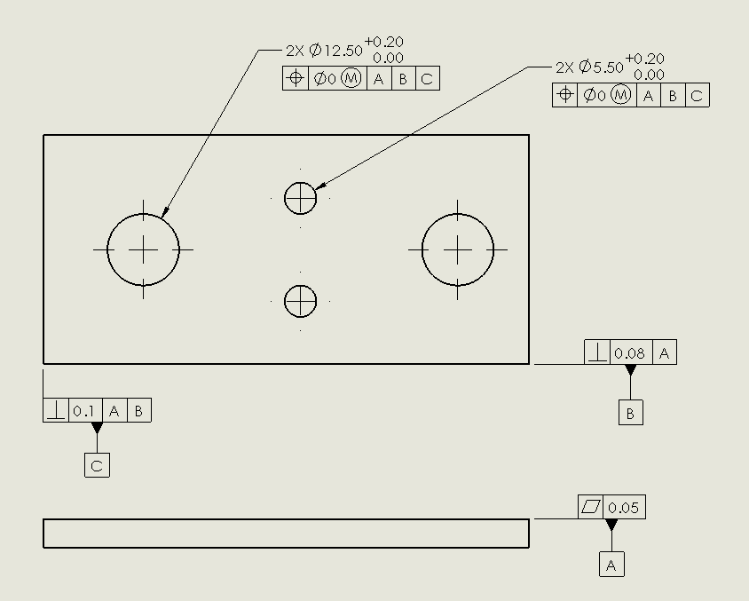
The part is now fully toleranced for fit

Slide 41
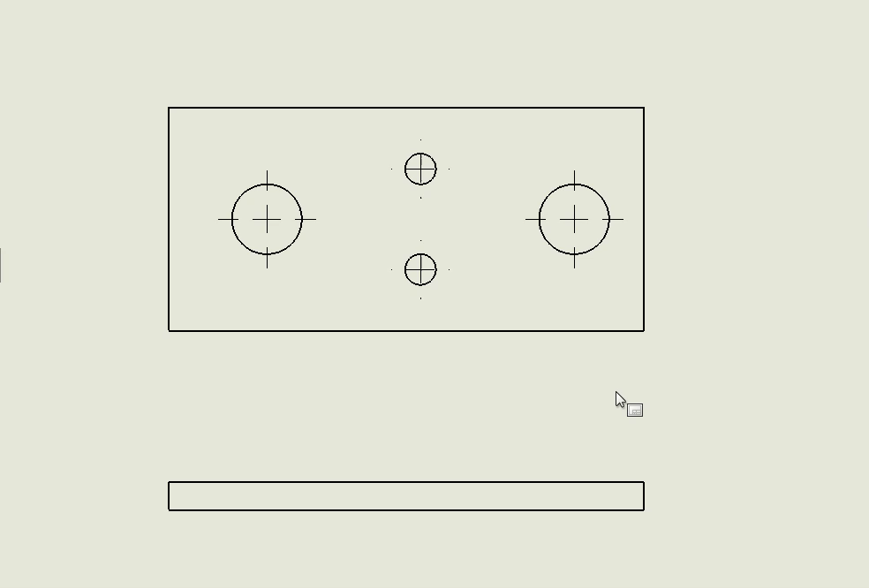
Video Demo: Case of 3 contact surfaces and two fit features

Slide 42
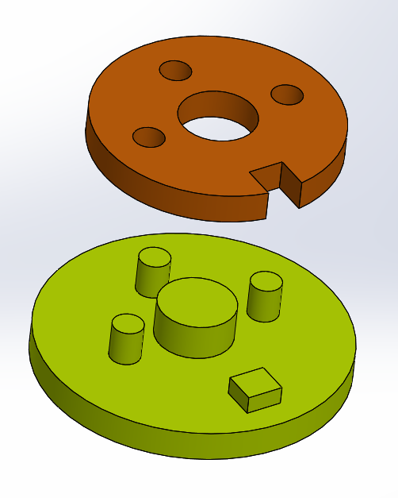
Another Example
Fit analysis for the primary fit feature
Location-Constrained Fit
1 Contact Surface
3 Fit features
  Center hole/boss
  Slot and rail
  Pattern of holes/bosses

Slide 43
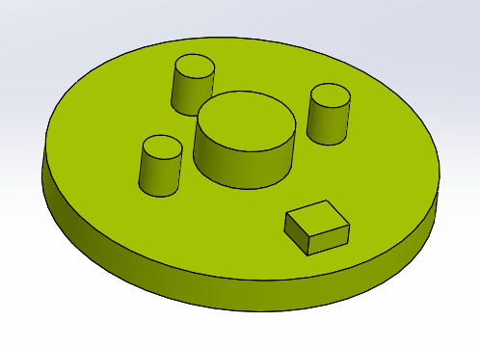
PFF
PCS
TFF
SFF

Slide 44
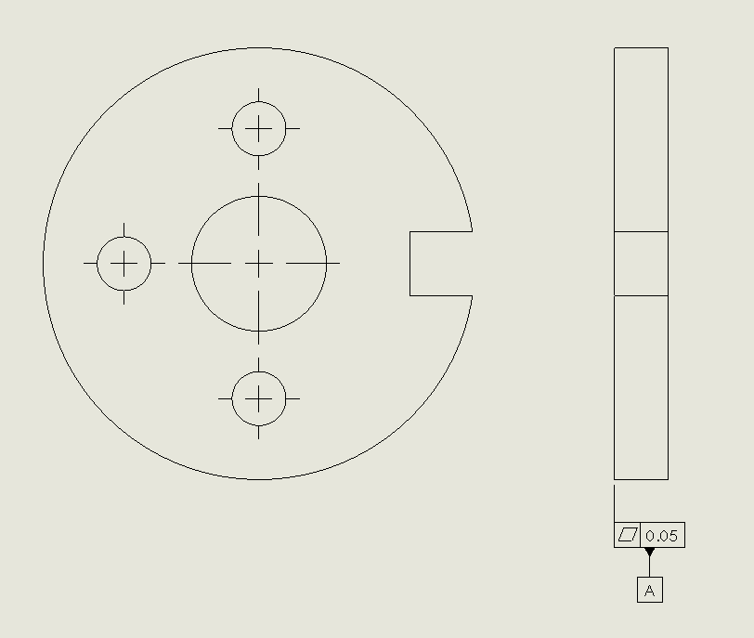
Result after PCS selection

Slide 45
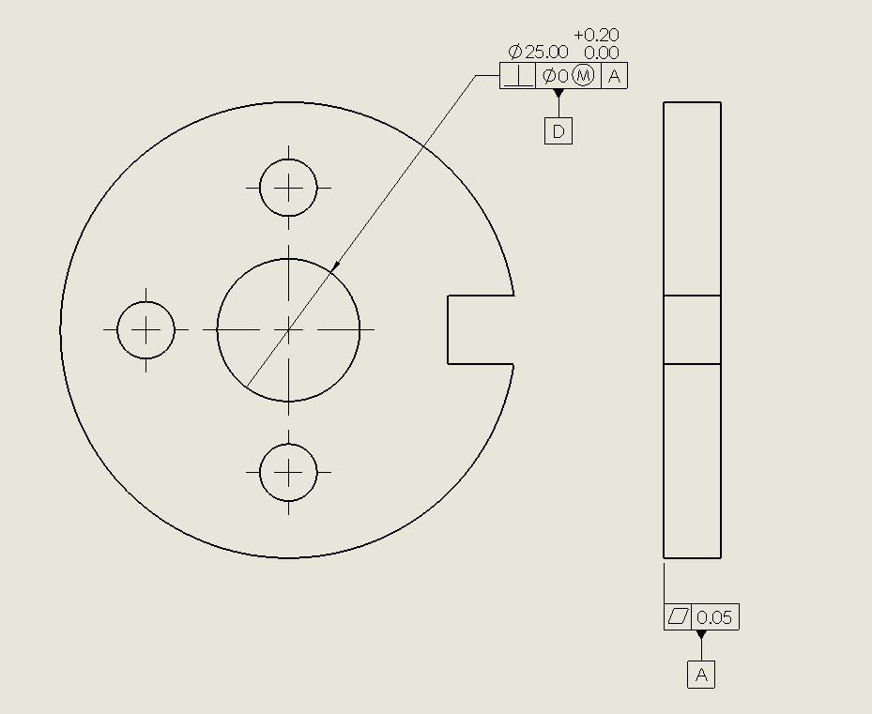
Result after PFF selection
Note: A,B, and C labels are used for contact surfaces.

Slide 46
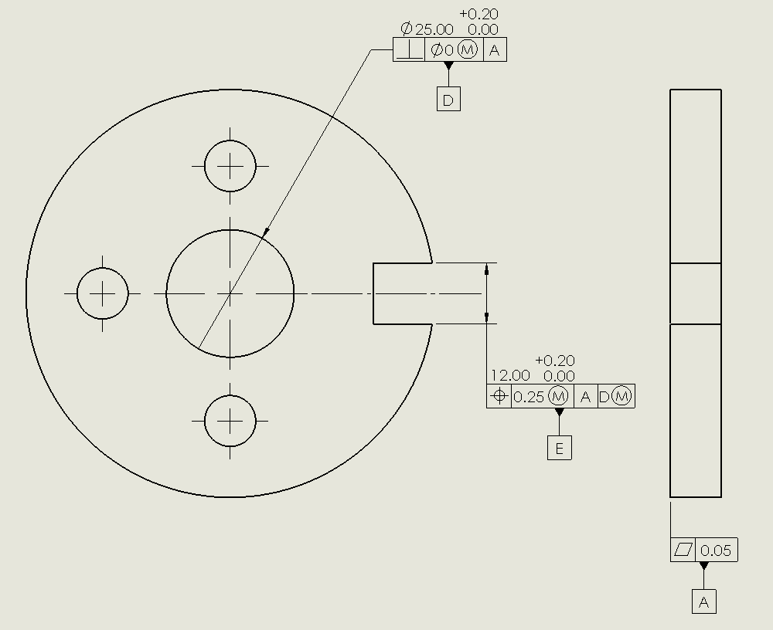
Result after SFF selection

Slide 47
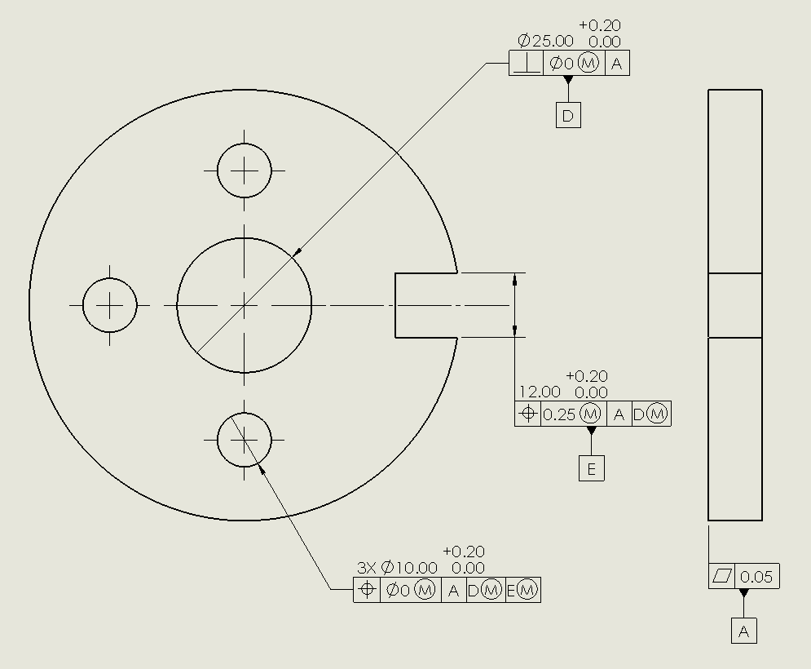
Result after TFF selection

Slide 48
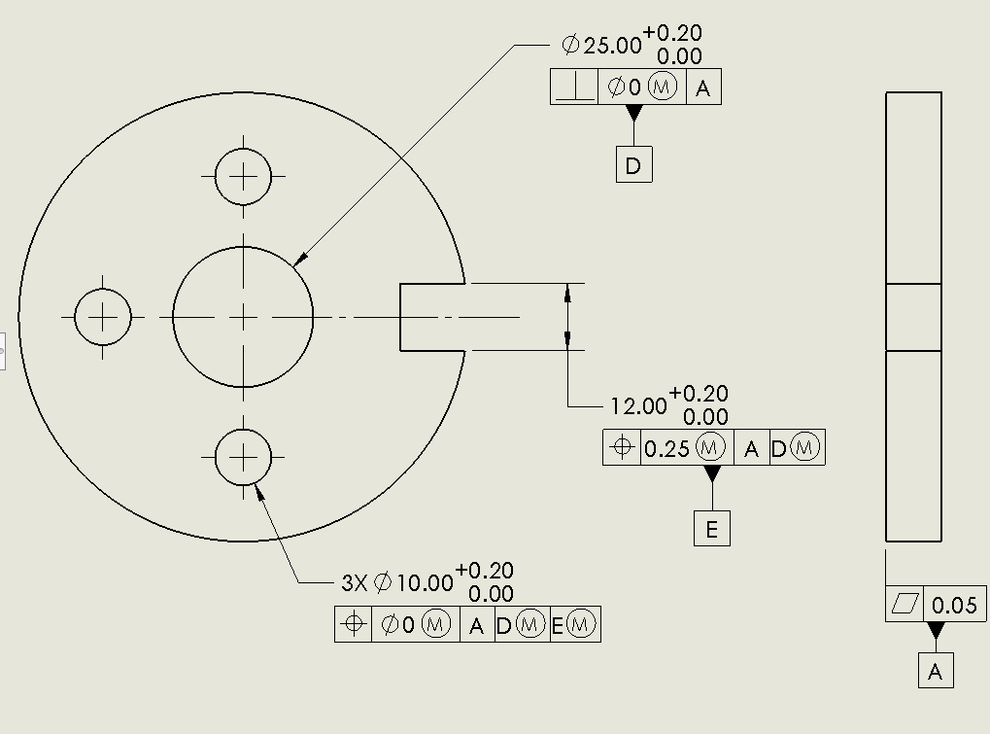
Finished

Slide 49
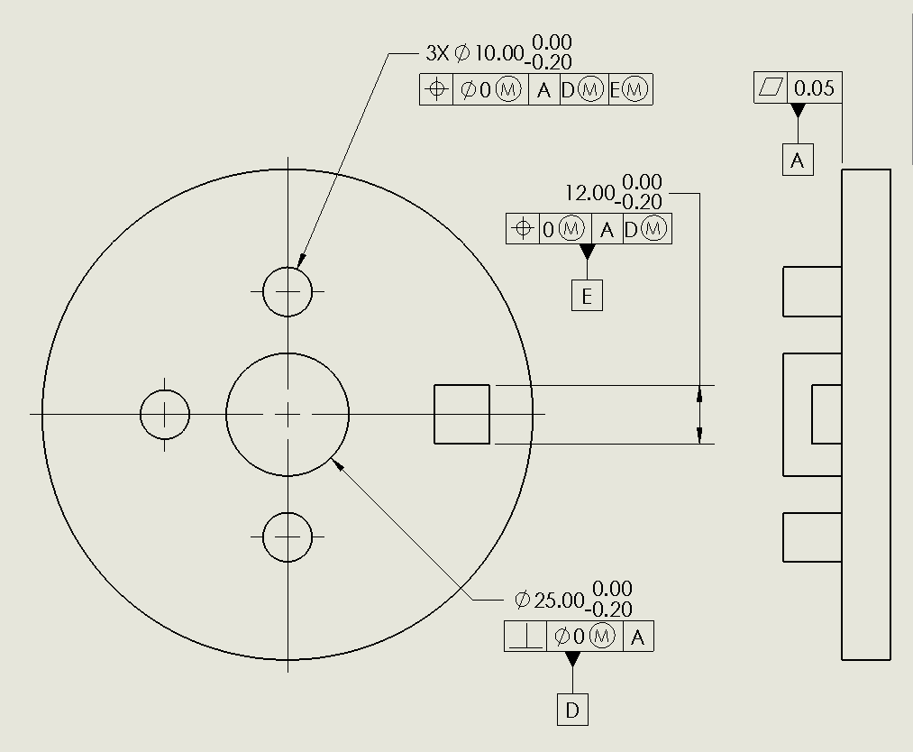
Finished tolerances for the part with pins

Slide 50
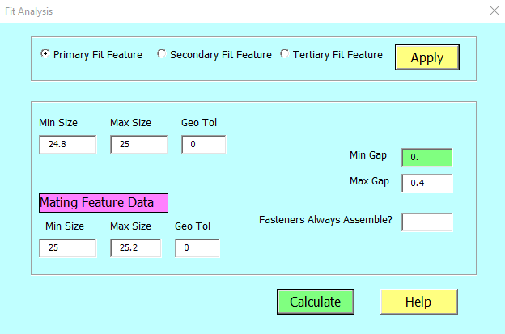
Fit analysis for the primary fit feature

Slide 51
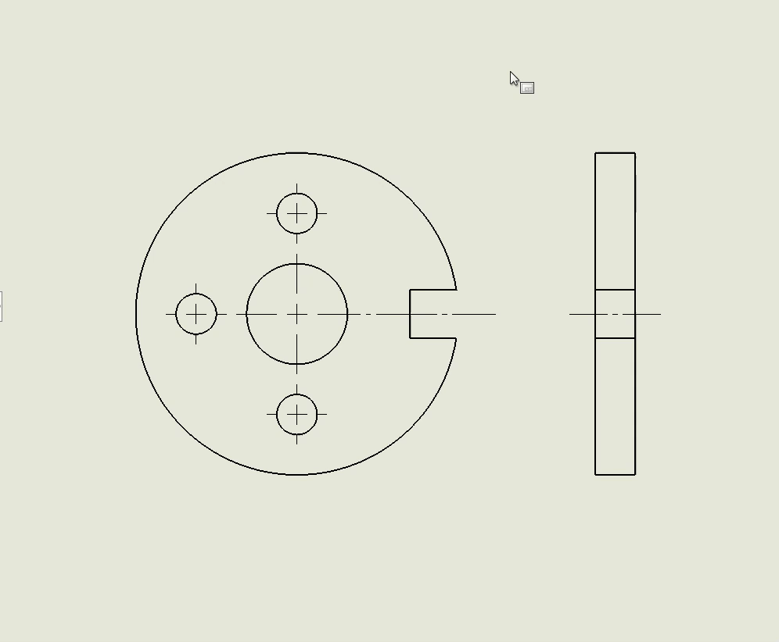
Demo for the part with holes

Slide 52
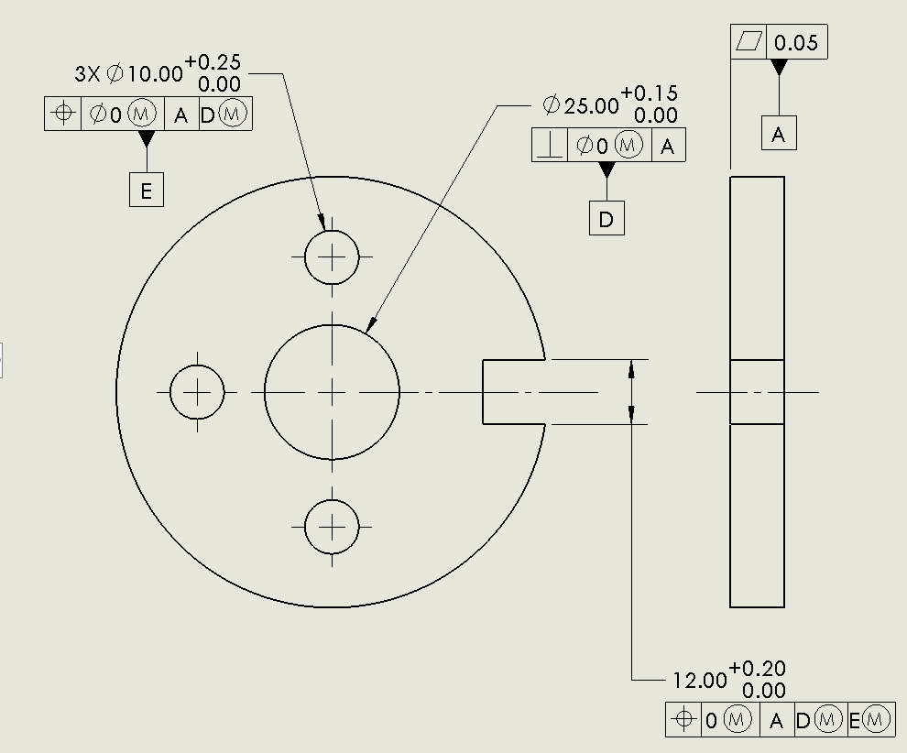
Version-1
Version-2

Slide 53
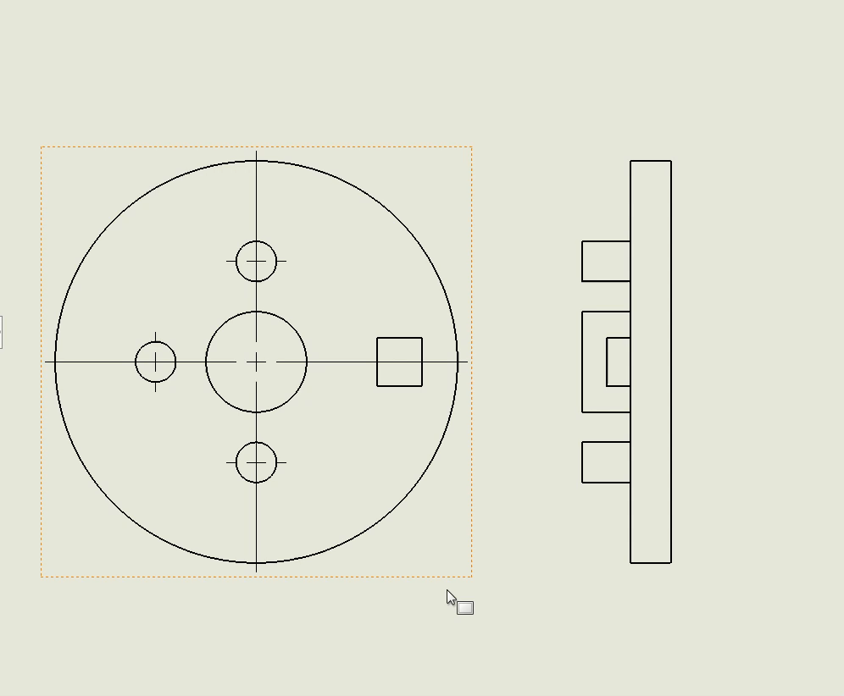
Demo for the part with Pins

Slide 54
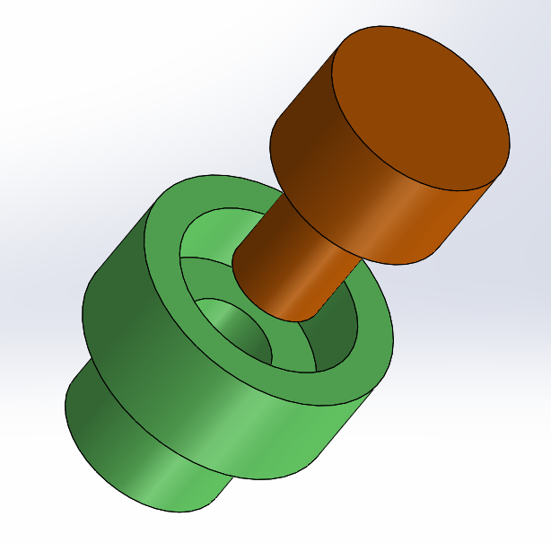
Example
Location-Constrained Fit
1 Contact Surface
2 Fit features
  Smaller hole/boss
  Larger hole/boss
Set up tolerances to assure fit while contact surfaces make full contact

Slide 55
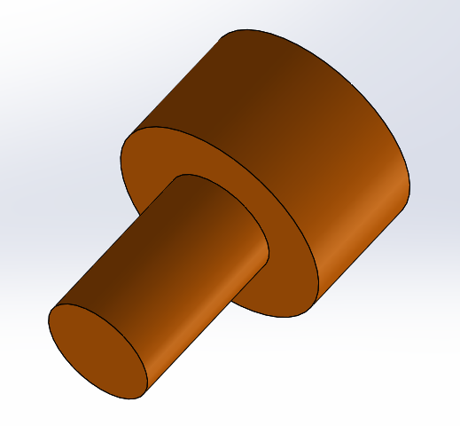
PCS
SFF
PFF

Slide 56
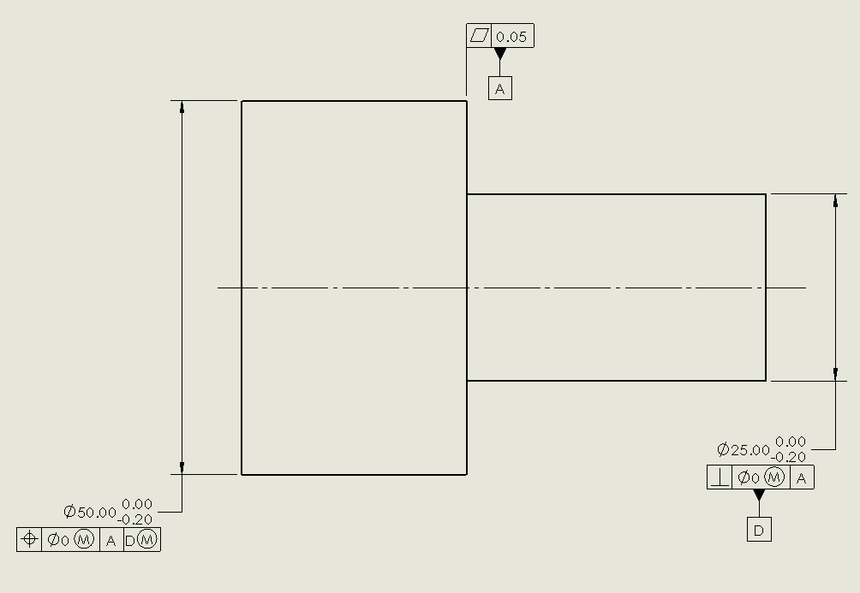
Result

Slide 57
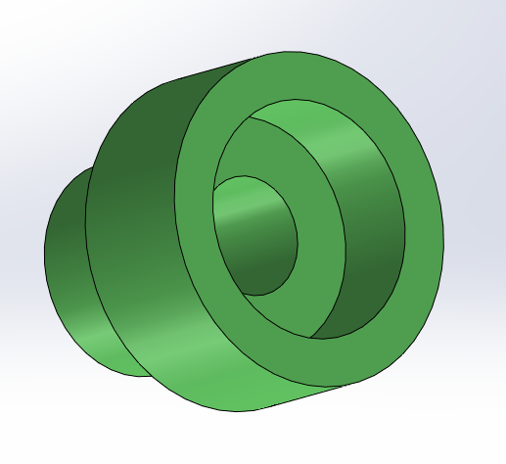
PCS
SFF
PFF

Slide 58
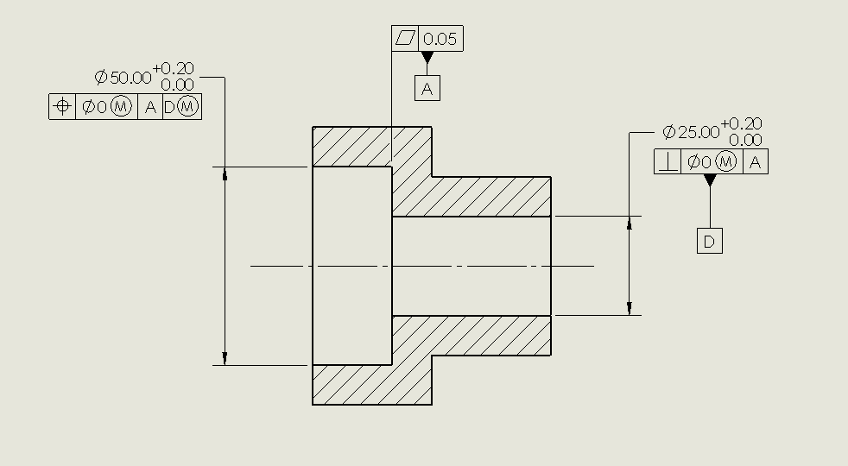
Result

