Slide 1
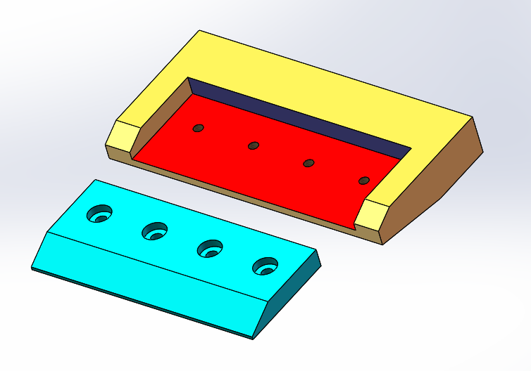

Instructions for the use of the
Design For Fit Tolerance Synthesis Program
Prepared by:
Faryar Etesami
Notes:
This is the instructions for the design for fit computer program. The program helps you, the design engineer, to set up geometric tolerances necessary to assure fit of many assemblies quickly and correctly. The program can also be used for educational purposes.

Slide 2
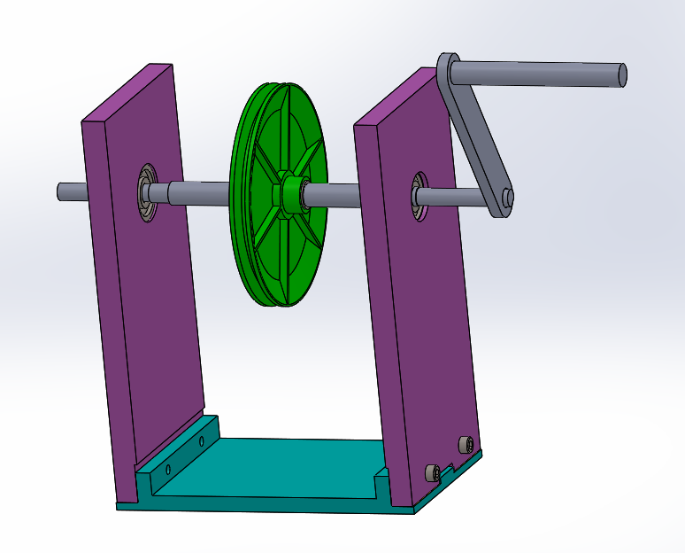
Scope of Application
Two parts fitting together
Two parts fit with fasteners
Multi-part fits
Notes:
The DFFTSP helps a design engineer specify part tolerances necessary for fit between two parts including two-parts fits that use of fasteners. This capability covers many fit applications. However, the more general case of multi-part fits is not within the scope of this program. For example, in this hand crank pulley device the fit of the base plate to side plates are two-part fits with fasteners. The fit of the handle to crank, crank to shaft, bearing fits to the side plates and to the shaft, as well as the fit of the pulley to the shaft are all two-part fits. The fit of the shaft to the size plates, however, is a multipart fit as that fit depends on the side plates and the base plate.

Slide 3
DFFTSP Structure
Notes:
Briefly, the program gets high-level design intent information from you and generates necessary tolerance statements. The program then annotates the part drawings with proper tolerance statements. An explanation module is provided for educational purposes. You can also check the fit clearances using the Analysis Module. Internally, the program uses Process Databases to determine correct tolerance values, the fastener databases for bolted assemblies, the GDT standard, and the Limits and Fits standards.

Slide 4
A Designer-Guided Method
Only three skills are necessary
  Identify the type of fit
  Identify fit features
  Identify fit-related contact surfaces
Tolerance Synthesis Program only asks about these items
Notes:
The strength and the beauty of this method is that the program only asks the designer about high-level design intent. You only need to know the type of fit, identify the fit features, and identify the contact surfaces. These questions are quite easy to answer with a little practice. The program does not use the typical lower-level vocabulary of tolerancing that deals with geometric relationships.

Slide 5
How to use the DFFTSP
Please do not use the program unless you have carefully viewed the instructions
  This PowerPoint document
Notes:
Please be aware that the program is not robust enough for trial and error type of learning – If you do not input the correct information, the program is likely to crash.

Slide 6


Learning from the Program
Notes:
Use the Help button for an explanation of options on the dialog window
Use the Explanation button for the justification of the resulting tolerance statements

Slide 7
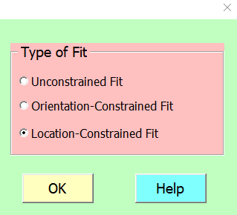
Types of Fit
The first dialog window
Notes:
Once you run the program, the first option to choose from is the type of fit. As shown in the next slide, the Help button gives a quick explanation of the three types of fit. It is usually quite easy to determine the type of fit but occasionally the correct choice is a little subtle.

Slide 8
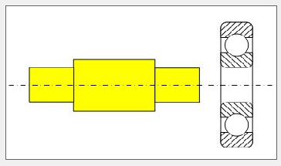
Unconstrained Fits

Slide 9
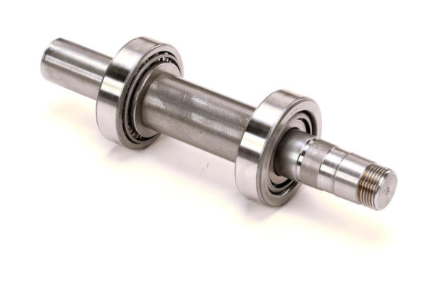
Unconstrained Fits

Slide 10
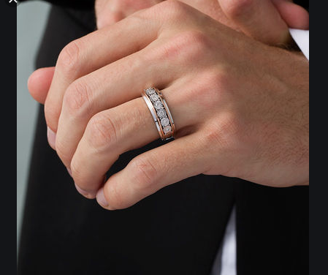
Unconstrained Fits
Notes:
A fit is unconstrained if one of the parts is free to center itself relative to the mating part during assembly.
Similar to a ring fitting a finger

Slide 11
Common Unconstrained Fits
The following fits are always unconstrained:
  Bearings and shafts
  Bearings and housings
  Shaft-fitting components
    Gears
    Pulleys
    Couplers
    Adapters
  All interference or tight fits
  Key and keyways
Notes:
Common unconstrained fits include all bearing fits, and all components that attach to rotating shafts

Slide 12
In an unconstrained fit, the fit is completed when the hole fits the shaft
Notes:
In unconstrained fits, the fit play or interference is critical to the proper function of the fit. The tolerances are extremely narrow to achieve the desired function. The tight fit would be impossible if the bearing is not free to center itself with respect to the shaft.

Slide 13
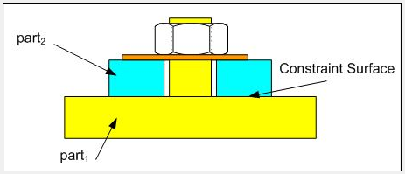
Orientation-Constrained Fits require one fit feature and one fit-related contact surface
The fit is acceptable only when fit-related contact surfaces are in full contact

Slide 14
Orientation-constrained Fits
A fit is Orientation-constrained if the two parts fit and make full contact on an orienting planar contact surface.
Notes:
A fit is Orientation-constrained if the two parts fit and make full contact on an orienting planar contact surface. Orientation constraint fits are always clearance fits allowing a small amount of play. The small play means the fit features precisely locate the two parts relative to each other.

Slide 15
In an Orientation-constrained fit, the fit is completed when the hole fits the shaft AND the contact surfaces make full contact
Notes:
In an Orientation-constrained fit, the fit is completed when the hole fits the shaft and the contact surfaces make full contact. Note that in the case of the figure the fit is acceptable as an unconstrained fit between the hole and boss but it is not acceptable as an orientation-constrained fit.

Slide 16
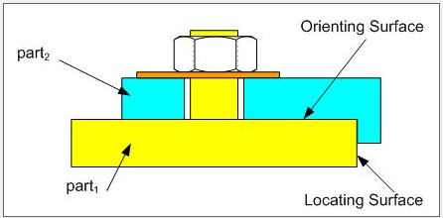
Location-Constrained Fits

Slide 17
Location-constrained Fits
Location
Location
Notes:
A fit is Location-constrained if the two fit features are constrained by at least one linear dimension.
The linear dimensions must be relative to fit-related contact surfaces.

Slide 18
Location-constrained Fits
Location
Location
Notes:
The linear dimensions can also be between fit features making up a pattern. Therefore the fit of a pattern of features is always location-constrained even if there are no fit-related contact surfaces

Slide 19
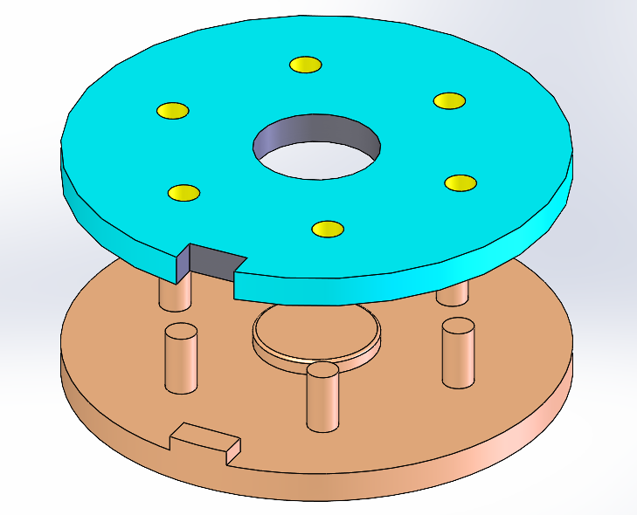
Identifying Fit Features and Contact Surfaces
Fit Features are either cylindrical or parallel planes
Notes:
Fit features are either cylindrical like holes and bosses or parallel planes like slots and rails. A pattern of identical fit features is counted as one feature. In this figure, the part with holes has three fit features: the center hole, the pattern of smaller holes, and the slot feature.

Slide 20
Identifying Fit Features and Contact Surfaces
Fit-related contact features are Planar
Notes:
Fit-related contact surfaces are planar. After the assembly is put together, these fit-related contact surfaces make full contact with their mating surface. In this figure, the mounting surfaces are fit-related contact surfaces. The selection of fit features and fit-related contact surfaces together allows the set up of tolerances so the fits are accomplished and the contact surfaces make full contact with each other.

Slide 21
Identifying Fit Features and Contact Surfaces
Function-related contact surfaces
Notes:
Occasionally a contact surface can not be chosen as a fit-related contact surface although it may appear that it should be. In this example the pin and hole are to have a press-fit. It is not possible to assure full contact on flat contact surfaces. To assure full contact we need a little clearance in the fit which in this case is not possible for press-fit features.
Function-related contact surfaces are controlled by separate tolerance statements not the ones that assure fit. In this case a separate tolerance statement assures a “good” contact between the surfaces.

Slide 22
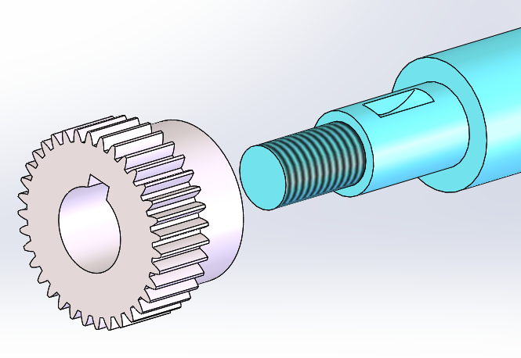
Identifying Fit Features and Contact Surfaces
This is an unconstrained fit
Notes:
This fit should be treated as an unconstrained fit where the shoulder contact is not a fit-related contact surface. There are two reasons for this. First, the fit of the gear to the shaft may be too tight to allow any clearance needed to assure full contact on the shoulders. Second, even if there is sufficient clearance to assure full contact, there are no design features that push and maintain such a full contact.

Slide 23
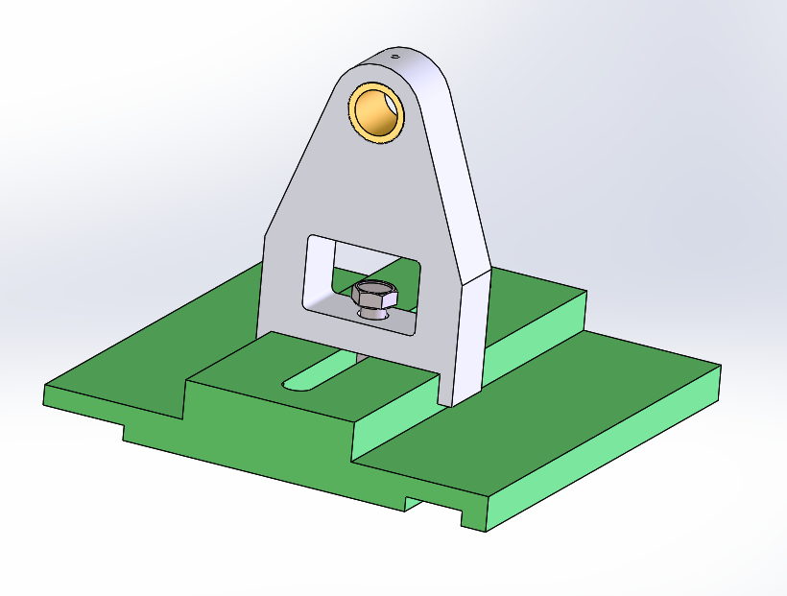
Identifying Fit Features and Contact Surfaces
This is a location-constrained fit
Notes:
Consider the fit between the two parts shown. On the top part, the slot and fastener hole are fit features while the sliding surface is a fit-related contact surface. On the bottom part, the rail and fastener hole are fit features while the sliding surface is a fit-related contact surface.

Slide 24
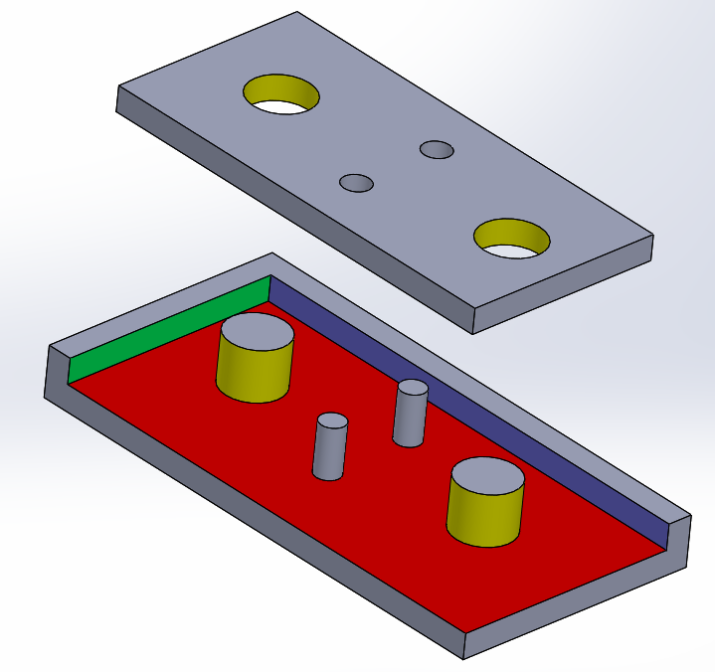
Identifying Fit Features and Contact Surfaces
This is a location-constrained fit
Notes:
In this assembly, holes and bosses are fit features (2 fit features on each part). The flat colored surfaces are fit-related contact surfaces

Slide 25
Identifying Fit Features and Contact Surfaces
In this location-constrained fit
Holes are fit features – Slot and rail are also fit features (2 fit features on each part)
Flat colored surfaces are fit-related contact surfaces

