Slide 1
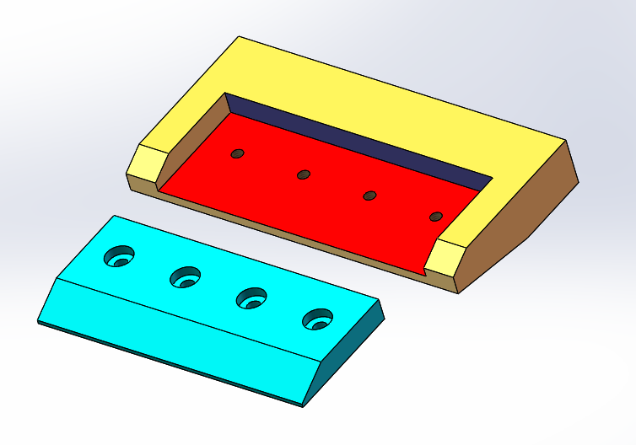
Another Example: Fasteners
Location-Constrained Fit
2 Contact Surfaces
2 Fit features
  Slot and rail
  Fastener holes (M3)

Slide 2
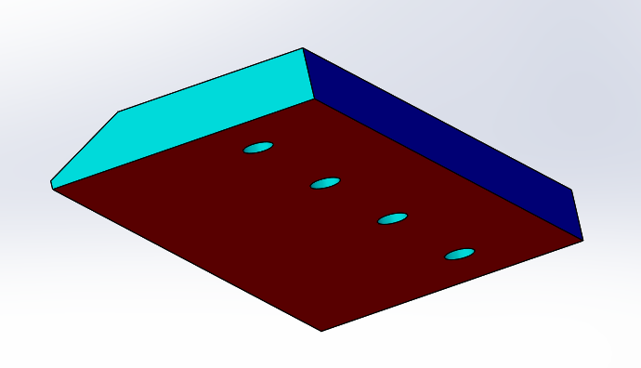
SCS
PCS

Slide 3
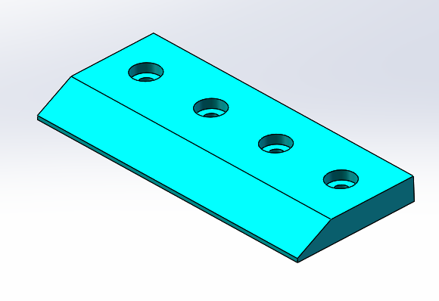
SFF
(Pattern of 4 clearance holes)
Set to 3.5 mm
PFF
(Rail)

Slide 4
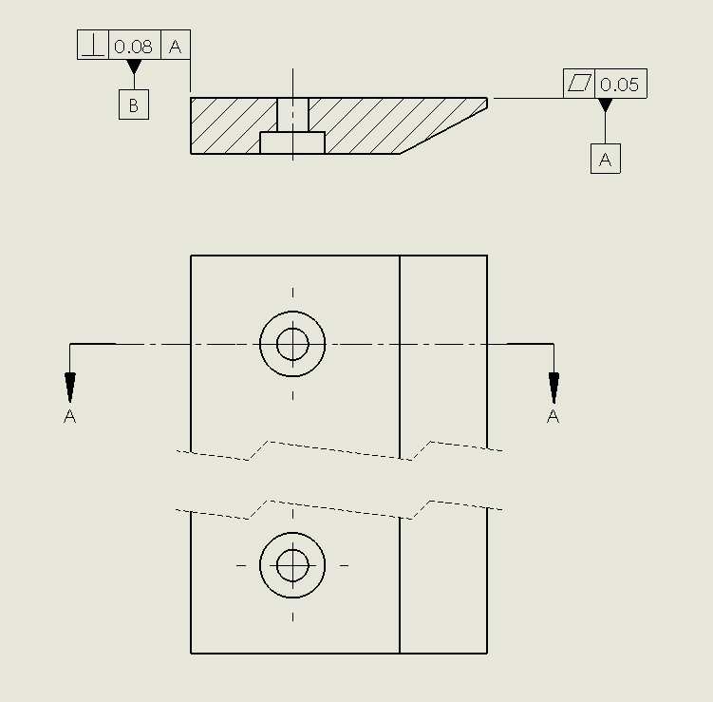
Result after the selection of the contact surfaces

Slide 5
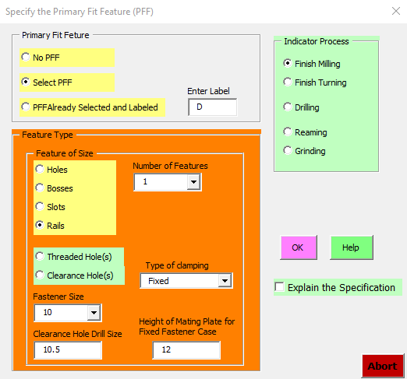
Dialog window for the selection of fit features

Slide 6
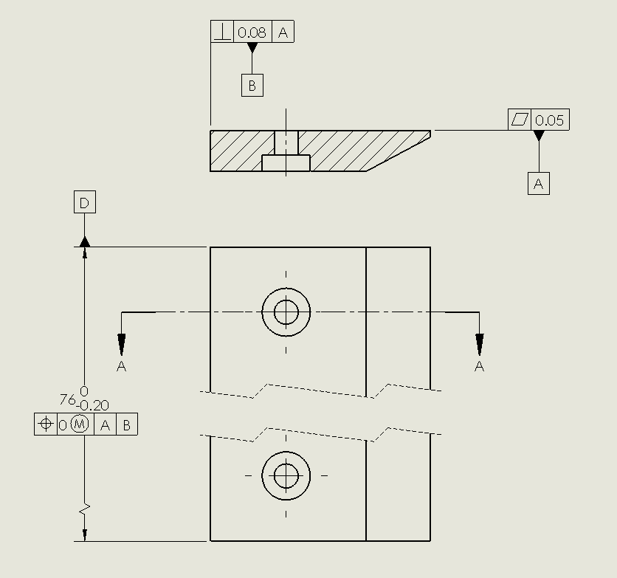
Result after selection of the rail fit feature

Slide 7
Two types of fastener clamping
Floating Fasteners
  Loose bolts and nuts
  Two plates with clearance holes
Fixed Fasteners
  Screws and threaded plates
  One plate with clearance holes
  One plate with threaded holes

Slide 8
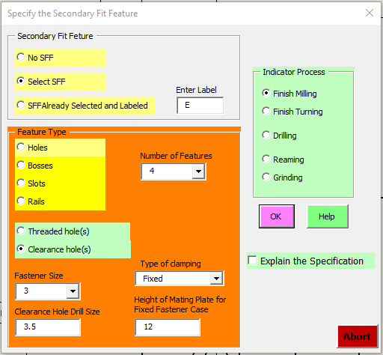
Select:
  Clearance Holes
  4 features
  Fixed fastener clamping
  Fastener size M3
  Nominal drill size 3.5
  Ignore Height of mating plate

Slide 9
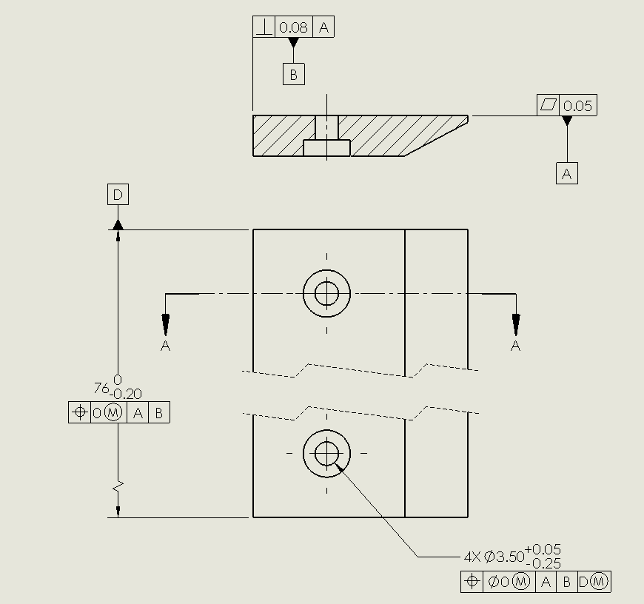

Result after selection of the fastener clearance holes

Slide 10
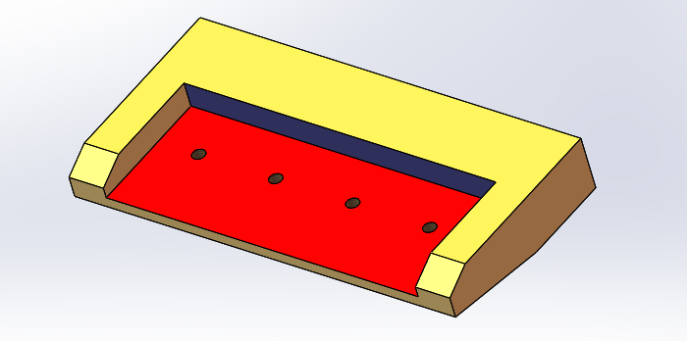
Contact Surfaces
SCS
PCS

Slide 11
SFF(pattern of 4 threaded holes)
M3 in this problem
PFF
(Slot)

Slide 12
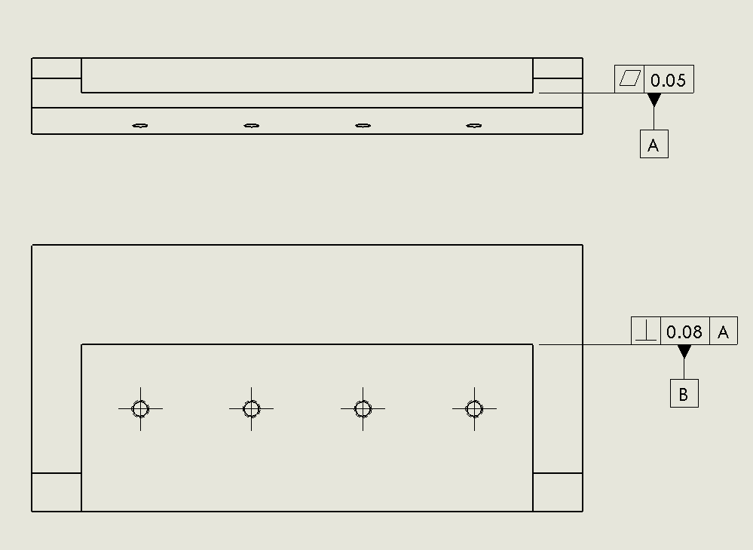
Result after selection of the contact surfaces

Slide 13
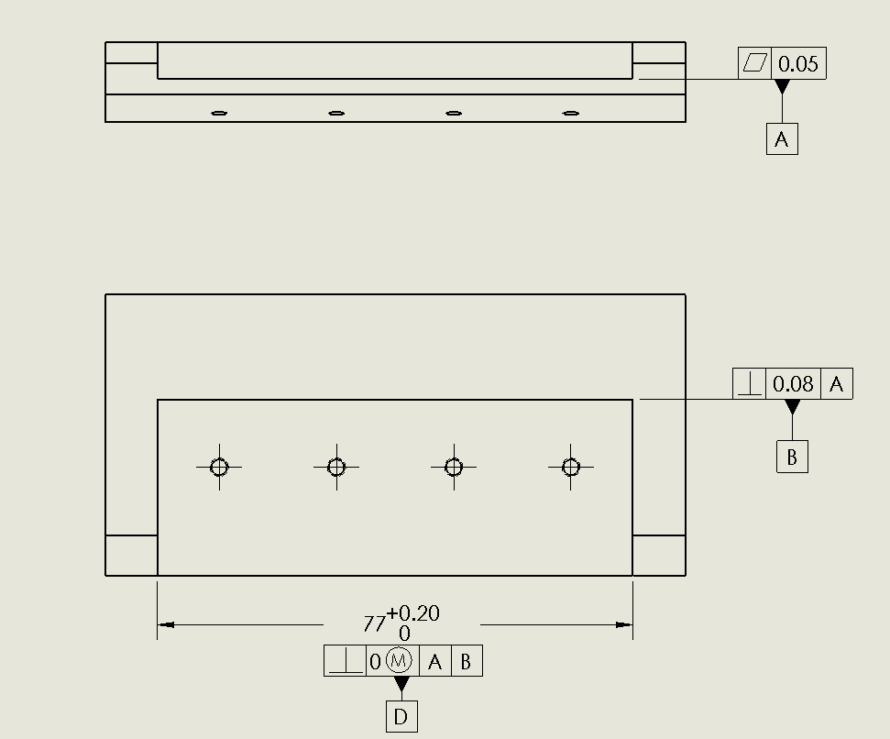
Result after selection of the slot fit feature

Slide 14
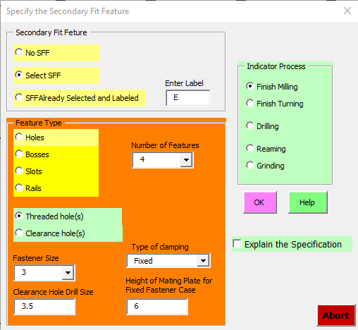
Select:
  Threaded Holes
  4 features
  Fixed fastener clamping
  Fastener size M3
  Nominal drill size 3.5
  Height of mating plate: 6

Slide 15
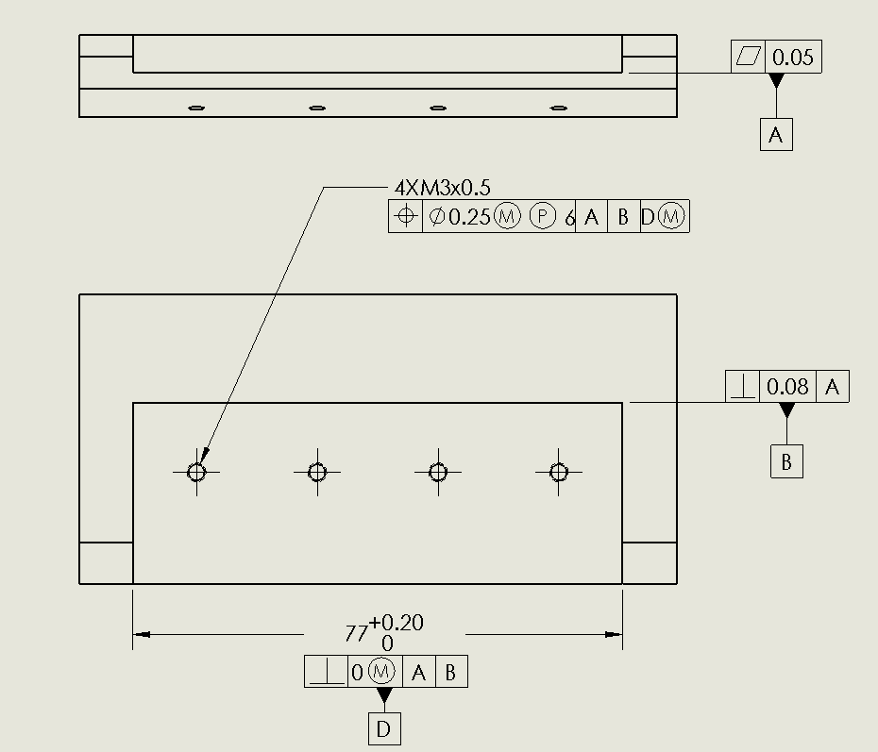
Result after selection of the fastener threaded holes

Slide 16
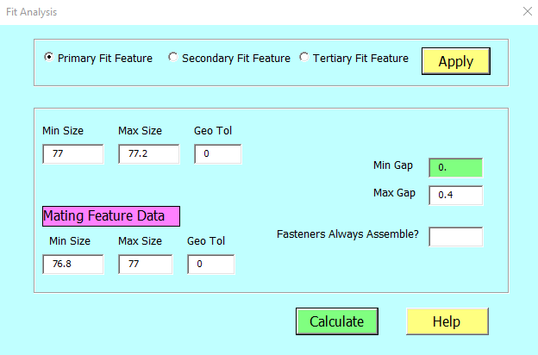
Fit analysis for the primary fit feature
(Slot and Rail)

Slide 17
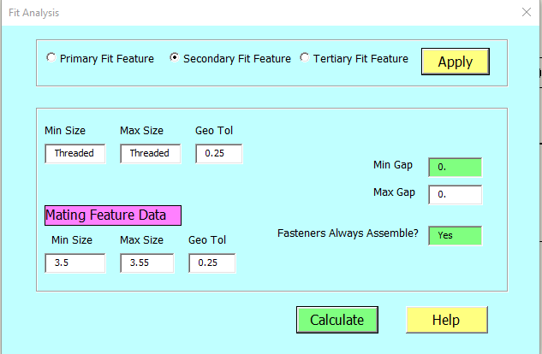
Fit analysis for the secondary fit feature (fastener fit)

Slide 18
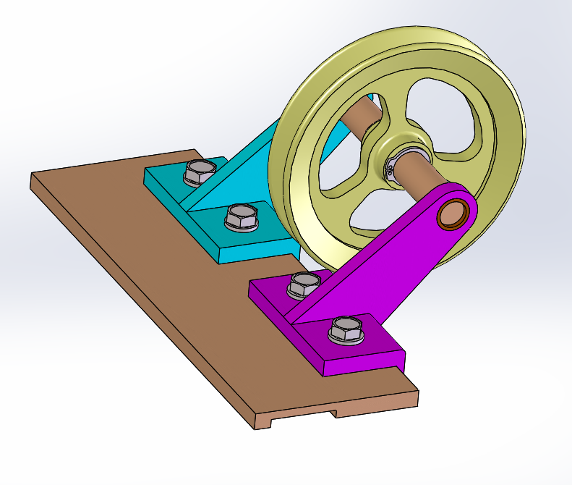
More Exercises
Support Arms
  Two Contact Surfaces
  Pattern of two clearance holes
Base Plate
  Two Contact Surfaces
  Pattern of two threaded holes for each Support Arm
  Run the program once for the fit of each Support Arm

Slide 19
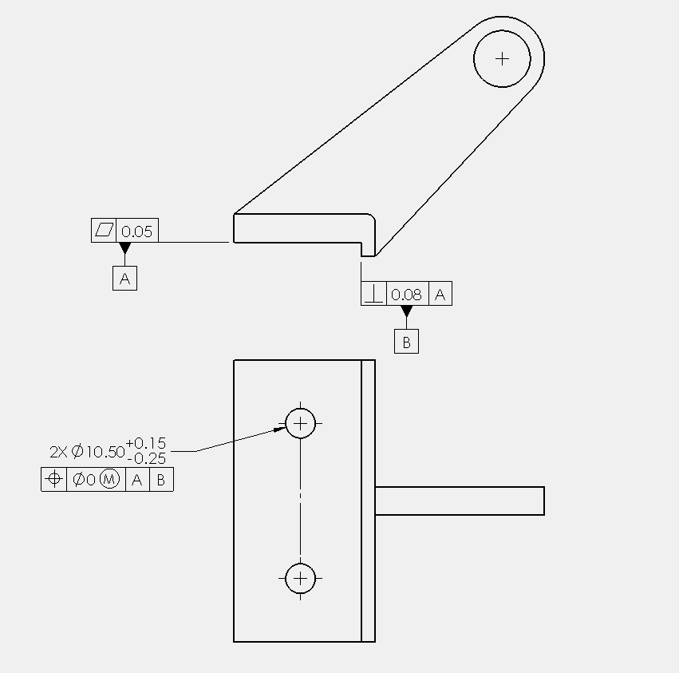

Slide 20
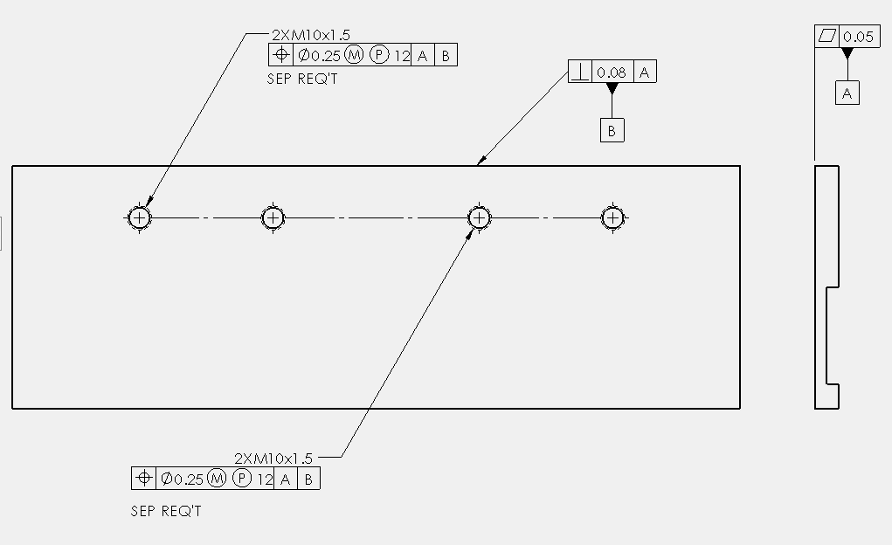

Notes:
The note Separate Requirements is not added by the program – These must be added manually. The separate requirements note simply indicate that the specifications applied to the pair of holes on the left side are unrelated to the specifications on the right side as each pair fits a separate part. By default if one or more specifications use exactly the same datum labels in a position statement, the features will be considered to be one pattern. The implication of the separate requirements is that the location of the two pairs of holes need not be controlled with respect to each other with high precision

Slide 21
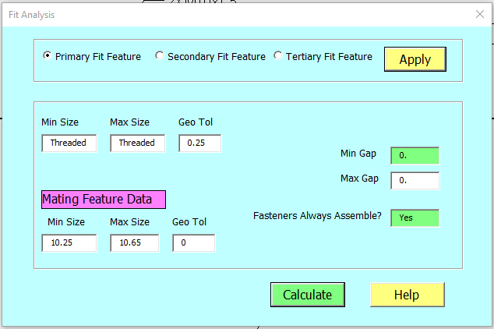
Fit Analysis

Slide 22
