Slide 1
How to use the DFFTSP
The program is easy to use
Only works with SolidWorks drawing files
The program is not suitable for trial-and-error-type learning
There is no undo button
If you make a wrong selection select Abort and start over
You can run the program again for a fit with a different part

Slide 2
How to Select Features on a Drawing
For a single hole or boss in the profile view, click on the circular profile.
When finished, press the ESC Key

Slide 3
How to Select Features on a Drawing
For a single hole or boss in the side view, select one line, hold the control key and select the other line
Also for a slot or rail feature, select one line, hold the control key and select the other line

Slide 4
How to Select Features on a Drawing
For a hole or boss pattern, select only one the features and select the number of features in the pattern
When finished, press the ESC Key

Slide 5
How to Select Features on a Drawing
For a slot or rail pattern select only one the features (two lines) and select the number of features in the pattern
When finished, press the ESC Key

Slide 6
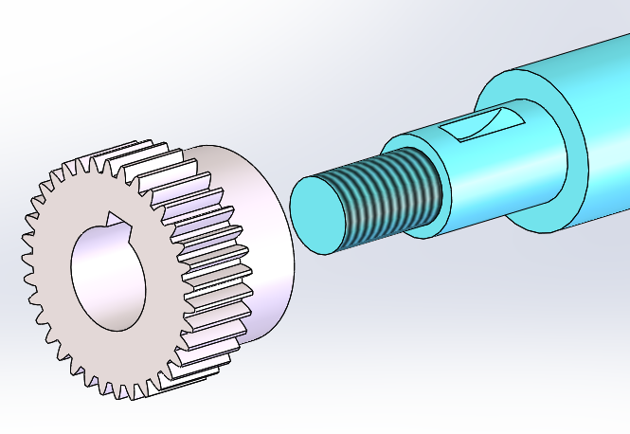
Fit of a Gear Bore to a Shaft
Contact with the shoulder is incidental
Fit along with a full contact with the shoulder is not possible or required

Slide 7
In unconstrained fits only single fit features take part
Any flat surface contact is incidental

Slide 8
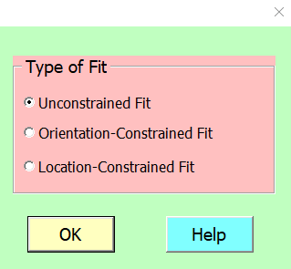

Start the program

Slide 9
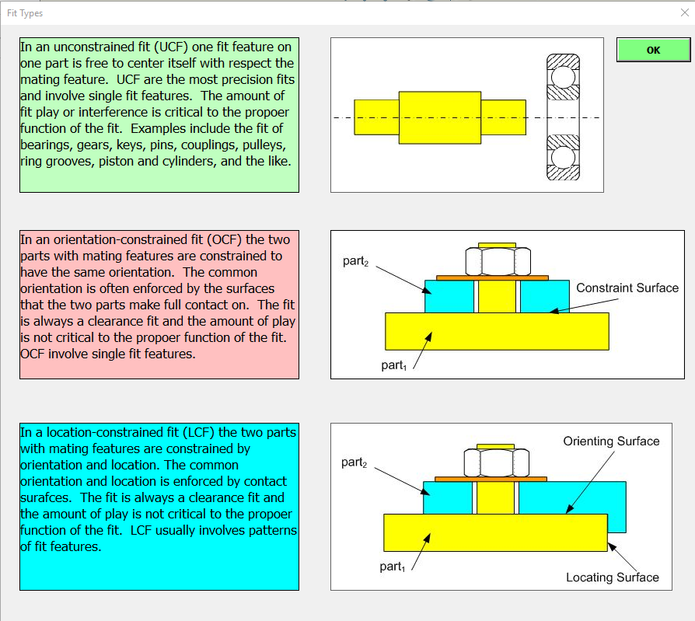
Help Button
Skip reading and go to the next slide

Slide 10
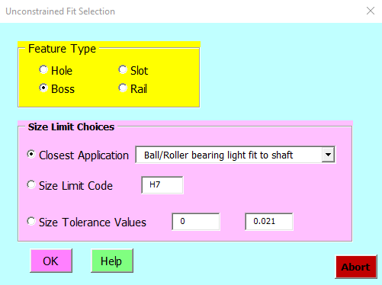
Notes:
For this unconstrained fit selection dialog window select Boss for feature type. For the size limits continue with the PP slides for an explanation

Slide 11
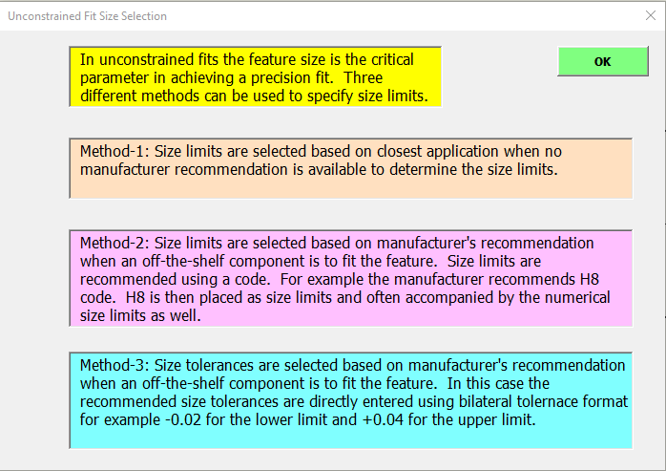
Help Button
Skip reading and go to the next slide

Slide 12

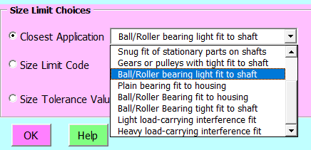
Method-1: No manufacturer recommendations
Notes:
If you have a component such as a gear fitting a shaft and you have no manufacturer recommendations about the best size limits for the shaft then choose the first option which is the closest application and pick one of the ten choices that best describes the application. In the case of the gear fit, select Gears or Pulleys with tight fit to a shaft.

Slide 13
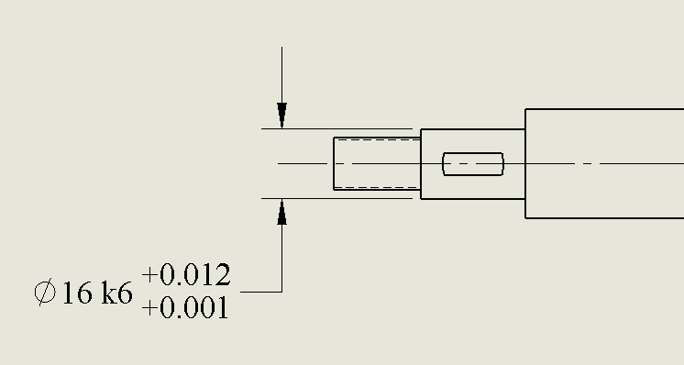

After Selecting the Feature press the ESC key
The result for selecting gears with “tight fit to shaft”
After the annotation is placed it can be moved around or make other modifications if necessary
See the video demo in the next slide

Slide 14
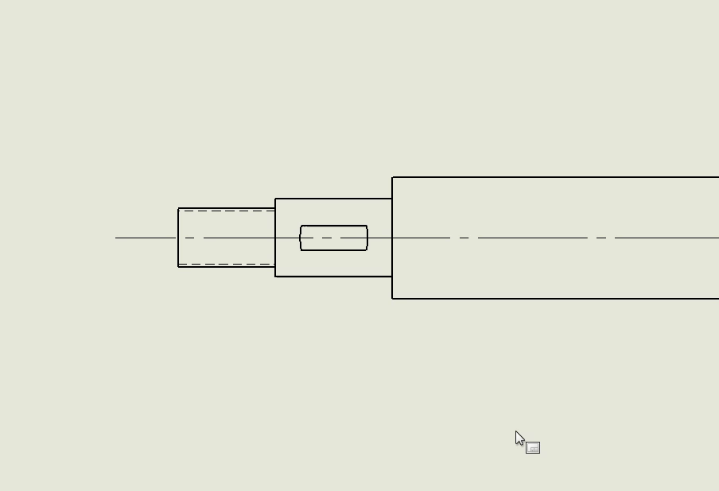
Video Demo: Unconstrained Fits

Slide 15
About the UF Size Tolerances
Size tolerances of UF are critical to the function of the fit.
Size tolerances of UF usually require precision manufacturing
In the standard coded format such as 16k6
  16 designates the basic size (16 mm)
  k designates a ideal offset for the function (+0.001) – from tables
  6 designate a size tolerance (0.011 mm) – from tables
    Min. Size = 16 + 0.001 = 16.001
    Max Size = 16.001 + 0.011 = 16.012

Slide 16
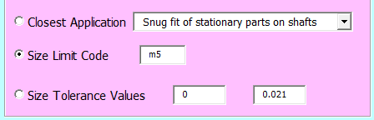
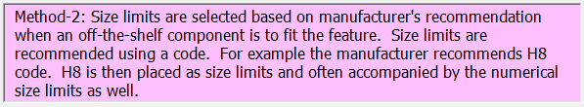
Method-2: Manufacturer recommends a coded limit

Slide 17
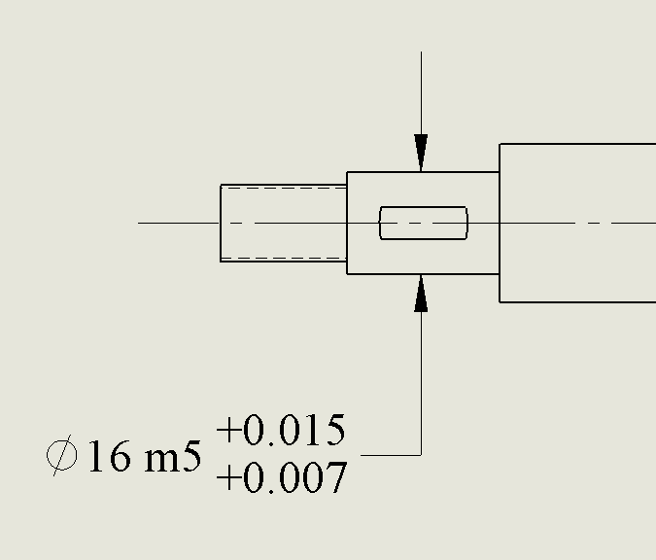
Assuming manufacturer recommends m5 fit
After the annotation is placed it can be moved around for a good position or other modifications if necessary

Slide 18
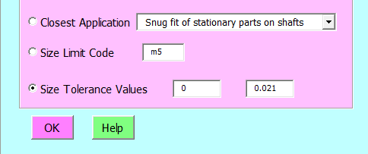
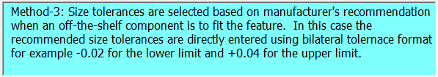
Method-3: Manufacturer recommends numerical size limits

Slide 19
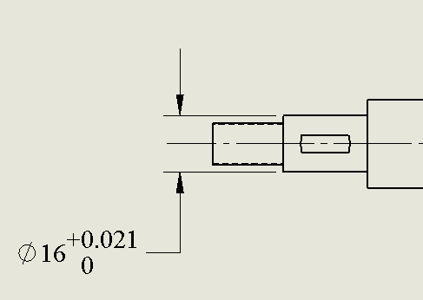
Assuming manufacturer recommends 0 to 0.021 limits
After the annotation is placed it can be moved around for a good position or other modifications if necessary

Slide 20
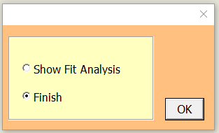
Once the annotation is finished and modifications are finished, press the ESC key to get the following window
You can finish tolerancing for this fit or show the fit analysis before existing

