Slide 1
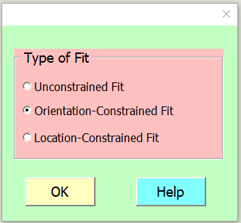
Orientation-Constrained Fit

Slide 2
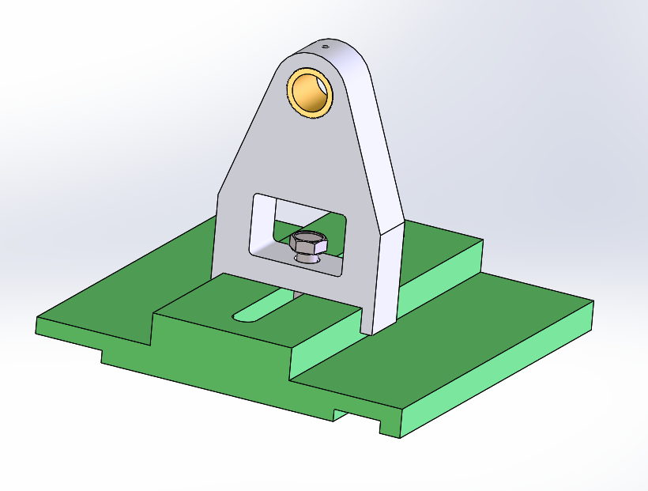
Example
Contact Surface

Slide 3
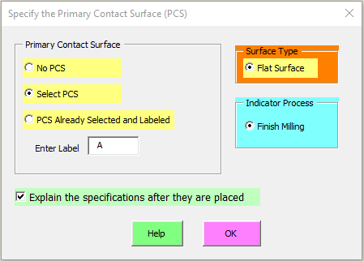
Selecting Contact Surfaces
Finish milling accuracy creates good flatness for contact surfaces

Slide 4

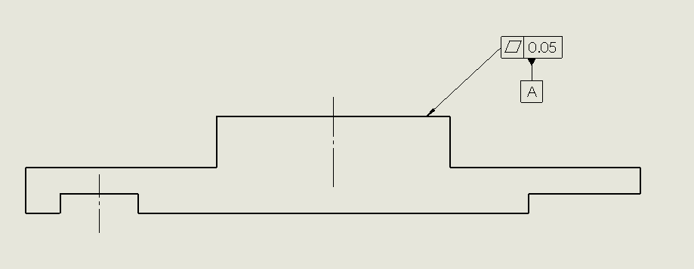
Selecting a Contact Surface
Select the line representing the contact surface and then the ESC key
Result

Slide 5
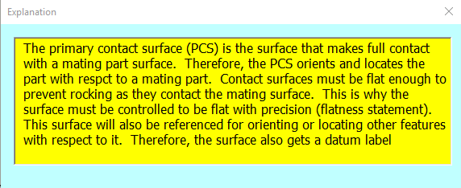
If you checked the explanation box

Slide 6
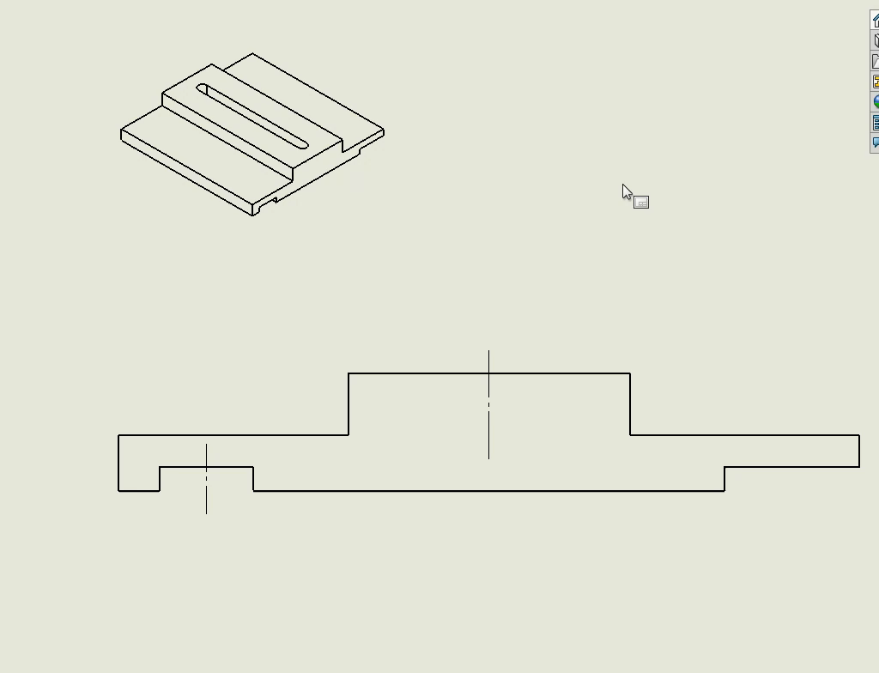
Video Demo: Selecting the Contact Surface

Slide 7
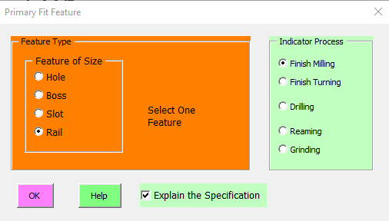
The fit feature is a rail
Milling provides adequate precision for fit

Slide 8
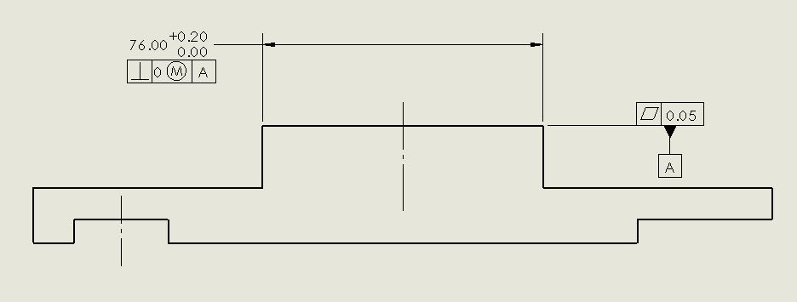
Result

Slide 9
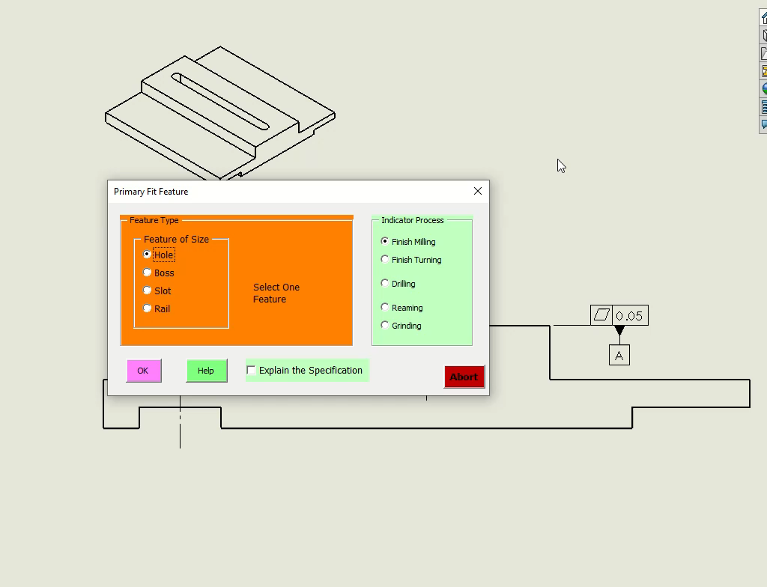
Video Demo: Selecting the Fit feature

Slide 10
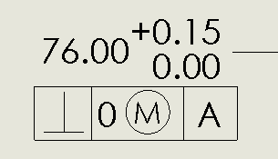
About the OCF Size Tolerances
Size tolerances of OCF can be critical to the function of the fit. They control the maximum play in the fit.
The more precision indicator processes lead to smaller play in the fit.

Slide 11
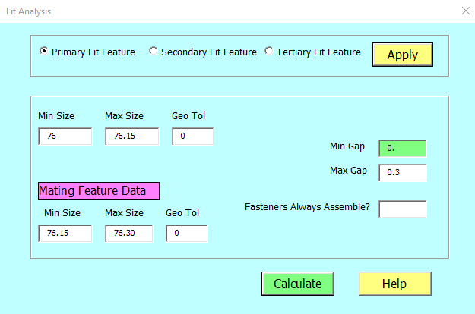

Fit Analysis
Notes:
If you like to do a fit analysis, select the Primary Fit Feature and push Apply. The analysis is based on the size limits of the rail feature and size limits of the mating slot feature provided the slot is toleranced the same way the rail toleranced. Otherwise, you can enter the actual size limits used with the mating part. In this case the analysis shows that the fit is always achieved with a fit play ranging from zero to 0.3 mm.

